Slide 1
SMOKA and FOCAS
Yoonsoo P. Bach
2018-11-06, 08

Slide 2
How to Retrieve Archived Data from SMOKA
2018-11-06

Slide 3

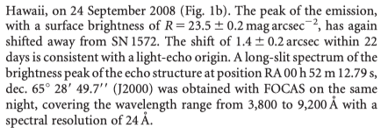
SMOKA archive
Say you want to find the data for this paper:
FOCAS: OK, we can use “SMOKA”
DATE-OBS = 2008-09-24, RA/DEC is given
They used R-filter (photometry)
& 3800-9200 \AA spectroscopy

Slide 4
Contents
Register
Search:
simple search
advanced search
Request
Download

Slide 5
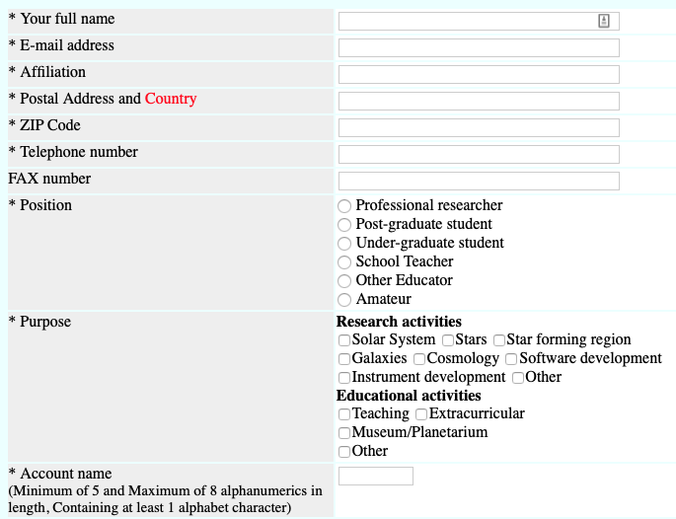
SMOKA archive
Register: https://smoka.nao.ac.jp/register.jsp

Slide 6
Simple Search

Slide 7
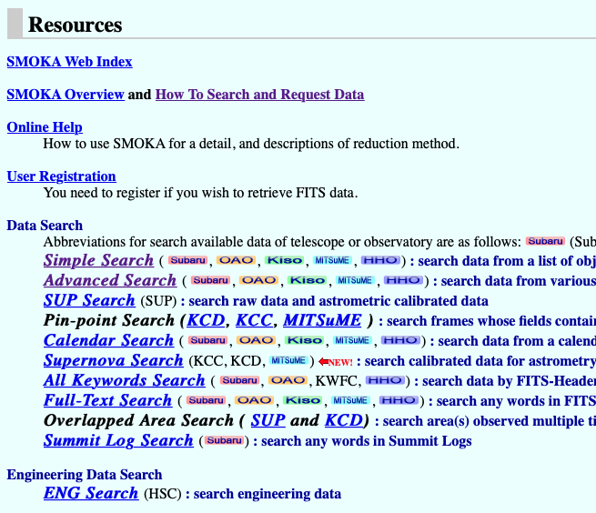
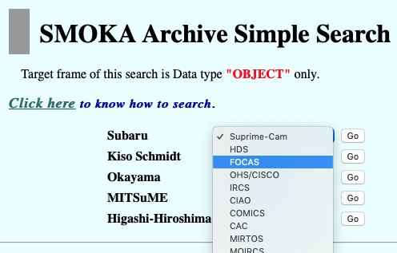
SMOKA archive: (1) Simple Search
https://smoka.nao.ac.jp

Slide 8
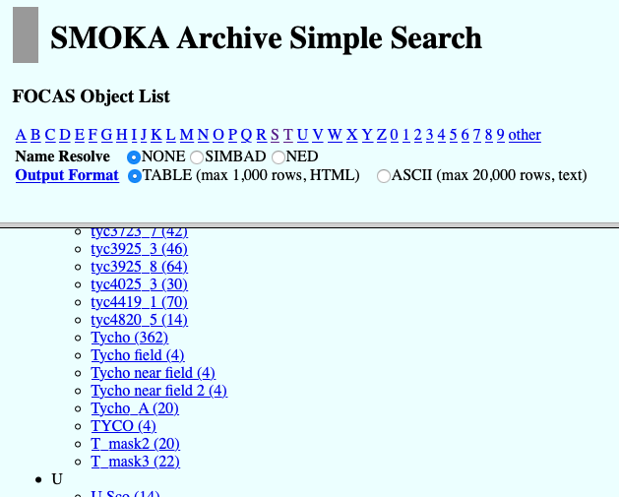
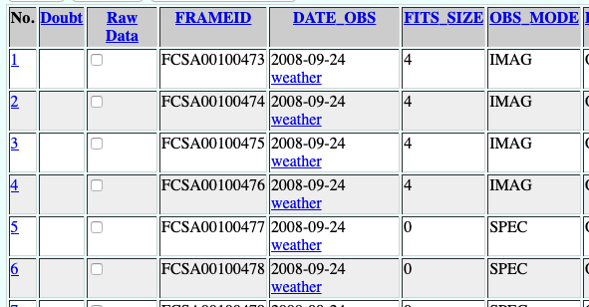
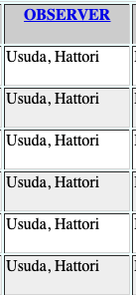
SMOKA archive: (1) Simple Search
Find your object (e.g., SN 1572 == Tycho SNR)
Check DATE-OBS
(same as the publication?)
Check OBSERVER
(co-authors of publication included?)
Click all candidates
Check RA/DEC, FILTER, WVLEN too for sure.

Slide 9
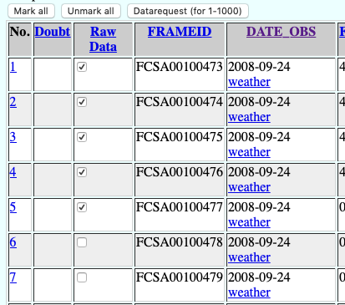
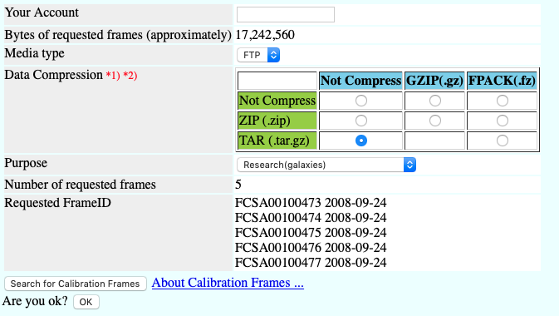
SMOKA archive: (1) Simple Search
Check “Raw Data” if you want to download → “Datarequest”
1
2
3
4
* sometimes DATE_OBS is not unique, so you may not want to click “Mark all”

Slide 10
Advanced Search

Slide 11
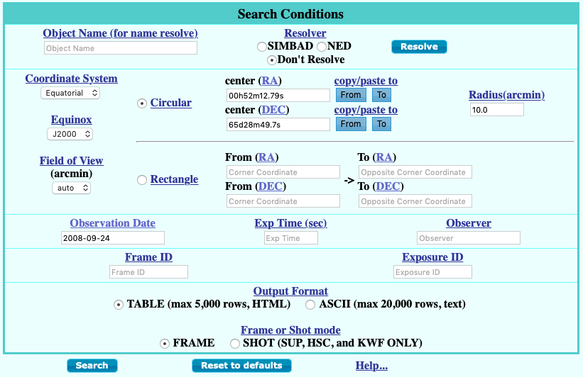
SMOKA archive: (2) Advanced Search
https://smoka.nao.ac.jp

Slide 12
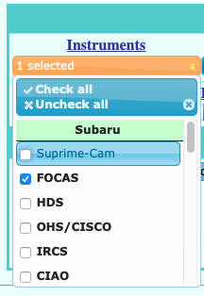
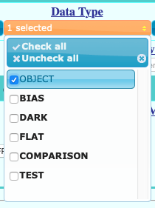
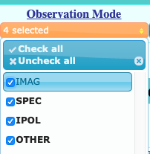
SMOKA archive: (2) Advanced Search
click blue links → explanations.
Check all not to lose any data
B/D/F will be retrievable later

Slide 13
SMOKA archive: (2) Advanced Search
click blue links → explanations.
Check all not to lose any data
B/D/F will be retrievable later

Slide 14
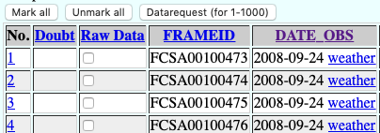
SMOKA archive: (2) Advanced Search
Most likely only one DATE_OBS → Mark all and Datarequest.
1
2
3
4

Slide 15
Download

Slide 16
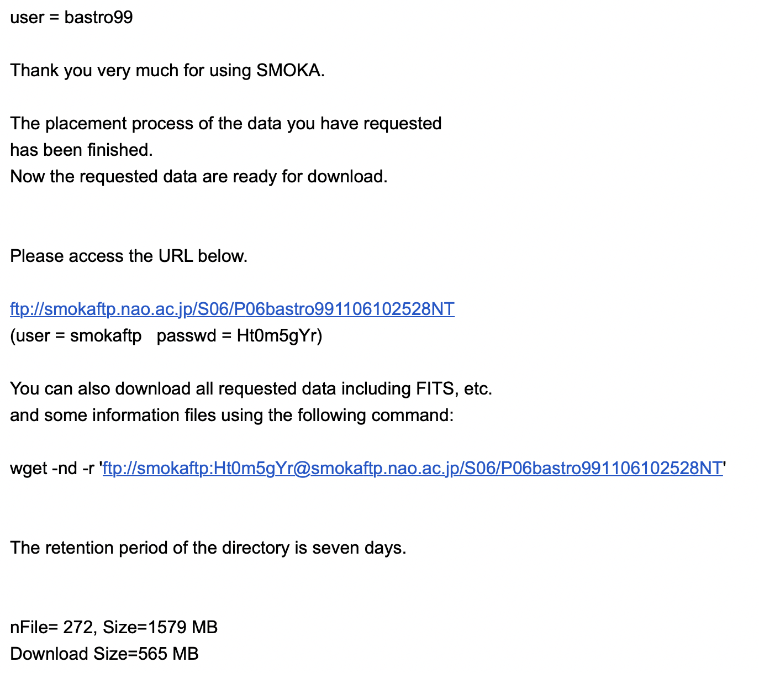
Email
You’ll get an email once it is ready to be downloaded.
It explains how to.
Windows: use git bash or WSL
UNIX: use terminal

Slide 17
FOCAS Description
2018-11-08

Slide 18
FOCAS
Faint Object Camera And Spectrograph
Optical imaging (photometry) / long-slit / multi-slit
FOV = 6’
Most useful explanations:
http://subarutelescope.org/Observing/Instruments/FOCAS/index.html

Slide 19
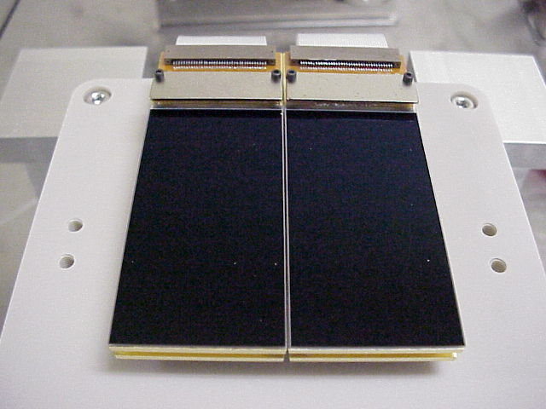
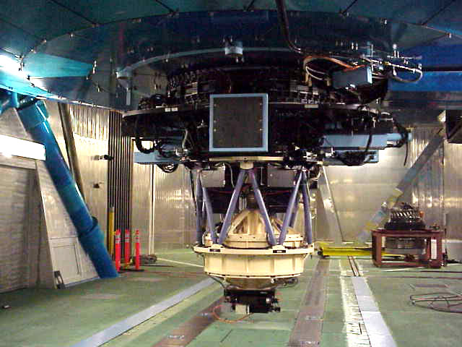
FOCAS
FOV 6’
CCD: two 2K*4K
~2m
http://subarutelescope.org/Observing/Instruments/FOCAS/Detail/UsersGuide/Introduction/SpecTable.html

Slide 20
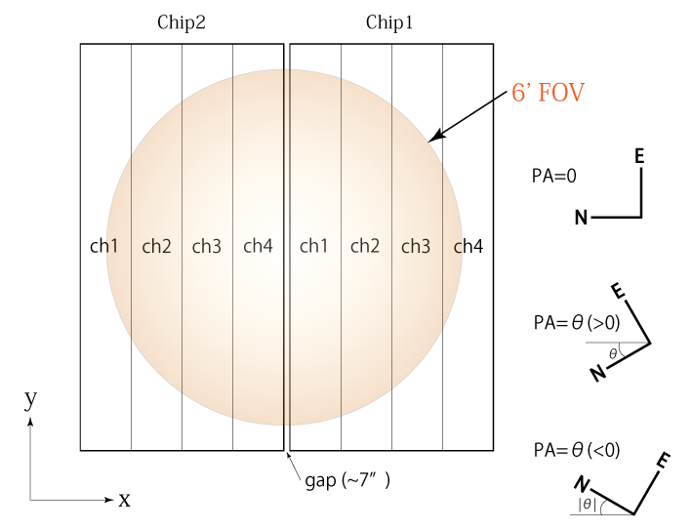
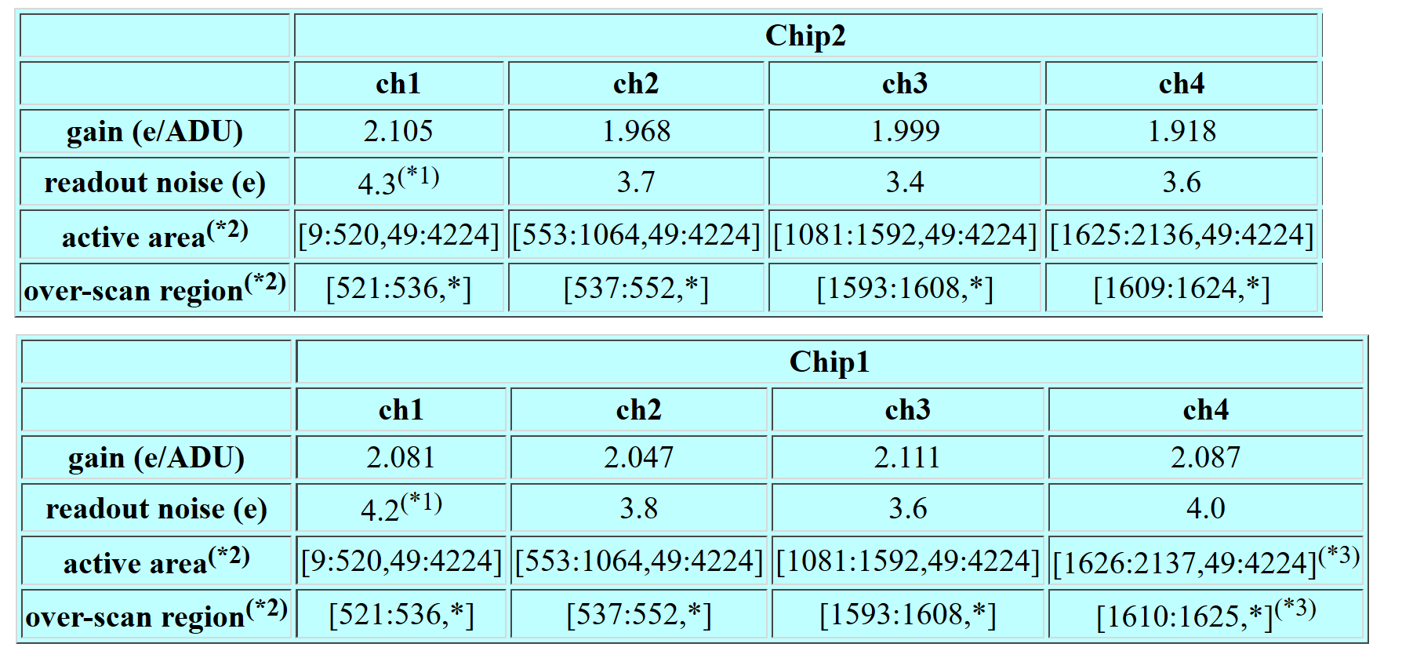
FOCAS
http://www.naoj.org/Observing/Instruments/FOCAS/ccdinfo.html

Slide 21
FOCAS
Grism List:
http://subarutelescope.org/Observing/Instruments/FOCAS/Detail/UsersGuide/PartsDetail/Grisms/GrismSelection_e.html
OR,
http://www.naoj.org/Observing/Instruments/FOCAS/spec/grisms.html
Use Grating&Filter ID to find out what had been used for your group project.

Slide 22
FOCAS
For image reduction, you may use python or use FOCASRED package.
FOCASRED Manual:
http://subarutelescope.org/Observing/Instruments/FOCAS/Detail/UsersGuide/DataReduction/focasred.html
And http://subarutelescope.org/Observing/Instruments/FOCAS/Detail/UsersGuide/DataReduction/IDL/SpecReduction.html
The package can be downloaded – ask TA

