Slide 1
How to Retrieve Archived Data from SMOKA
Yoonsoo P. Bach
2018-11-06

Slide 2
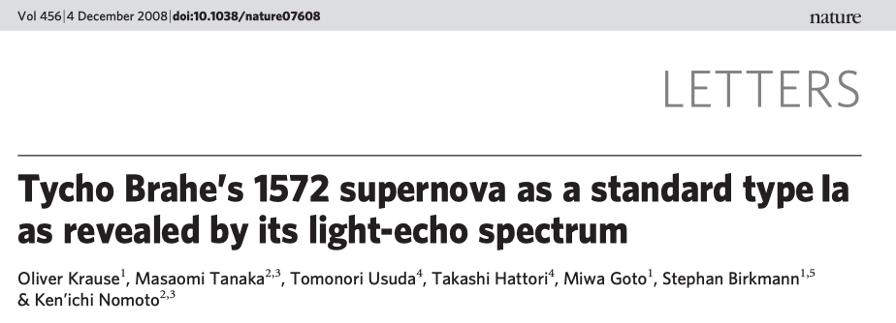
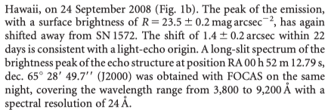
SMOKA archive
Say you want to find the data for this paper:
FOCAS: OK, we can use “SMOKA”
DATE-OBS = 2008-09-24, RA/DEC is given
They used R-filter (photometry)
& 3800-9200 \AA spectroscopy

Slide 3
Contents
Register
Search:
simple search
advanced search
Request
Download

Slide 4
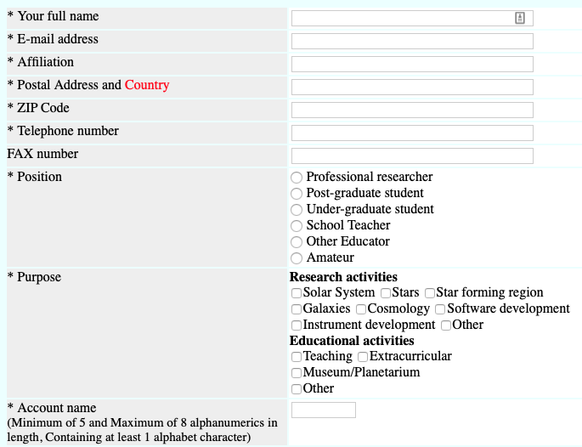
SMOKA archive
Register: https://smoka.nao.ac.jp/register.jsp

Slide 5
Simple Search

Slide 6
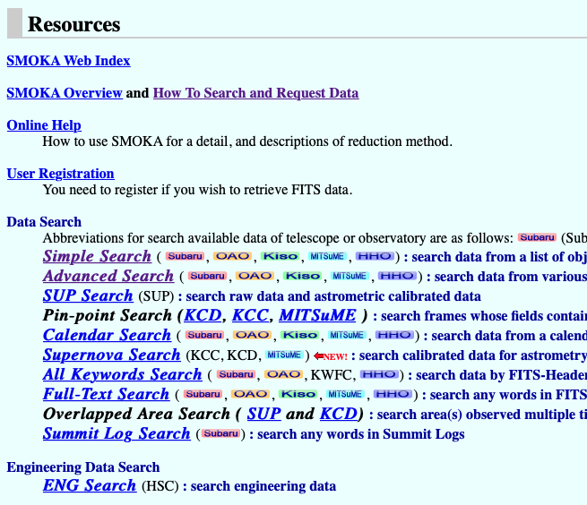
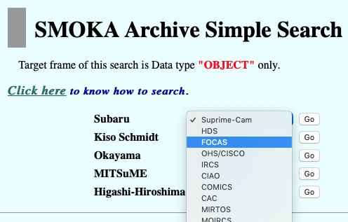
SMOKA archive: (1) Simple Search
https://smoka.nao.ac.jp

Slide 7
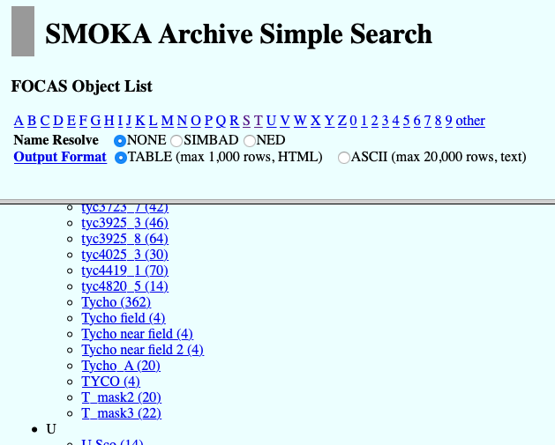
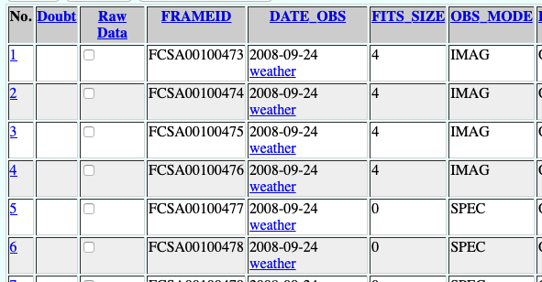
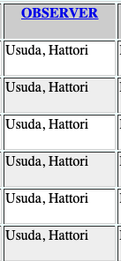
SMOKA archive: (1) Simple Search
Find your object (e.g., SN 1572 == Tycho SNR)
Check DATE-OBS
(same as the publication?)
Check OBSERVER
(co-authors of publication included?)
Click all candidates
Check RA/DEC, FILTER, WVLEN too for sure.

Slide 8
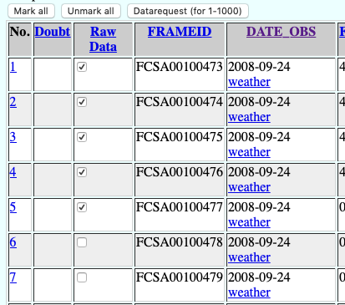
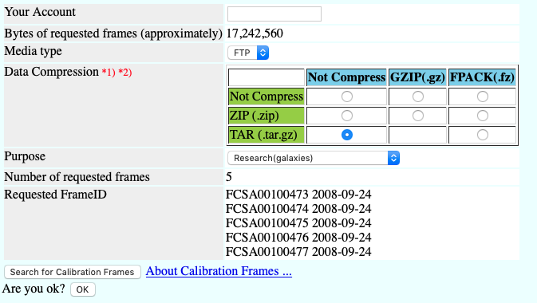
SMOKA archive: (1) Simple Search
Check “Raw Data” if you want to download → “Datarequest”
1
2
3
4
* sometimes DATE_OBS is not unique, so you may not want to click “Mark all”

Slide 9
Advanced Search

Slide 10
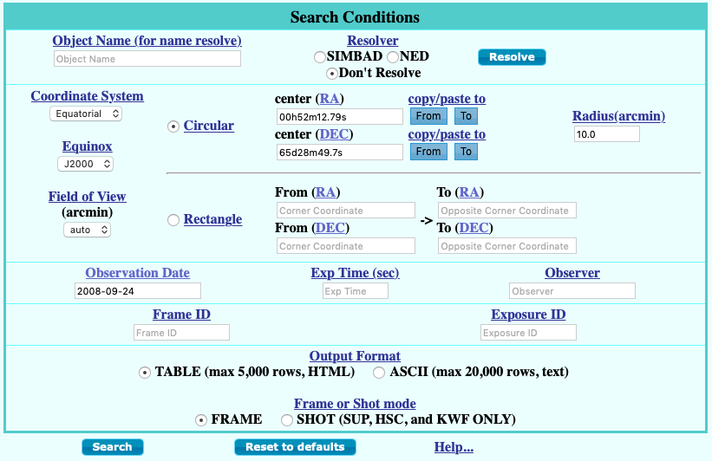
SMOKA archive: (2) Advanced Search
https://smoka.nao.ac.jp

Slide 11
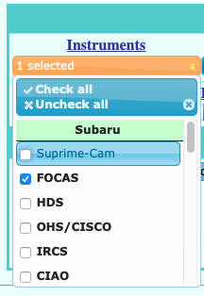
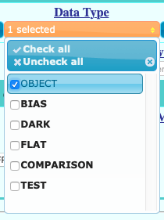
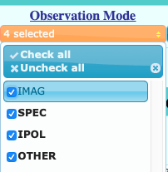
SMOKA archive: (2) Advanced Search
click blue links → explanations.
Check all not to lose any data
B/D/F will be retrievable later

Slide 12
SMOKA archive: (2) Advanced Search
click blue links → explanations.
Check all not to lose any data
B/D/F will be retrievable later

Slide 13
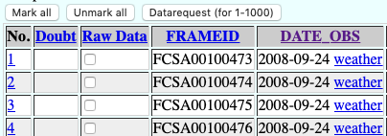
SMOKA archive: (2) Advanced Search
Most likely only one DATE_OBS → Mark all and Datarequest.
1
2
3
4

Slide 14
Download

Slide 15
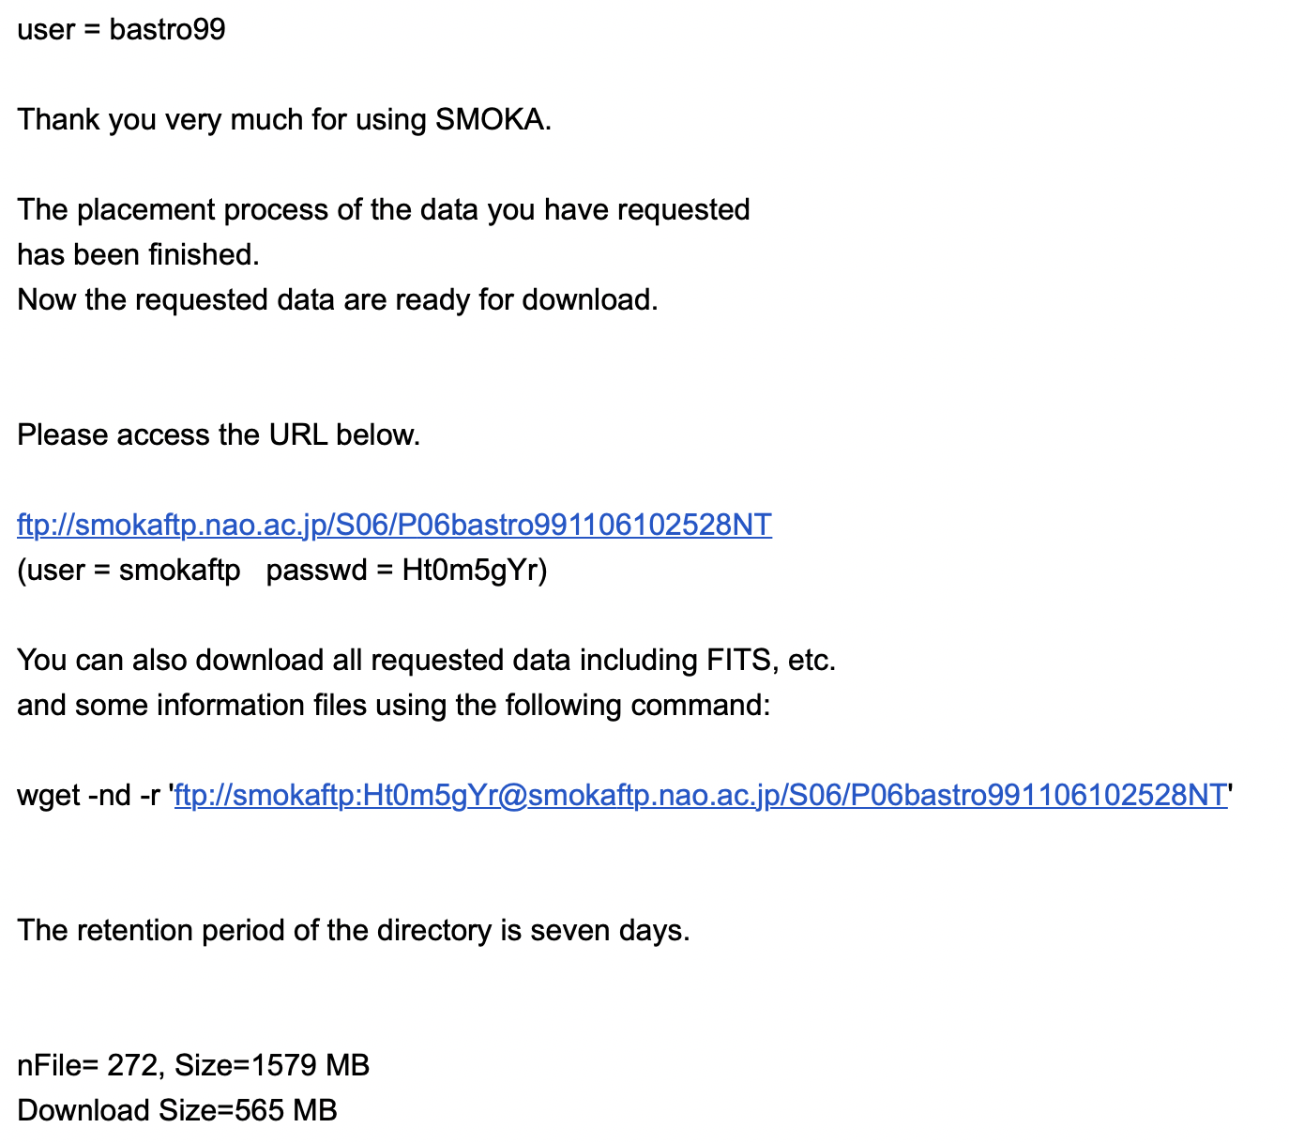
Email
You’ll get an email once it is ready to be downloaded.
It explains how to.
Windows: use git bash or WSL
UNIX: use terminal

