Slide 2
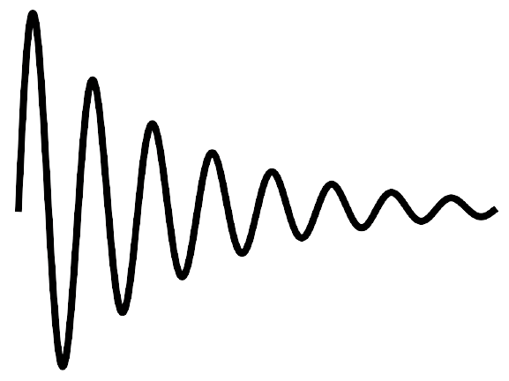
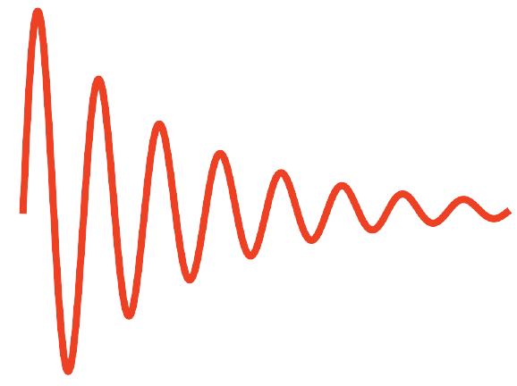
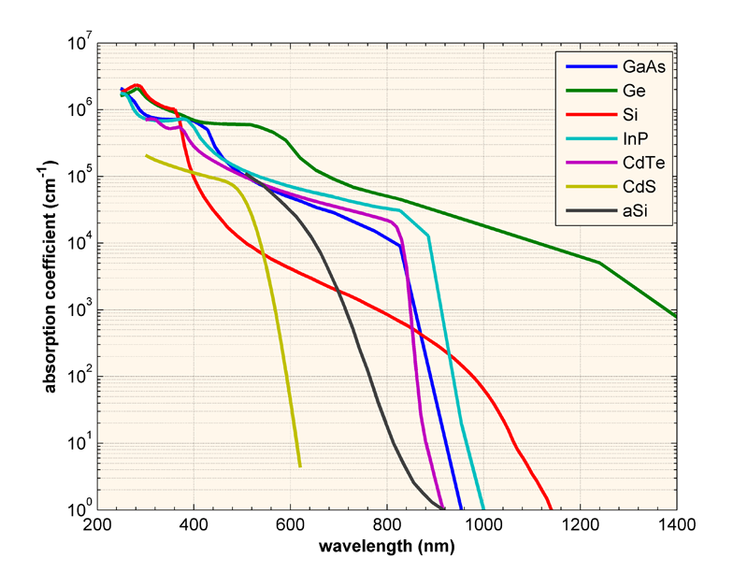
(a)
photo-sensitive
region
(~50 - ≲1000 µm)
insulation layer
poly gate
electrodes
If there were no reflection...
(b)
https://www.pveducation.org/pvcdrom/pn-junctions/absorption-coefficient
Attenuated by 1/e
at distance of...
↓
1 µm
10 µm
50 µm
100 µm
1mm
1cm

Slide 3
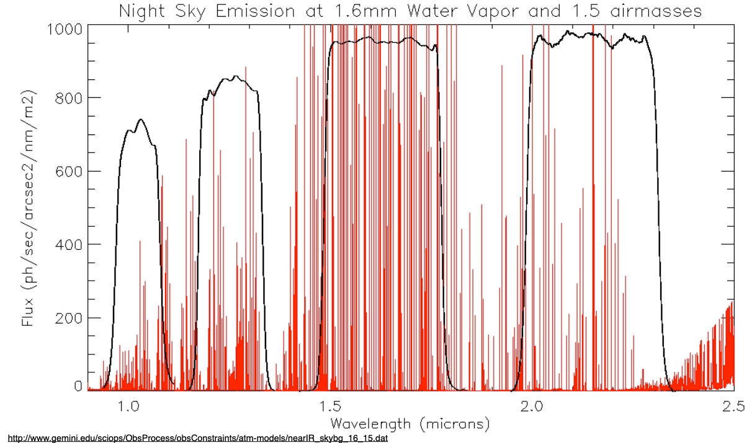
Flat
Sky
airglow
emissions
A B C D
FLAT = 1*( A + B + C + D)
SKY = MSKY*(1.1A + 0.0B + 0.0C + 0.3D)
λ

Slide 4
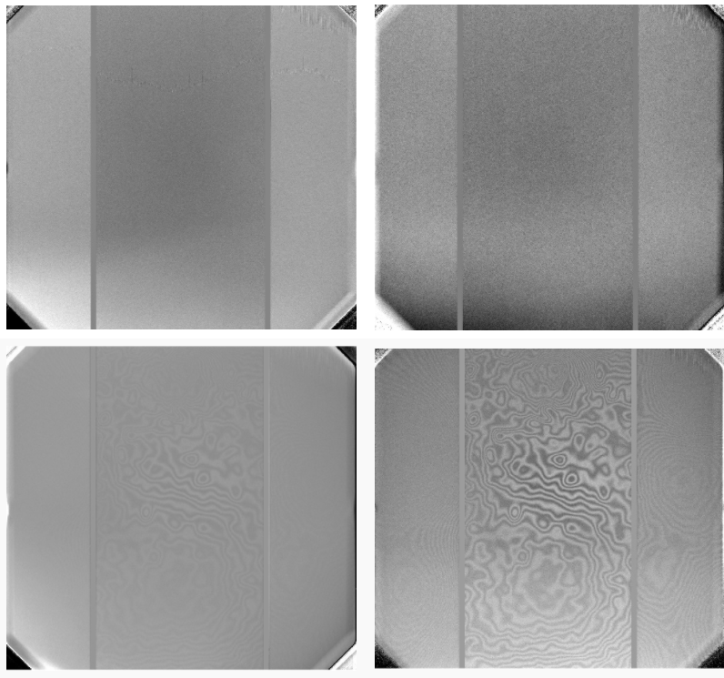
http://www.gemini.edu/instrumentation/gmos/data-reduction
i', Z, z', Y filters, Hamamatsu CCDs GMOS-N

