Slide 1
Password Management v0.1

Slide 2
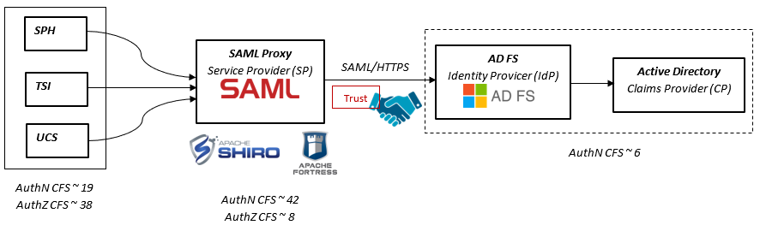
Technical Architecture an overview
Prerequisites (ADFS & AD, password policy)
Configure IdP (ADFS)
SP Proxy SAML
Integration to applications
Authorization RBAC
Protocol SAML 2.0
IdP https://idp.ssocircle.com/
SP OpenSAML

Slide 3
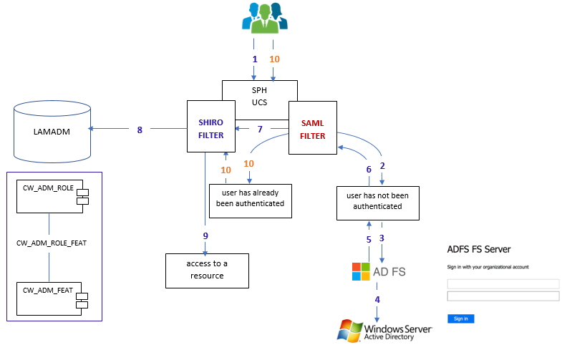
Technical Architecture Steps

Slide 4
Technical Architecture Steps
1. Access request to resource.
2. The SP (SAML FILTER) intercepts access request, case the user has not been authenticated, create a SAML 2.0 authentication request.
3. Send a HTTPS SAML 2.0 request to AD FS IdP.
4. Authentication AD with a trust relationship ADFS/AD.
5. Send a HTTPS SAML 2.0 response to SP (SAML FILTER).
6. Check the SAML 2.0 response message (decoding, verify).
7. Create an Shiro authentication token containing the SAML2 response received on the Service Provider Consumer URL configured (/acs): ACS Assertion Consumer Service.
8. Populate Shiro authorization realms with roles/features from LAMADM database. The concept of Role-Based Access Control (RBAC) will be used, refers to the idea of assigning permissions to users based on their role (token Shiro). It provides fine-grained control.
9. Starting and store SAML session and redirect to initial requested resource.
10. For all access request to protected resources for example with prefix (e.g. /api/*), the Shiro Filter check permission and redirect to requested resource.

Slide 5
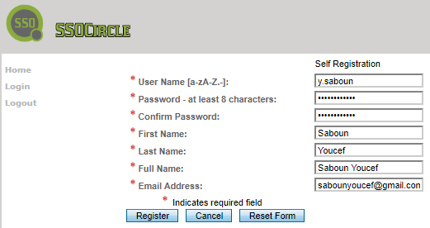
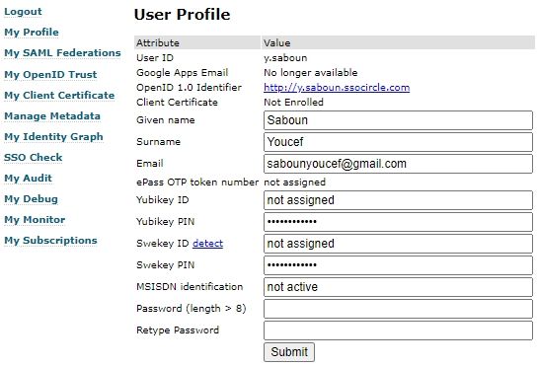
1) Config IdP ssocircle (https://www.ssocircle.com/en/)
Lab Dev with ADFS or an other IdP solution: e.g. ssocircle
Create a user profile

Slide 6
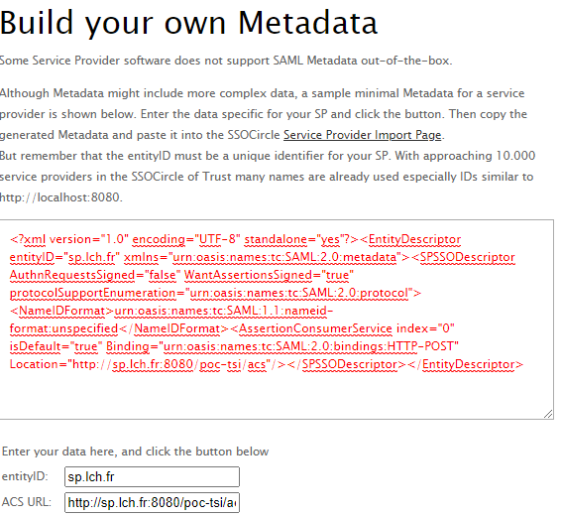
1) Config IdP ssocircle
Generate a metadata with
EntityID sp.lch.fr and
ACS URL http://sp.lch.fr:8080/poc-tsi/acs
C:\Windows\System32\drivers\etc
hosts
127.0.0.1 sp.lch.fr

Slide 7
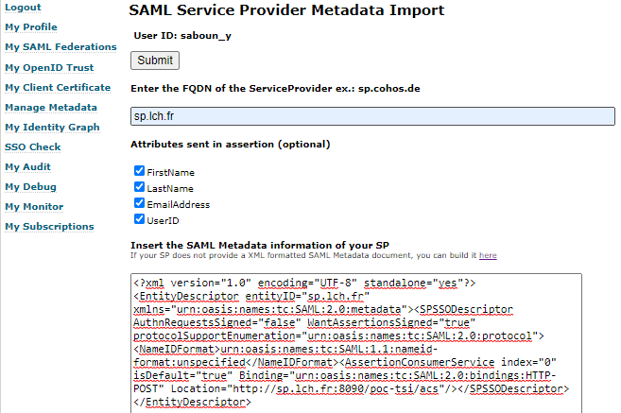
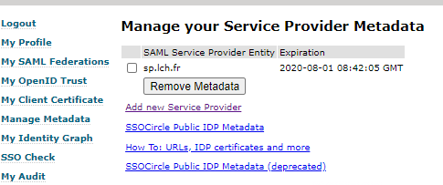
1) Config IdP ssocircle
Import SP Metadata

Slide 8
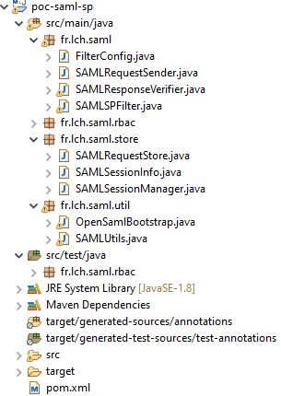
2) SP OpenSAML
pom.xml
<dependency>
<groupId>org.opensaml</groupId>
<artifactId>opensaml</artifactId>
<version>2.6.4</version>
</dependency>
A common module SP SAML proxy/filter with OpenSAML.

Slide 9
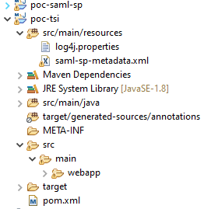
2) SP OpenSAML
e.g. filter app integration

Slide 10
2) SP OpenSAML
Import SP Metadata in application (e.g TSI)
saml-sp-metadata.xml
<md:EntityDescriptor xmlns:md="urn:oasis:names:tc:SAML:2.0:metadata"
entityID="sp.lch.fr">
<md:SPSSODescriptor AuthnRequestsSigned="false" ID="sp.lch.fr"
protocolSupportEnumeration="urn:oasis:names:tc:SAML:2.0:protocol">
<md:AssertionConsumerService
Binding="urn:oasis:names:tc:SAML:2.0:bindings:HTTP-POST"
Location="http://sp.lch.fr:8080/poc-tsi/acs" index="1"
isDefault="true"/>
</md:SPSSODescriptor>
</md:EntityDescriptor>

Slide 11
2) SP OpenSAML
Config Dependencies
Using a shared SAML module which transfers information about the authenticated user to the target application using a custom mechanism.
pom.xml
<dependency>
<groupId>fr.lch.saml</groupId>
<artifactId>poc-saml-sp</artifactId>
<version>1.0-SNAPSHOT</version>
<exclusions>
<exclusion>
<artifactId>log4j-over-slf4j</artifactId>
<groupId>org.slf4j</groupId>
</exclusion>
</exclusions>
</dependency>

Slide 12
2) SP OpenSAML
web.xml
<filter>
<filter-name>SpFilter</filter-name>
<filter-class>fr.lch.saml.SAMLSPFilter</filter-class>
<init-param>
<param-name>idProviderSSOUrl</param-name>
<param-value>https://idp.ssocircle.com:443/sso/SSORedirect
/metaAlias/ssocircle</param-value>
</init-param>
<init-param>
<param-name>spProviderId</param-name>
<param-value>sp.lch.fr</param-value>
</init-param>
<init-param>
<param-name>acsUrl</param-name>
<param-value>http://sp.lch.fr:8080/poc-tsi/acs</param-value>
</init-param>
<init-param>
<param-name>logoutUrl</param-name>
<param-value>/logout</param-value>
</init-param>
</filter>
Add a filter with parameters:
idp url (ssocircle,ADFS,…), sp id, acs url, logout action.
In web.xml or with a java filter

Slide 13
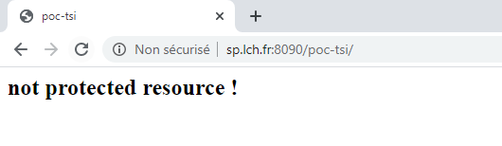
3) Demo
Not protected resource

Slide 14

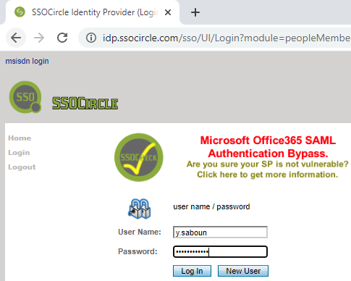

3) Demo
Before authentication
A protected resource

Slide 15
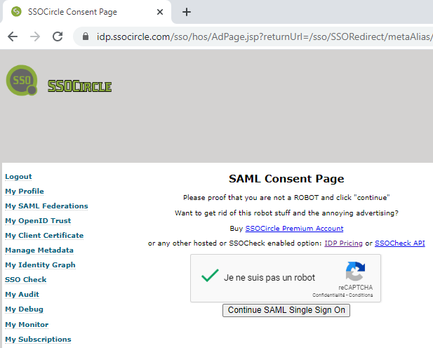

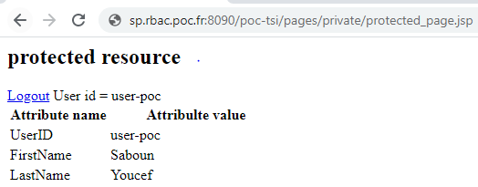
3) Demo
After authentication
A protected resource

Slide 16
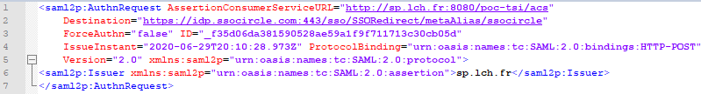
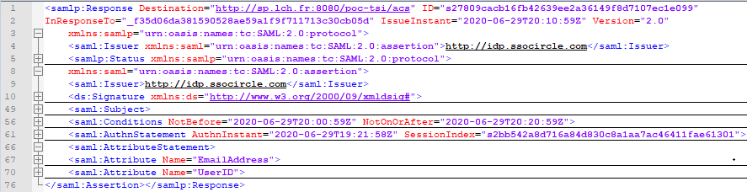
3) Demo

Slide 17
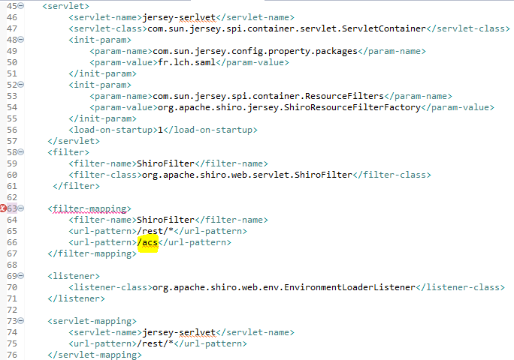
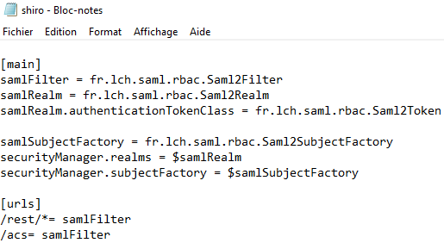
3) Demo

Slide 18
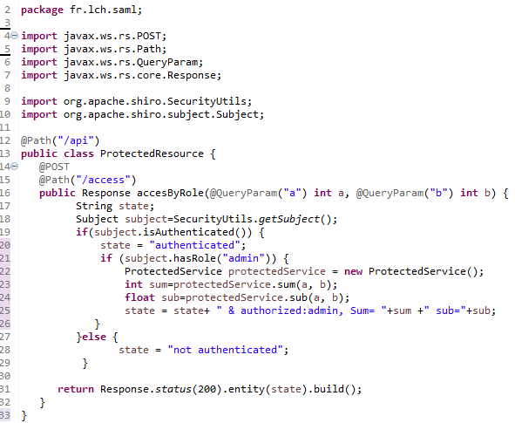
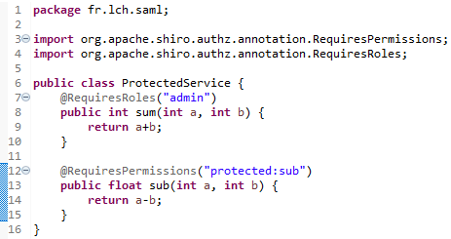
3) Demo

Slide 19
Conclusion
SAML SP Filter 
Client integration example 
Config IdP example 
Integration with Shiro and application the RBAC concept 

