Slide 1


S8: Final Presentation for Glowworm Music Studio
Team Glowworm 🐛
Allan Hernandez, Hennysa Omoregie, Laurelle Sekpe, Gregory Treinen
Notes:
Greg

Slide 2
What product did you develop and why?
Interactive PWA that transforms keyboard input into playable digital instruments, score‑writing, and multi‑track song or “band” performances via overlay process
Why? Wanted to make a PWA that improved upon existing music applications that had similar functionality
Notes:
Greg

Slide 3
Who is your product for?
Musicians and/or creators who want an intuitive and customizable way to compose and perform music that can be shared
General users who have limited traditional musical knowledge that want an easy way to create music with easily accessible instruments
Notes:
Greg

Slide 4
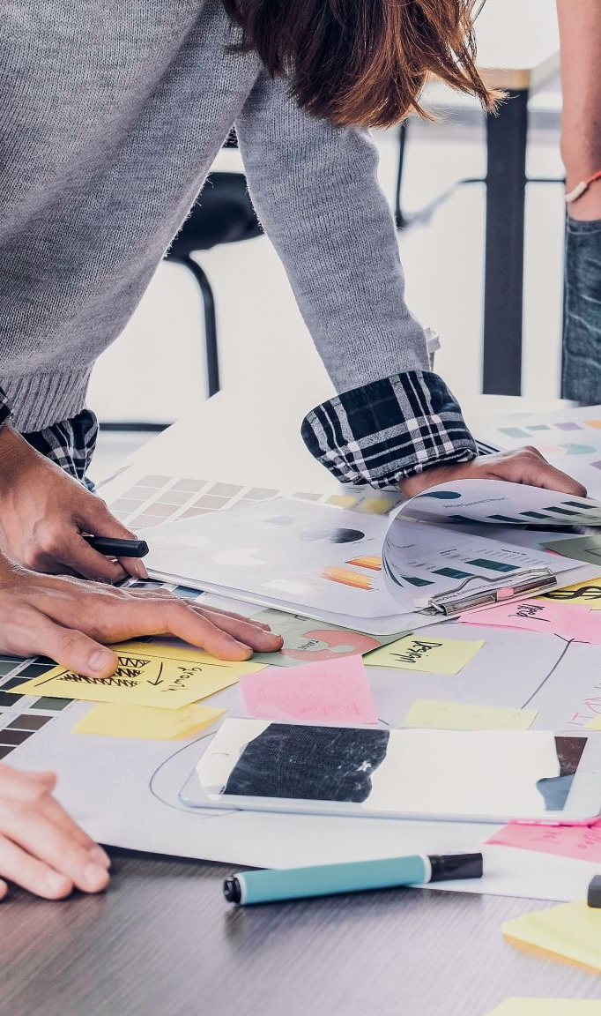
What did your design process look like?
General PWA idea and wireframe ➔ Improve upon based on design method results ➔ Test ➔ Add/ change functionalities based on test results ➔ iterate testing
Mode 1.12 Initial Opportunity Map
Mode 2.10 Industry Diagnostics
Mode 2.13 Interest Groups Discussion
Mode 4.20 Results
Mode 5.6 Concept-Generating Matrix
Mode 6.6 Solution Diagramming
Mode 7.2 Platform Plan
Notes:
Henny

Slide 5
How did your design change over the length of the project?
Core functions of the design stayed the same
Mostly UI changes based on personal preference and testing feedback + new minor functionalities added, e.g.:
Metronome
Change key bindings
Keyboard tooltips
More control with overlaying
Notes:
Henny

Slide 6

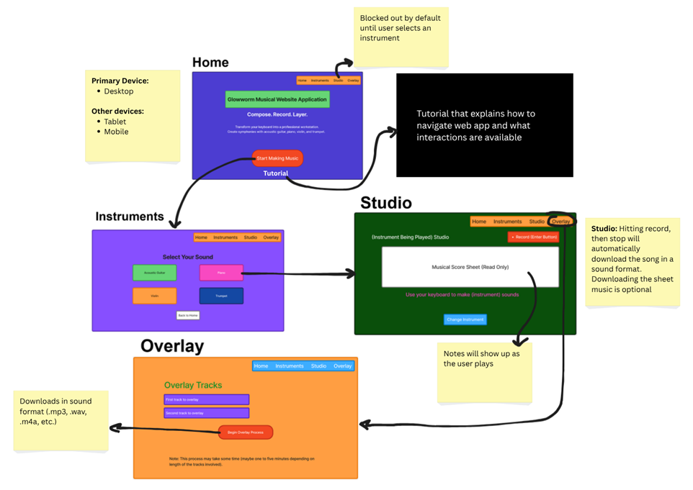



Notes:
Henny

Slide 7
How did you test your design and what were the results of the test?
Started with testing navigation for the low-fidelity prototype
From the medium-fidelity prototype and so forth, tested ability to make a song
Results: Generally, users were able to navigate the web application
Users fine with UI (ish)
Mostly wanted additional features to Overlay/Studio or existing features made more obvious
Notes:
Allan

Slide 8
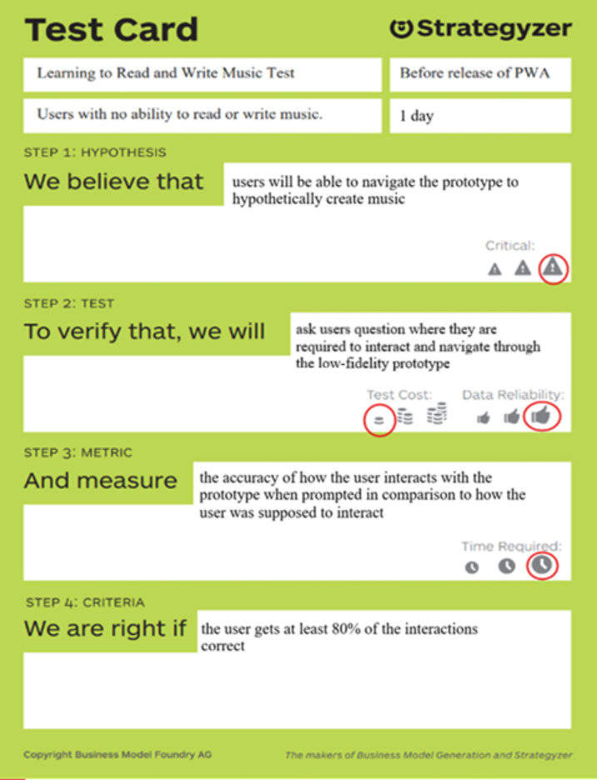
General Testing A
Hypothesis: We believe that users will be able to navigate the prototype to "create" music.
Testing procedure: To verify, we will ask users questions where they are required to interact with and navigate through the low-fidelity prototype.
Metric: We measure the accuracy of how the user interacts with the prototype when prompted in comparison to how the user was intended to interact.
Notes:
Allan

Slide 9
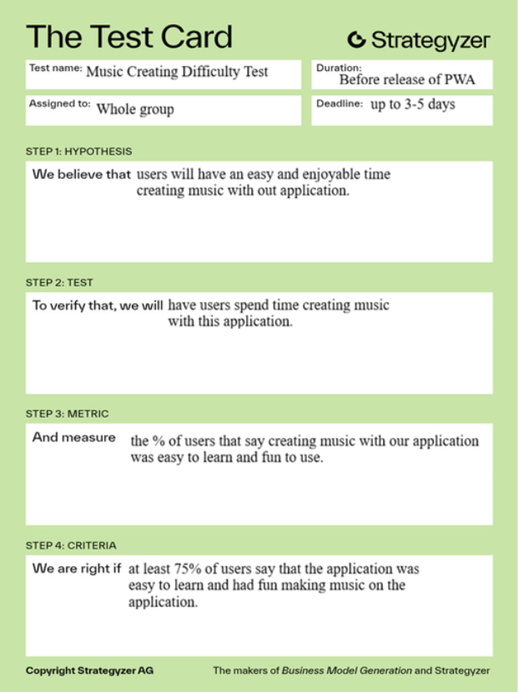
General Testing B
Hypothesis: We believe that users will have an easy/enjoyable time creating music on our application
Testing procedure: To verify, we will ask users to create a song using all the web application's features w/ deadline of up to 3-5 days.
Metric: We measure the general response and % of users that say creating music with our app was easy to do and fun to use.
Notes:
Allan

Slide 10
What are you most proud of from your project?
Great teamwork
Intuitive design, lots of instruments, unique score feature
Overlay and edit feature
Adaptability with feedback from tests
Notes:
Laurelle

Slide 11
What would you change about the product if you were given infinite money and time to bring it to market?
Ability to livestream music playing and have collaborators working together in real time
Add more editing features in Overlay similar to paid digital audio workstations (GarageBand, Ableton Live, etc.)
Notes:
Laurelle

