Slide 1
S4: Low Fidelity Prototype
Team Glowworm

Slide 2
About
Interactive PWA that transforms keyboard input into playable digital instruments, score‑writing, and multi‑track “band” performances for musicians and/or creators who want an intuitive and customizable way to compose and perform music that can be shared

Slide 3
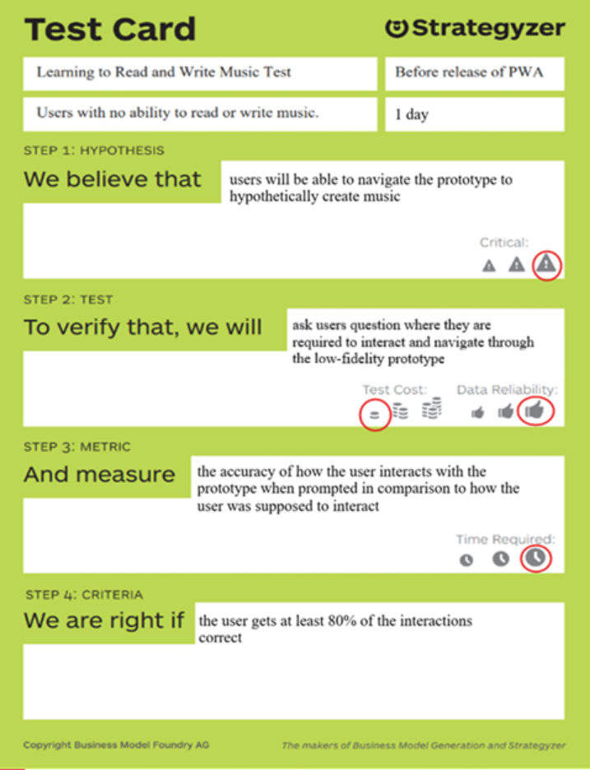
Testing
Hypothesis: We believe that users will be able to navigate the prototype to "create" music.
Testing procedure: To verify, we will ask users questions where they are required to interact with and navigate through the low-fidelity prototype.
Metric: We measure the accuracy of how the user interacts with the prototype when prompted in comparison to how the user was intended to interact.

Slide 4
Test Question Examples
How would you start making music?
Where would you go if you want to test an instrument?
Where would you go if you want to change your instrument?
Where would you go if you want to overlay another score?
Where would you go if you want to play your score?

Slide 5
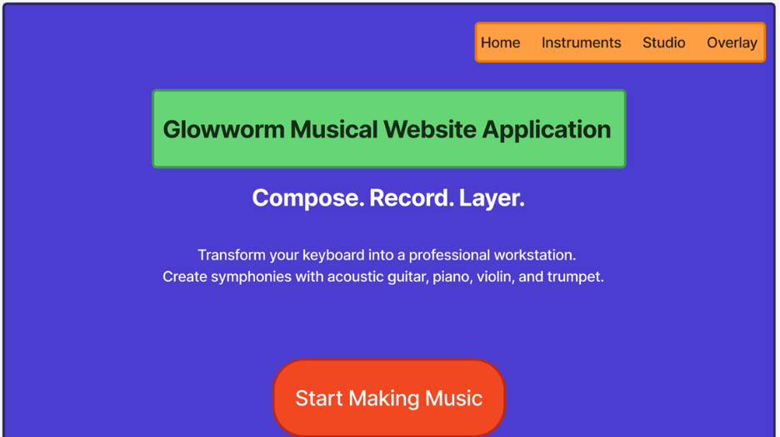

Slide 6
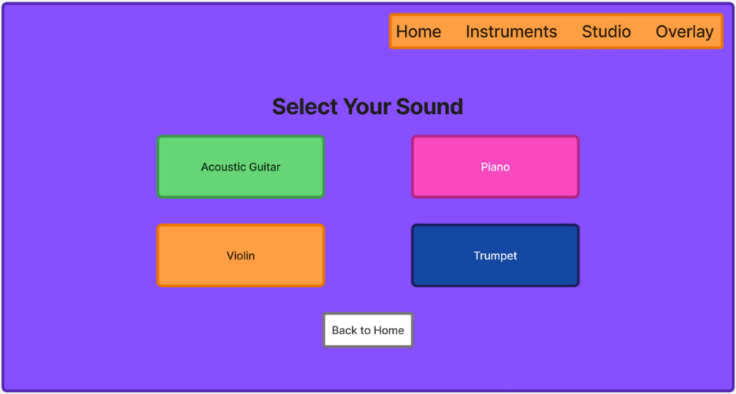

Slide 7
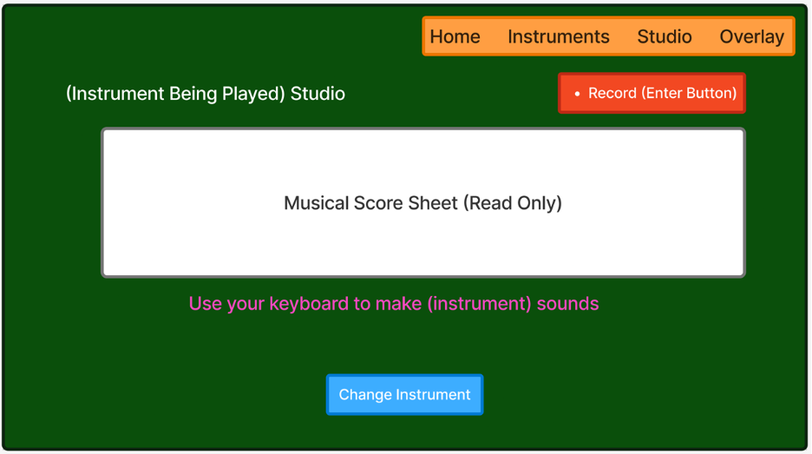

Slide 8
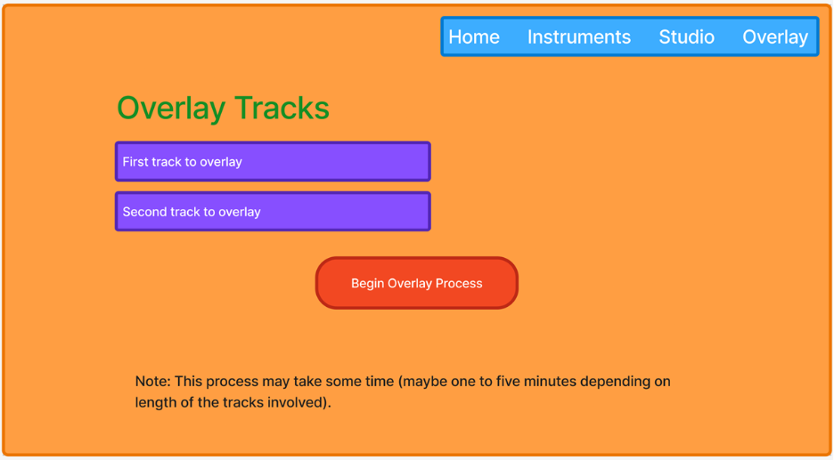

Slide 9
Testing Results
All users were able to answer the navigation questions with at least 80% accuracy
Response Feedback/Changes
Ambiguity on where tracks are being stored when downloaded
Confusion on where user was at based off the navbar (highlight)
Confusion on what each navbar item does at first glance. Maybe add flavor text on link hover?
Need for page design consistency
What file types can be used for overlay process (.m4a, .mp3, etc.)?
How to save tracks? Is it automatic?
How do you share songs? (Need for visible share button)
Can user overlay more than 2 tracks?
If not too complicated, maybe add settings for users the change their keybindings

