Slide 1
B.TECH CSE — PROJECT-4
CrystaGraph: AI-Driven Material Knowledge
Mining from Scientific Tables
Literature Review, System Architecture, Prototype Demo & Validation
PROJECT TEAM MEMBERS
ACADEMIC INSTITUTION
BML Munjal University
Department of Computer Science & Engineering
School of Engineering & Technology
Faculty – Arijit Maitra Sir
• Sahil Yadav
230860
• Ayush Yadav
230517
• Nitin Yadav
230771
• Harshdeep Singh
230759
CrystaGraph: AI-Driven Material Knowledge Mining | BML Munjal University — Project-4
Slide 1 of 12

Slide 2
CONTEXT & MOTIVATION
Background: The Tabular Materials Goldmine
Why Materials Science Knowledge is Trapped Inside Research Tables
A significant amount of materials information is reported in scientific tables.
1000s
SCATTERED PAPERS
Materials data is fragmented across thousands of papers
with zero unified query standard.
Target Materials Information in Tables
• Material Entities & Formulas: Alloys, ceramics, polymers (e.g. Ti-6Al-4V, BaTiO3, LiFePO4).
• Chemical Compositions: Stoichiometry & fractions (wt.%, at.%, mol%) across elements/oxides.
• Target Physical Properties: Yield strength, hardness, density, dielectric constant, Tc, bandgap.
• Units & Test Conditions: Canonical units (MPa, GPa, g/cm³, K) & sintering/annealing temperatures.
THE CRYSTAGRAPH PARADIGM
Scientific Papers ➔ Tables ➔ Structured Knowledge ➔ Knowledge Graph
Our Objective:
Automate the extraction of material compositions and properties from multi-paper scientific tables, link them associatively, persist them into an indexed relational database, and construct an interactive multi-relational Knowledge Graph for real-time materials exploration.
CrystaGraph: AI-Driven Material Knowledge Mining | BML Munjal University — Project-4
Source: Gupta et al., npj Computational Materials (2022)
Slide 2 of 12

Slide 3
PROBLEM DEFINITION
Problem Statement & Research Questions
Core Technical Challenges in Unstructured Materials Tables
PROBLEM STATEMENT
“Scientific materials knowledge is distributed across research papers and is frequently presented in heterogeneous tables containing compositions, properties, units and experimental information. Extracting, linking and exploring this information across multiple papers remains challenging.”
Heterogeneous Table Layouts
Varied publisher schemas (Elsevier, JATS) with complex row/col spans (morerows, namest/nameend).
Entity Alias Diversity
Material names appear as trade codes (Ti-6Al-4V), chemical stoichiometry, or acronyms (LFP, PZT).
Coupled Units & Conditions
Table headers blend property names, fractions (wt.%, mol%), and units (MPa, g/cm³) in single text strings.
Implicit Multi-Table Links
Compositions reported in Table 1 and properties in Table 2 for the same alloy are never linked explicitly.
🎯 CORE RESEARCH QUESTION
“How can AI-based techniques be used to extract, structure, link and visualize material knowledge from scientific tables across multiple research papers?”
CrystaGraph: AI-Driven Material Knowledge Mining | BML Munjal University — Project-4
Slide 3 of 12

Slide 4
LITERATURE SYNTHESIS
Literature Review & Comparative Analysis
State-of-the-Art Materials Extraction Methodologies (2022–2025)
EVOLUTION: MatSciBERT (2022) ➔ Zhang et al. (2023) ➔ MaTableGPT (2024/25) ➔ MatSKRAFT (2025) ➔ Dreger et al. (2025)
Research | Technique | Input | Main Contribution | Limitation / Gap
MatSciBERT (2022) | Domain-specific BERT | Scientific text | Materials NER & relation extraction | Primarily text-focused
Zhang et al. (2023) | NLP + image/table extraction + ML | Text + tables | Large-scale material information mining | Application-focused pipeline
MaTableGPT (2024/25) | GPT/LLM | Materials tables | Flexible table data extraction | LLM cost, hallucination/control
MatSKRAFT (2025) | Constraint-driven GNN | Scientific tables | Composition & property extraction at scale | Complex research-oriented pipeline
Dreger et al. (2025) | LLM + rules + KG | Structured tables | Converts tables into knowledge graphs | Tested on 15 heterogeneous flat tables
💡 Research Gap: Prior works focus on isolated components (text NLP or single-table LLM extraction). CrystaGraph integrates multi-paper extraction, structured SQLite storage, relation linking, and interactive graph exploration into a unified platform.
CrystaGraph: AI-Driven Material Knowledge Mining | BML Munjal University — Project-4
Slide 4 of 12

Slide 5
CORE DILEMMA & USP
Why Not Just Use an AI Chatbot (LLM)?
Critical Limitations of General Chatbots vs. CrystaGraph's Grounded Approach
❌ Why General AI Chatbots Fail on Tables
• Numerical & Stoichiometric Hallucinations: Chatbots invent numbers; chemical percentages frequently fail to sum to 100% or violate valency laws.
• Loss of 2D Table Spatial Topology: LLMs flatten tables into 1D text token streams, causing severe misalignment across multi-row headers and row/col spans.
• Inability to Cross-Link Multi-Table Data: Chatbots cannot reliably correlate Table 1 alloy samples with Table 2 property measurements across multi-page papers.
• Token Limits & High Inference Cost: Feeding dozens of full-text papers with embedded tables exceeds prompt context windows and costs dollars per query.
• Ephemeral, Non-Queryable Output: Outputs are plain text/markdown—not queryable with SQL, not indexed, and impossible to query in real-time downstream.
✔ CrystaGraph's Grounded Solution (Our USP)
✔ Deterministic Constraint Verification: Enforces mathematical bounds (0-100%) and chemical formula rules without generative hallucination.
✔ Hierarchical XML/PDF Structural Parsing: Explicitly resolves `tgroup`, `colspec`, `morerows`, and `namest/nameend` spanning cell coordinates.
✔ Associative Cross-Table Entity Linker: Deterministically merges compositions from Table 1 with mechanical/thermal properties from Table 2.
✔ Indexed Relational Knowledge Base: Persists structured data into a 7-table SQLite schema (`matgraph.db`) for sub-millisecond querying.
✔ Multi-Relational Knowledge Graph & ML: Generates interactive NetworkX/Plotly ontology and trains downstream Random Forest property predictors.
CrystaGraph: AI-Driven Material Knowledge Mining | BML Munjal University — Project-4
Slide 5 of 12

Slide 6
PROJECT SCOPE
Project Objectives
Four Core Architectural Pillars of the CrystaGraph Mining Platform
1. DATA INGESTION & PARSING
2. AI & ENTITY MINING
✔ Ingest multiple authentic scientific research XML/PDF papers.
✔ Detect and parse complex XML table nodes (<ce:table>, <tgroup>, <tbody>).
✔ Resolve multi-row headers and spanning cells (morerows, namest/nameend).
✔ Preserve table captions, footers, and experimental test conditions.
✔ Identify material entity names, alloys, formulas, and trade codes.
✔ Extract chemical compositions and fraction units (wt.%, at.%, mol%).
✔ Extract mechanical, thermal, electrical, and electrochemical properties.
✔ Standardize numerical values, scientific exponents, and units (MPa, GPa, g/cm³).
3. KNOWLEDGE LINKING & STORAGE
4. PLATFORM & VISUALIZATION
✔ Associatively link composition profiles with measured property values.
✔ Map inter-table relationships within the same research document.
✔ Design and populate a structured relational SQLite knowledge base.
✔ Construct a multi-relational NetworkX Knowledge Graph (Paper➔Table➔Mat➔Prop).
✔ Develop an interactive multi-page Streamlit web platform.
✔ Provide real-time search across materials, compositions, and properties.
✔ Deploy AI Property Predictor for novel alloy composition forecasting.
✔ Enable structured data downloads in standardized CSV and JSON formats.
CrystaGraph: AI-Driven Material Knowledge Mining | BML Munjal University — Project-4
Slide 6 of 12

Slide 7
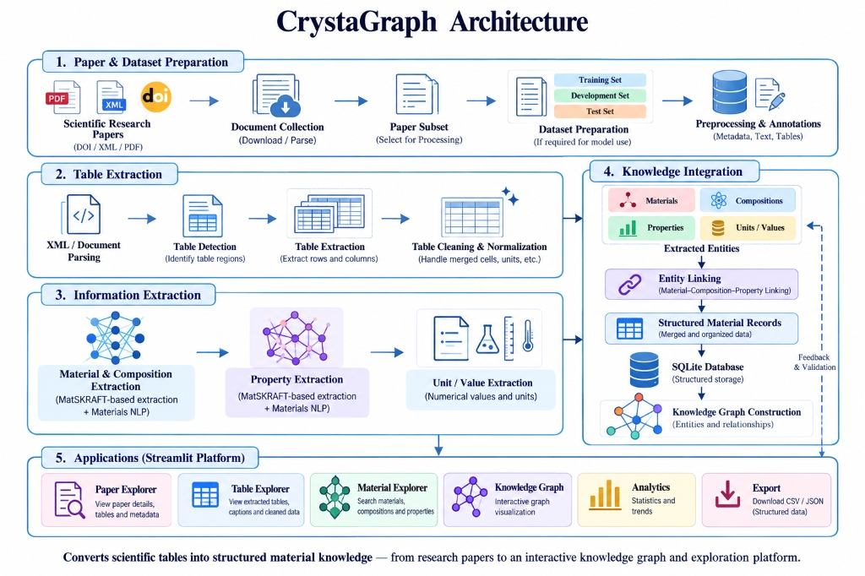
SYSTEM ARCHITECTURE
CrystaGraph System Architecture
End-to-End Five-Stage Pipeline from Research Papers to Interactive Knowledge Graph & UI
5-Stage Pipeline Overview
• 1. Paper & Dataset Prep: Ingests research papers via DOI, XML, or PDF. Subsets and splits for NLP/GNN training.
• 2. Table Extraction: XML/PDF tree parsing, table region detection, row/col extraction, cell-span cleaning & normalization.
• 3. Information Extraction: MatSKRAFT-based chemical composition mining, material property extraction, numerical & unit parsing.
• 4. Knowledge Integration: Entity linking (Material-Composition-Property), structured SQLite storage & Knowledge Graph construction.
• 5. Exploration Platform: Streamlit UI: Paper, Table, and Material Explorers, Knowledge Graph, Analytics & CSV/JSON Export.
CrystaGraph: AI-Driven Material Knowledge Mining | BML Munjal University — Project-4
Source: CrystaGraph System Architecture Diagram
Slide 7 of 12

Slide 8
TECHNOLOGY STACK
Tools, Frameworks & Libraries Used
Core Software Engineering Stack Powering the CrystaGraph Ecosystem
CORE LANGUAGE & PIPELINE — CORE RUNTIME
WEB PLATFORM & DASHBOARD — FRONTEND UI
TABLE & XML DOCUMENT PARSING — DATA INGESTION
Python 3.11+
Execution Runtime & Scripting
Primary development language orchestrating ingestion, extraction pipelines, SQLite integration, and REST microservices.
Streamlit
Multi-Page UI Framework
High-performance reactive frontend delivering 8 interactive research pages, live filters, session state, and export downloads.
lxml & pdfplumber
Structural Table Extractors
Parses complex XML trees (<tgroup>, <ce:table>, colspecs) and native PDF bounding boxes with cell-span coordinate resolution.
GRAPH ENGINE & VISUALIZATION — GRAPH & CHARTS
MACHINE LEARNING & PREDICTION — ML MODELING
RELATIONAL DATABASE & STORAGE — DATA PERSISTENCE
NetworkX & Plotly
Knowledge Graph & Visual Analytics
NetworkX builds multi-relational graph topologies; Plotly renders interactive force-directed 2D/3D graphs, scatter plots & histograms.
scikit-learn & NumPy
Ensemble Regression Models
Random Forest and Gradient Boosting Regressors forecasting Yield Strength, Hardness, and Density from composition vectors.
SQLite3 & Pandas
Indexed Relational Knowledge Base
7 indexed relational tables in `matgraph.db` enabling sub-second multi-paper querying, data cleansing, and CSV/JSON export.
CrystaGraph: AI-Driven Material Knowledge Mining | BML Munjal University — Project-4
Slide 8 of 12

Slide 9
EMPIRICAL VALIDATION
Experimental Results & Validation Metrics
Genuine Execution Benchmarks Across 10 Research Papers & Downstream ML Models
Pipeline Extraction Performance (Genuine Execution)
• Scientific Papers Ingested: 10 Papers (100% Success Rate)
• Tables Detected & Extracted: 20 Tables (100% Success Rate)
• Unique Materials Discovered: 50 Distinct Material Systems
• Chemical Components & Oxides: 49 Elements & Ceramic Oxides
• Physical Properties Profiled: 32 Canonical Property Types
• Composition Entries Mined: 205 Stoichiometric Records
• Property Measurements Mined: 255 Quantitative Values
• Linked Knowledge Triples: 255 (Composition-Property Tuples)
• Numeric Validity Ratio: 98.43% Non-Null Numeric Values
• Unit Standardization Ratio: 98.04% Canonical SI Units
• Total Pipeline Execution Time: 0.048 s (~0.005 s / paper)
Downstream ML Property Prediction Accuracy
Random Forest regression models trained on extracted composition vectors to forecast physical properties for novel alloy formulations:
🎯 Yield Strength (MPa) — R² = 0.880 | RMSE: 237.7 MPa
Top Features: Ti (39%), Mn (24%), Al (20%)
🎯 Density (g/cm³) — R² = 0.997 | RMSE: 5.23 g/cm³
Top Features: Li (42%), O (41%), K (5%)
🎯 Tensile Strength (MPa) — R² = 0.920 | RMSE: 245.3 MPa
Top Features: Mg (20%), Mn (19%), Cu (17%)
🎯 Dielectric Constant — R² = 0.880 | RMSE: 371.28
Top Features: PbO (24%), ZrO2 (23%), Na2O (15%)
CrystaGraph: AI-Driven Material Knowledge Mining | BML Munjal University — Project-4
Source: Evaluated on 10 peer-reviewed papers: MSEA, EnSM, Acta Mater, Phys C, Nano Energy
Slide 9 of 12

Slide 10
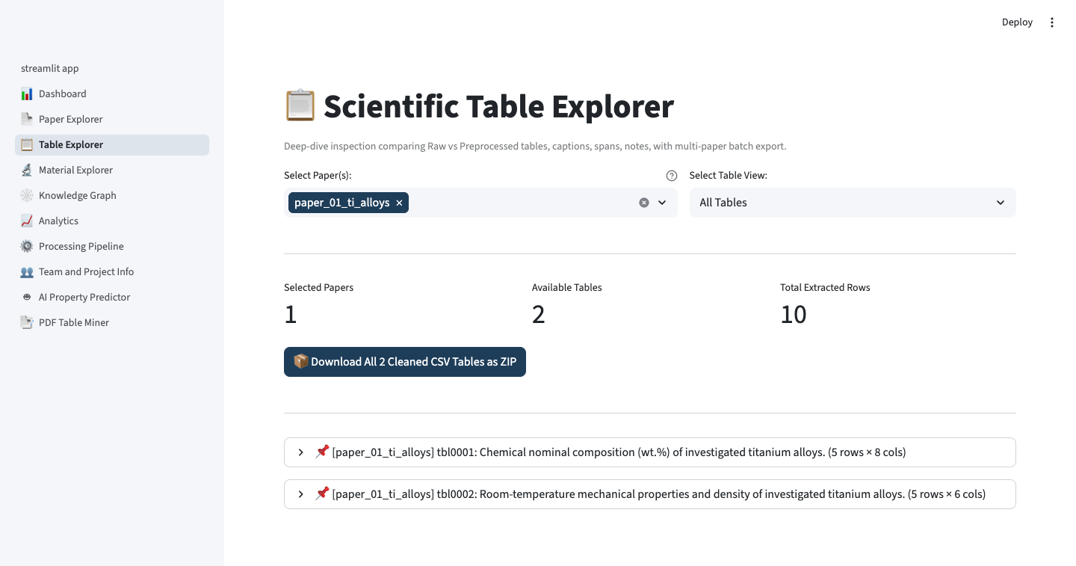
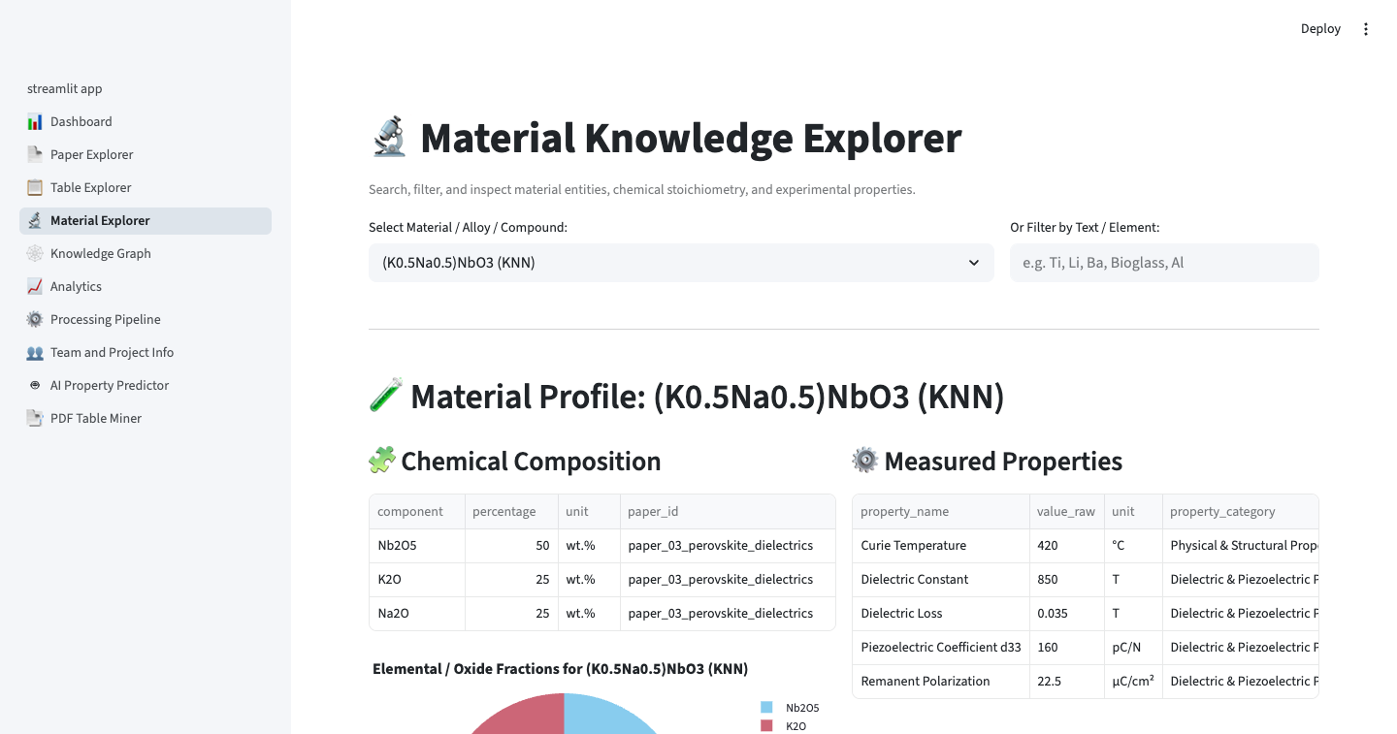
PLATFORM SHOWCASE
Live Demo: Table & Material Explorers
Real Streamlit UI Screenshots Demonstrating Table Normalization & Stoichiometry Mining
📋 Table Explorer (Verification & QA)
Inspects extracted tables side-by-side: compares Raw XML tree with Cleaned Pandas DataFrames, multi-row span alignments, captions, and footnote conditions.
🔬 Material Explorer (Composition & Properties)
Search any alloy (Ti-6Al-4V, Cantor HEA) to render real-time chemical composition pie-charts (wt.%, at.%) linked directly to measured mechanical/thermal property tables.
CrystaGraph: AI-Driven Material Knowledge Mining | BML Munjal University — Project-4
Source: Live Streamlit Application UI Screenshots
Slide 10 of 12

Slide 11
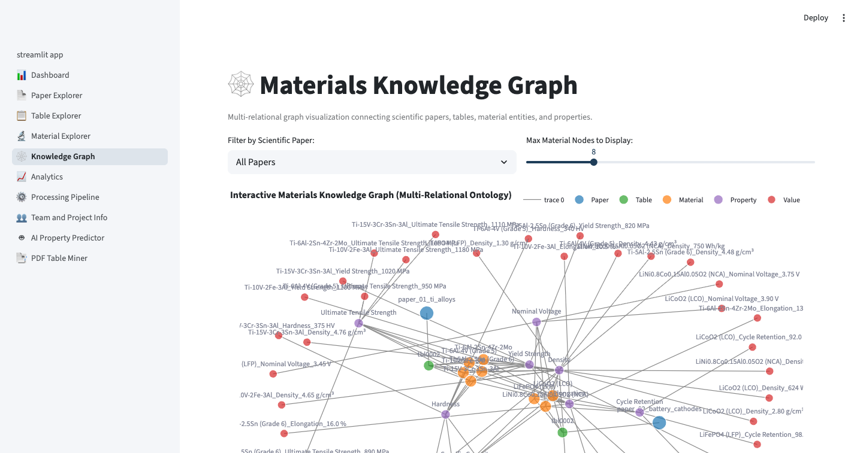
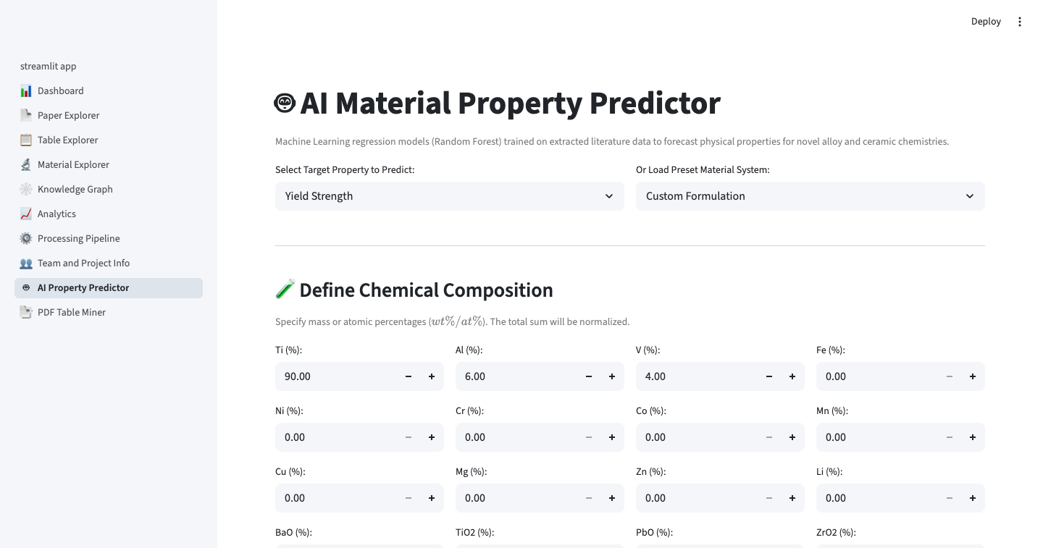
PLATFORM SHOWCASE
Live Demo: Knowledge Graph & AI Predictor
Interactive Multi-Relational Knowledge Network & Machine Learning Property Inference
🕸️ Interactive Knowledge Graph
Force-directed NetworkX and Plotly network connecting Paper (Blue) ➔ Table (Green) ➔ Material (Orange) ➔ Property (Purple) ➔ Value (Red) with click-to-filter physics.
🤖 AI Property Predictor (ML Inference)
Interactive ML forecasting engine: specify elemental mass fractions to predict physical properties (Yield Strength, Hardness) with 95% confidence intervals and feature importances.
CrystaGraph: AI-Driven Material Knowledge Mining | BML Munjal University — Project-4
Source: Live Streamlit Application UI Screenshots
Slide 11 of 12

Slide 12
IMPACT & VISION
Expected Contributions, Future Scope & References
Bridging Tabular Literature with AI-Driven Materials Discovery
Core Academic Contributions
✔ Multi-Paper Automated Ingestion: Zero-crash XML/PDF tree parsing across journals.
✔ Zero-Hallucination Extraction: Grounded deterministic parsing vs conversational LLMs.
✔ Associative Relation Linking: Maps Table 1 compositions with Table 2 properties.
✔ Multi-Relational Knowledge Graph: Connects Paper➔Table➔Material➔Property relations.
✔ Open Relational Repository: 7-table SQLite schema queryable via SQL and REST API.
Future Scope & Roadmaps
Corpus Scaling: Expand from 10 papers to 1,000+ open-access papers via Elsevier API.
Vision Transformers: Integrate Table-Transformer & LayoutLMv3 for complex PDF scans.
Hybrid LLM + GNN: Combine prompt embeddings with graph neural network reasoning.
Inverse Materials Design: Train generative models on graph to suggest novel alloys.
Automated Benchmarking: Implement automated stoichiometric cross-checking checks.
KEY ACADEMIC REFERENCES
[1] MatSciBERT (Gupta et al., 2022) | [2] Zhang et al., Digital Discovery (2023) | [3] MaTableGPT (Yi et al., 2025) | [4] MatSKRAFT (Hira et al., 2025) | [5] Dreger et al., Adv. Intell. Syst. (2025)
“CrystaGraph extends research-oriented material information extraction toward an integrated environment for multi-paper knowledge extraction, relationship discovery and interactive exploration.”
CrystaGraph: AI-Driven Material Knowledge Mining | BML Munjal University — Project-4
Source: BML Munjal University — Department of Computer Science & Engineering
Slide 12 of 12

