Slide 1
Where Should we move to after the boot camp?
A Exploratory Data Analysis of Global on Artificial intelligence Salaries

Slide 2
Research Questions
Question number 1:
Average salary for entry jobs
Question number 2:
What is the most common education requirement for each type of industry that has A.I employees.
Question number 3:
What is the impact of industry, country and experience level on salary?

Slide 3
Dataset Overview
• 15,000 AI-related job records across multiple countries
• 20 columns
• Numeric variables: salary_usd, years_experience, benefits_score, salary_local
• Categorical variables: job_id, job_title, Salary_currency, experience_level, employment_type, posting_date, Application_deadline,
company_location, company_size, employee_residence, required_skills, job_description_length, education_required, industry and company_name.

Slide 4
Data Cleaning
We confirmed that there is no NAN and no duplicate values in the database
We changed the posting_date and Application_deadline to a datetime format.
We erased the columns salary_currency, salary_local, posting_date, application_deadline, job_descriprion_length.

Slide 5
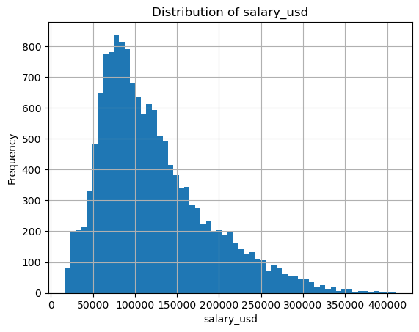
Salary Offers
mean 121991.938267 std 63968.361846
min 16621.000000 max 410273.000000
The majority of the Job offers have a salary between $50.000 and $150.

Slide 6
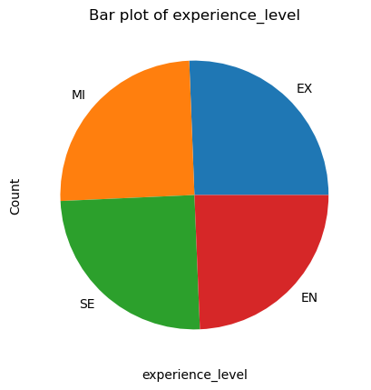
Experience Level
unique: 4
EX : 25.62% SE: 24.94%
MI: 25.09% EN: 24.35%
The experience level is equally distributed.

Slide 7
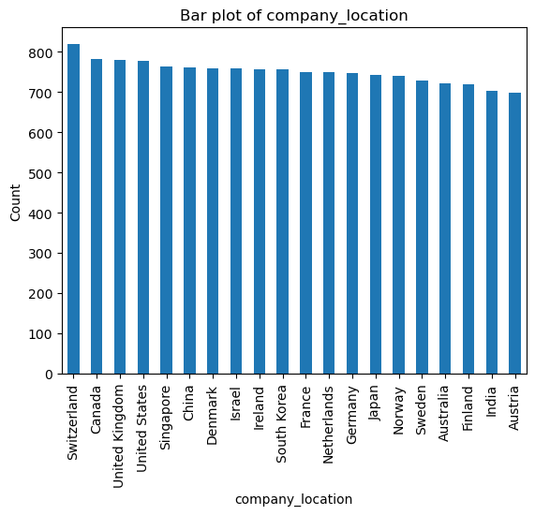
Company Location
unique: 20
Top 5: Switzerland 819 Canada 781 United Kingdom 780 United States 776 Singapore 762
Low 5: Sweden 729 Australia 721 Finland 718 India 702 Austria 699

Slide 8
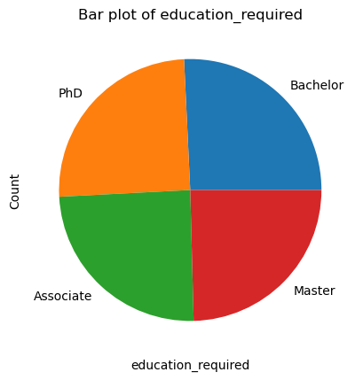
Education Required
unique: 4
PHD: 25.07% MA: 24.59%
BA: 25.75% AS: 24.59%
The experience level is equally distributed.

Slide 9
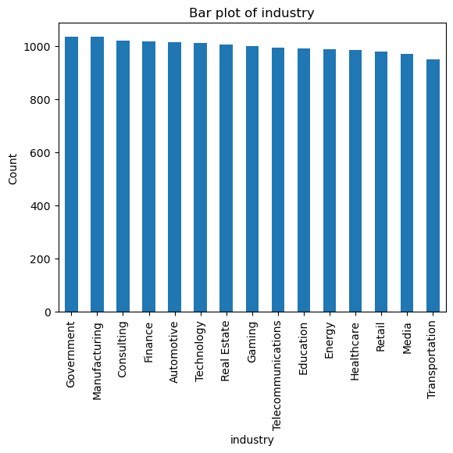
Types of Industry
unique: 15
Top 5: Government 1035 Manufacturing 1035 Consulting 1021
Low 5: Retail 978 Media 972 Transportation 951

Slide 10
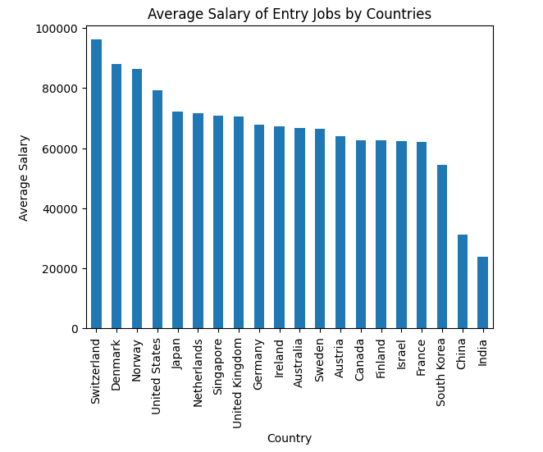
Question 1 We should all move to Switzerland!
Average salary for entry jobs:
Top country: Switzerland $172.995 Average for entry jobs Switzerland: $96.106
Overall average: $121.991 Overall entry salary average: $66.773

Slide 11
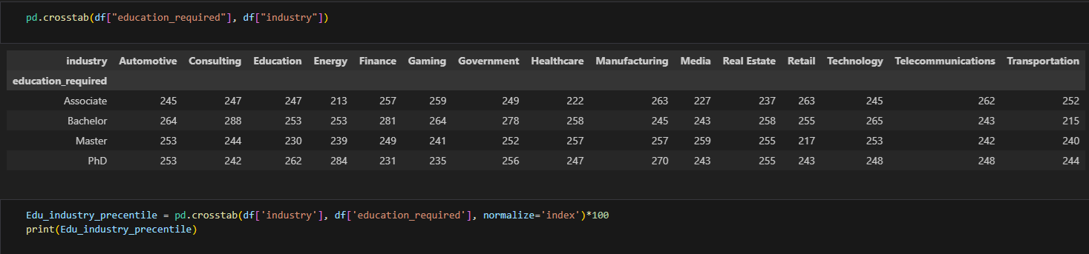
Question 2 What is the most common education requirement for each type of industry that has A.I employees.
Step 1 – We created the crosstab.
Step 2 – we turned the required values into a percentile number.
Step 3 – A Heat map was created.

Slide 12
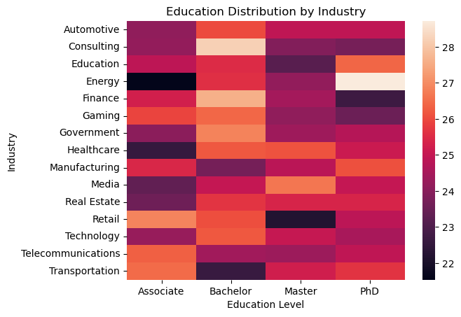
Conclusion:
No single education level dominates the AI field, it’s balanced, showing that AI welcomes multiple entry paths
Bachelor’s degrees are most common across nearly all industries
PhDs domains in research heavy industries like Energy, Manufacturing, and Education.
Associate degrees are more hired industries like finance, retail and telecommunications.
Master’s degrees hold strong presence in Healthcare and Media

Slide 13
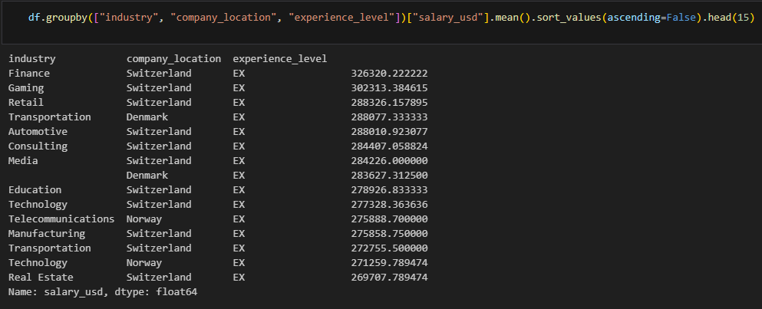
Question 3
What is the impact of industry, country and experience level on salary?
We grouped all the variables needed sorting the industries by their mean salary
In the company_location and the experience_level appears only the top 1 value with the highest salary.

Slide 14
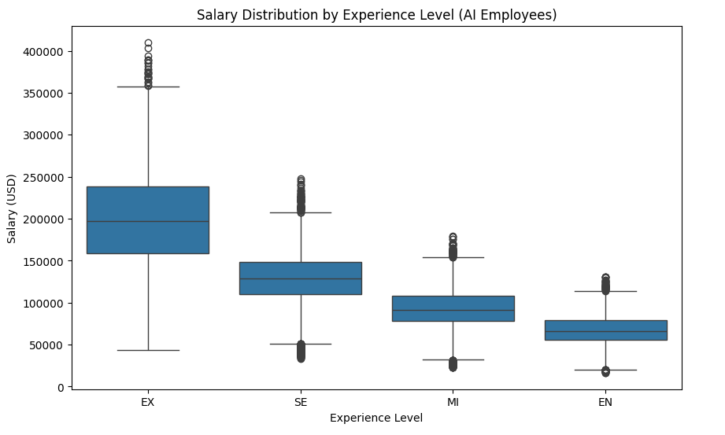
Salary distribution by experience level of AI employees
Salary growth with experience is very strong — consistent across all industries.
Executives (EX) earn ~3x more than entry-level (EN) employees.

Slide 15
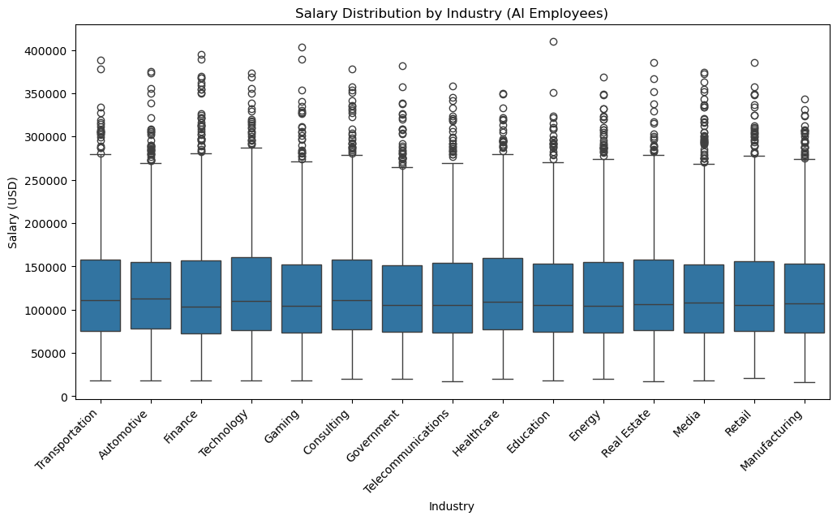
Salary distribution by Industry of AI employees
Education, Consulting, and Real Estate are on the lower end — possibly due to less profit margin or smaller-scale A.I. adoption.
Technology, Transportation and Automotive have the highest salary distribution across all the employee levels

Slide 16
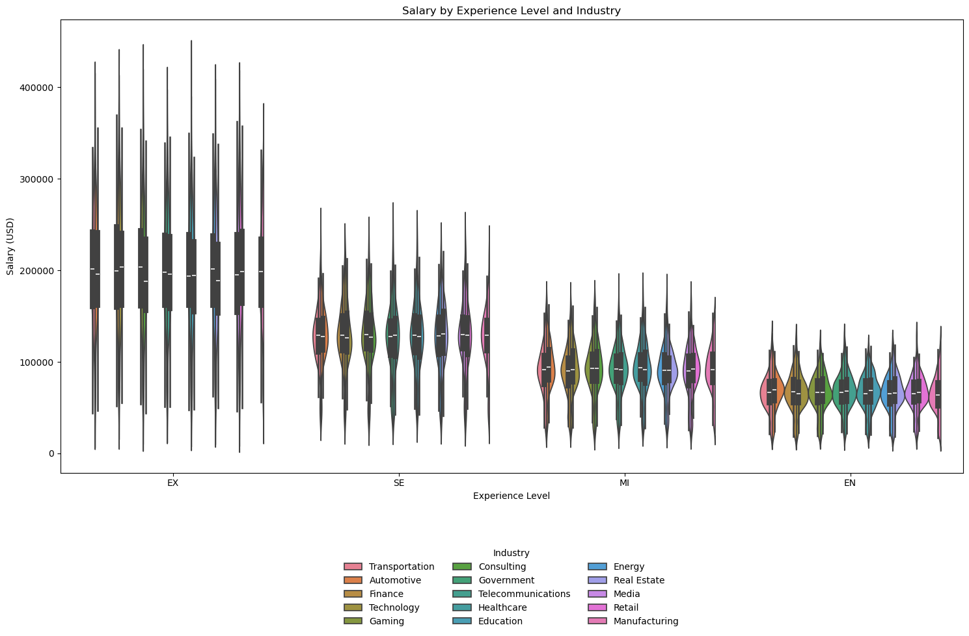

Slide 17
Conclusions
Experience is a strong determinant of A.I. salary.
Industry matters: Tech and Finance consistently lead, while public or creative sectors lag.
Education alone doesn’t drive salary — it supports progression but doesn’t replace experience.
The intra-level pay-gap is proporcional to the experience level. The intra-executive pay gap is much wider than the intra-entry-level pay gap.
See you all in Switzerland after the bootcamp!

