Slide 1
YieldGrid
Application for Farm-to-Retail Inventory
Subject: Object-Oriented Programming through Java (25PC1CS201)
A desktop Direct-to-Consumer (D2C) marketplace connecting agricultural producers with retail consumers. Engineered in pure Java Swing with Type-4 JDBC and MySQL relational persistence, enforcing ACID consistency and salted PBKDF2 authentication.
Java 17+ LTS | Java Swing & AWT | MySQL 8.0+ | JDBC Type-4 | PBKDF2 Security
STUDENT PROJECT TEAM
• Yejju Sathyasai
Role: Full-Stack Development & DB
• Pervala Yashwanth (26075A6610)
Role: Architecture, Security & Docs
• Shaik Abdul Rasheed (26075A6612)
Role: UI/UX Swing Engineering & QA
• Nagula Abhilash(26075A6609)
Role: Testing, prototype development
ACADEMIC GUIDANCE & INSTITUTION
Faculty Project Supervisor:
Ms. K. Divya, Assistant Professor, Dept. of CSM
Head of Department:
Dr. Sagar Yeruva, Assoc. Professor & HOD
Institution:
Vallurupalli Nageswara Rao Vignana Jyothi Institute of Engineering and Technology (VNR VJIET), Hyderabad

Slide 2
EXECUTIVE SUMMARY & PROBLEM CONTEXT
Problem Statement & System Overview
Analyzing traditional farm-to-retail supply chain friction and introducing YieldGrid's direct architecture.
PROBLEM STATEMENT (Agricultural Supply Chain Inefficiencies)
The agricultural supply chain suffers from high intermediary margins, inventory fragmentation, produce spoilage, and inefficient manual order management. The lack of digital inventory tracking and integrated sales records reduces transparency, limits farmers’ earnings, and makes demand analysis difficult.
INTRODUCTION & SOLUTION (YieldGrid Architecture)
YieldGrid is a Java-based desktop application that connects farmers directly with customers, reducing intermediary costs. It uses MySQL transactions for inventory consistency, role-based authentication with secure password hashing, and a modular MVC/DAO architecture. The project demonstrates Java OOP concepts, including inheritance, exception handling, collections, and JDBC connectivity.
INTENDED END-TO-END TRANSACTIONAL WORKFLOW
1. Farmer Lists Crops
Stock, unit price, produce availability CRUD
2. Customer Browses
Filter catalog, search produce, view stock
3. Customer Orders
Atomic multi-item cart checkout & deduction
4. Farmer Processes
Advance order: PENDING → CONFIRMED → COMPLETED
5. Customer Tracks
Live pipeline: fulfillment tracking & order history
YieldGrid — Farm-to-Retail Inventory System | Review 1 • Object-Oriented Programming through Java
Slide 2 of 12

Slide 3
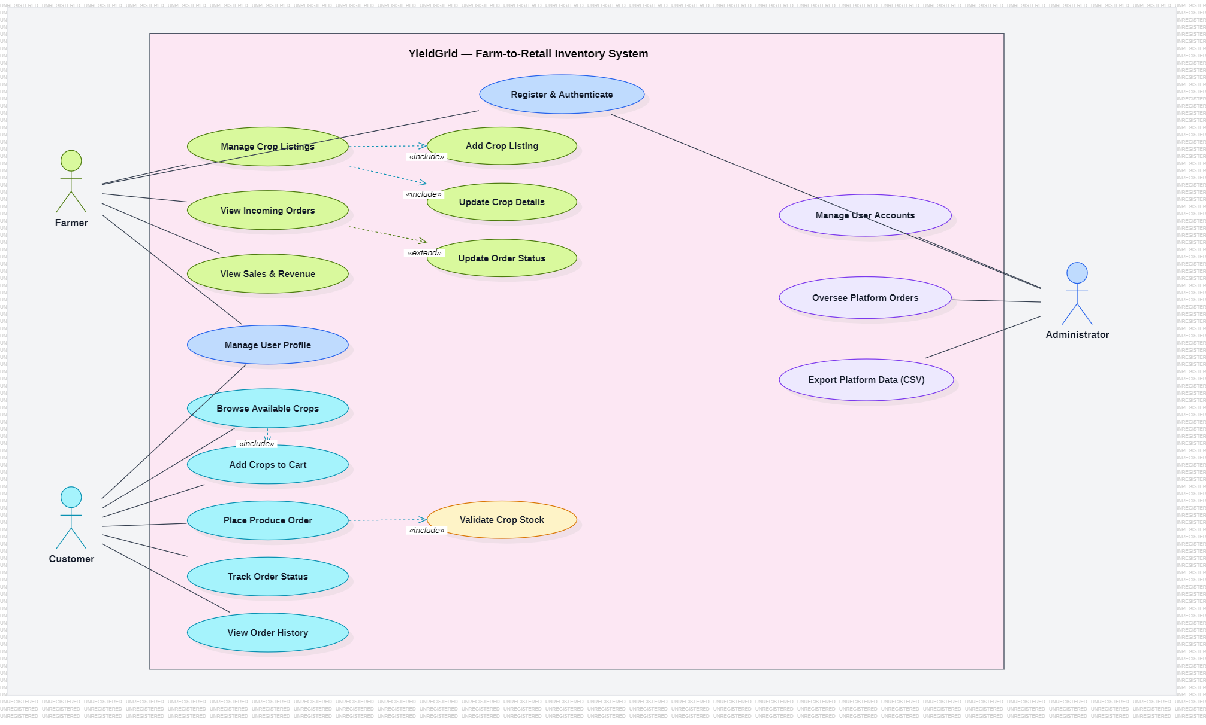
UML BEHAVIORAL MODELING · SYSTEM INTERACTIONS
Use Case Diagram
Capturing functional boundaries, role actors, and core interactions across the farm-to-retail lifecycle.
USE CASE SPECIFICATIONS
System Actors & Roles
• Farmer: Manage crop listings (CRUD), update stock & prices, process incoming orders, inspect revenue.
• Customer: Search fresh produce, maintain cart, execute atomic checkout, track live fulfillment.
• Administrator: Moderate users, audit crop catalog, oversee orders, monitor system metrics.
Core Use Cases & <<include>>
• Place Order <<includes>> Verify Stock Availability & Calculate Subtotals.
• User Login <<includes>> Verify PBKDF2 Hash Credentials.
• Boundary: Encompasses all desktop services inside YieldGrid system.
Implementation Grounding
• Mapped directly to yieldgrid.service (CropService, OrderService, AuthenticationService).
YieldGrid — Farm-to-Retail Inventory System | Review 1 • Object-Oriented Programming through Java
Slide 3 of 12

Slide 4
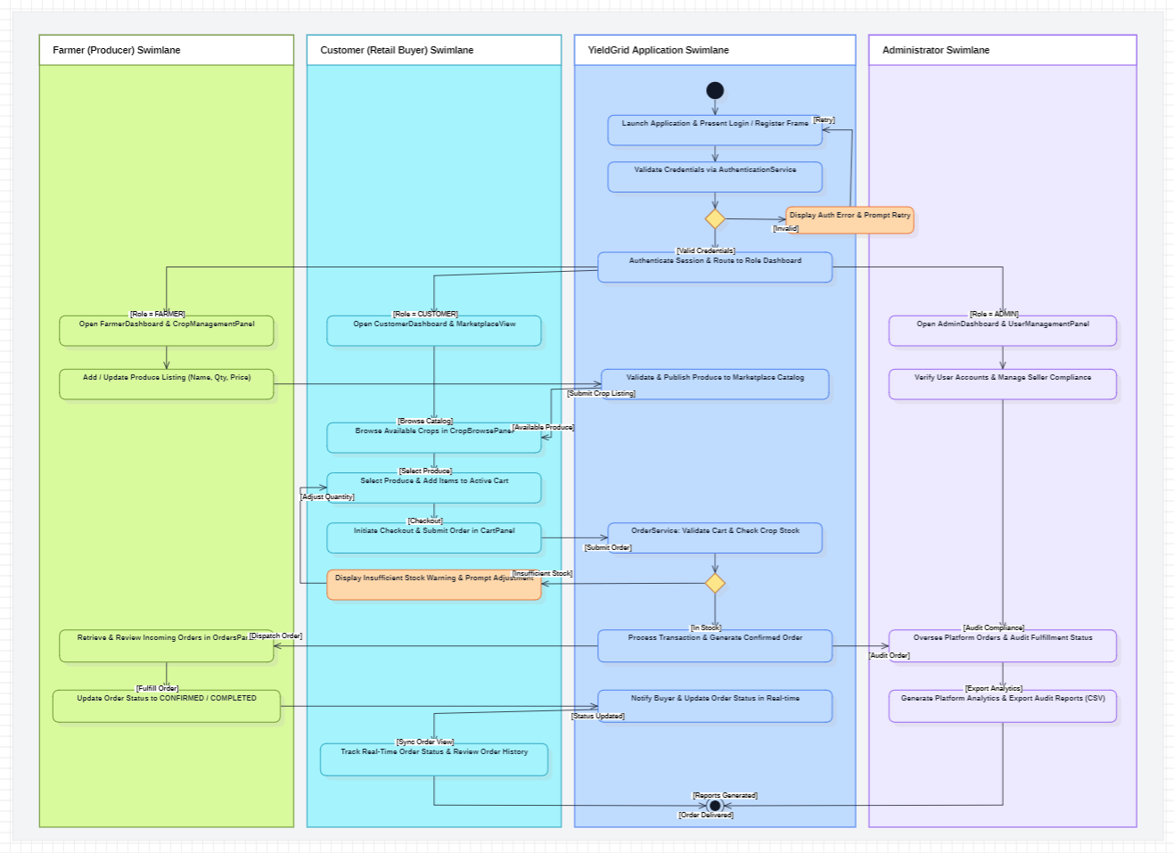
UML BEHAVIORAL MODELING · BUSINESS WORKFLOW
Activity Diagram
Modeling end-to-end transactional execution and decision pathways across Customer, System, and Farmer swimlanes.
ACTIVITY FLOW SPECIFICATIONS
Workflow Swimlanes
• Customer Lane: Authenticate, browse catalog, manage shopping cart, and submit checkout.
• System Lane: Coordinate stock verification, start ACID transaction, decrement stock, generate order.
• Farmer Lane: View incoming order queue, confirm produce readiness, advance status to Shipped.
Decision Points & Logic
• [Stock >= Requested]: Deduct inventory and commit transaction.
• [Insufficient Stock]: Trigger conn.rollback() and notify customer of shortage.
Terminal Activity
• Customer receives dispatch and delivery confirmation; transaction finalizes in sales ledger.
YieldGrid — Farm-to-Retail Inventory System | Review 1 • Object-Oriented Programming through Java
Slide 4 of 12

Slide 5
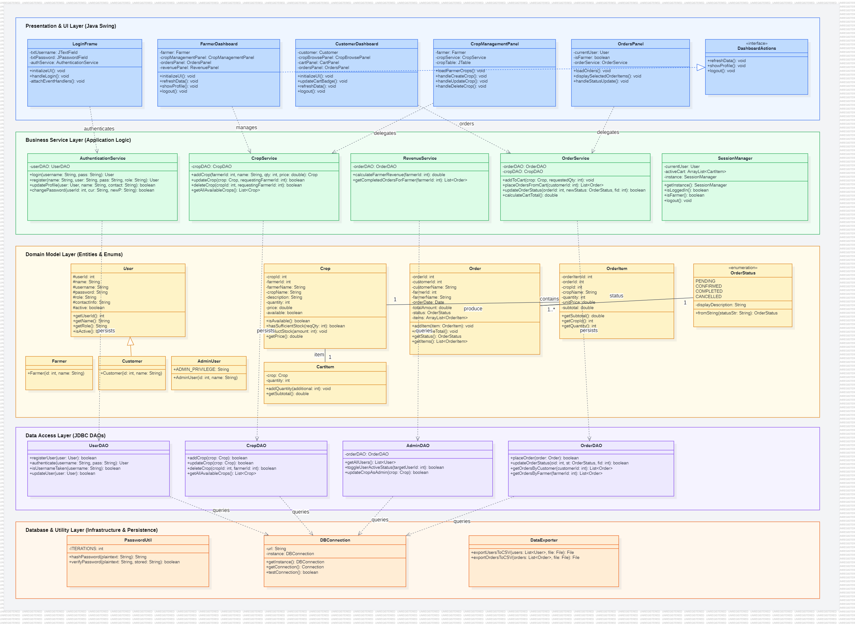
UML STRUCTURAL MODELING · OOP DESIGN PATTERNS
Class Diagram
Object-oriented architecture highlighting Domain Models, Data Access Objects (DAOs), Services, and Swing UI hierarchy.
CLASS ARCHITECTURE DETAILS
Layer Responsibilities
• Model Layer: Encapsulated entities User, Crop, Order, OrderItem, and OrderStatus enum.
• DAO Layer: UserDAO, CropDAO, OrderDAO, AdminDAO manage parameterized SQL execution.
• Service Layer: AuthenticationService, CropService, OrderService encapsulate business invariants.
• UI Layer: Swing frames & panels (LoginFrame, FarmerDashboard, CustomerDashboard).
Key OOP Relationships
• Inheritance: Farmer, Customer, and Admin specialize base User.
• Composition: Order HAS-A List<OrderItem> (cascade delete on orders).
• Aggregation: Farmer HAS-A Crop inventory list.
YieldGrid — Farm-to-Retail Inventory System | Review 1 • Object-Oriented Programming through Java
Slide 5 of 12

Slide 6
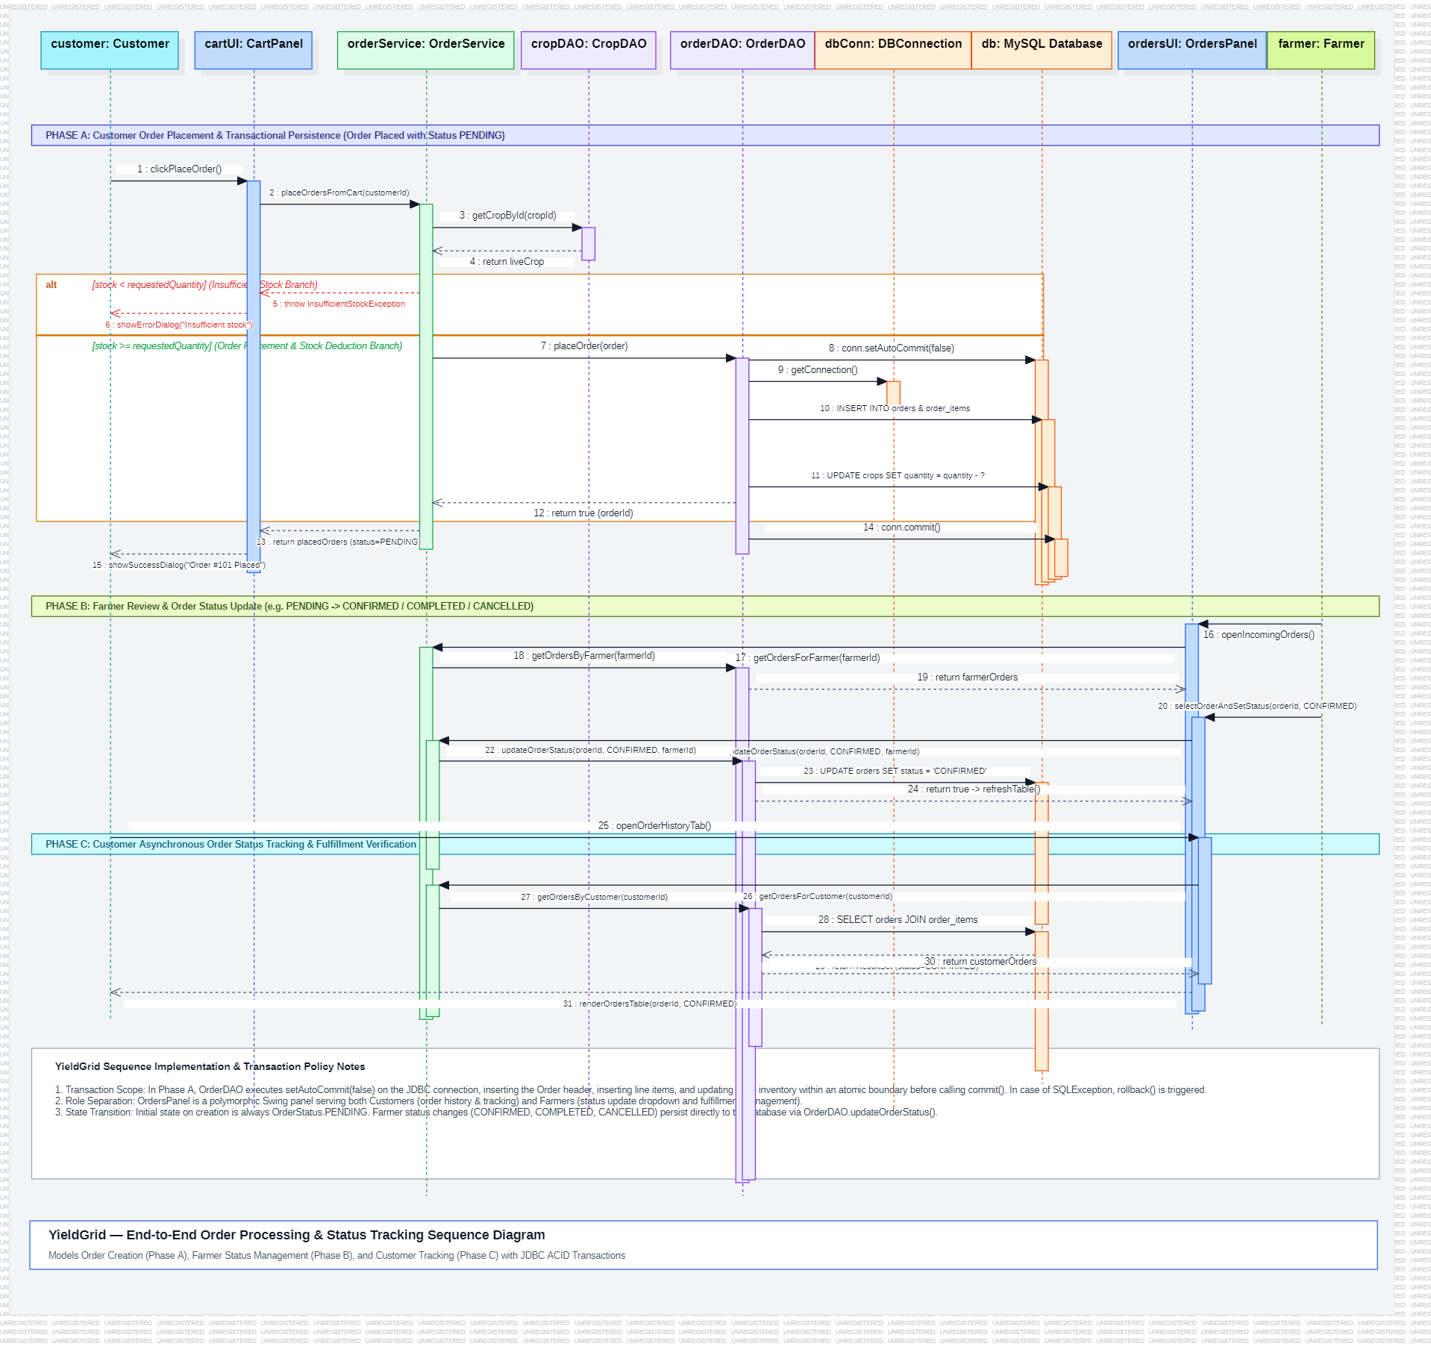
UML INTERACTION MODELING · TIME-ORDERED DYNAMICS
Sequence Diagram
Chronological message exchange during customer multi-item order placement and atomic inventory deduction.
INTERACTION FLOW SEQUENCE
Time-Ordered Participants
• Customer (Actor) interacts with CustomerDashboard UI.
• CustomerDashboard delegates to OrderService.
• OrderService coordinates with OrderDAO.
• OrderDAO executes SQL via DBConnection & MySQL Database.
Chronological Message Flow
• 1. placeOrder(items) from UI to OrderService.
• 2. createOrder() starts transaction (setAutoCommit(false)).
• 3. Atomic UPDATE crops stock decrement executed.
• 4. INSERT into orders and order_items tables.
• 5. conn.commit() finalizes ACID order creation.
Rollback Guarantee
• SQLException or shortage triggers conn.rollback(), restoring initial stock.
YieldGrid — Farm-to-Retail Inventory System | Review 1 • Object-Oriented Programming through Java
Slide 6 of 12

Slide 7
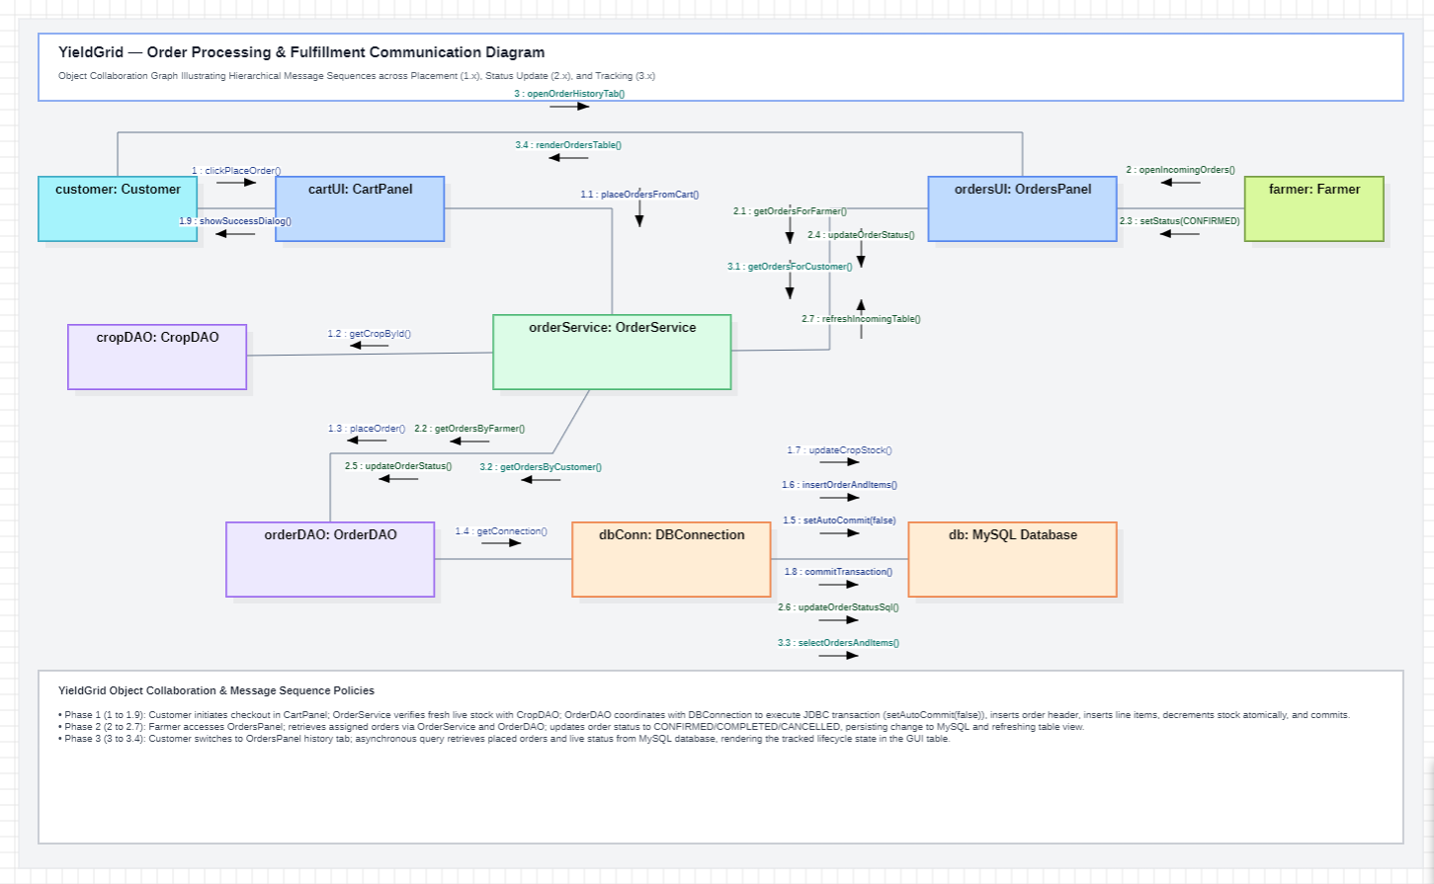
UML INTERACTION MODELING · COLLABORATIVE ARCHITECTURE
Communication Diagram
Highlighting structural associations, object topology, and numbered message flows for order placement.
COLLABORATION TOPOLOGY
Object Collaboration Topology
• Focuses on structural associations between objects rather than a timeline axis.
• Demonstrates direct collaboration between UI, Service, DAO, and Database instances.
Numbered Message Trace
• 1: checkout(cart) — Customer triggers UI.
• 1.1: processOrder() — UI invokes OrderService.
• 1.1.1: insertOrder() — Service calls OrderDAO.
• 1.1.1.1: getConnection() — DAO gets connection.
• 1.1.1.2: setAutoCommit(false) — Starts transaction.
• 1.1.1.3: updateStock() & 1.1.1.4: commit() — Executes atomic updates and commits.
YieldGrid — Farm-to-Retail Inventory System | Review 1 • Object-Oriented Programming through Java
Slide 7 of 12

Slide 8
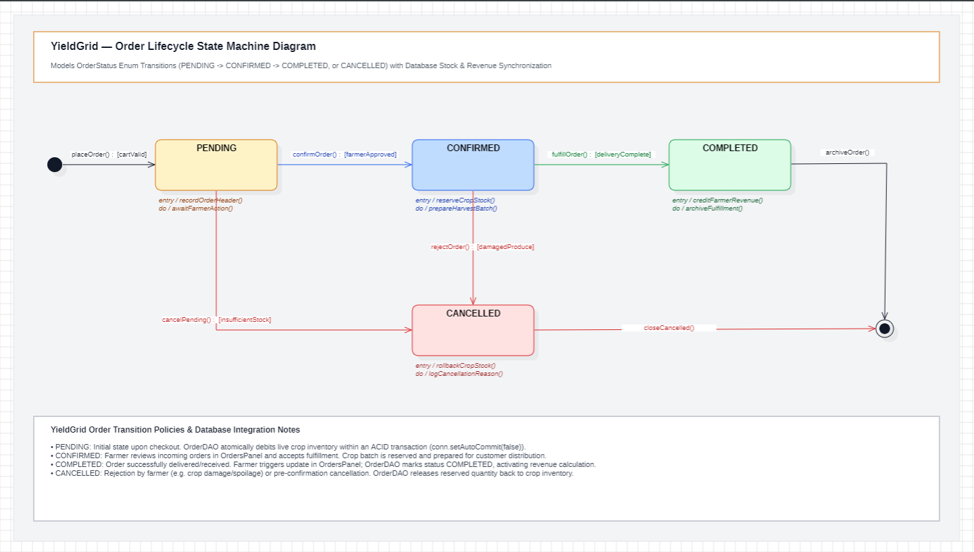
UML DYNAMIC MODELING · ORDER LIFECYCLE
State Chart Diagram
Formal state machine modeling discrete order lifecycle transitions, triggers, and guard conditions.
ORDER LIFECYCLE STATES
Order State Progression
• PENDING: Initial state upon checkout; order header recorded and harvest stock reserved.
• CONFIRMED: Farmer reviews itemized order and confirms harvest readiness [farmerApproved].
• COMPLETED: Produce delivered; credited to farmer revenue ledger (Terminal Final State).
Alternate & Cancellation Paths
• CANCELLED: Order rejected by farmer (e.g., [damagedProduce]) or aborted due to [insufficientStock].
• Rollback Action: Triggers automatic database rollbackCropStock() returning produce to active inventory.
• Guards: Strict sequential transitions prevent invalid state bypass.
YieldGrid — Farm-to-Retail Inventory System | Review 1 • Object-Oriented Programming through Java
Slide 8 of 12

Slide 9
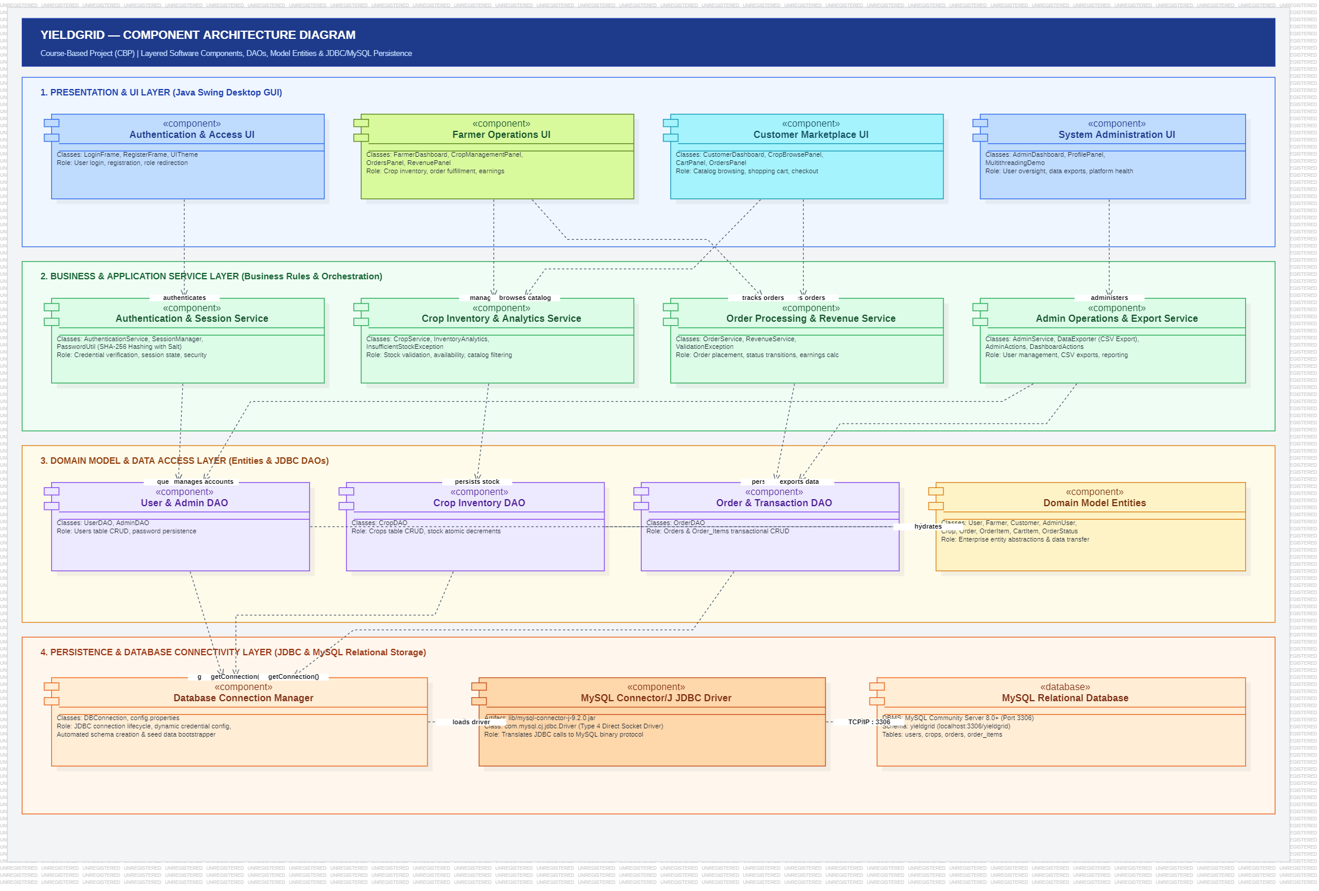
UML IMPLEMENTATION MODELING · SOFTWARE ARCHITECTURE
Component Diagram
Decomposing YieldGrid into modular software subsystems, executable JAR archives, and dependency interfaces.
COMPONENT SUBSYSTEMS
Subsystem Components
• UI Component (yieldgrid-ui.jar): Swing views, table models, and UITheme.
• Service Component (yieldgrid-service.jar): Core business invariants and validation rules.
• DAO Component (yieldgrid-dao.jar): Encapsulated CRUD and JDBC transactions.
• Security & Utils: PasswordUtil (PBKDF2) and DataExporter (CSV export).
Interfaces & Connectivity
• Components communicate via interfaces (IAuthService, ICropDAO, IOrderDAO).
• Type-4 JDBC driver connects directly to MySQL via TCP/IP 3306.
YieldGrid — Farm-to-Retail Inventory System | Review 1 • Object-Oriented Programming through Java
Slide 9 of 12

Slide 10
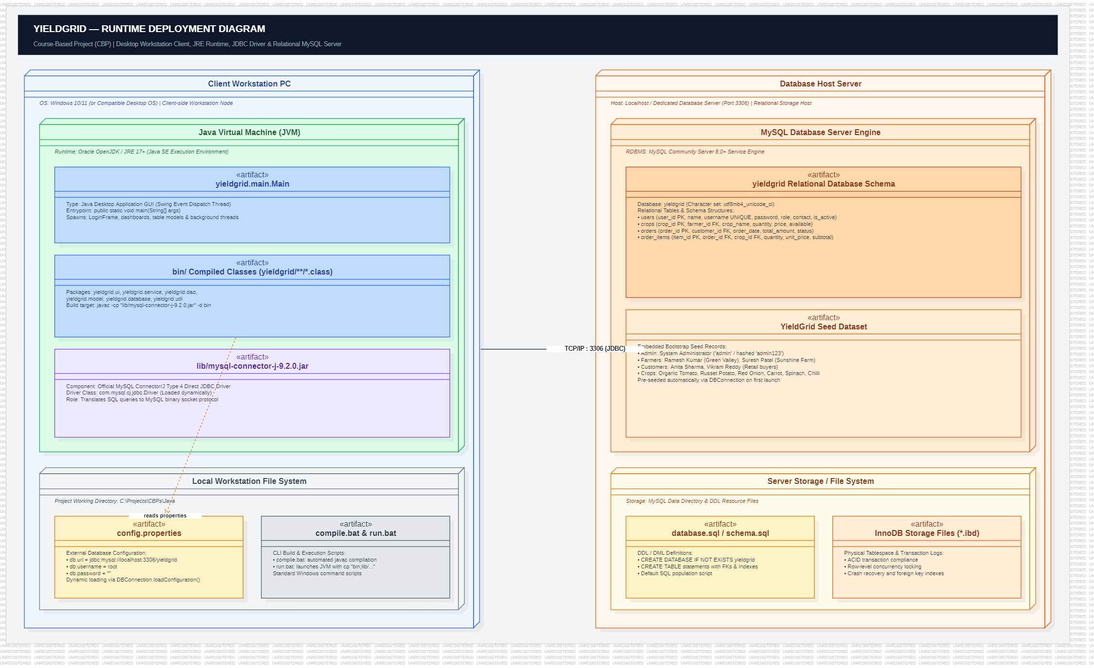
UML DEPLOYMENT MODELING · INFRASTRUCTURE & RUNTIME
Deployment Diagram
Hardware nodes, execution environments, network protocols, and database deployment topology.
DEPLOYMENT TOPOLOGY
Physical Hardware & Nodes
• Client Workstation Node: Desktop PC executing YieldGrid.jar inside Java Runtime Environment (JRE 17+ LTS).
• Database Server Node: Localhost / LAN machine executing MySQL 8.0+ Community Server.
Network & Protocol
• Communication Path: TCP/IP socket connection on standard MySQL port 3306.
• JDBC URL: jdbc:mysql://localhost:3306/yieldgrid.
• Runtime config loaded securely from local config.properties file.
YieldGrid — Farm-to-Retail Inventory System | Review 1 • Object-Oriented Programming through Java
Slide 10 of 12

Slide 11
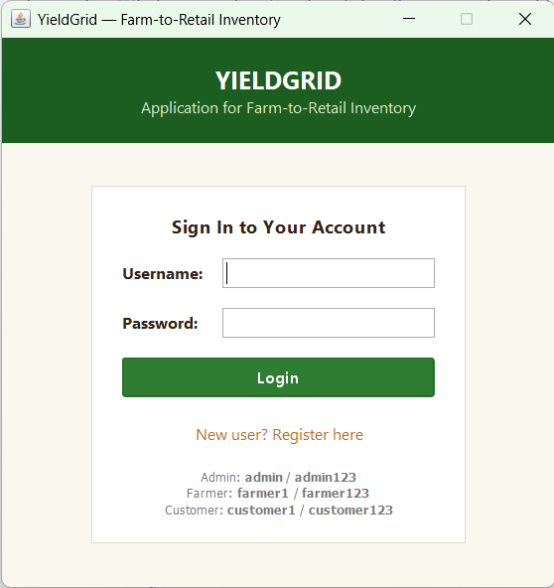
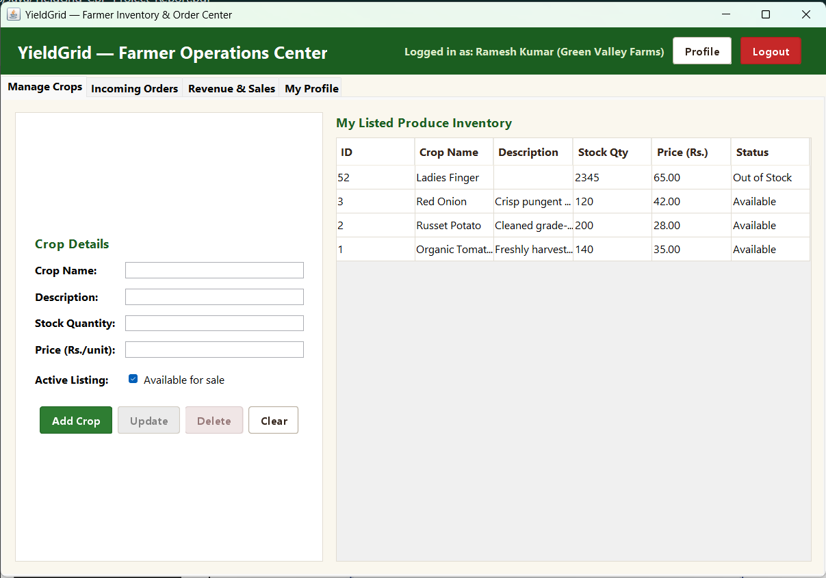
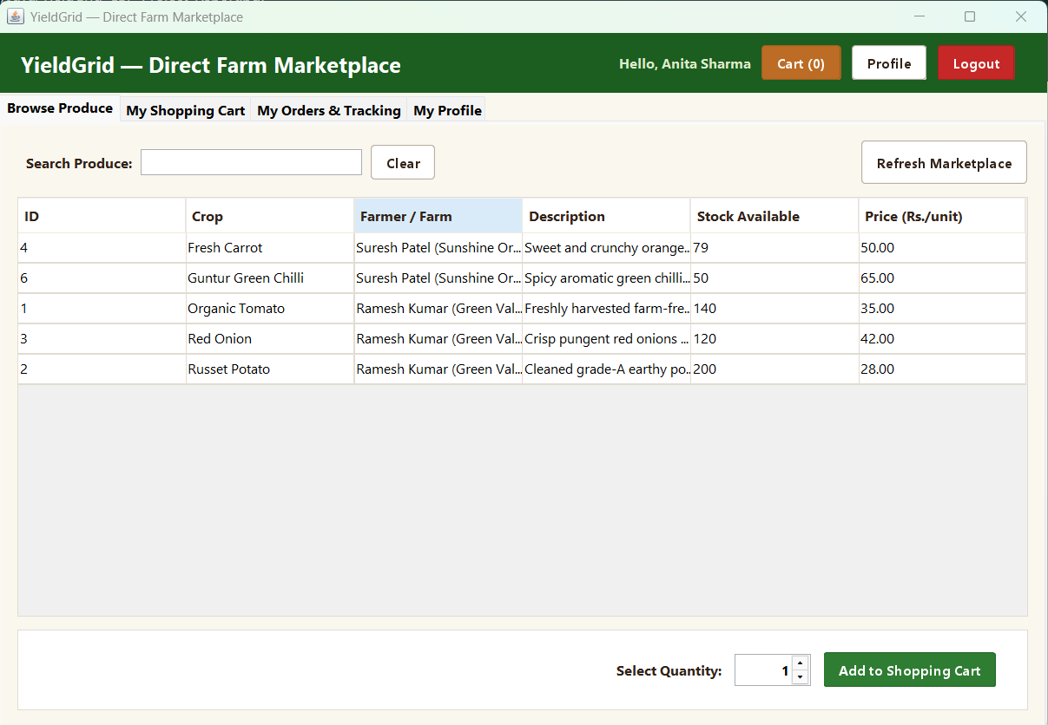
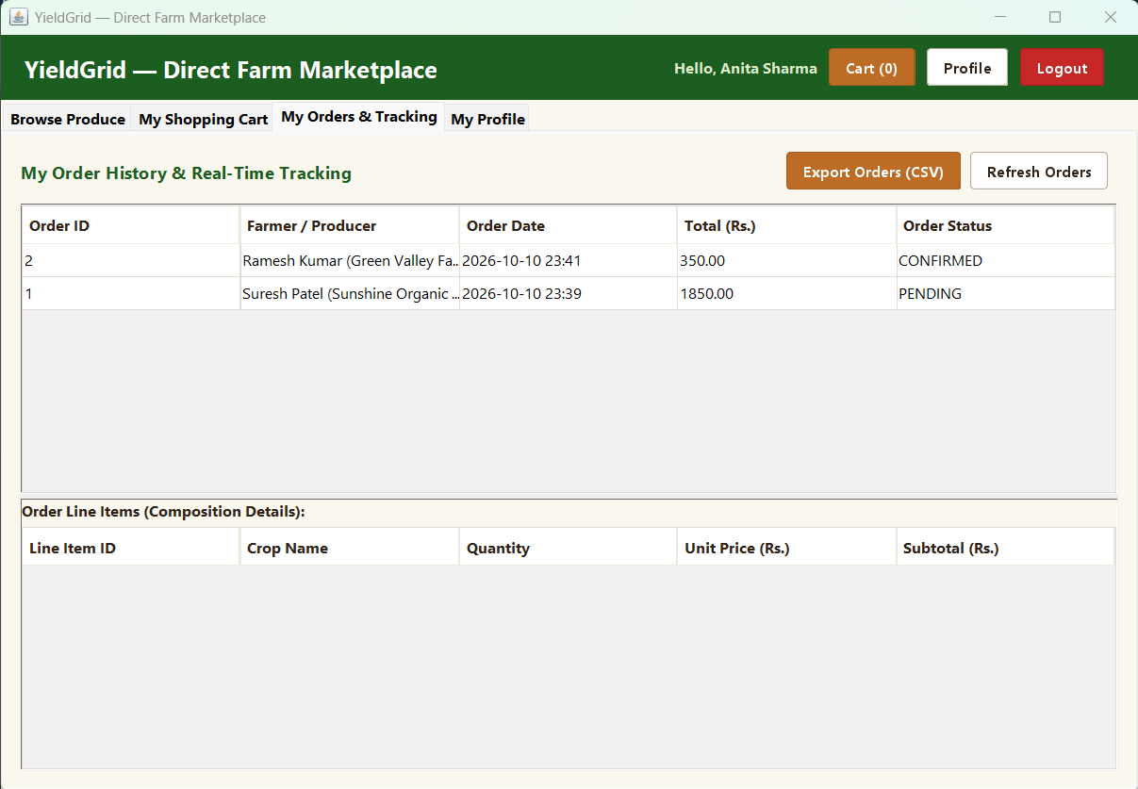
SYSTEM IMPLEMENTATION & PROTOTYPE DEMONSTRATION
Results and Prototype
Visual evidence of operational Java Swing interface, demonstrating authentication, inventory CRUD, discovery, and order tracking.
Figure 11.1: Authentication & Role Selection (LoginFrame)
Role-based login modal (Farmer, Customer, Admin) enforcing PBKDF2 password verification and session initialization.
Figure 11.2: Farmer Crop Inventory Management (FarmerDashboard)
Full CRUD crop inventory management: add seasonal crops, edit available stock, modify unit pricing, and toggle listing availability.
Figure 11.3: Customer Marketplace Discovery (CustomerDashboard)
Direct-to-consumer catalog search: real-time produce filtering, stock visibility, unit price display, and shopping cart addition.
Figure 11.4: Customer Order History & Pipeline (OrdersPanel)
End-to-end order status tracking: inspect past orders, view itemized breakdown dialog, and monitor live fulfillment status (PENDING → DELIVERED).
PROTOTYPE IMPLEMENTATION & TEST VERIFICATION SUMMARY
Fully functional desktop application engineered in Java Swing connected to MySQL 8.0 via Type-4 JDBC. Successfully demonstrates end-to-end transactional workflows: produce listing, catalog search, atomic multi-item cart checkout, and live order tracking. Verified with 53/53 passing automated test cases.
YieldGrid — Farm-to-Retail Inventory System | Review 1 • Object-Oriented Programming through Java
Slide 11 of 12

Slide 12
PROJECT CONCLUSION & ACADEMIC OUTCOMES
Conclusion & Future Scope
Reflecting on core engineering achievements, academic learning, and practical roadmap for YieldGrid.
Core Problem Solved
• Eliminated Middleman Friction: Built an operational direct D2C platform connecting farmers directly to retail customers.
• Farmer Pricing Autonomy: Agricultural producers maintain full authority over unit prices, harvest stock, and revenue tracking.
• Consumer Transparency: Retail buyers access fresh local produce with transparent pricing and verified stock counts.
• Transactional Integrity: Enforced ACID-consistent checkout with zero data anomalies.
Java OOP Mastery Demonstrated
• Complete Course Coverage: Implemented all core concepts across Units I to V (Encapsulation, Inheritance, Polymorphism, Interfaces).
• Data Access & Transactions: Decoupled architecture using DAOs, PreparedStatement, and JDBC transaction commit/rollback.
• Cryptographic Security: PBKDF2 password hashing with 16-byte random salt and transparent legacy hash upgrade.
• Test Automation: 53 automated unit & integration tests passing across all functional domains.
Academic Boundaries & Future Scope
• RESTful Backend Migration: Decouple business logic into Spring Boot microservices for web and mobile client access.
• Native Mobile Apps: Develop Flutter/Android clients for real-time crop logging in field conditions.
• Digital Payment Gateway: Integrate UPI / Razorpay payment APIs for automated settlement.
• Push Notification Service: Implement WebSocket or SMS alerts for immediate order status updates.
Thank You! Questions & Discussion Welcomed.
YieldGrid — Farm-to-Retail Inventory System | Review 1 • Object-Oriented Programming through Java (25PC1CS201)
Team: Pervala Yashwanth (26075A6610) • Yejju Sathyasai (26075A6613) • Shaik Abdul Rasheed (26075A6612)
Academic Guide: Ms. K. Anitha, Assistant Professor | Dept. of CSE (AI&ML, IoT) • VNR VJIET, Hyderabad
YieldGrid — Farm-to-Retail Inventory System | Review 1 • Object-Oriented Programming through Java
Slide 12 of 12

