Slide 2
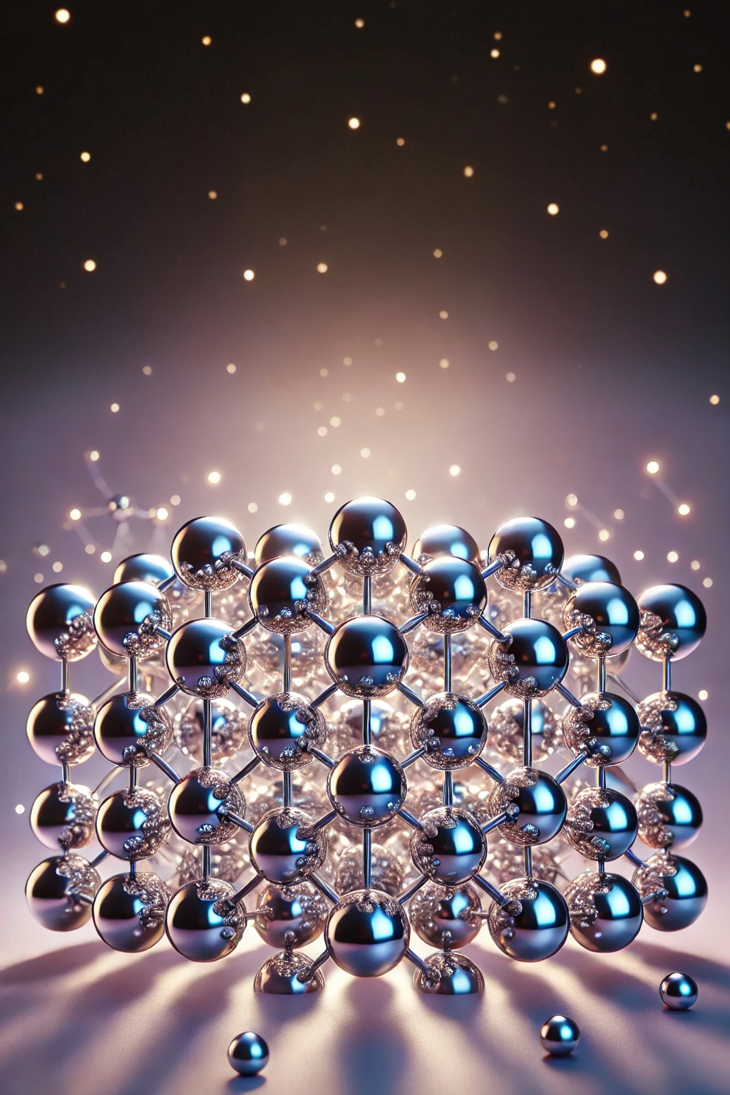
We are a theoretical chemistry group specializing in excited state physics within materials. By developing quantum chemistry simulation methods and data-driven models, we design innovative materials tailored for advanced optoelectronic technologies of the future.

