Slide 1
DEPARTMENT TRAINING
AI-Native
Software Engineering
Golden Playbook for faster, safer, evidence-based delivery
Research → Design → Plan → Implement → Validate
v1.14 Baseline Candidate

Slide 2
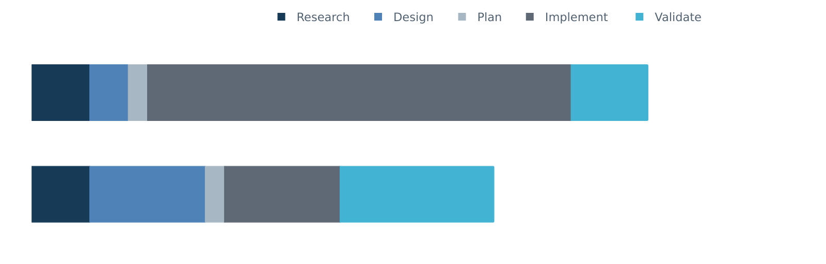
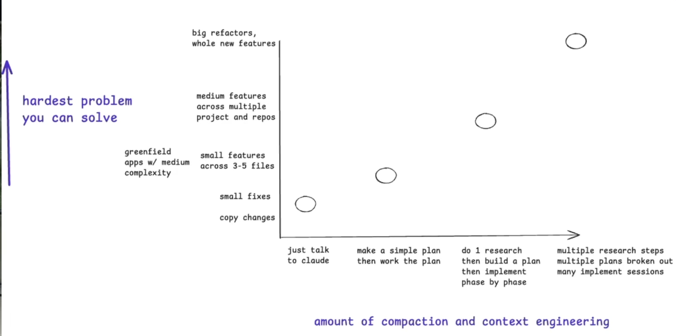
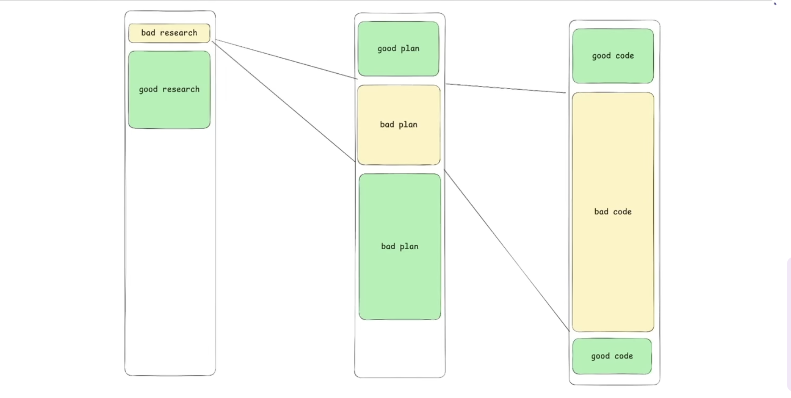
只有 Vibe Coding 不夠：我們要解的兩個工程問題
PROBLEM 1
PROBLEM 2
不同大小的工作，需要不同深度的 AI development workflow。
Coding 變得又快又便宜；前面想錯，bad code 與技術債也會更快放大。
AI 先自動化 coding；software engineering 的價值移向問題定義、設計判斷與責任。
2

Slide 3
AI 執行愈多，工程責任愈需要清楚分工
HUMAN JUDGMENT
DURABLE WORKFLOW
AI EXECUTION
人決定方向
流程保存共識
AI 加速執行
定義問題與 outcome
做 design trade-off
決定 scope / risk / approval
對結果負責
Golden Flow：決定下一步
OpenSpec：durable agreement
Superpowers：engineering discipline
CI / PR：evidence trail
Research / synthesis
Implementation / TDD
Review / verification
Subagents / automation
OWNS
KEEPS
ACCELERATES
Intent · design · decisions
Context · SSOT · evidence
Speed · scale · feedback
TAKEAWAY · AI models 會一直變；human accountability、SSOT、evidence 與 approval 必須持久。
03

Slide 4
新工作先回答六題；執行中只更新 Stage 與 Next Move
WHEN TO CHECK
開始新工作：六題全答 | 執行中：更新 Stage · Next Move | Context 改變：六題重答
1
2
3
4
5
Research
Design
Plan
Implement
Validate
Understand · Explore · Define
System Design* · Feature Design
P1→P0 · P0→tasks JIT
TDD · bounded change
Review · fresh evidence
Release & Operate
Observe · Recover · Learn
* System Design：P3/P2 required · P1 risk-triggered · P0 normally skip
04

Slide 5
P3–P0 只決定深度；以下用 P1 Feature 示範
P3
Product / Program
判斷規則
方向、architecture、Epic / Wave map
1
P1 是可整體驗收 / release / control 的 Feature outcome。
P2
Epic
跨 Feature capability、System Design、Feature map
2
P1 的 Plan 不是 files / tasks；先切成 P0 vertical slices。
P1
Feature
本 deck example：approved outcome → P0 slices
3
P0 是 Sprint-ready、narrow but complete、可獨立驗證。
P0
PBI / User Story
4
Task / Plan Step / Commit 位於 P0 下方，不是 Work Level。
Sprint-ready tracer bullet、independent evidence
接下來全部用 P1 Feature 示範一條具體 Golden Path。
Execution Layer · Task / Plan Step / Commit
05

Slide 6
P0 開始實作前，只選一條路：Fast 或 Durable
Approved P1
Feature Design
to-tickets
P0 tracer bullets
+ Blocked by
Choose route Fast / Durable
Reviewable change
tests · evidence
FAST DELIVERY｜需求明確
DURABLE CHANGE｜需要 durable spec
Superpowers 端到端： writing-plans*（需要時）→ TDD → review
OpenSpec tasks.md 是唯一 ledger： /opsx:apply → Superpowers per-task TDD
粗 task 就地展開：1.2 → 1.2.1 / 1.2.2 / 1.2.3 ｜ 只長子項 = JIT；改變做法 = /opsx:update
同一 change 只保留一本 ledger；Durable 不使用 writing-plans，也不建立第二份 plan。
06

Slide 7
工程師只要記住：一張 Feature，沿 Golden Flow 走到底
1 · 把問題弄對
2 · 把交付切小
3 · 用證據完成
Research → Design
Plan → Implement
Validate → Release
問：change boundary / FR / NFR？
用：read-only codebase research
→ brainstorming / grill-me
留：approved Feature Design
to-tickets → P0 vertical slices
Fast｜Superpowers
writing-plans* → TDD
Durable｜OpenSpec tasks.md /opsx:apply → Superpowers TDD 一本 ledger、可 review
Review actual diff
Verify acceptance + affected risk
Prepare rollback / observe
Hand off to existing release / E3
DONE WHEN
DONE WHEN
DONE WHEN
Understanding + Change Gate
P0 acceptance + tests
Evidence Gate + release readiness
TAKEAWAY · Golden Flow 決定下一步；default capability 決定怎麼做；risk 只改變 rigor，不改變路徑。
7

Slide 8
AI Engineering：Design / Implement 各 1.5 週，總時間 8 → 6 週
AS-IS · 8 WEEKS
4 × 2-week sprints
single-repo research
unclear FR/NFR · thin tests
AI · 6 WEEKS · -25%
≈ 3 × 2-week sprints
system-wide research
explicit design · TDD evidence
COLLABORATION
LEAD TIME
CHANGE FAILURE RATE
↑ Shared context
8 → 6 wk target
↓ Lower rate
documented decisions
shared evidence · handoff
faster implementation
fewer rework loops
design · code · test quality
release readiness
Human judgment × AI execution 才是 productivity leverage；8 → 6 weeks 僅為 illustrative target，仍以 pilots 校準。
8

Slide 9
START WITH A FEATURE
明天從一張 P1 Feature 開始：六個問題全部回答
P1 FEATURE · 60-SECOND START
WHAT CHANGES TOMORROW
1
工作位置？ existing activity / system of record
Engineer
Use active defaults；candidate skill 不阻塞 Research
2
Work Level？ P3 / P2 / P1 / P0
Tech Lead / Architect
Approve design、equivalent skills 與 gate decisions
3
Archetype？ Greenfield / Modernization / Standard
4
Current Stage？ 第一個還不能可靠回答的問題
Manager
Integrate existing workflow；remove blockers；review outcomes
5
Control Profile？ criticality / risk / AI authority
6
Next Move？ capability → evidence → Gate
TEAM ADAPTER
Map local activity → Golden Stage / Gate / artifact
Department：minimum contract + defaults · Team：approved equivalents
AI 執行更多；Engineer 仍負責六題、design trade-off、evidence 與 approval。執行中更新 Stage／Next Move。
9

