Slide 1
Apps Rating Comparison: Google vs Apple
Problem: Did Apple Store apps receive better reviews than Google Play apps?
Plan:
Source data on Kaggle.com
Select relevant fields and records
Clean (fix data types), transform (join two datasets, filter), visualize (rating histograms)
Hypothesis testing (non-parametric)
Conclusion and decision (choose Google Play)

Slide 2
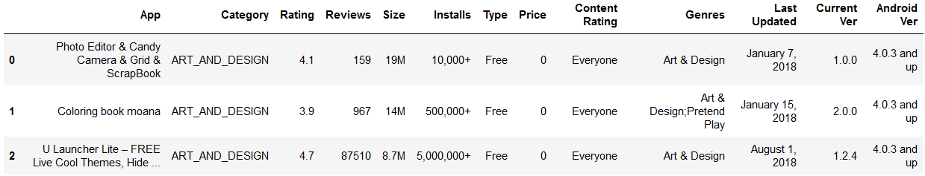
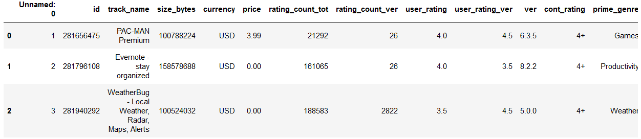
Data Selection
Google
Apple
Google = Google[['Category', 'Rating', 'Reviews', 'Price']]
Apple = Apple[['prime_genre', 'user_rating', 'rating_count_tot', 'price']]

Slide 3
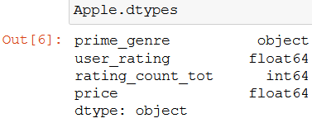
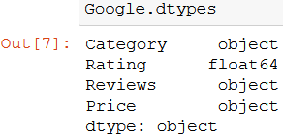
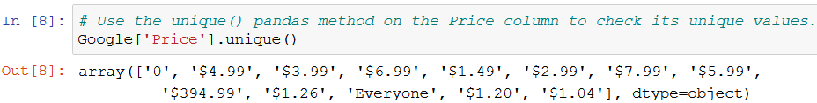
Data Cleaning
Check and fix the data types
Google = Google[Google['Price']!='Everyone'] # remove non-numeric value
nosymb = Google['Price'].str.replace('$','') # remove ‘$’
Google['Price'] = pd.to_numeric(nosymb) # make column numeric
Google['Reviews'] = pd.to_numeric(Google['Reviews'])

Slide 4
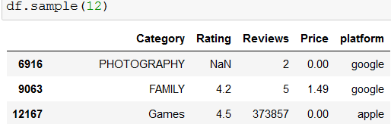
Data Transformation
Prepare to join: Add a “platform” column to both frames
Apple['platform'] = 'apple‘; Google['platform'] = 'google'
Make column names same in the dataframes
new_names = Google.columns
Apple = Apple.rename(columns = dict(zip(old_names,new_names)))
Join
df = Google.append(Apple, ignore_index= True)
Filter: Eliminate NaN; apps reviewed at least once
df = df.dropna(); df = df[df['Reviews'] != 0]

Slide 5
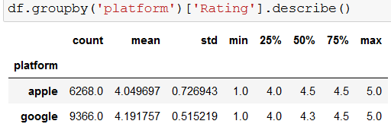
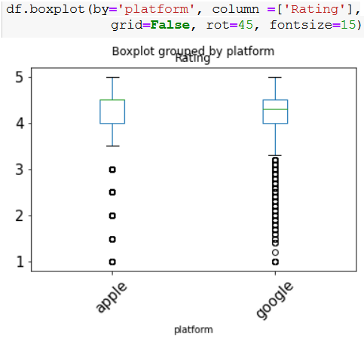
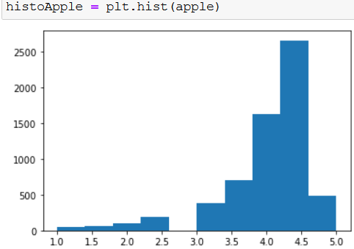
Summary and Visualization
Descriptive Statistics
Data are not normal: use non-parametric statistics

Slide 6
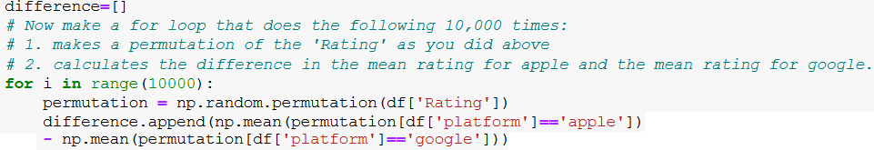
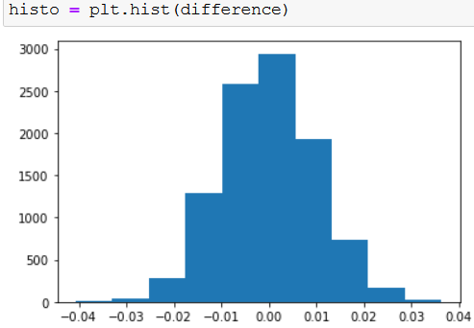
Hypothesis Testing and Decision
Ho: mean ratings are same for Google and Apple apps
Ha: Google has a higher mean rating than Apple
Permutation test
Differences of mean ratings are normally
distributed and never reach observed 0.14
Conclusion: Google apps have higher ratings
Decision: Sign contract with Google

