Slide 1

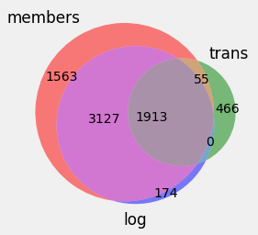
Customer Churn Prediction
Problem: accurately predict churn
of KKBOX music streaming service.
Churn: no new subscription within 30 days after membership expires.
Success criterion: Accuracy of prediction stays high for new data.
Data: customers, transaction details, usage statistics.
Cleaning: missing and incorrect.
Filtering: no future data, transactions are available.
Kaggle competition: https://www.kaggle.com/c/kkbox-churn-prediction-challenge

Slide 2
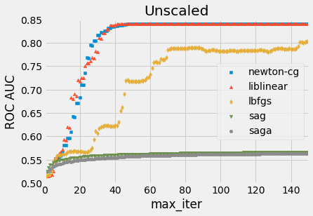
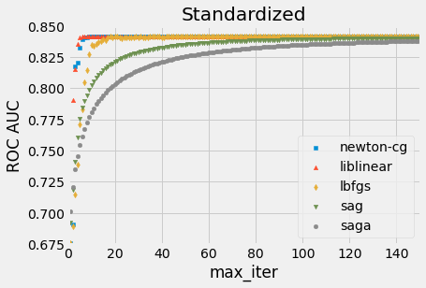
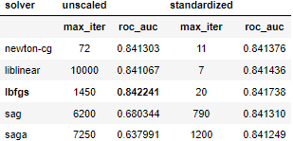
Logistic Regression
Why to scale input? Faster convergence and higher accuracy
Convergence of solvers with increasing iterations
Solver steps | Unscaled | Standardized
newton-cg | 72 | 16
liblinear | 44 | 7
lbfgs | 2150 | 78
sag | 6200 | 795
saga | 7250 | 1200

Slide 3
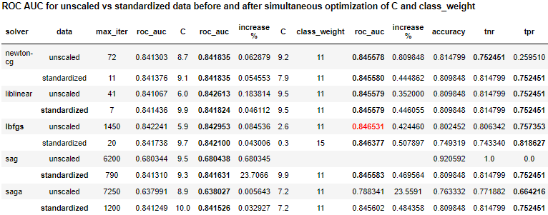
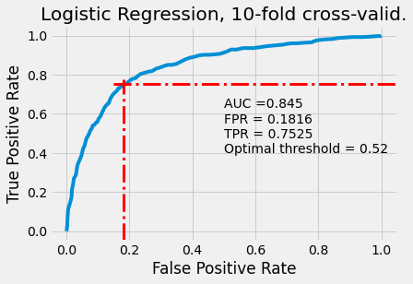
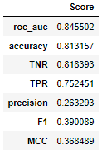
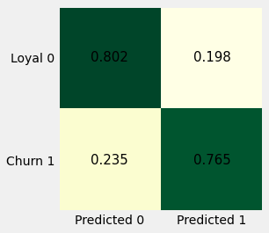
Logistic Regression
- Low AUC & accuracy
- Hard to interpret
- Balancing
class weight lowers
accuracy.

Slide 4
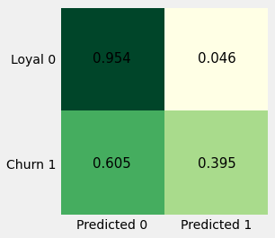
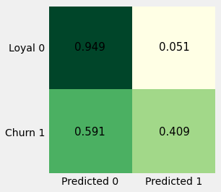
Decision Tree
Default hyperparameters, entropy and Gini index criteria
X[38] <= 0.5
Payment plan days ≠ 7
gini = 0.145
samples = 11986
value = [11040, 946]
class = 0
True
False
X[8] <= 0.5
discount ≠ $149 gini = 0.129
samples = 11805
value = [10984, 821]
class = 0 – more loyal
X[22] <= 5.292
Small number of songs listened in full last week
gini = 0.427
samples = 181
value = [56, 125]
class = 1 – more churn
Unscaled data
Standardized data
Data | Crit. | AUC | Acc. | TNR | TPR
Raw | entr. | .691 | .910 | .954 | .395
 | gini | .692 | .904 | .947 | .402
Std. | entr. | .689 | .906 | .950 | .395
 | gini | .697 | .906 | .948 | .409
+ Easy to interpret
+ Higher accuracy
Do not rescale input,
use default criterion 'gini'.
Entropy –p₀log₂p₀ – p₁log₂p₁
Gini index 1 – p₀² – p₁²

Slide 5
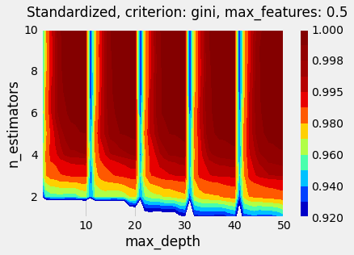
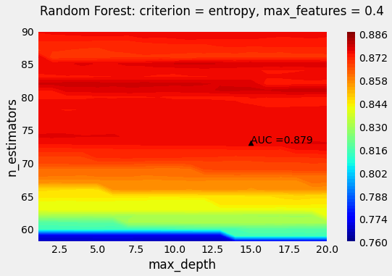
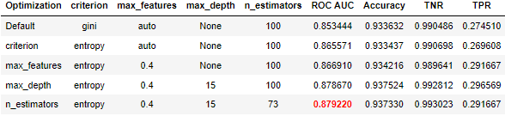
Random Forest
How to find the optimal set of several hyperparameters?
Grid sweeping of ROC AUC, 70-30% train-test split
RF can achieve ~100% accuracy on training data
n_estimators is more important than max_depth
AUC and Accuracy are higher than in Logistic Regression and Decision Tree
Best: criterion = entropy, max_features = 0.4, max_depth = 15, n_estimators = 73; ROC AUC = 0.879, accuracy = 0.937

Slide 6
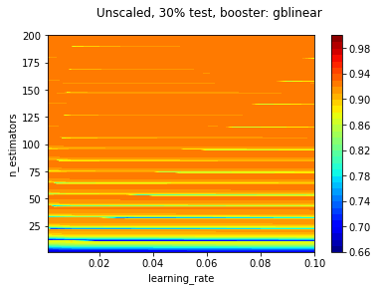
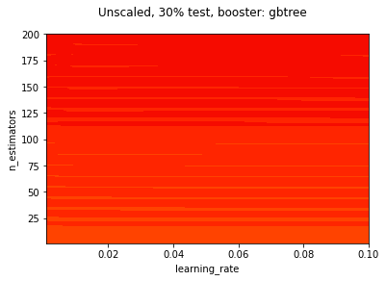
XGBoost
How to find the optimal set of several hyperparameters?
Grid sweeping of ROC AUC: 70-30% train-test split
gblinear booster is faster than gbtree
n_estimators is more important than learning_rate
Carefully select n_estimators due to stripy profile of ROC AUC. Max =.92689
gbtree booster has superior accuracy
dart booster is very close to gbtree
Max. ROC AUC = .968587 @ booster = gbtree, learning_rate = 0.01, n_estimators = 70

Slide 7
XGBoost
How to find the optimal set of several hyperparameters?
Optimize each one at a time, then all pairs, again one, etc.
Default: gbtree
AUC = 0.845409
Accur. = 0.931685
learning_rate
0.039
AUC = 0.870159
Accur. = 0.933632
n_estimators
216
AUC = 0.872758
Accur. = 0.934605
booster
max_depth
reg_alpha
3.363, 1.030
AUC = 0.876614
Accur. = 0.931296
220
AUC = 0.876461
Accur. = 0.931491
n_estimators
3.360
AUC = 0.876391
Accur. = 0.931296
reg_alpha,
reg_lambda
n_estimators
Any one
hyperparameter
reg_lambda,
scale_pos_weight
221
AUC = 0.876669
Accur. = 0.931296
reg_alpha
3.362
AUC = 0.876670
Accur. = 0.931296
0.043, 0.992
AUC = 0.876862
Accur. = 0.932269
learning_rate, scale_pos_weight
n_estimators
198
AUC = 0.877932
Accur. = 0.933826
0.033, 9, 3.357
AUC = 0.877574
Accur. = 0.934605
learning_rate,
max_depth,
reg_alpha
223
AUC = 0.876914
Accur. = 0.932269
n_estimators

Slide 8
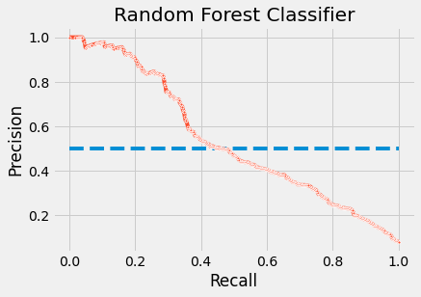
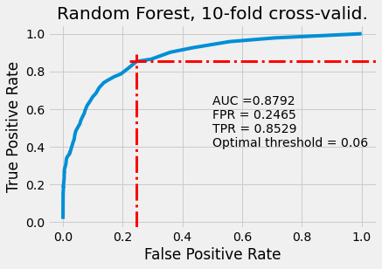
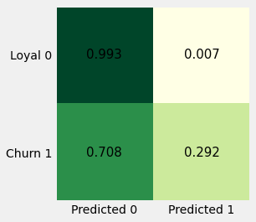
Performance & Hyperparameters
Logistic Regression |  | Decision Tree |  | Random Forest |  | XGBoost
AUC | .846531 | .696687 |  | 0.879220 |  | 0.878893
Accuracy | .802452 | .905800 |  | 0.937330 |  | 0.934800
Data | Unscaled | Standardized |  | Unscaled |  | Unscaled
solver | lbfgs | criterion | gini | criterion | ent-ropy | booster | gbtree
max_iter | 1450 |  |  | max_features | 0.4 | learning_rate | 0.033
C | 2.6 |  |  | max_depth | 15 | max_depth | 9
class_weight | 11 |  |  | n_estimators | 73 | n_estimators | 206
 |  |  |  |  |  | reg_alpha | 3.356
 |  |  |  |  |  | reg_lambda | 0.707
 |  |  |  |  |  | scale_pos_ weight | 0.955
70-30% train-test

Slide 9
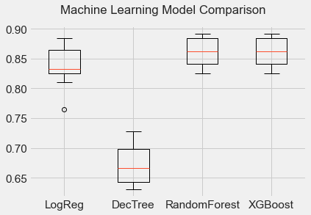
Performance Comparison
Best model: Random Forest
Model | AUC CV | SD AUC | AUC test | Accuracy | TNR | TPR
XGBoost | .861316 | .024332 | .879147 | .924484 | .970402 | .392157
Random Forest | .857779 | .026130 | .876482 | .934216 | .995560 | .223039
Logistic Regression | .836855 | .033439 | .845863 | .803815 | .807188 | .764706
Decision Tree | .672499 | .033853

Slide 10
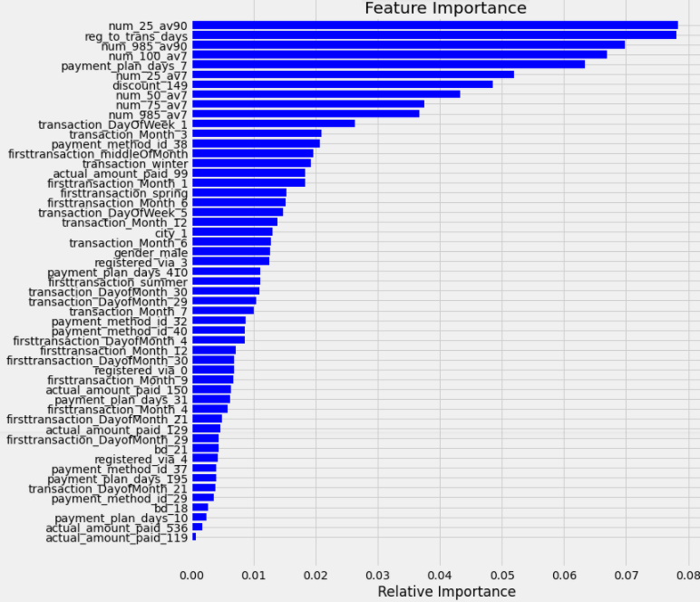
1. Number of songs played < ¼ length last 3 months.
2. Longer wait time before 1st transaction.
3. Number of songs played 75-98.5% last 3 months.
4. Number of fully played songs last week.
5. Short 7-day subscription.

Slide 11
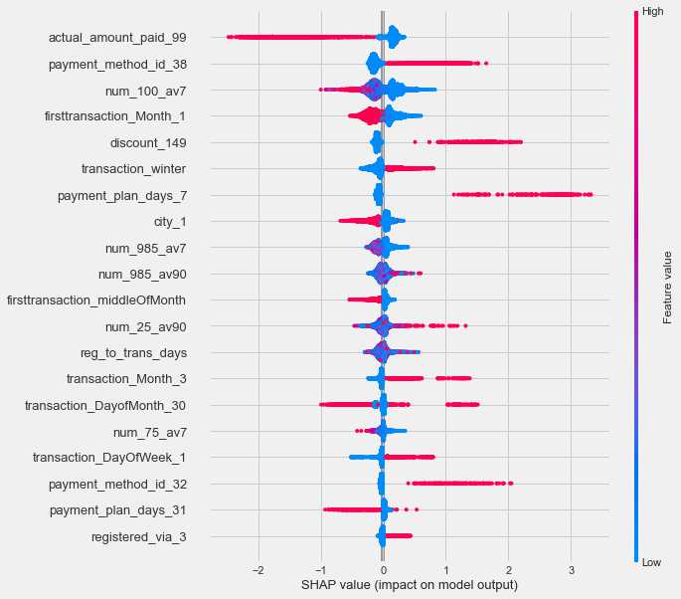
Insights: SHapley Additive exPlanations

Slide 12
Suggestions & Insights
Improve data collection: enforce completeness 23.48% of members have missing transactions and usage logs; 21.69% of members do not have usage logs; 19.15% of members with transactions have no membership; 66.93% of missing gender in membership information, especially many in data collection channels 3, 4, 7, and 9.
Factors responsible for most churn
Payment plan is only for 7 days: proportion of churn grows from 7.89% in all transactions to 69.06%.
Number of songs played in full last week: churn increases to 84.8% in a subgroup with 5 or less songs and 7-day plan.
Payment method ID 38: churn increases to 88.03%.
Jan 1,2015 - Oct 22, 2016
samples = 11986
churn = 7.89%
Plan 7 days
Short subscription
samples = 181
churn = 69.06%
≤ 5 full songs last week
Low usage
samples = 125
churn = 8.48%

