Slide 1
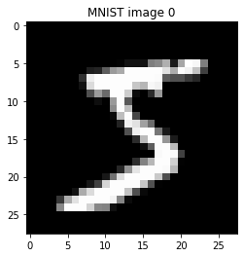
Problem: Recognize handwritten digits (multi-label classification). Solution: Train a model that can classify an image as one of the 10 digits. Develop a GUI where user can test performance of the model and provide feedback: draw digits, save misclassified images and provide correct labels. Scope of solution space: Supervised learning methods – sequential neural networks (NN), including convolutional nets (CNN). Constraints: Images used for training may not reflect handwriting styles of the users. CNN model training takes several hours. A tedious handwriting of the digits to assess accuracy and generate manually labelled images for model re-training. Data: MNIST handwritten digit database with 60,000 train images and 10,000 test images (28 x 28 pixels). User-generated images with correct labels.
Handwritten Digit Recognition App using Neural Networks

Slide 2
Computational Workflow
Import packages
Load images, labels
Preprocessing
GUI testing & feedback
Training
60,000 MNIST
0 – 800 manual labels
Reshape NN:
X.reshape(-1,28*28)
input_shape = (28*28, )
CNN:
input_shape = (28, 28, 1)
Scale
X.astype('float')/255
One-hot encode labels
y = to_categorical(y, 10)
Canvas: Handwrite a digit
Button ‘Recognise’:
Resize image to 28x28 pixels
Convert to grayscale
Reshape: (1,28,28,1)
Rescale: /255
Invert: 1 – img
If recognized correctly:
Button ‘Clear’:
Wipe out the window
Update and display accuracy
If misclassified:
Grab & save this image
Enter correct label
Get & save this label
Update and display accuracy
numpy
pandas
matplotlib
keras
PIL
tkinter
win32gui
Test 10,000 MNIST
∞ user via GUI
Model training
Configuration NN
Layer | Neurons | Activation | dropout
Dense | 50 | ReLU | -
Dropout | - | - | 0
Dense | 50 | ReLU | -
Dense | 10 | softmax | -
Compiler parameters
loss: categorical_crossentropy
mean_squared_error
User-defined: mean_absolute_error
optimizer: Adam, Adadelta,
Adagrad, NAG, RMSprop, SGD
metrics: accuracy, AUC
Training parameters
epochs = 200, batch_size=128
CNN
Layer | Neurons | Activation | kernel_size / pool_size | dropout
Conv2D | 32 | ReLU | 3, 3 | -
Conv2D | 64 | ReLU | 3, 3 | -
MaxPooling2D | - | - | 2, 2 | -
Dropout | - | - | - | 0.25
Flatten | - | - | - | -
Dense | 256 | ReLU | - | -
Dropout | 256 | ReLU | - | 0.5
Dense | 10 | softmax | - | -
Save optimized model parameters,
train & test performance

Slide 3
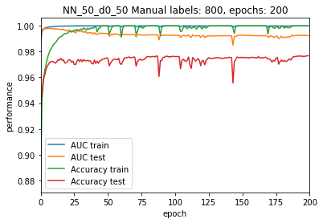
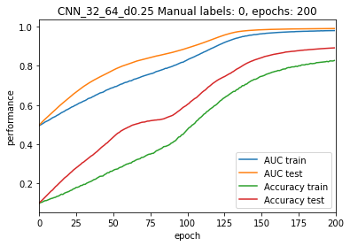
NN Model Parameters
Training Performance
Layer type | Output shape | Parameters #
Dense | (None, 50) | 39250 = 50(28·28+1)
Dense | (None, 50) | 2550 = 50(50+1)
Dense | (None, 0) | 510
Best model (NN)
CNN Model Parameters
Layer type | Output shape | Parameters #
Conv2D | (None, 26, 26, 32) | 320 = 32((28-3+2)//3+1)
Conv2D | (None, 24, 24, 64) | 18496 = (32((26-3+2)//3+1) + 1)64
MaxPooling2D | (None, 12, 12, 64) | 0
Dropout | (None, 12, 12, 64) | 0
Flatten | (None, 9216) | 0
Dense | (None, 256) | 2359552 = (9216+1)256
Dropout | (None, 256) | 0
Dense | (None, 10) | 2570 = (256+1)10
Best CNN model
CNN has a smoother training curve, requires longer training due to many parameters.

Slide 4
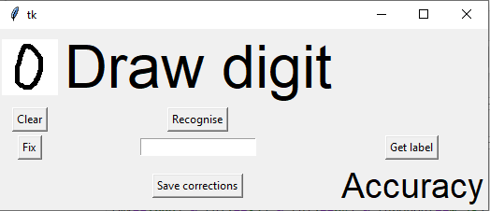
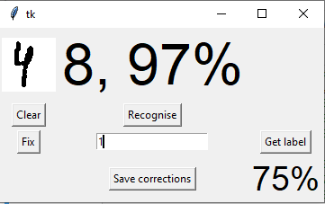
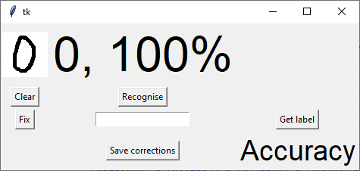
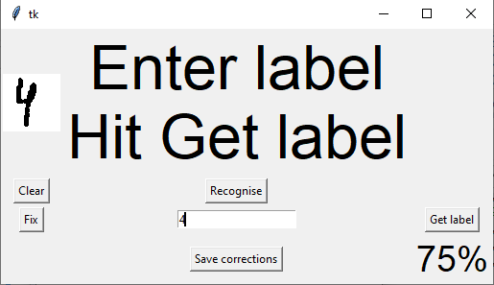
Instructions for GUI
1. Start by drawing a digit in the canvas window (60 x 60).
4. If the handwritten digit is misclassified, press "Fix" button to add the image to train set, which will be concatenated with the MNIST data before next training cycle.
2. Press “Recognise” and see the predicted class and its probability.
5. Type in correct label and press "Get label" button to add the label to train set.
6. Press "Save corrections“
to save manually labelled
images and labels.
7. Accuracy % is displayed.
3. If classified correctly, press “Clear” and go to Step 1.

Slide 5
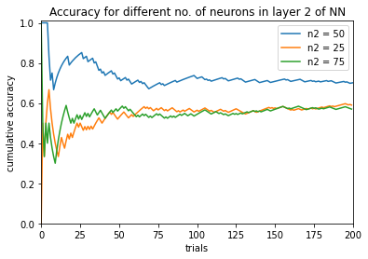
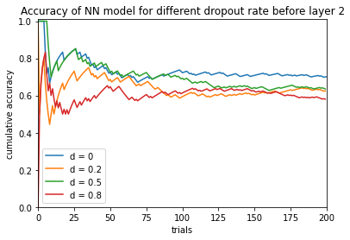
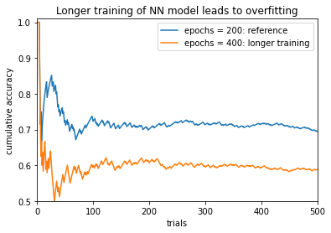
Tests of Handwritten Digits Recognition in the GUI
The recognition of handwritten digits was tested by applying the model to 10,000 test images and in the actual test by handwriting the digits in the GUI window.
We iterated over the digits from 0 to 9 until accuracy curve has reduced its fluctuations.
During the development of GUI, 78 misclassified digits were encountered, which were not saved.
After implementing the user feedback in the GUI, all misclassified images and their correct labels were saved in two CSV files (all images in one file and all labels in a separate file).
Hyperparameter Optimization: NN model
The optimal number of neurons in layer 2 is 25 < n₂ < 75, unless there are several maxima in accuracy.
The effect of dropout is negative: accuracy decreases for the three tested values {0.2, 0.5, 0.8}.
Longer training (epochs = 400) led to overfitting: accuracy dropped down to 0.588.

Slide 6
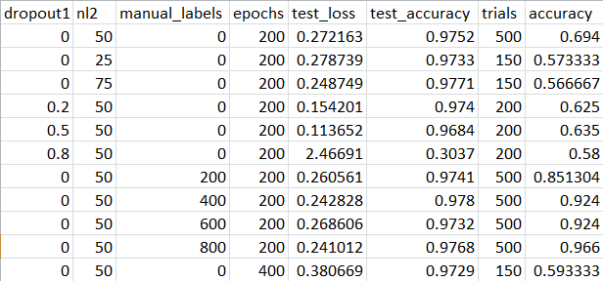
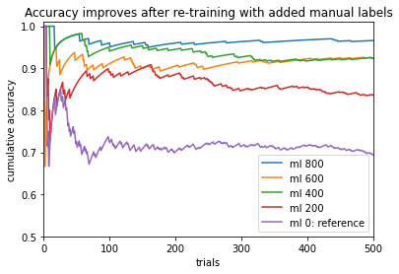
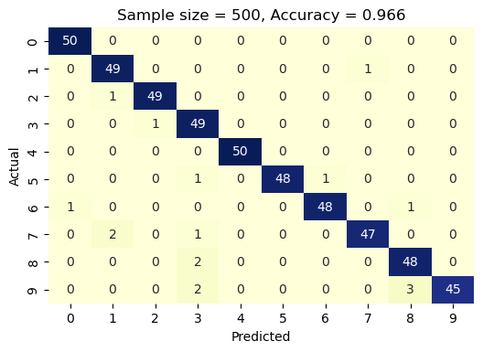
Best NN model
The highest accuracy was achieved by adding manually labeled images and re-training the model with these data added to the MNIST database. The more data added, the higher the accuracy is.
However, there is no difference in accuracy between 400 and 600 manual labels added, since all 200 additional labels were generated during testing of lower-accuracy models, and not the model with 400 manual labels.
The number of added labeled images is indicated in the legend following the ml. Tested 0 to 800 labels with step 200.
Common hyperparameter values
n₁ = 50
loss = ‘categorical_crossentropy’
dropout₂ = 0
optimizer = ‘Adam’
Accuracy of digit recognition: 96.6%
Recommendation 1:
Start from the most accurate saved model,
test your handwritten digit recognition using GUI,
provide correct label for each misclassified image and save them.
Re-train the model with the added manually labelled images.
Repeat the above steps of testing and adding manual labels until performance no longer improves.

Slide 7
Observations for NN models
After adding 200 manually labeled images, test accuracy has slightly decreased (from 0.9752 to 0.9741), while the actual performance of digit recognition of the images drawn in the GUI window has strongly increased. Thus, test accuracy is not a reliable metric of actual performance.
Test loss is also not related to the actual accuracy.
NN model is prone to overfitting: the accuracy for 400 training epochs is significantly lower than for 200 epochs when not using manual labels.
Recommendation 2: Keep the number of epochs below 400 in NN model.
Recommendation 3: Avoid using dropout after the first layer in NN model.
Recommendation 4: First focus on hyperparameters of NN model, which is much faster to train than CNN model.
However, keep training the CNN models in the background.

Slide 8
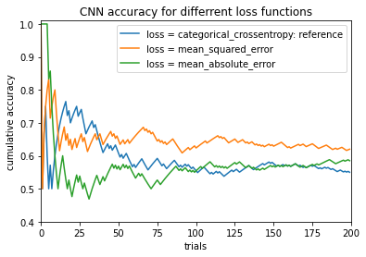
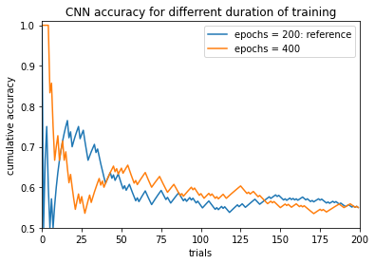
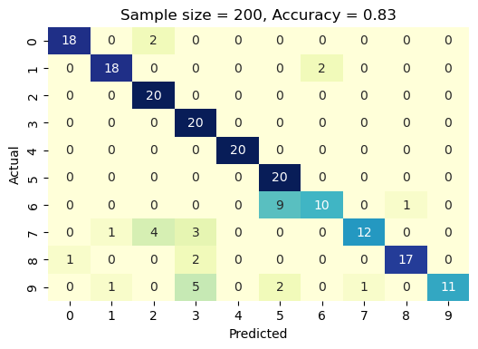
Hyperparameter Optimization: CNN model
loss | optimizer | epochs | test_loss | test_accuracy | trials | accuracy
categorical_crossentropy | Adadelta | 200 | 0.122603 | 0.9631 | 200 | 0.55
mean_squared_error | Adadelta | 200 | 0.017082 | 0.8916 | 200 | 0.62
mean_absolute_error | Adadelta | 200 | 0.022845 | 0.9011 | 200 | 0.585
categorical_crossentropy | Adadelta | 400 | 0.011047 | 0.9285 | 200 | 0.55
categorical_crossentropy | Adam | 200 | 0.068824 | 0.9927 | 200 | 0.83
Common hyperparameters
n₁ = 32, dropout₁ = 0.25, n₂ = 64
dropout₂ = 0.5, manual labels: 0
loss = ‘categorical_crossentropy’
Highest accuracy: 83.0%
Different loss functions were tested, including user-defined mean absolute error function. Some improvement in accuracy was achieved (after 200 trials). Ranking of the loss functions together with corresponding accuracies is: ‘categorical_crossentropy’ (0.55)
‘mean_absolute_error’ (0.585)
‘mean_squared_error’ (0.62).
Training CNN model longer (400 epochs) did not lead to a change in accuracy,
which stayed at 0.55 (after 200 trials).
Recommendation 5: When adding more manual labels, generate them using the model that is being upgraded, and not some other lower-accuracy model.

Slide 9
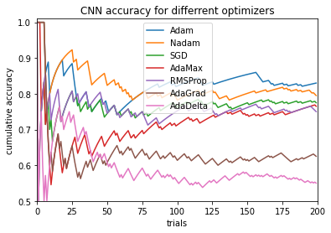
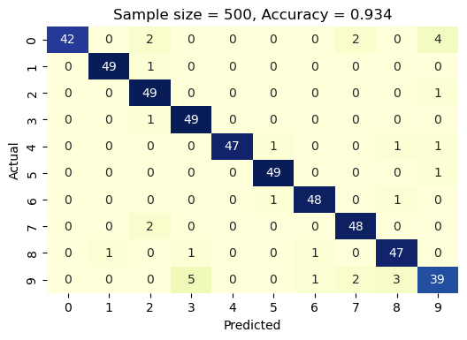
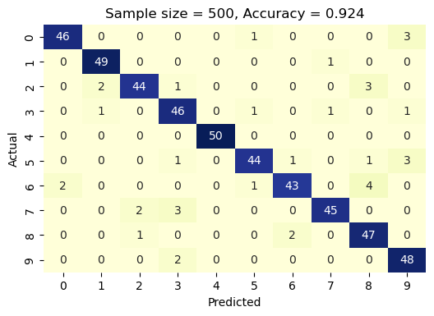
Hyperparameter Optimization: CNN
Identify errors in labels
0 mislabeled as 9
High off-diagonal confusion numbers may indicate mislabeled images in the training set.
Best optimizer ‘Adam’ gives much higher accuracy of 0.83
than ‘Adadelta’ with the accuracy of 0.55.
After correction of mislabeling errors 9 → 0, 6 → 0.
Some yet unknown factors led to a lower accuracy.
Recommendation 6: Try reduced number of epochs to speed up training.
Recommendation 7: Test all optimizers and optimizer – loss pairs.

Slide 10
Future Directions
Compare the accuracy of recognition of original hand writer whose manual labels were used to re-train the NN model to the accuracy values for another user with the same models.
Narrow down the optimal ranges of all hyperparameters within current NN and CNN configurations, including number of neurons in each hidden layer and dropout rates after each layer, loss function, optimizer, and activation functions.
Test different numbers of layers.
Minimize the number of control buttons in the GUI to simplify and speed up the process of dealing with misclassified digits. For instance, try to implement input of correct label via hitting Enter key, which would allow one to eliminate the button 'Get label'.
Enable creation of new classes for letter symbols. This would require switching from integer to string variables for the labels.

