Slide 1
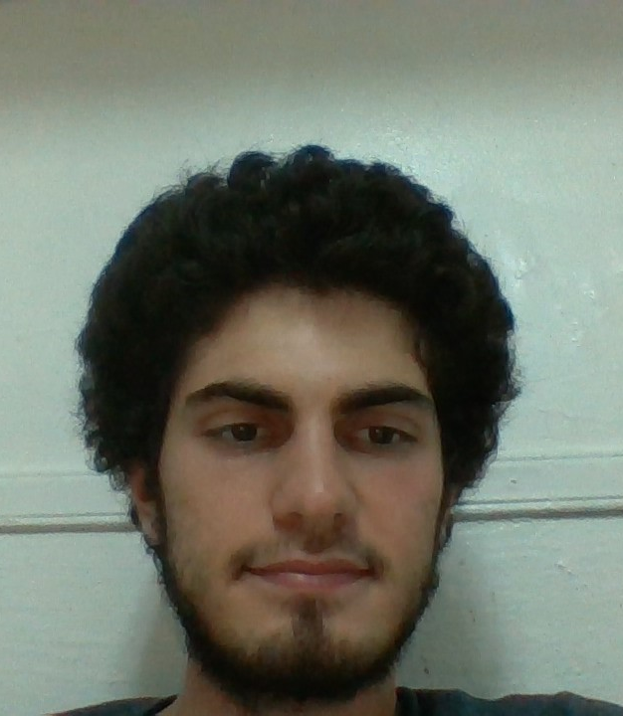
Name: Yusuf Ahmet Nihat Hekimoglu Course: 229 Web application development Assigment1
Number:
301081665

