Slide 1

Centos 7

Slide 2
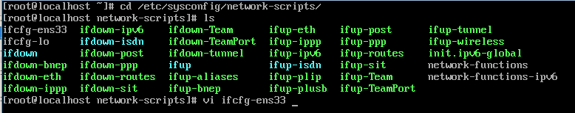
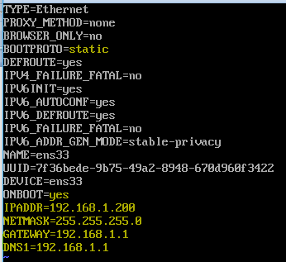
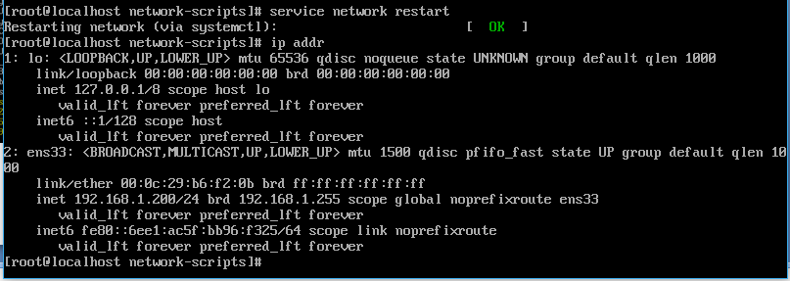
Connect network and set static IP

Slide 3
Wget
yum –y install wget

Slide 4
Install Hadoop

