Slide 1

Centos 7

Slide 2
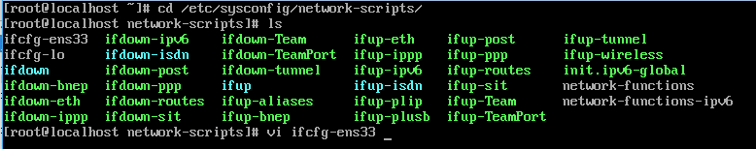
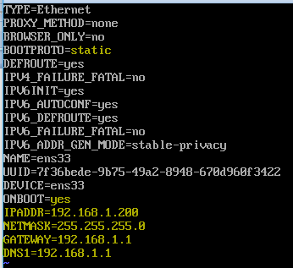
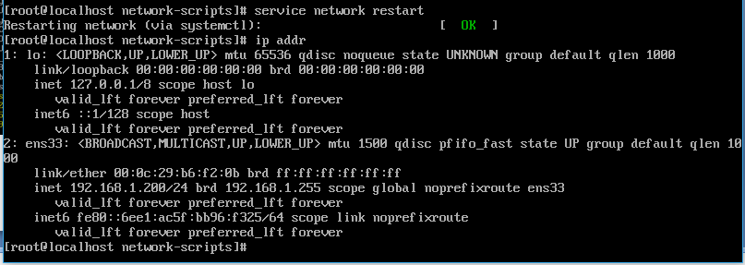
Connect network and set static IP

Slide 3
Prepare Environment

Slide 4
Install Hadoop

