Slide 1

Gitlab

Slide 2
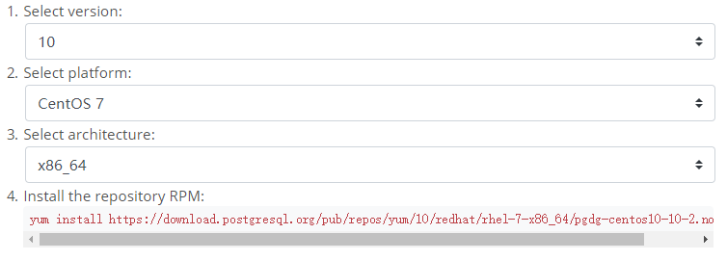
Installation
yum install postgresql10
yum install postgresql10-server
/user/pgsql-10/bin/postgresql-10-setup initdb
systemctl enable postgresql-10
systemctl start postgresql-10
su postgres
psql –U postgres
ALTER USER postgres WITH PASSWORD ‘password’;
\q
su postgres
psql
\password postgres
Enter new password:
Enter it again:
\q

Slide 3
Configuration

