Slide 1

Kafka

Slide 2
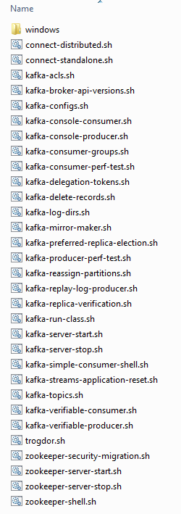
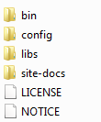
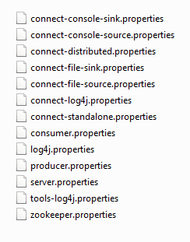
安装
下载kafka并解压

Slide 3
配置
服务器Centos7 | 编号
192.168.1.200 | 0
192.168.1.201 | 1
192.168.1.202 | 2
broker.id=0
listeners=PLAINTEXT://192.168.200:9092
log.dirs=/usr/software/kafka_2.11-1.1.0/data
zookeeper.connect= 192.168.1.200:2181, 192.168.1.201:2181, 192.168.1.202:2181
cd kafka_2.11-1.1.0
cd config
vi server.properties
启动
bin/kafka-server-start.sh config/server.properties

