Slide 1

ZooKeeper

Slide 2
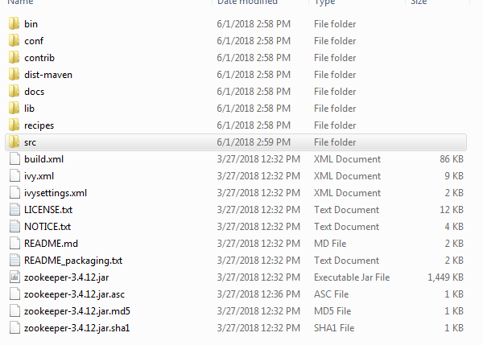
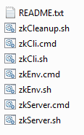

安装
下载ZooKeeper并解压

Slide 3
配置
cd zookeeper-3.4.12
cd conf
mv zoo_sample.cfg zoo.cfg
vi zoo.cfg
cd /var/lib/zookeeper/data
touch myid
vi myid (配置文件中声明的服务器编号)
服务器Centos7 | 编号/端口/端口
192.168.1.211 | 1 / 2888 / 3888
192.168.1.212 | 2 / 2888 / 3888
192.168.1.213 | 3 / 2888 / 3888
tickTime=2000
dataDir=/var/lib/zookeeper/data
dataLogDir=/var/lib/zookeeper/logs
clientPort=2181
initLimit=5
syncLimit=2
server.1=192.168.1.211:2888:3888
server.2=192.168.1.212:2888:3888
server.3=192.168.1.213:2888:3888
启动
bin/zkServer.sh start
状态
bin/zkServer.sh status

