Slide 1

Postgresql
10

Slide 2
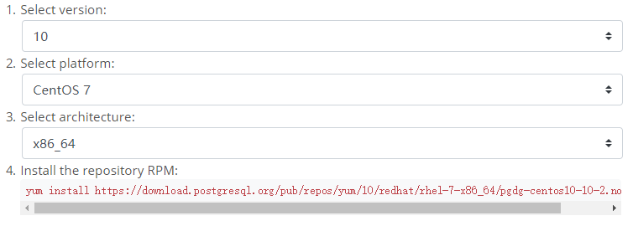
Installation
yum install postgresql10
yum install postgresql10-server
/user/pgsql-10/bin/postgresql-10-setup initdb
systemctl enable postgresql-10
systemctl start postgresql-10
su postgres
psql –U postgres
ALTER USER postgres WITH PASSWORD ‘password’;
\q
su postgres
psql
\password postgres
Enter new password:
Enter it again:
\q
psql –U postgres [databasename]

Slide 3
DDL
create database mydb;
drop database mydb;
\l
\c mydb
CREATE TABLE public.mytb(
id integer NOT NULL,
name character(100),
subjects character(1),
CONSTRAINT mykey PRIMARY KEY (id)
) ;
drop table mytb;
\d
CREATE SCHEMA my_schema;
drop schema my_schema;
\dn

Slide 4
DML

Slide 5
DML

