Slide 1
Chapter 4
Process Models
Slide Set to accompany
Software Engineering: A Practitioner’s Approach, 8/e
by Roger S. Pressman and Bruce R. Maxim
Slides copyright © 1996, 2001, 2005, 2009, 2014 by Roger S. Pressman
For non-profit educational use only
May be reproduced ONLY for student use at the university level when used in conjunction with Software Engineering: A Practitioner's Approach, 8/e. Any other reproduction or use is prohibited without the express written permission of the author.
All copyright information MUST appear if these slides are posted on a website for student use.
These slides are designed to accompany Software Engineering: A Practitioner’s Approach, 8/e (McGraw-Hill, 2014). Slides copyright 2014 by Roger Pressman.

Slide 2
Prescriptive Models
Prescriptive process models advocate an orderly approach to software engineering
That leads to a few questions …
If prescriptive process models strive for structure and order, are they inappropriate for a software world that thrives on change?
Yet, if we reject traditional process models (and the order they imply) and replace them with something less structured, do we make it impossible to achieve coordination and coherence in software work?
These slides are designed to accompany Software Engineering: A Practitioner’s Approach, 8/e (McGraw-Hill, 2014). Slides copyright 2014 by Roger Pressman.

Slide 3
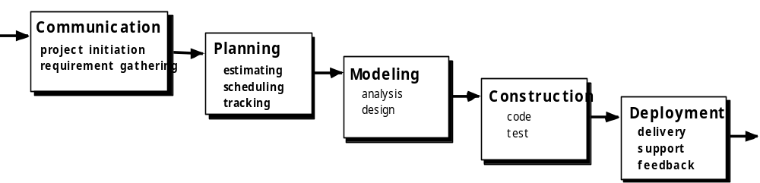
The Waterfall Model
These slides are designed to accompany Software Engineering: A Practitioner’s Approach, 8/e (McGraw-Hill, 2014). Slides copyright 2014 by Roger Pressman.

Slide 4

The V-Model
These slides are designed to accompany Software Engineering: A Practitioner’s Approach, 8/e (McGraw-Hill, 2014). Slides copyright 2014 by Roger Pressman.

Slide 5
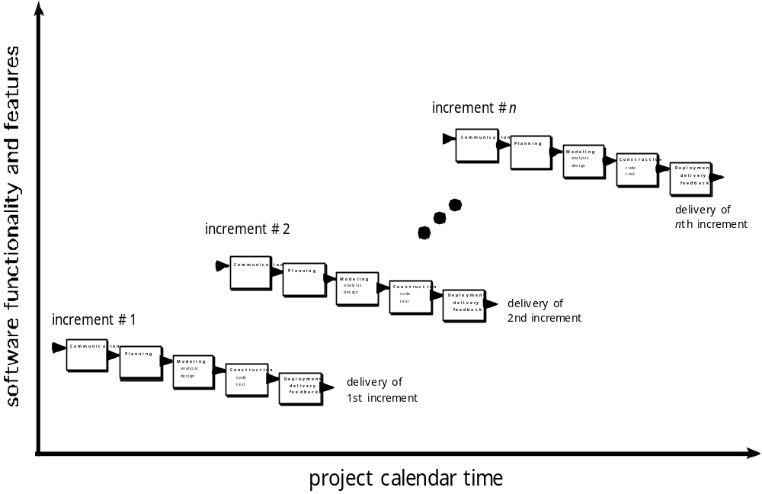
The Incremental Model
These slides are designed to accompany Software Engineering: A Practitioner’s Approach, 8/e (McGraw-Hill, 2014). Slides copyright 2014 by Roger Pressman.

Slide 6

Evolutionary Models: Prototyping
Quick
plan
communication
Modeling
Quick design
Deployment
delivery &
feedback
Construction
of prototype
Construction
of prototype
These slides are designed to accompany Software Engineering: A Practitioner’s Approach, 8/e (McGraw-Hill, 2014). Slides copyright 2014 by Roger Pressman.

Slide 7
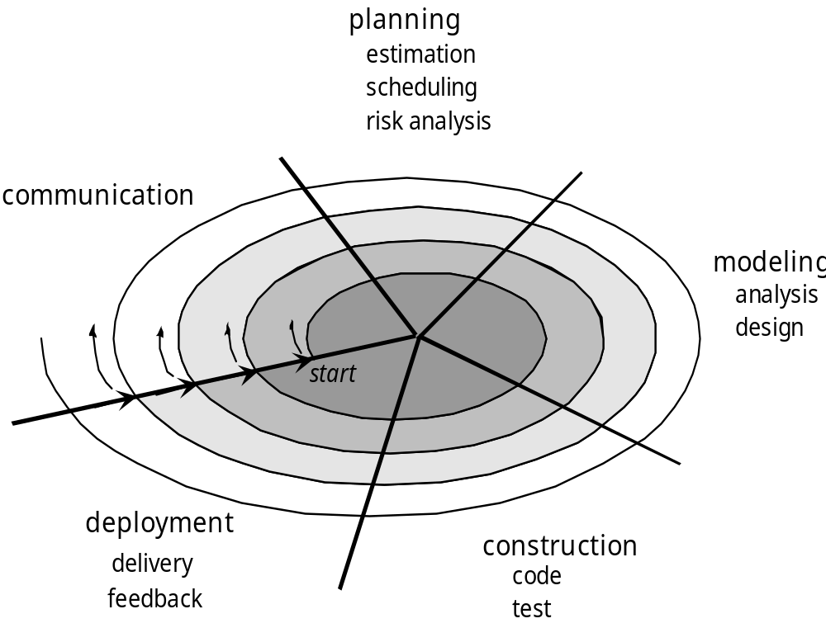
Evolutionary Models: The Spiral
These slides are designed to accompany Software Engineering: A Practitioner’s Approach, 8/e (McGraw-Hill, 2014). Slides copyright 2014 by Roger Pressman.

Slide 8
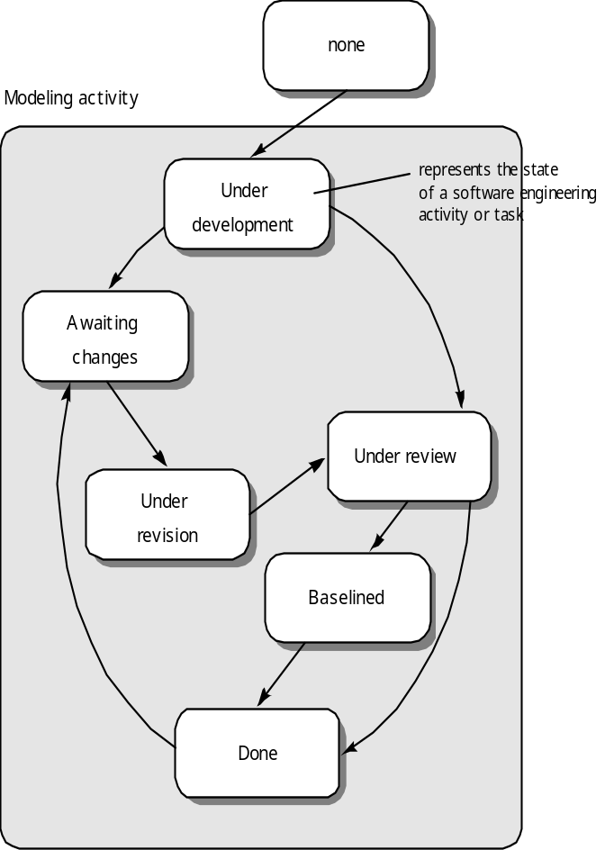
Evolutionary Models: Concurrent
These slides are designed to accompany Software Engineering: A Practitioner’s Approach, 8/e (McGraw-Hill, 2014). Slides copyright 2014 by Roger Pressman.

Slide 9
Still Other Process Models
Component based development—the process to apply when reuse is a development objective
Formal methods—emphasizes the mathematical specification of requirements
AOSD—provides a process and methodological approach for defining, specifying, designing, and constructing aspects
Unified Process—a “use-case driven, architecture-centric, iterative and incremental” software process closely aligned with the Unified Modeling Language (UML)
These slides are designed to accompany Software Engineering: A Practitioner’s Approach, 8/e (McGraw-Hill, 2014). Slides copyright 2014 by Roger Pressman.

Slide 10
Aspect Oriented Software Engg
AOSE is based around abstractions called aspects, which implement system functionality that may be required at several different places in a program.
The key benefit of an aspect-oriented approach is that it supports the separation of concerns.
Example: user authentication may be represented as an aspect that requests a login name and password. This can be automatically woven into the program wherever authentication is required. (In banking transactions, they ask Profile Password, Transaction password, login password, OTP whenever needed, before completing the transaction.)
Aspects encapsulate functionality that cross-cuts and coexists with other functionality that is included in a system.
They are used alongside other abstractions such as objects and methods.

Slide 11
Aspect Oriented Software Engg
An executable aspect-oriented program is created by automatically combining (weaving) objects, methods, and aspects, according to specifications that are included in the program source code.
aspect-oriented approach supports the separation of concerns.
There are several different types of stakeholder concern:
1. Functional concerns, which are related to the specific functionality to be included in a system. For example, in a train control system, a specific functional concern is train braking.
2. Quality of service concerns, which are related to the non-functional behavior of a system. These include characteristics such as performance, reliability, and availability.
3. Policy concerns, which are related to the overall policies that govern the use of a system. Policy concerns include security and safety concerns and concerns related to business rules.
4. System concerns, which are related to attributes of the system as a whole, such as its maintainability or its configurability.
5. Organizational concerns, which are related to organizational goals and priorities. These include producing a system within budget, making use of existing software assets, and maintaining the reputation of the organization.

Slide 12
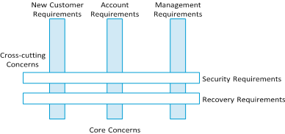
Aspect Oriented Software Engg: Internet Banking System
This system has requirements relating to new customers such as credit checking and address verification. It also has requirements related to the management of existing customers and the management of customer accounts.
All of these are core concerns that are associated with the system’s primary purpose—the provision of an Internet banking service.
However, the system also has security requirements based on the bank’s security policy, and recovery requirements to ensure that data is not lost in the event of a system failure.

Slide 13
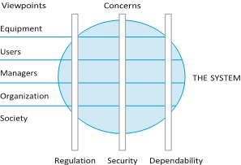
Aspect Oriented Software Engg: View Points

Slide 14

The Unified Process (UP)
elaboration
inception
These slides are designed to accompany Software Engineering: A Practitioner’s Approach, 8/e (McGraw-Hill, 2014). Slides copyright 2014 by Roger Pressman.

Slide 15
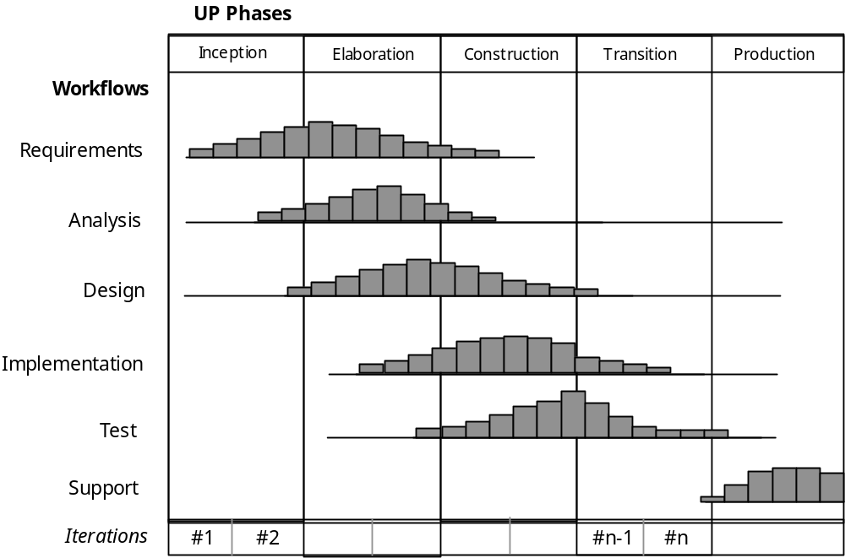
UP Phases
These slides are designed to accompany Software Engineering: A Practitioner’s Approach, 8/e (McGraw-Hill, 2014). Slides copyright 2014 by Roger Pressman.

Slide 16
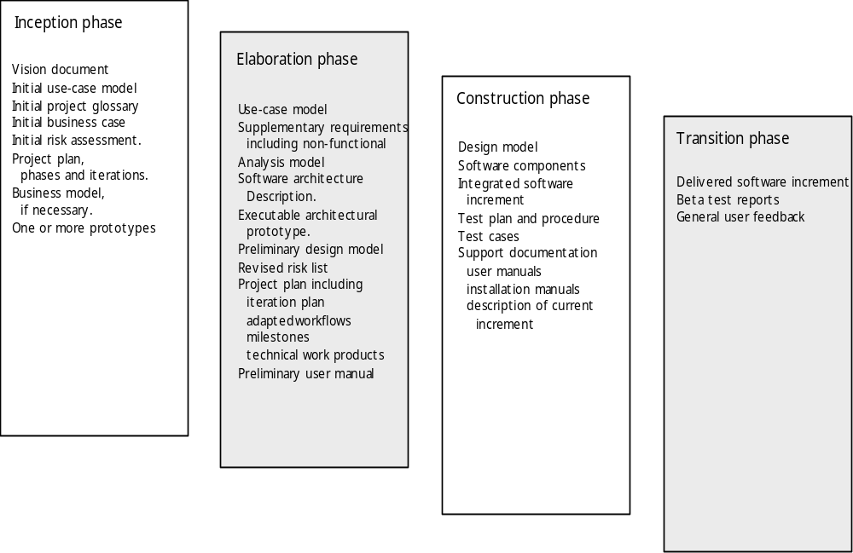
UP Work Products
These slides are designed to accompany Software Engineering: A Practitioner’s Approach, 8/e (McGraw-Hill, 2014). Slides copyright 2014 by Roger Pressman.

Slide 17
Personal Software Process (PSP)
Planning. This activity isolates requirements and develops both size and resource estimates. In addition, a defect estimate (the number of defects projected for the work) is made. All metrics are recorded on worksheets or templates. Finally, development tasks are identified and a project schedule is created.
High-level design. An external specification is created for each component and a component design is created. Prototypes are built when uncertainty exists. All issues are recorded and tracked.
High-level design review. Formal verification methods (Chapter 21) are applied to uncover errors in the design. Metrics are maintained for all important tasks and work results.
Development. The component level design is refined and reviewed. Code is generated, reviewed, compiled, and tested. Metrics are maintained for all important tasks and work results.
Postmortem. Using measures and metrics collected the effectiveness of the process is determined. If this is a large amount of data it should be analyzed statistically), Measures and metrics should provide guidance for modifying the process to improve its effectiveness.
These slides are designed to accompany Software Engineering: A Practitioner’s Approach, 8/e (McGraw-Hill, 2014). Slides copyright 2014 by Roger Pressman.

Slide 18
Process metrics
Time taken for process activities to be
completed
  E.g. Calendar time or effort to complete an activity or process.
Resources required for processes or activities
  E.g. Total effort in person-days.
Number of occurrences of a particular event
  E.g. Number of defects discovered.
Chapter 2 Software Processes

Slide 19
The SEI capability maturity model
Initial
  Essentially uncontrolled
Repeatable
  Product management procedures defined and used
Defined
  Process management procedures and strategies defined
  and used
Managed
  Quality management strategies defined and used
Optimising
  Process improvement strategies defined and used
Chapter 2 Software Processes

Slide 20
Team Software Process (TSP)
Build self-directed teams that plan and track their work, establish goals, and own their processes and plans. These can be pure software teams or integrated product teams (IPT) of three to about 20 engineers.
Show managers how to coach and motivate their teams and how to help them sustain peak performance.
Accelerate software process improvement by making CMM Level 5 behavior normal and expected.
  The Capability Maturity Model (CMM), a measure of the effectiveness of a software process, is discussed in Chapter 30.
Provide improvement guidance to high-maturity organizations.
Facilitate university teaching of industrial-grade team skills.
These slides are designed to accompany Software Engineering: A Practitioner’s Approach, 8/e (McGraw-Hill, 2014). Slides copyright 2014 by Roger Pressman.

