Slide 1
Chapter 9
Requirements Modeling: Scenario-Based Methods
Slide Set to accompany
Software Engineering: A Practitioner’s Approach, 8/e
by Roger S. Pressman and Bruce R. Maxim
Slides copyright © 1996, 2001, 2005, 2009, 2014 by Roger S. Pressman
For non-profit educational use only
May be reproduced ONLY for student use at the university level when used in conjunction with Software Engineering: A Practitioner's Approach, 8/e. Any other reproduction or use is prohibited without the express written permission of the author.
All copyright information MUST appear if these slides are posted on a website for student use.
These slides are designed to accompany Software Engineering: A Practitioner’s Approach, 8/e (McGraw-Hill, 2014). Slides copyright 2014 by Roger Pressman.

Slide 2
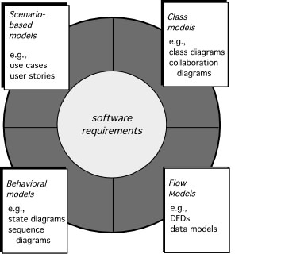
Elements of Requirements Analysis
These slides are designed to accompany Software Engineering: A Practitioner’s Approach, 8/e (McGraw-Hill, 2014). Slides copyright 2014 by Roger Pressman.

Slide 3
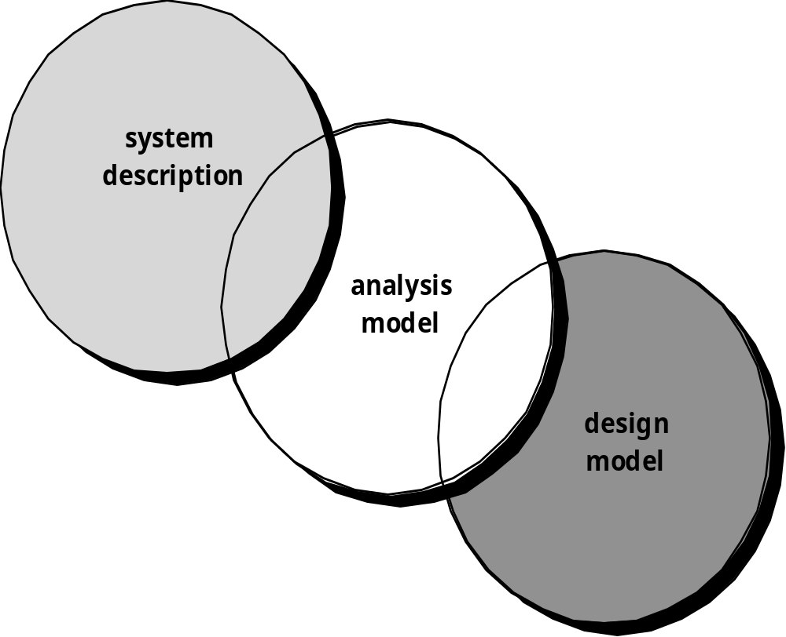
A Bridge
These slides are designed to accompany Software Engineering: A Practitioner’s Approach, 8/e (McGraw-Hill, 2014). Slides copyright 2014 by Roger Pressman.

Slide 4
Rules of Thumb
The model should focus on requirements that are visible within the problem or business domain. The level of abstraction should be relatively high.
Each element of the analysis model should add to an overall understanding of software requirements and provide insight into the information domain, function and behavior of the system.
Delay consideration of infrastructure and other non-functional models until design.
Minimize coupling throughout the system.
Be certain that the analysis model provides value to all stakeholders.
Keep the model as simple as it can be.
These slides are designed to accompany Software Engineering: A Practitioner’s Approach, 8/e (McGraw-Hill, 2014). Slides copyright 2014 by Roger Pressman.

Slide 5
Domain Analysis
Define the domain to be investigated.
Collect a representative sample of applications in the domain.
Analyze each application in the sample.
Develop an analysis model for the objects.
These slides are designed to accompany Software Engineering: A Practitioner’s Approach, 8/e (McGraw-Hill, 2014). Slides copyright 2014 by Roger Pressman.

Slide 6
Scenario-Based Modeling
“[Use-cases] are simply an aid to defining what exists outside the system (actors) and what should be performed by the system (use-cases).” Ivar Jacobson
  (1) What should we write about?
  (2) How much should we write about it?
  (3) How detailed should we make our description?
  (4) How should we organize the description?
These slides are designed to accompany Software Engineering: A Practitioner’s Approach, 8/e (McGraw-Hill, 2014). Slides copyright 2014 by Roger Pressman.

Slide 7
Use-Cases
a scenario that describes a “thread of usage” for a system
actors represent roles people or devices play as the system functions
users can play a number of different roles for a given scenario
These slides are designed to accompany Software Engineering: A Practitioner’s Approach, 8/e (McGraw-Hill, 2014). Slides copyright 2014 by Roger Pressman.

Slide 8
Developing a Use-Case
What are the main tasks or functions that are performed by the actor?
What system information will the the actor acquire, produce or change?
Will the actor have to inform the system about changes in the external environment?
What information does the actor desire from the system?
Does the actor wish to be informed about unexpected changes?
These slides are designed to accompany Software Engineering: A Practitioner’s Approach, 8/e (McGraw-Hill, 2014). Slides copyright 2014 by Roger Pressman.

Slide 9
Reviewing a Use-Case
Use-cases are written first in narrative form and mapped to a template if formality is needed
Each primary scenario should be reviewed and refined to see if alternative interactions are possible
  Can the actor take some other action at this point?
  Is it possible that the actor will encounter an error condition at some point? If so, what?
  Is it possible that the actor will encounter some other behavior at some point? If so, what?
These slides are designed to accompany Software Engineering: A Practitioner’s Approach, 8/e (McGraw-Hill, 2014). Slides copyright 2014 by Roger Pressman.

Slide 10
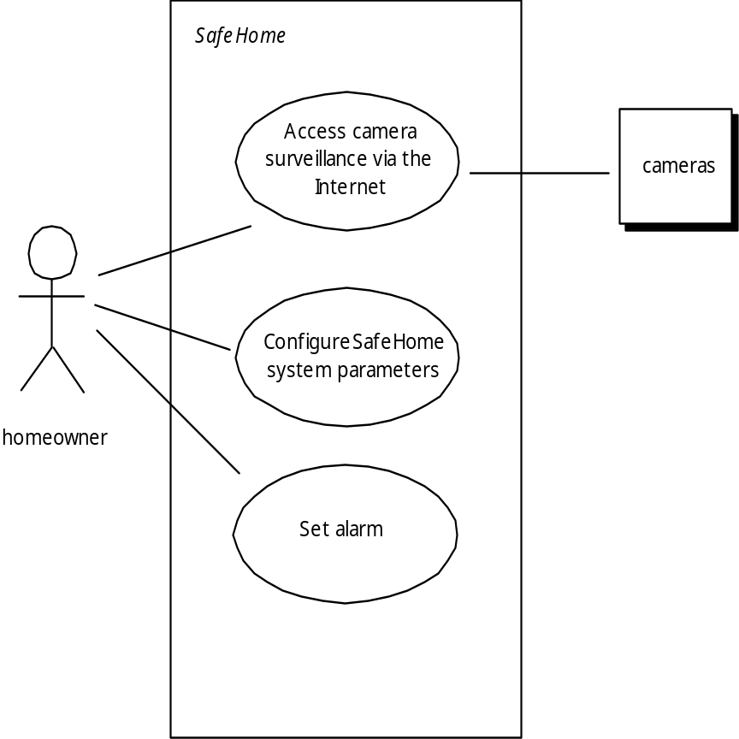
Use-Case Diagram
These slides are designed to accompany Software Engineering: A Practitioner’s Approach, 8/e (McGraw-Hill, 2014). Slides copyright 2014 by Roger Pressman.

Slide 11
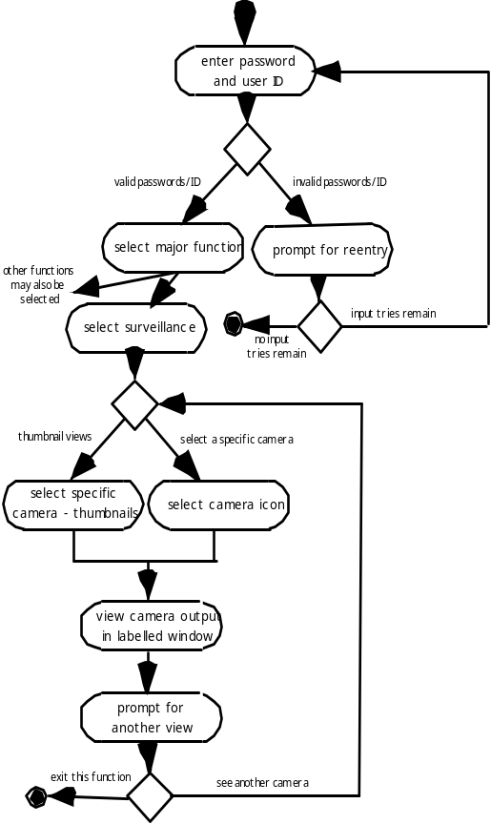
Activity Diagram
Supplements the use case by providing a graphical representation of the flow of interaction within a specific scenario
These slides are designed to accompany Software Engineering: A Practitioner’s Approach, 8/e (McGraw-Hill, 2014). Slides copyright 2014 by Roger Pressman.

Slide 12
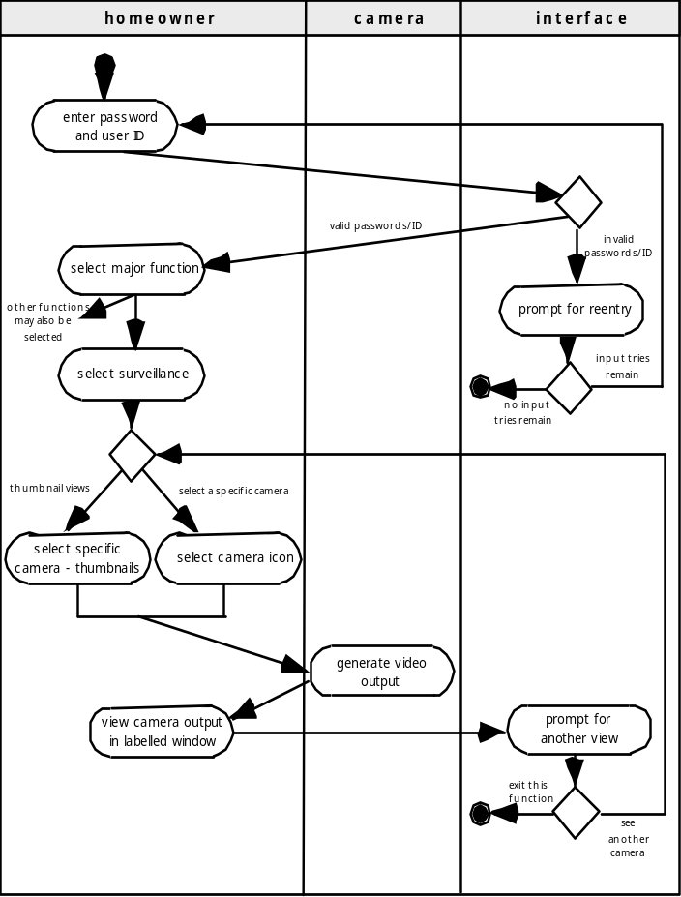
Swimlane Diagrams
Allows the modeler to represent the flow of activities described by the use-case and at the same time indicate which actor (if there are multiple actors involved in a specific use-case) or analysis class has responsibility for the action described by an activity rectangle
These slides are designed to accompany Software Engineering: A Practitioner’s Approach, 8/e (McGraw-Hill, 2014). Slides copyright 2014 by Roger Pressman.

