Slide 1

Streamlit
Yusuf Shaheen - OIM 7502

Slide 2
What is Streamlit?
Streamlit is an open-source Python library for building interactive web apps.
Turns .py files into shareable dashboards instantly.

Slide 3
Why Use Streamlit?
Fast, intuitive app building for data analysis
Perfect for dashboards, ML demos, and model explainability
Easily deployed on Streamlit Cloud
Interactive & Visual
Open Source

Slide 4
Deployment
Streamlit Cloud: https://streamlit.io/cloud
Steps:
Push project to GitHub
Connect repo to Streamlit Cloud
App is live instantly (no servers or setup needed)

Slide 5
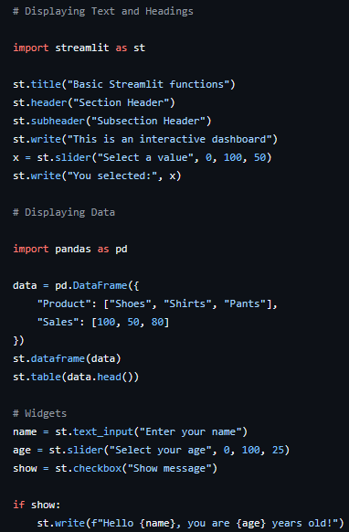
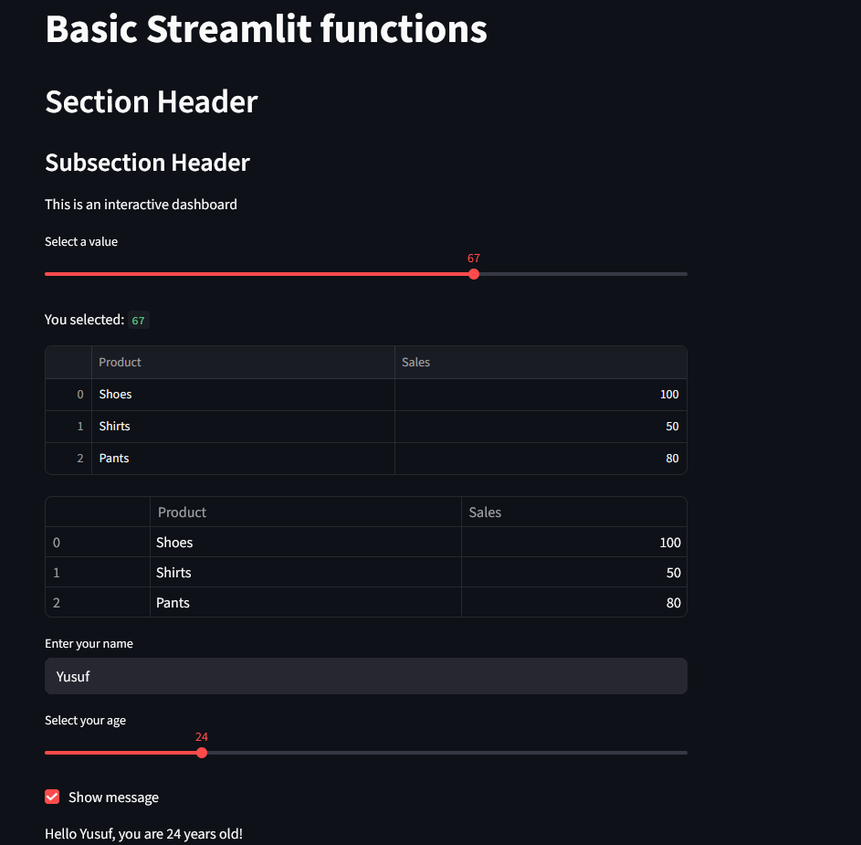
Basic Streamlit Capabilities

Slide 6
Applying Streamlit
Simulated retail data
Features: Data table, visualizations, map, KPIs
Goals: Analyze sales, profit, and store distribution
The three demos together showcase Streamlit’s ability to connect data, visuals, and geography in one cohesive dashboard
This illustrates how data scientists can turn Python analysis into an interactive, shareable web app in minutes.

Slide 7
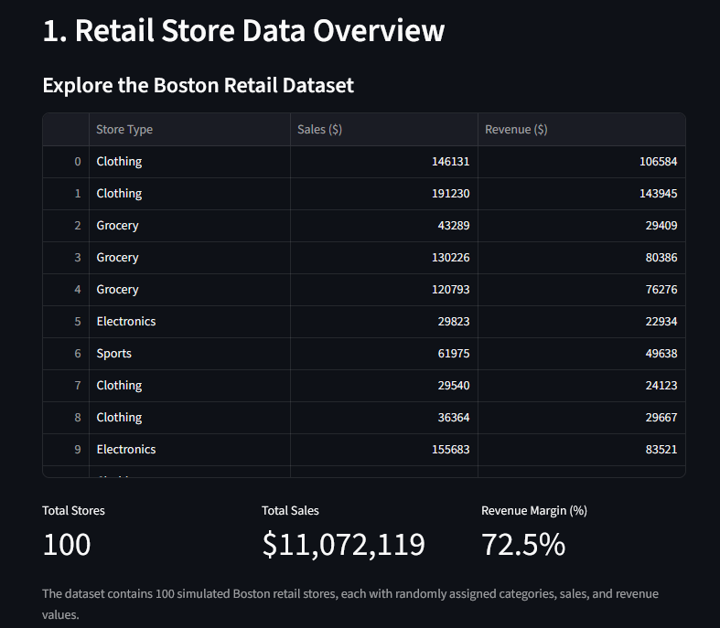
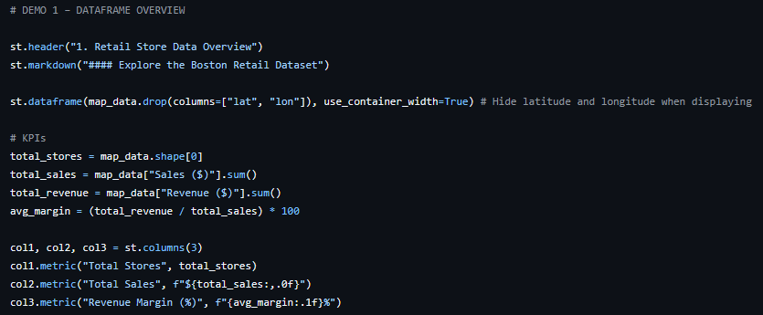
DATAFRAME DEMO

Slide 8
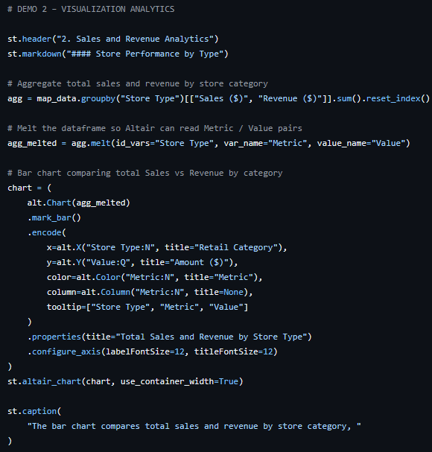
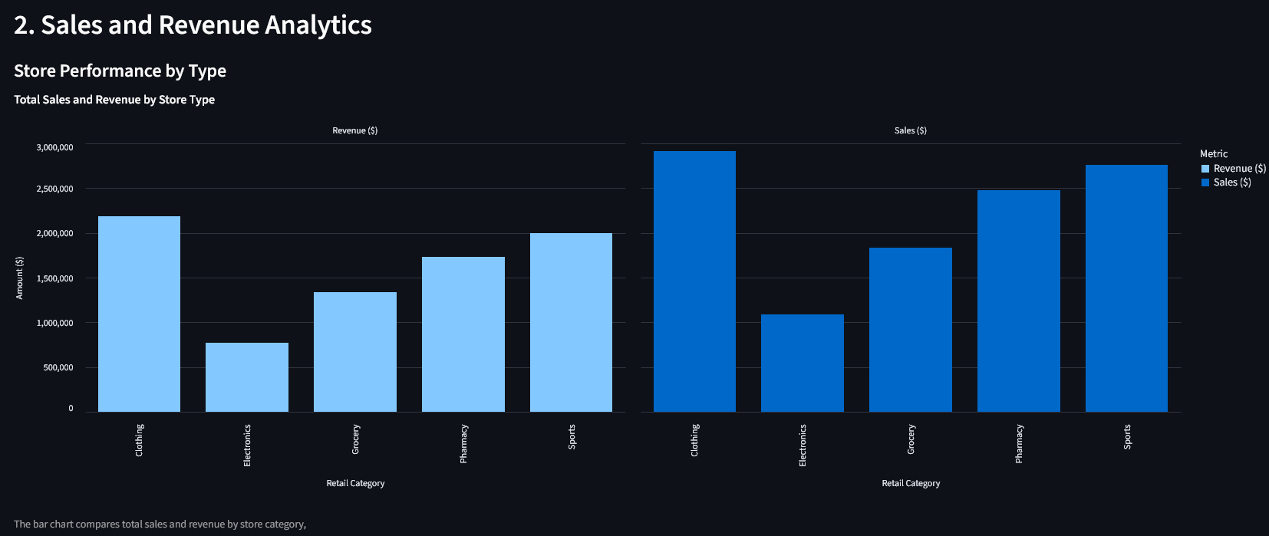
Visualization DEMO (1)

Slide 9
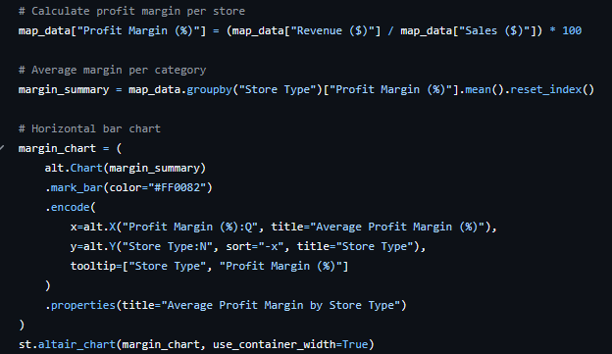
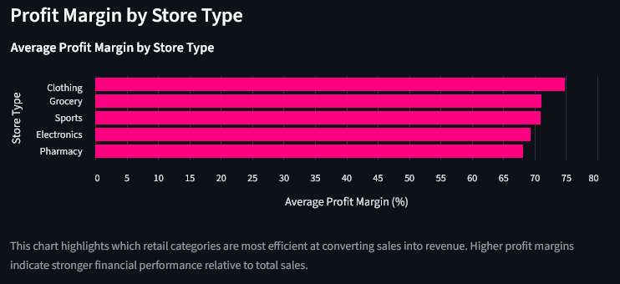
Visualization DEMO (2)

Slide 10
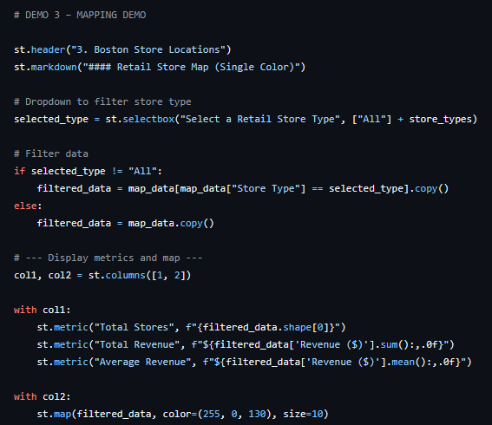
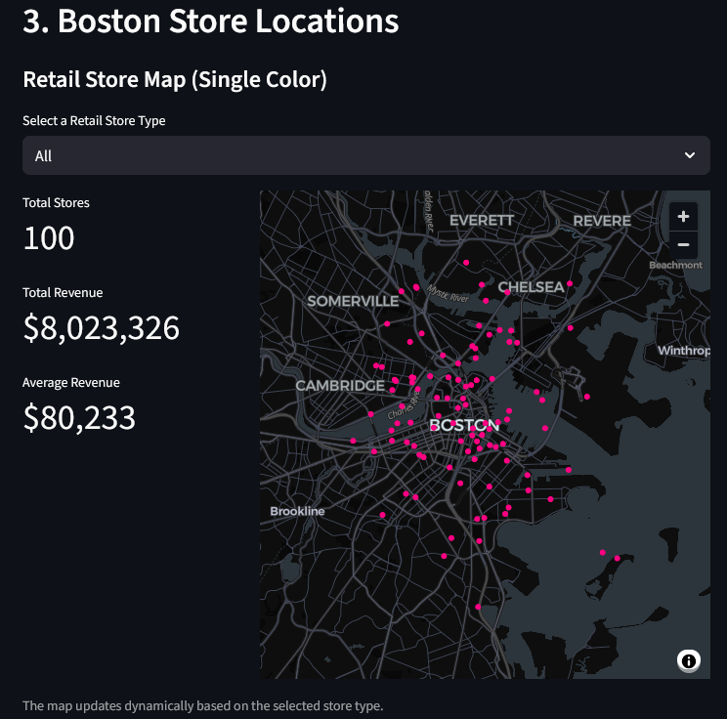
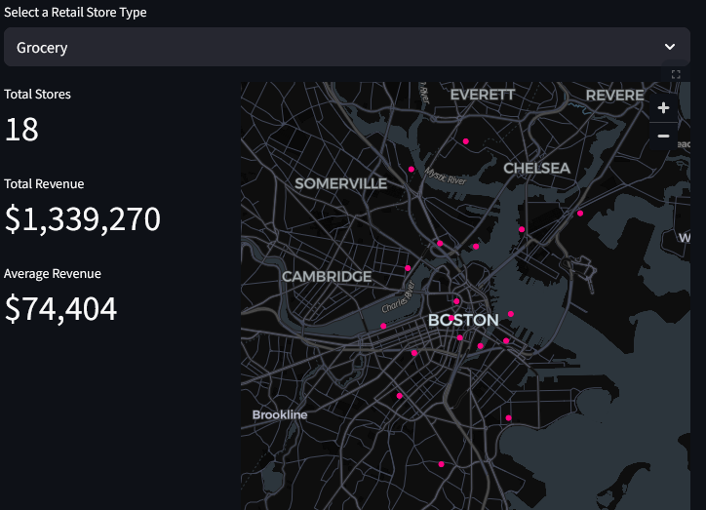
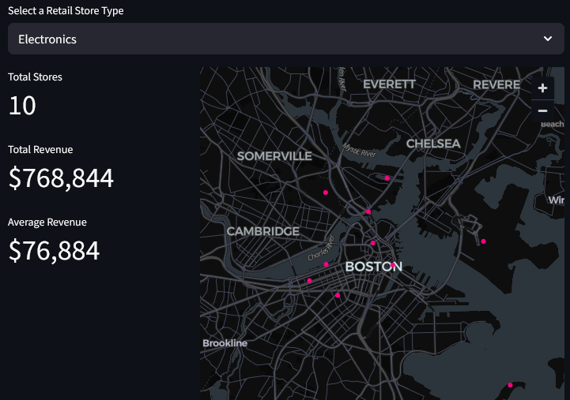
MAPPING DEMO

