Slide 1
CAPSTONE PROJECT
Battle of the neighbourhoods

Slide 2
Business Question
If I want to open a new restaurant or want to go to a popular place which neighborhood in Toronto would the best option?

Slide 3
Required data
Toronto post codes
Data source: Wikipedia
Venues in Toronto
Data source: Foursquare location data platform
Venues retrieved using latitude and longitude information

Slide 4
Methodology
Explore similarities between neighbourhoods based on the number of people’s visit
Data acquisition and cleansing
Data preparation
Feature selection
Clustering

Slide 5
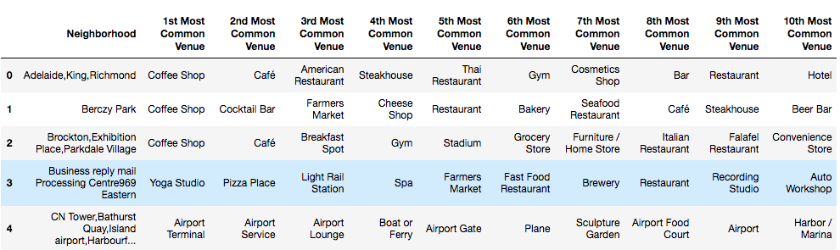
Results Most common venues
Neighborhood were divide clustered into 5 five different groups

Slide 6
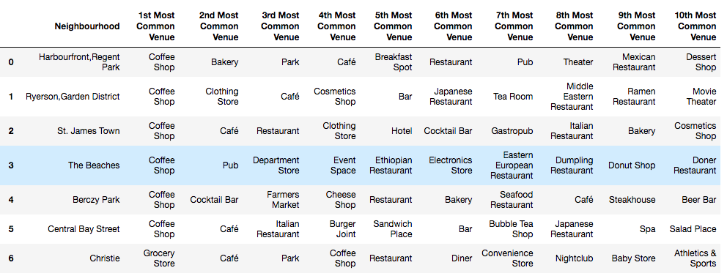
Results K-mean clustering. #1
Neighborhood were divide clustered into 5 five different groups

Slide 7
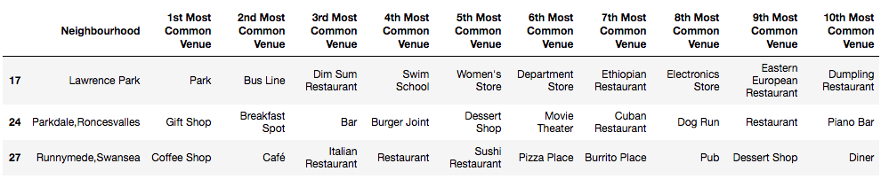
Results K-mean clustering. #2

Slide 8
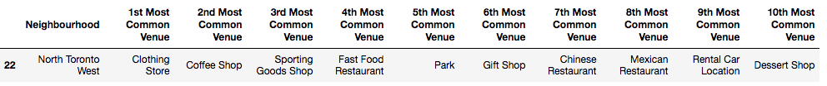
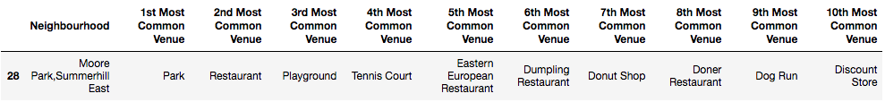
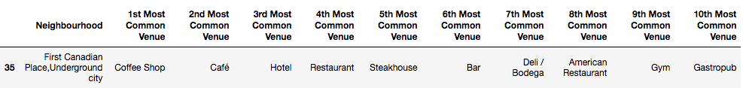
Results K-mean clustering. #3
K-mean clustering. #4
K-mean clustering. #5

Slide 9
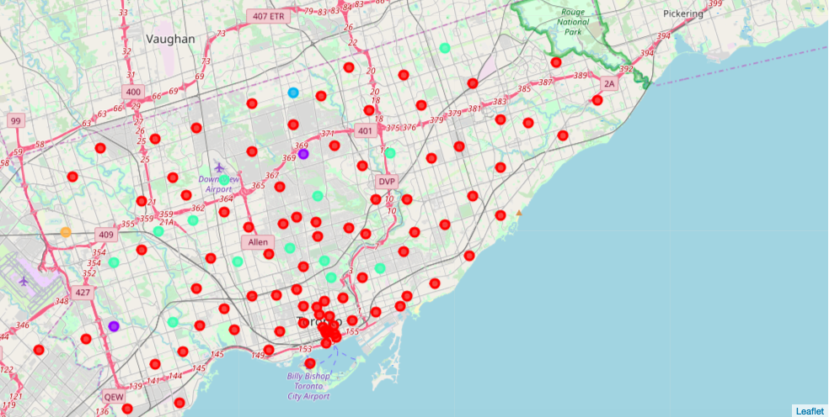
Map of K-mean clustering

Slide 10
Conclusion
Clustering using venue information from Foursquare can potentially guide decisions on where to open up a new restautrant or to find popular place.
As neighbourhoods evolve, this process would need to be repeated to identify updated visiting information.
Demographic data could also help paint a clearer picture.

