Slide 1
CAPSTONE PROJECT
Battle of the neighbourhoods

Slide 2
Business Question
If I want to open a new restaurant or want to go to popular place which neighborhood in Toronto would the best option?

Slide 3
Required data
Toronto post codes
Data source: Wikipedia
Venues in Toronto
Data source: Foursquare location data platform
Venues retrieved using latitude and longitude information

Slide 4
Methodology
Explore similarities between neighbourhoods based on the number of people’s visit

Slide 5
Results
Neighborhood were divide clustered into 5 five different groups

Slide 6
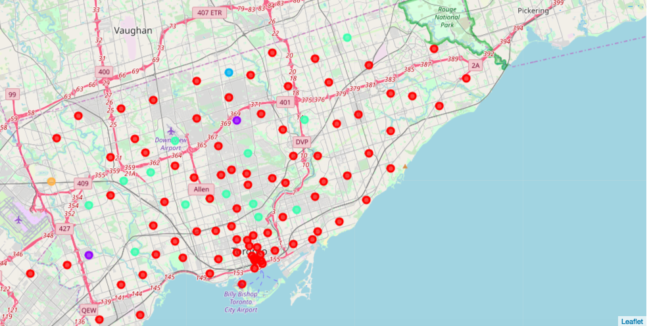
Map

