Slide 1
Identifying Background Points in Dynamic Video
Robust Background Identification for Dynamic Video Editing (2016)
Eleanor Tursman and Yijun Shao
ENGN-2560/Spring 2017
Professor Benjamin Kimia
Notes:
Start with a question: We’ve talked about finding features in images in class. How can we track these features through a video sequence, while isolating background points?

Slide 2
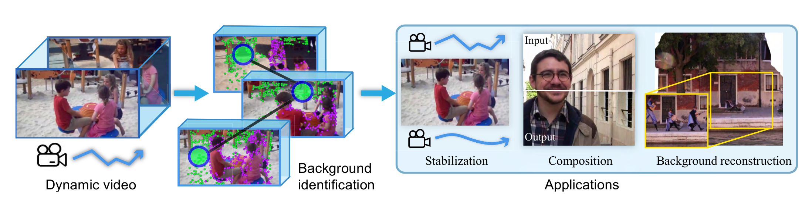
Overview
Notes:
Take video with lots of movement, moving subjects
By analyzing how features move through frames, can pick out background points
Identified bg points can be used for smoother video stabilization, composition, and bg reconstruction

Slide 3
Motivation
Target: Extracte background feature for estimating the camera path
Challenges: Videos are highly dynamic
Notes:
Camera path:
Important: many video editing and enhancement application
Example: the task of inserting a new object in the background of a video shot by a moving camera, if the camera motion can be reliably estimated, the user can simply place the object in the first frame, and have it propagated to the rest of the sequence automatically
Challenges:
Example: moving cameras, severe foreground occlusion

Slide 4
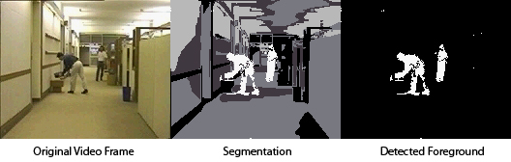
Previous Work
Video Segmentation: Background extraction using segmentation, depth, or probabilistic models
Motion Segmentation: Matrix decomposition to cluster feature trajectories, where background trajectories make a low-rank matrix
Video Stabilization: Compute smoother camera motion paths with bundle optimization, 3D reconstruction, etc.
Notes:
Video segmentation - segment portions of video, can be used for background subtraction (like for surveillance cameras)
Issues: can’t handle large moving objects, bc homography estimation gets messed up
Depth hard to get accurately
prob. models assume bg is same for entire video, so can’t handle large camera movement like pans
Motion segm. - features tracked across frames, movement stored in big matrix, then matrix decomposition to find the best clustering. Methods exist for fixing corrupted trajectories (corrupt by occlusion for eg), getting long-range trajectories.
Issues: do not explicitly pick out bg trajectories
Bg trajectories known to form a low rank matrix. Issues: assume you can do long term tracking, which you can’t do with lots of camera motion- need to leverage short range
Video stabilization - stabilize camera motion. (explain method- features, tracking, original path, new path, render new frames)
Issues: tend to use RANSAC to remove outliers. So fail with dynamic scenes. This work as replacement for RANSAC here

Slide 5
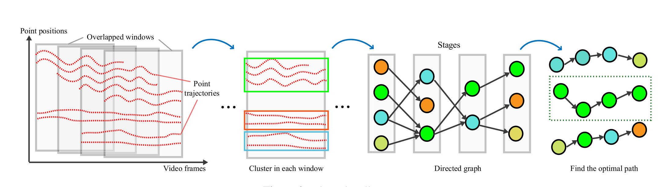
The Pipeline

Slide 6
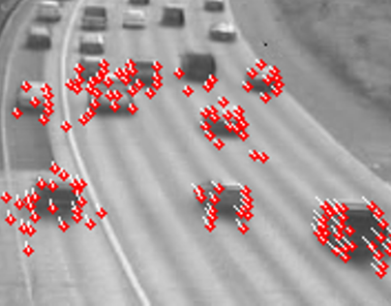
Calculating Feature Trajectories
Input: Raw video
Output: Features and feature trajectories
Method:
Use the Kanade-Lucas-Tomase (KLT) tracker
Let the i-th feature p at time t be denoted (math)
Notes:
Use KLT tracker to get feature points and track them
Take features with both eigenvalues larger than some threshold
Calculate displacement to next frame via gradient descent (optimization algo)
Store new position and update corner position
ith feature p at time t as p^i_t

Slide 7
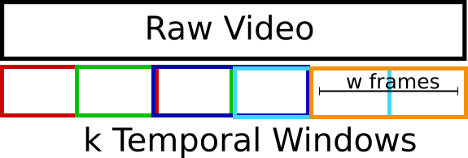
Overlapping Windows
Input: Raw video and p^i_t(math)
Output: Windows and a feature set pk(math) for each window
Method:
Cut the raw video into k overlapping temporal windows with w frames each
Make a feature set pk(math) for each temporal window
Throw away short trajectories
Notes:
Segment video into k overlapping temporal windows, with w frames each
Make feature sets for each of the k windows, p_k
Only use points that are tracked for at least .5w (for 30fps, w=40, so 20 frames) because short trajectories are not as reliable

Slide 8
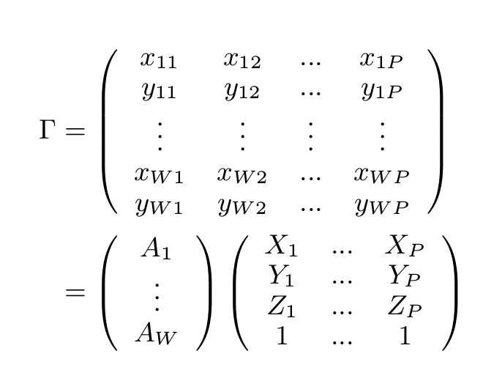
Clustering Trajectories
Input: Windows, feature sets pk(math)
Output: Clustered tracks (gammas here)
Method:
Apply motion clustering to each feature set pk(math)
Decompose trajectory matrices
Fill in missing parts of the trajectory matrix
Use agglomerative lossy compression to get best clustering result
Notes:
Apply motion clustering to each feature set p_k, matrix of x,y points along paths
Assume decomposes into affine matrix and world coord (get picture of matrices)- affine bc shown to be good for similar cases in previous work (explain the matrices more)
Motion segmentation by decomposing the trajectory matrix
Use related work to fill in missing bits of traj matrix due to occlusion (Rao et al) via convex programming
Use agglomerative lossy compression method to get best clustering with smallest error
Compression where you make imprecise approx and discard some data

Slide 9
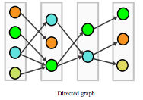
Global Optimization(Create a direct graph)
Stage k
Input: windows, feature clusters
Output: directed graph
Method:
Taking different windows as stages from start to end, we define each node Nn corresponds to a frame to a feature cluster. Thus, for stage k, we have nodes {N1,N2,...}
Add an arrow from one node in the current stage to another in the next stage only if some same feature trajectories, and the number of shared trajectories between the two nodes are denoted as S^{u,v}_{k,K+1}
Stage k+1
S

Slide 10

Optimal Path
Input: Directed graph (No link between 2 stages: divide the graph to 2 parts)
Output: Optimal path
Method:
Use SVD method to estimate rank of trajectory matrix (background feature matrix’s rank is lower than foreground feature matrix’s rank)
Define weight of the edges between neighboring states
Find an optimal path minimizing the sum of edges from all possible path from 1st stage to last
Notes:
Background matrix has lower rank reason:
Background motion is simpler than foreground motion
W:
w^i,j = exp(-\alpha S)r
Background motion is caused by camera motion alone

Slide 11
Label Refinement
H
E
Input: Optimal path, features, windows
Output: Refined labels
Method:
Exclude label that have been labeled as background in optimal path
Re-cluster the remaining in the joint color and spatial (average Luv color, normalize spatial features)
Check if each feature group’s motion is consistent with the existing background features. If yes, add points group to background features(Compare errors)
Iteratively perform procedure above until no more point group can be added to background features
Notes:
Reason:
Background features may not in the same cluster of each stage
Re-cluster:
average Luv color, normalize spatial feature points
Check:
Hk and Bk, compared to average mapping errors ct , if smaller it is back features

Slide 12
The Pipeline: Recap

Slide 13
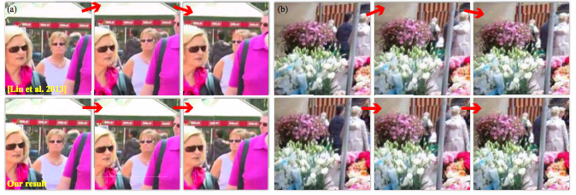
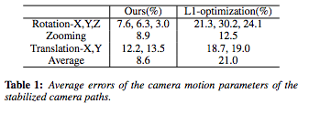
Applications
Video stabilization
Comparisons and Evaluation:
Notes:
1:46-2:04

Slide 14
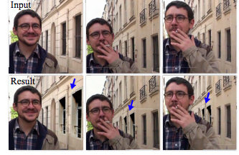
Applications
Layered video editing
Notes:
3:50-4:00

Slide 15
Applications
Background reconstruction
Better align video frame into a global space
Determine which region to take on each frame in order to produce the final background plate
Notes:
4:18-4:23

Slide 16
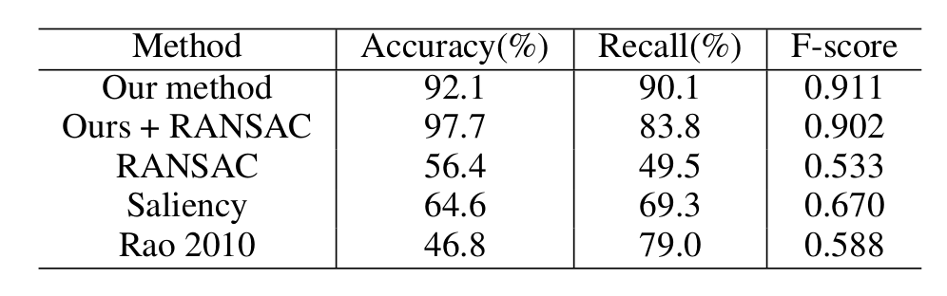
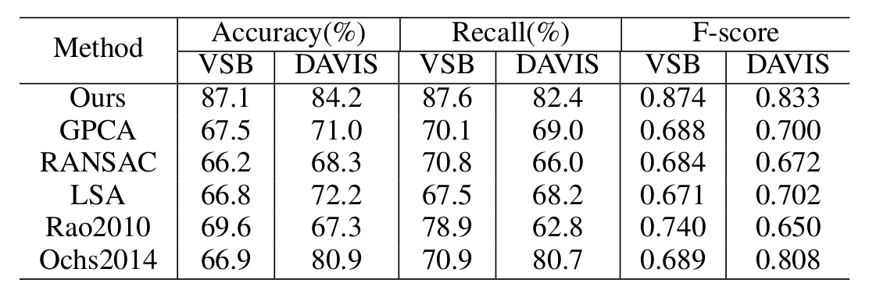
Results- Two Quantitative Evaluations
Evaluation 1: User labeled home videos as ground truth
Evaluation 2: Two video segmentation datasets (VSB and DAVIS) with added background labels as ground truth
Notes:
Eval1: user labeled home videos as ground truth, 52000 trajectories w 8100 bg trajectories
Compare w ransac, saliency method, ALC method of Rao (look up)
Significant improvement over other methods
+ Eval2: take existing dataset of videos for segmentation, and manually add bg labels, 96000 feature trajectories
+ testing against other motion segmentation methods that cluster trajectories
+ label all tracks using “oracle” classifier
+ lower performance overall compared to eval1, bc objects that dont move much relative to the camera are incorrectly identified as bg points

Slide 17
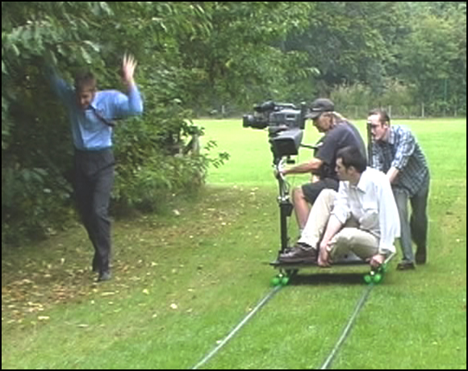
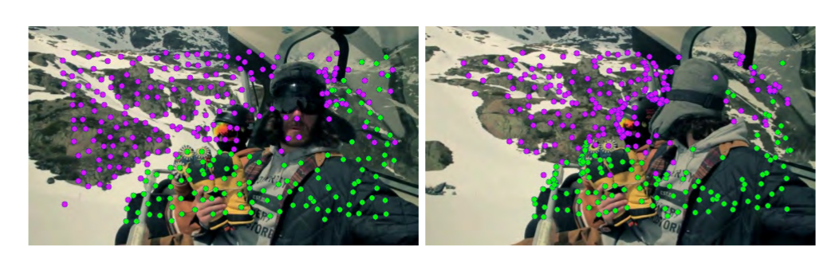
Assumptions and Limitations
Assumptions
Background feature movement can be approximated by a global homography
Background features are visible at every frame in the video
Failure cases
Tracking shots
Foreground fills entire frame
Notes:
Assume bg features movement can be approx. by a global homography
Tracking shot
Foreground filling frame means the graph will be split into “chunks,” which would break the global optimization process; fix by adding long-term feature tracking

Slide 18
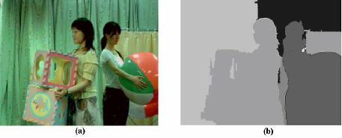
Potential Improvements
“Learn” backgrounds using machine learning techniques
Use depth as an additional segmentation cue
Use foreground segmentation as a prior for trajectory clustering
Apply work to 3D reconstruction methods
Notes:
Look into ochs et al 2014 about segmentation masks- works for slow cam movement in small range
Fix tracking problem: make virtual camera that moves differently somehow???

