Slide 1
Graph-cut Textures: Image and Video Synthesis Using Graph Cuts
Vivek Kwatra, Arno Schodl, Irfan Essa, Greg Turk, Aaron Bobick
Yijun Shao

Slide 2
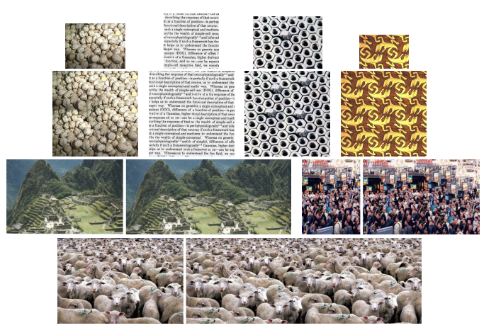
Recap
Original Problem: Texture Synthesis

Slide 3
Steps of synthesizing new texture
Step 1: Select the offset location in output area
Step 2: Select candidate patches in input patch (rectangle)
Step 3: The optimal portion of this rectangle should be added to output area
Step 2
Selected candidate patches
Input
Output area
Step 1
Optimal portion of candidate patch
Selected offset
Selected offset location
Notes:
Compare candidate patch and the pixels already in the output image
Determined by using a graph cut algorithm

Slide 4
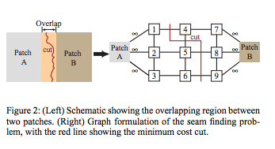
Paper method for step 3: Graph Cut Algorithm- Find Minimum Cut

Slide 5
Assumption
Already found a good patch offset location

Slide 6
Midterm
Find out a method to select the offset location in output area
Fill in the output area automatically

Slide 7
Algorithm
Step1: Select region in output area with highest filling priority[A. Criminisi 2004]
Step2: Select most similar patch to this region using matching similar patch method[Kaiming He and Jian Sun 2006]
Step3: Using Graph-Cut algorithm to fit new patch into selected region[Vivek Kwatra 2008]

Slide 8
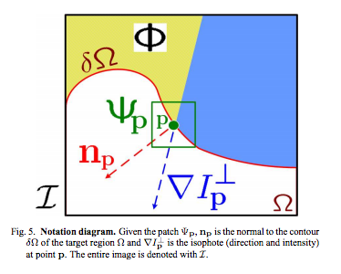

Step 1: Select region with highest filling priority
Func: toFill=findlocation(origImg,mask,psz)
Given a patch centered at the point p, its priority P(p) is the product of two terms:
P(p) = C(p)D(p)
-C(p) is the confidence term: Surrounded by high-confidence pixels
$$C\left(p\right)=\frac{\sum_{q∈patch∩I−Ω}{C(q)}}{|patch|}$$
-D(p) is the data term: On the continuation of strong edges
$$D\left(p\right)=\frac{|∇I_{p}^{⊥}n_{p}|}{α}$$
-[1] Region Filling and Object Removal by Exemplar-Based Image Inpainting[A. Criminisi 2004]

Slide 9
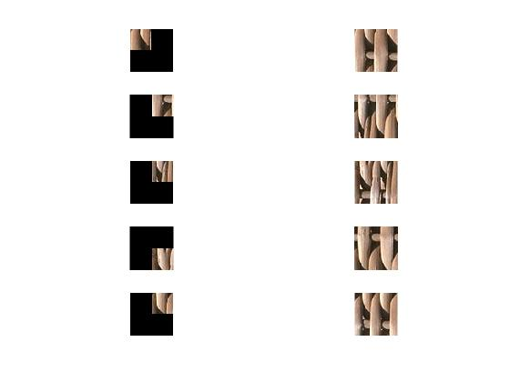
Step 2: Select most similar patch
targetPatch
matchpatch
Matching Similar Patches[1]
Formula: S(X) =argmin_{s}||P(x+s)-P(x)||², st |s|>t
My form:
Patch(x) = argmin_{patch} ||Patch(x)-targetpatch(x)||², x within overlapped area
Func matchpatch = MatchingSimilarPatches(toFill,targetPatch,Patch,t,step)
-[1] Statistics of Patch Offsets for Image Completion-Kaiming He and Jian Sun

Slide 10
Step 3: Fit selected patch into tofill region
Graph Cut Algorithm- Find Minimum Cut
Func matchpatch = findseam

Slide 11
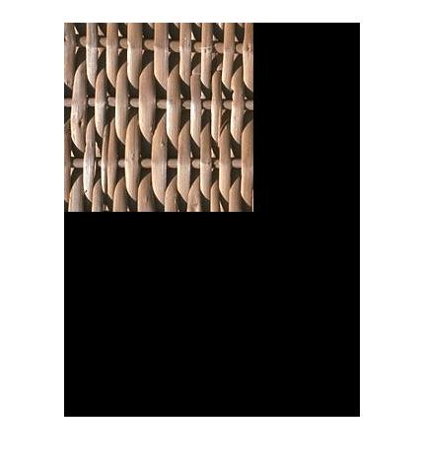
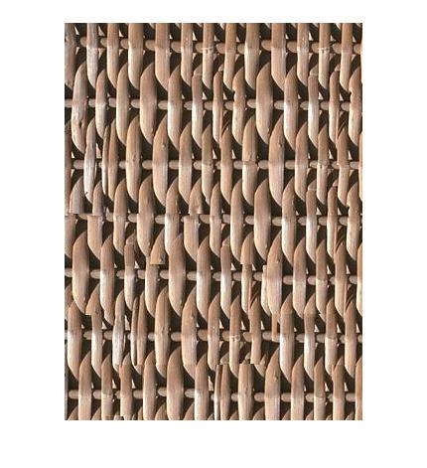
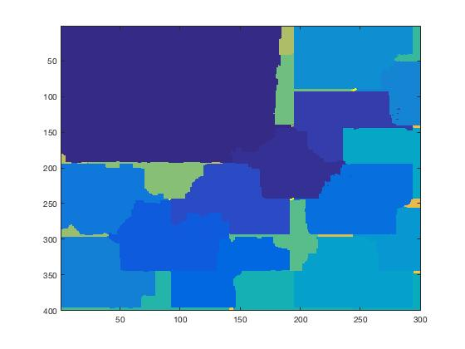
Result: Texture Systhesis

Slide 12
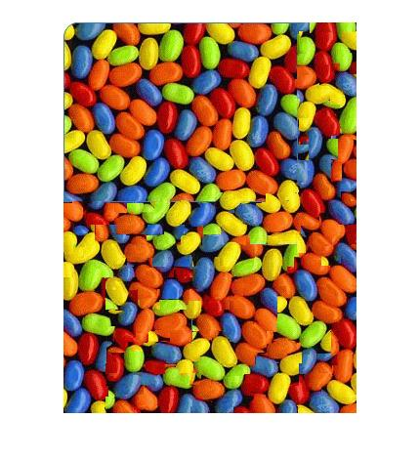
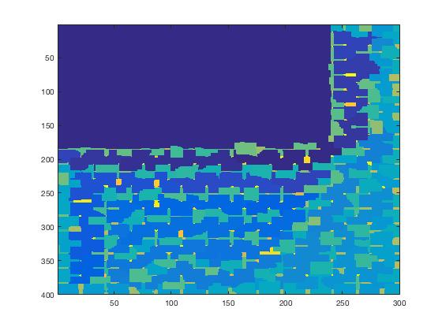
Result: Texture Systhesis

Slide 13
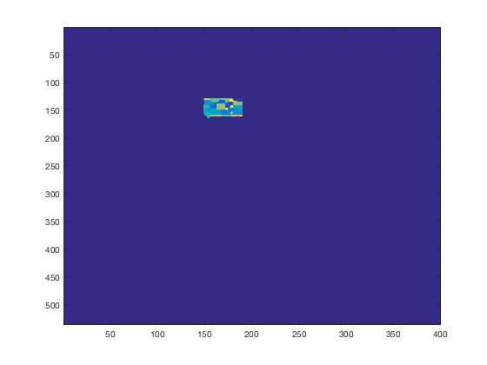
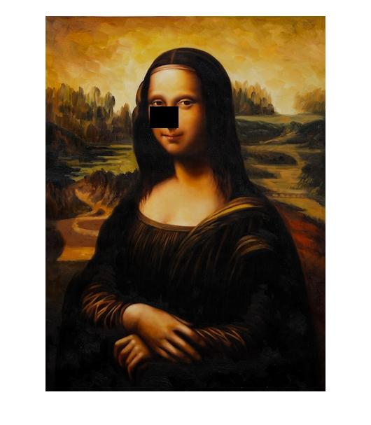
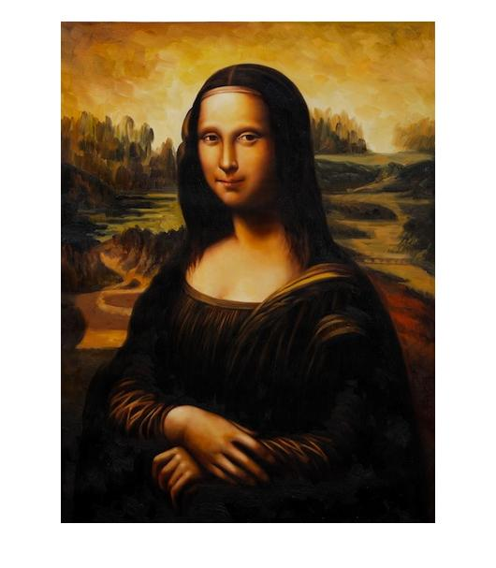
Extended Application
Image inpainting

Slide 14
Final Target
FOCUS ON IMAGE INPAINTING
EVALUATION:
-Test on larger data set
-Compare inpainting result with other inpainting method
Notes:
Patch size is too large

Slide 15
Pseudocode
Func outputimage = inpaint(original image, mask, patch size, threshold)
while #not inpainted pixel!=0
1. selected tofill region(highest priority)
2. selected most similar patch from unmasked region
3. fit selected patch into tofill region

Slide 16
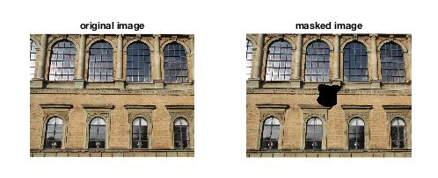
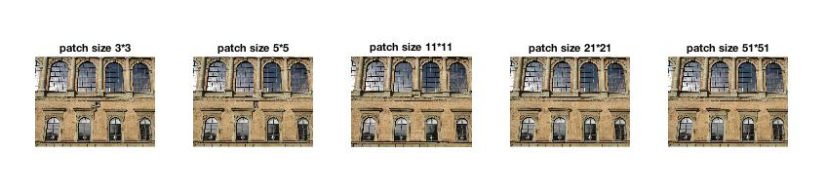
Patch size

Slide 17
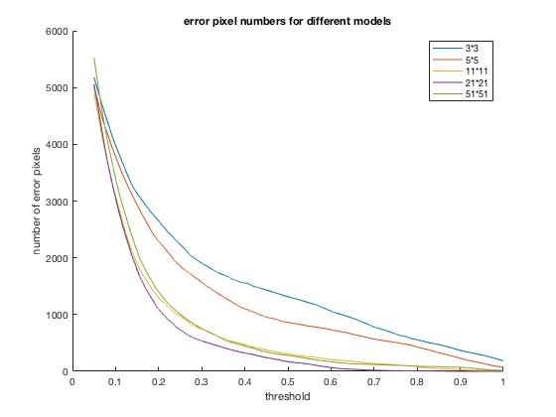

Slide 18
Compared to:
[1] AurÈlie Bugeau, Marcelo Bertalm¥ io, Vicent Caselles, and Guillermo Sapiro, ìA comprehensive framework for image inpainting,î IEEE Transactions on Image Processing, vol. 19,no. 10, pp. 2634ñ2645, 2010.
[2] Jan Herling and Wolfgang Broll, ìPixmix: A real-time approach to high-quality diminished reality,î in International Symposium on Mixed and Augmented Reality. 2012, pp. 141ñ150, IEEE
[3] Pascal Getreuer, ìTotal variation inpainting using split bregman,î Image Processing On Line, vol. 2, pp. 147ñ157, 2012.
[4] Zongben Xu and Jian Sun, ìImage inpainting by patch propagation using patch sparsity,î IEEE Transactions on Image Processing, vol. 19, no. 5, pp. 1153ñ1165, 2010

Slide 19
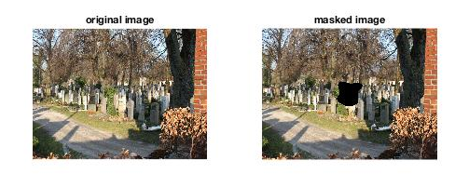
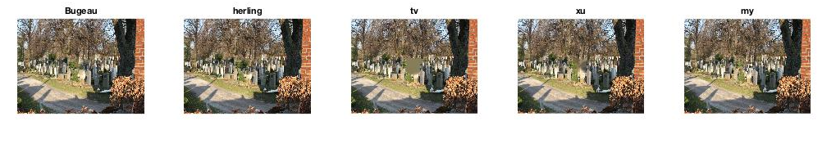
Result :

Slide 20
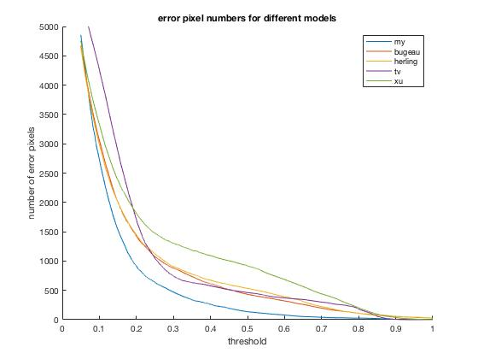

Slide 21
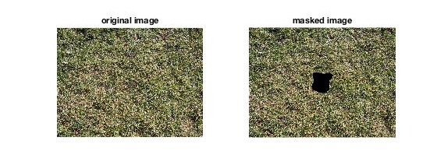

Results 1:

Slide 22
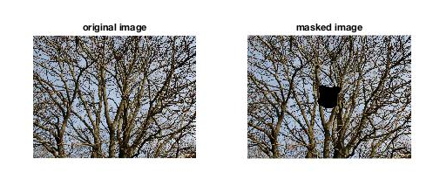
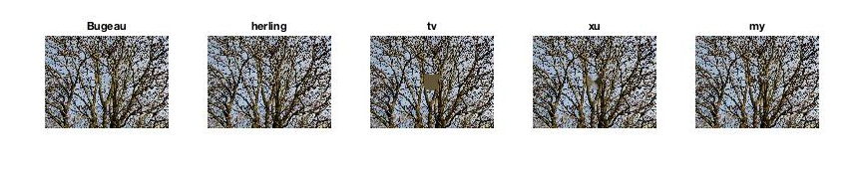
Result 2:

Slide 23
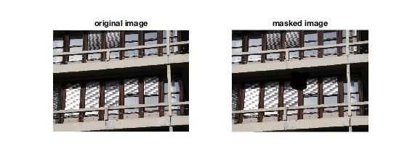
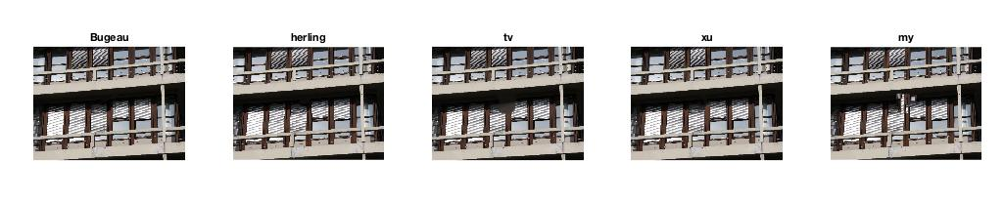
Fail case:

Slide 24
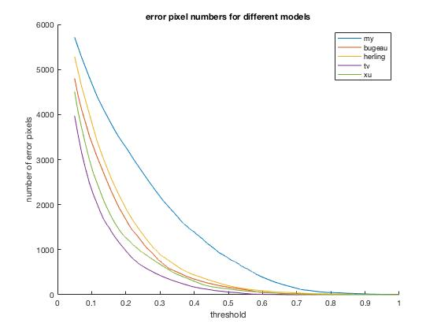
Fail case:

Slide 25
Reason
Dominio effect
-One iteration’s result is bad, next find tofill region, find most similar patch result is bad. Thus, the next iteration’s result is bad
Solution:
Find a new find most similar patch method[best buddy pair etc]

Slide 26
Summary
Numerical plot: In most of cases, better than herling’s result, but worse than Xu and Getreuer’s methods
Visually: looks smooth and consistent, better than Xu , Getreuer and Bugeau’s result
[1] AurÈlie Bugeau, Marcelo Bertalm¥ io, Vicent Caselles, and Guillermo Sapiro, ìA comprehensive framework for image inpainting,î IEEE Transactions on Image Processing, vol. 19,no. 10, pp. 2634ñ2645, 2010.
[2] Jan Herling and Wolfgang Broll, ìPixmix: A real-time approach to high-quality diminished reality,î in International Symposium on Mixed and Augmented Reality. 2012, pp. 141ñ150, IEEE
[3] Pascal Getreuer, ìTotal variation inpainting using split bregman,î Image Processing On Line, vol. 2, pp. 147ñ157, 2012.
[4] Zongben Xu and Jian Sun, ìImage inpainting by patch propagation using patch sparsity,î IEEE Transactions on Image Processing, vol. 19, no. 5, pp. 1153ñ1165, 2010

Slide 27
Conclusion
In most cases, combined new method did well on image inpainting
Result sensitive to patch size, but find a suitable patch size could waste a lot of time
New method could fail, sensitive to each iteration’s result

