Slide 1
Graph-cut Textures: Image and Video Synthesis Using Graph Cuts
Yijun Shao
Vivek Kwatra, Arno Schodl, Irfan Essa, Greg Turk, Aaron Bobick

Slide 2
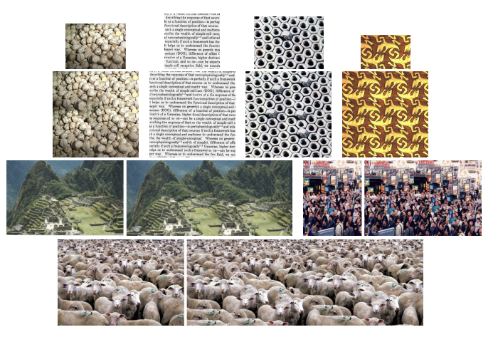
Recap:
Problem: Texture Synthesis
Notes:
Texture Synthesis is a methodology to generate a newer form of Output from a smaller example. How to make it looks smooths and informational.

Slide 3
Steps of synthesizing new texture
Step 1: Select the offset location in output area
Step 2: Select candidate patches in input patch (rectangle)
Step 3: The optimal portion of this rectangle should be added to output area
Step 2
Selected candidate patches
Input
Output area
Step 1
Optimal portion of candidate patch
Selected offset
Selected offset location
Notes:
Compare candidate patch and the pixels already in the output image
Determined by using a graph cut algorithm

Slide 4
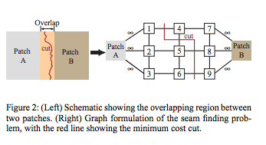
Paper method for step 3: Graph Cut Algorithm- Find Minimum Cut

Slide 5
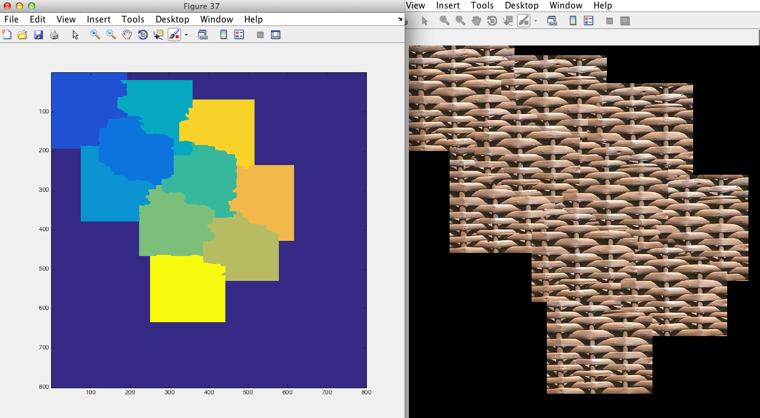
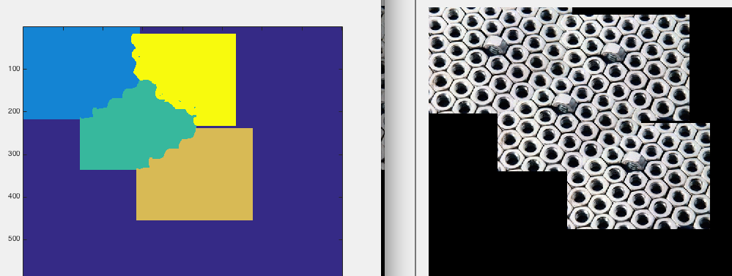
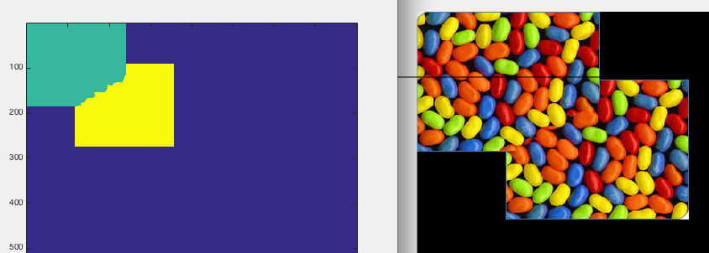
Results:
5

Slide 6
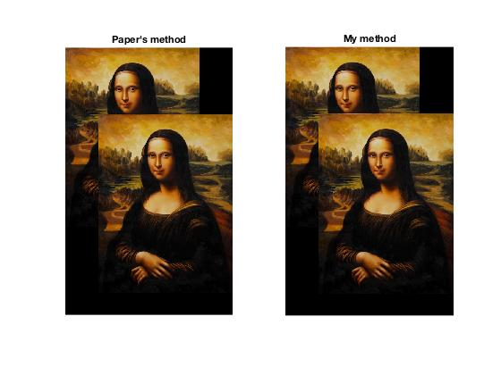
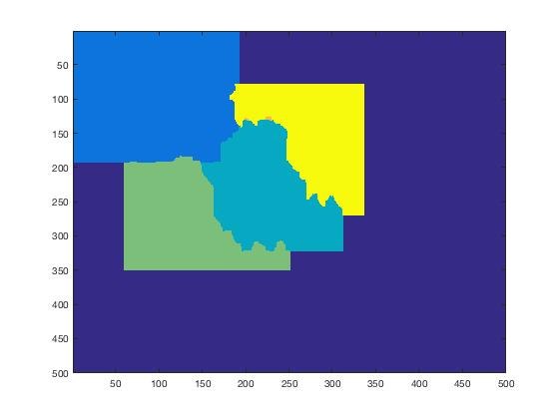
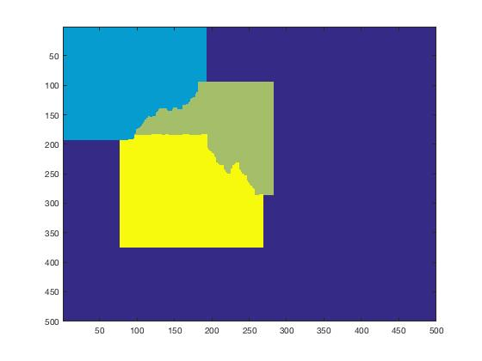
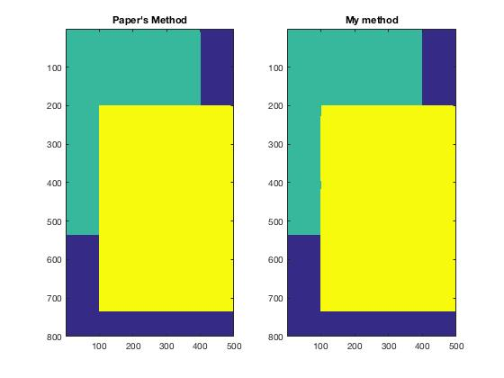
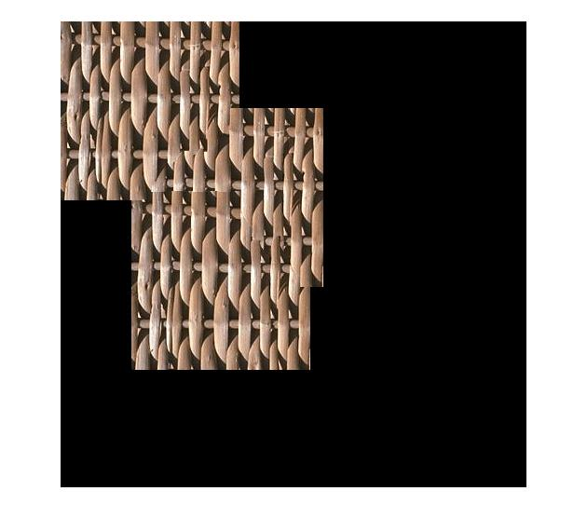
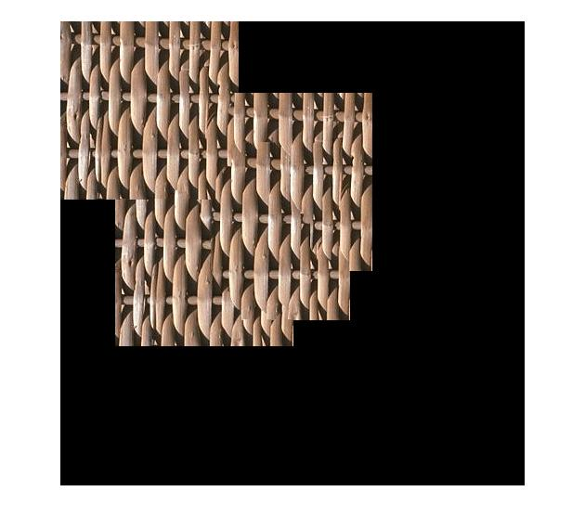

Midterm Project
New Method:
Paper’s Method:
Find good method to compute edge weight
Original: M (s,t,A,B) = $\frac{Σ_{s,t}|\sqrt{{\left(R_{A}−R_{B}\right)}^{2}+{\left(G_{A}−G_{B}\right)}^{2}+{\left(B_{A}−B_{B}\right)}^{2}}| }{∑each pixels^{′}Gradient in edge direction}$
New : M (s,t,A,B) = $\frac{Σ_{s,t}|\sqrt{{2\left(R_{A}−R_{B}\right)}^{2}+{4\left(G_{A}−G_{B}\right)}^{2}+{3\left(B_{A}−B_{B}\right)}^{2}}| }{∑each pixels^{′}Gradient in edge direction}$
Reason: Weighted RGB could better fit human perception

Slide 7
Midterm project
How to select the offset location in output area?

Slide 8
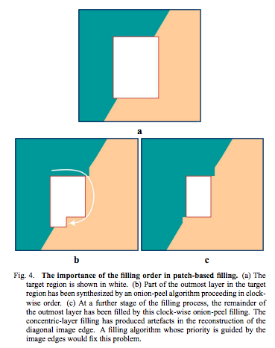
Algorithm^{[1]}
-Filling Priority
Computed patch priorities
Based on:
1)On the continuation of strong edges
2)Surrounded by high-confidence pixels
-[1] Region Filling and Object Removal by Exemplar-Based Image Inpainting[A. Criminisi 2004]

Slide 9
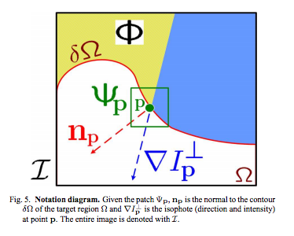

Algorithm^{[1]}
Given a patch centered at the point p, its priority P(p) is the product of two terms:
P(p) = C(p)D(p)
-C(p) is the confidence term:
$$C\left(p\right)=\frac{\sum_{q∈patch∩I−Ω}{C(q)}}{|patch|}$$
-D(p) is the data term:
$$D\left(p\right)=\frac{|∇I_{p}^{⊥}n_{p}|}{α}$$
-[1] Region Filling and Object Removal by Exemplar-Based Image Inpainting

Slide 10
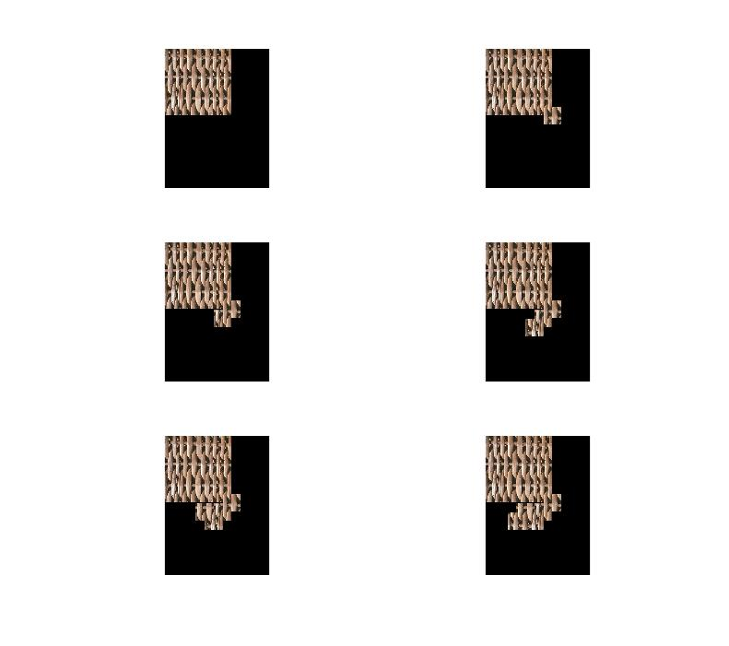
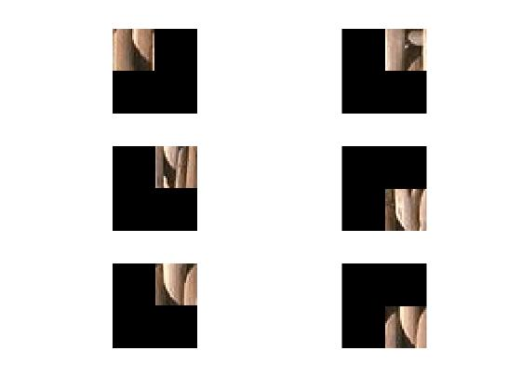
Result: Func toFill=findlocation(origImg,mask,psz)

Slide 11
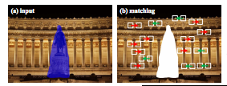
Algorithm^{[1]}
Matching Similar Patches
Formula: S(X) =argmin_{s}||P(x+s)-P(x)||², st |s|>t
-In my case, only compare overlapped area, and find out a patch in the input patch which has least distance to offset location
-[1] Statistics of Patch Offsets for Image Completion-Kaiming He and Jian Sun

Slide 12
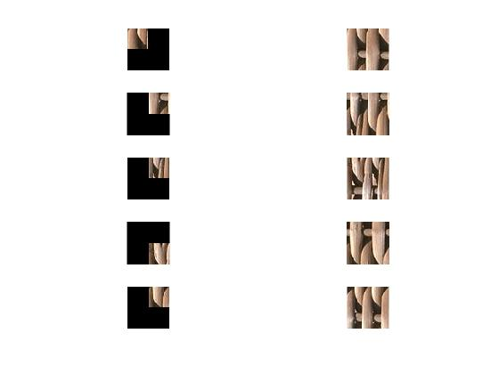
Result: Func matchpatch= MatchingSimilarPatches(toFill,targetPatch,Patch,t,step)

Slide 13
Combined Algorithm
Step1: Select region in output area with highest filling priority
Step2: Select most similar patch to this region using matching similar patch method
Step3: Using Graph-Cut algorithm to fit new patch into selected region

Slide 14
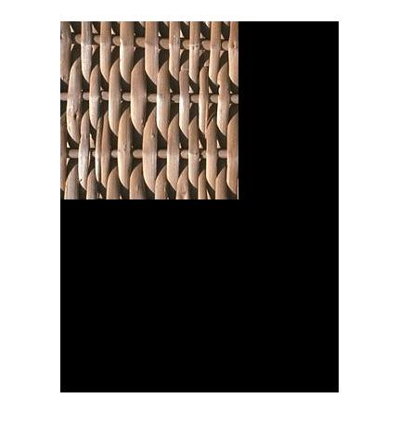
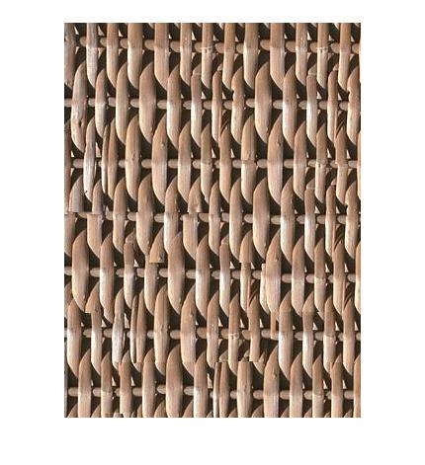
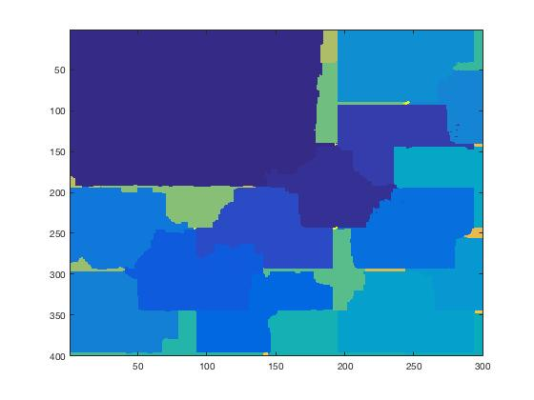
Result: Texture Systhesis

Slide 15
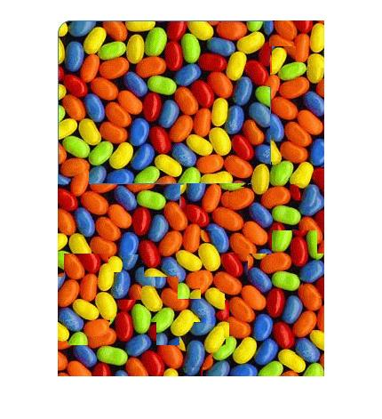
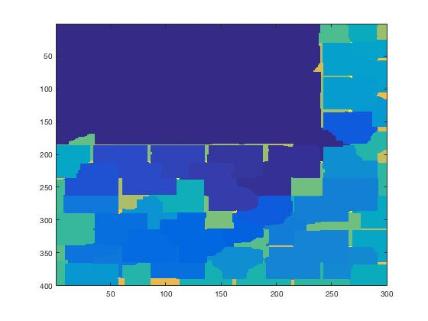
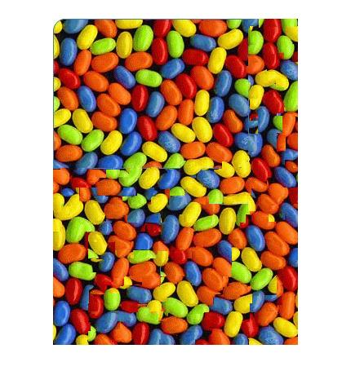
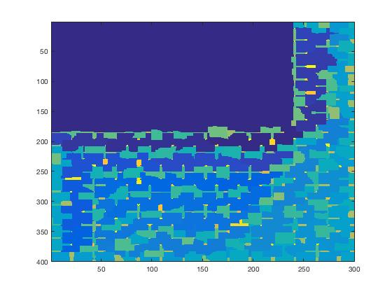
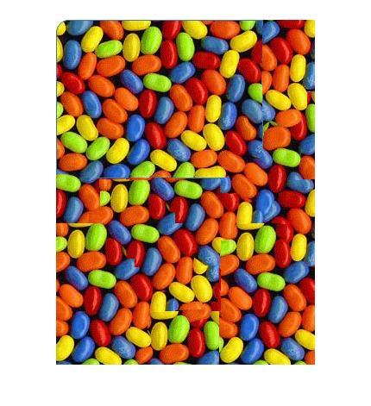
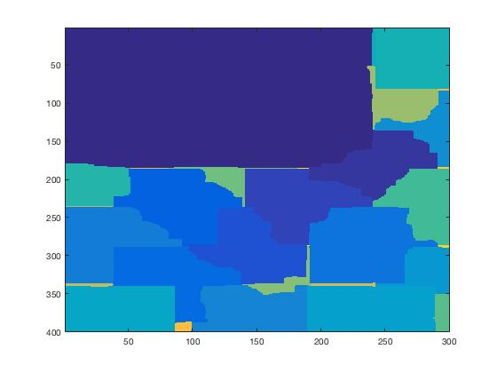
Result: Compare different patch sizes
Patch size:51
Patch size:21
Problem:
1)No matching patch
2)Hard to find best patch size
3)No good seam
Patch size:101

Slide 16
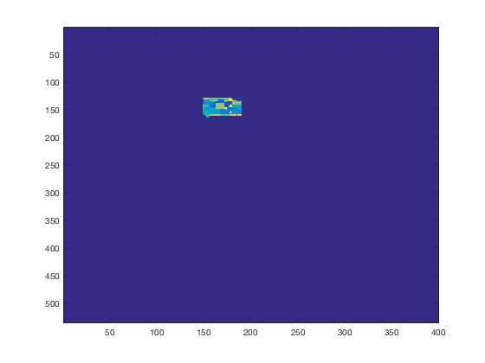
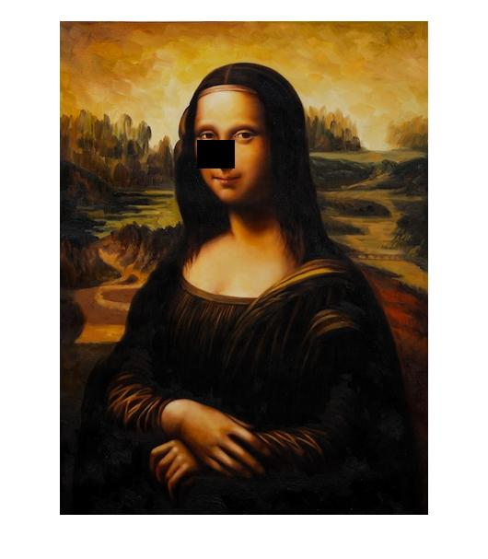
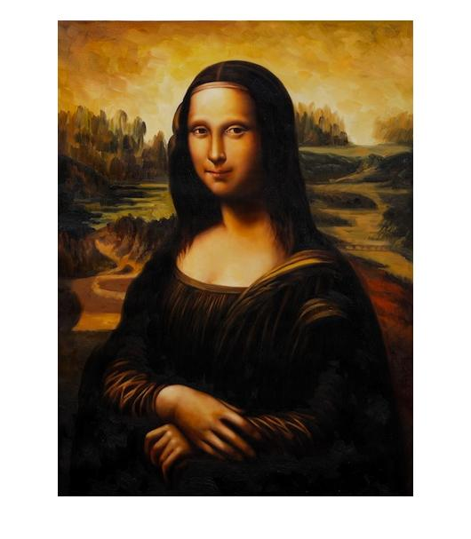
Extension: Image inpainting validation

Slide 17
Final Target
FOCUS ON IMAGE INPAINTING
EVALUATION:
-Test on larger data set (Any recommendation?)
-Compare inpainting result with other patch-base inpainting method
-Find out some improvement methods
Notes:
Patch size is too large

