Slide 1
Graph-cut Textures: Image and Video Synthesis Using Graph Cuts
Yijun Shao
Vivek Kwatra, Arno Schodl, Irfan Essa, Greg Turk, Aaron Bobick

Slide 2
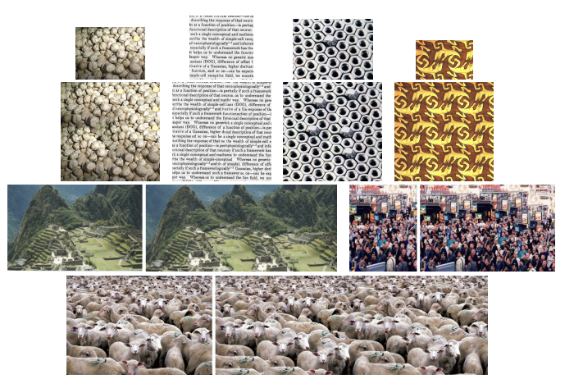
Overview
Generate a newer form of Output from a smaller example
Notes:
Texture Synthesis is a methodology to generate a newer form of Output from a smaller example. How to make it looks smooths and informational.

Slide 3
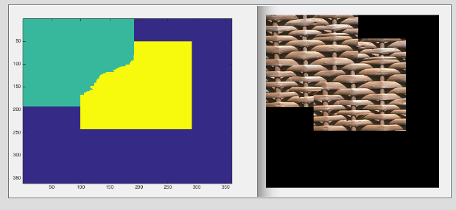
Motivation
Target:
-Use graph cuts method to generate a larger pattern output using small example patch of texture
Challenges:
-Where to position the input texture relative to the output patch
-Which parts of the input texture to transfer into the output space(Find the patch seam of the input)

Slide 4
Related Works
Use fixed number of parameters to model texture
-Problem: Cannot synthesize as large a variety of textures as other model
Use a collection of examples to model texture
-Problem: One pixel at a time (take a long time)
Copy whole patches from the input
-Problem: Yield a limited amount of information for texture analysis

Slide 5
Patch Fitting using Graph Cuts

Slide 6
Graph Cuts Algorithm- Form a Graph
Overlap
Patch A
Patch B
Patch A
Patch B
-Overlap between old and new blocks is typically 4 or 8 pixels in width

Slide 7




Graph Cut Algorithm- Set Weight to Edges
$$∞$$
$$∞$$
Patch A
$$∞$$
$$∞$$
Patch B
$$∞$$
$$∞$$
S
t
Distance of pixels in 2 patches
-Separate Patch A and Patch B
-Find most smooth cut

Slide 8
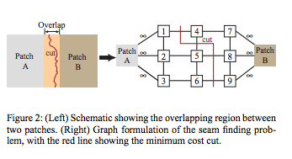
Graph Cut Algorithm- Find Minimum Cut

Slide 9
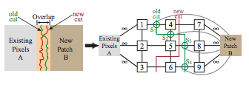
Add a New Patch
5

Slide 10




Single seam node case
Case 1
Case 2
Case 3
M(2,3, $A_{2,}A_{3}$)
X
A
1
2
S
3
4
B
$$\left(only node 3 comes from patch B\right) ||A\left(3\right)−B(3)||$$
$$||A\left(2\right)−B(2)||$$
Assumption: At most one of three arcs connected to seam node is cut
My guess: How about connecting the pixel after old seam cut to new patch?
$||A\left(3\right)−B(3)||$+||A(2)-B(2)||
Notes:
-If the arc between a seam node and the new patch node B is cut, this means that the old seam remains in the output image.
-If such an arc is not cut, this means that the seam has been overwritten by new pixels, so the old seam cost is not counted in the final cost.
-If one of the arcs between a seam node and the pixels adjacent to it is cut, it means that a new seam has been introduced at the same position and a new seam cost (depending upon which arc has been cut) is added to the final cost.

Slide 12
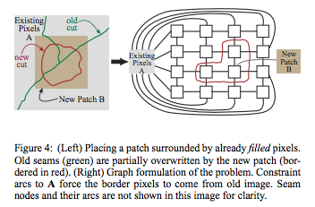
Surrounded Regions

Slide 13
Steps of synthesizing new texture
Step 1: Select the offset in background
Step 2: Select candidate patches in input example (rectangle)
Step 3: The optimal portion of this rectangle is computed to add to the offset in output
Step 2
Selected candidate patches
Input
Background
Step 1
Optimal portion of candidate patch
Selected offset
Selected offset
Notes:
Compare candidate patch and the pixels already in the output image
Determined by using a graph cut algorithm

Slide 14
Pick candidate patches
Methods:
Depend on different type of texture we are synthesizing, there are 3 methods:
-Random placement: select the entire input image, but translated it to a random offset location in output a lot of times.
-Entire patch matching: search for translations of input that match well with the current synthesized output
-Sub-patch matching: only pick a small sub-patch in the output texture(which is usually significantly smaller than the input texture), and look for translations of the input matches sub-patch in the output
Notes:
Translation could be rotation, scaling, affine or projective

Slide 15
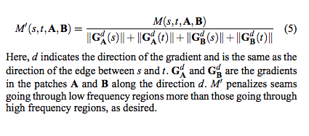
Extension & Refinements
Matching Cost function
-solution: Take gradient of image along each direction into account and scale the match cost appropriately

Slide 16
Extension & Refinements
Bad seam
-solution:
(1)Feathering pixel using a Gaussian kernel
(2)Multi-resolution splining[Burt and Adelson 1983]: Reduce the contrast of two pixels crossing seam point

Slide 17
Results & Evaluation

Slide 18
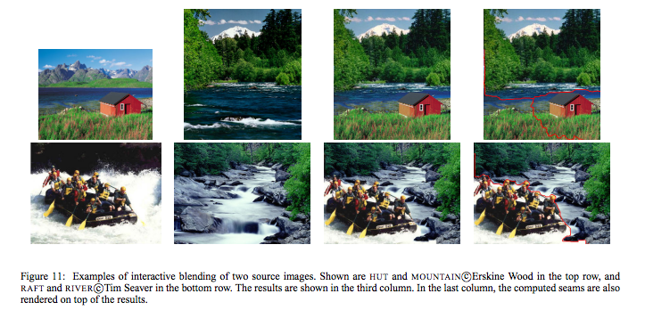
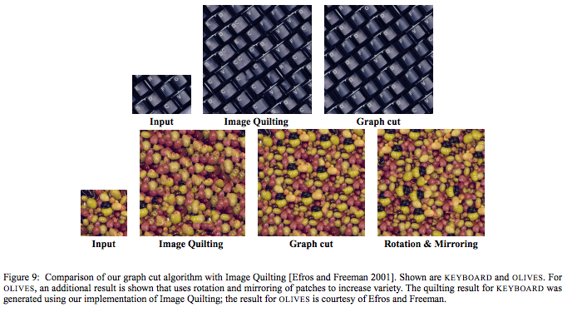
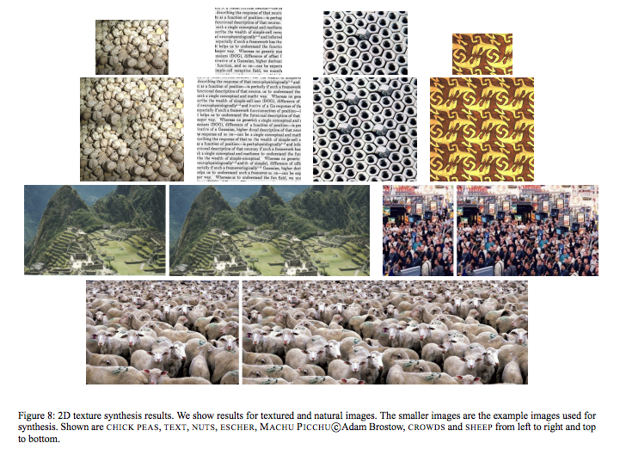
Image Synthesis

Slide 19
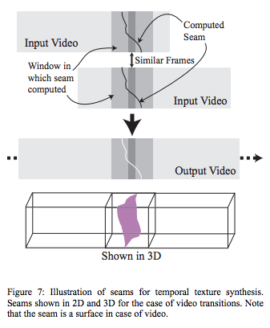
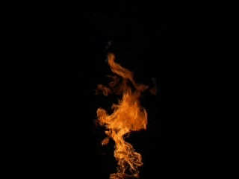


Video Synthesis
Notes:
One of the main strengths of the graph cut technique proposed here is that it allows for a straightforward extension to video synthesis. Consider a video sequence as a 3D collection of voxels, where one of the axes is time. Patches in the case of video are then the whole 3D space-time blocks of video, which can be placed anywhere in the 3D (space-time) volume. Hence, the same two steps from image texture synthesis, patch placement and seam finding, are also needed for video texture synthesis. Similar to 2D texture, the patch selection method for video must be chosen based on the type of video. Some video sequences just show temporal stationarity whereas others show stationarity in space as well as time. For the ones showing only temporal stationarity, searching for patch translations in all three dimensions (space and time) is unnecessary. We can restrict our search just to patch offsets in time, i.e., we just look for temporal translations of the patch. However, for videos that are spatially and temporally stationary, we do search in all three dimensions

Slide 20
Assumptions and Limitations
Assumptions:
-Already found a good patch offset
- Only one arc could be cut for arcs connected to same seam node
Limitations:
-Need good transformed input before start synthesis
-Cannot segment the objects clearly
-Cannot evaluate goodness of the algorithm

Slide 21
Timeline
Mid-term
-Find a good method to get a good offset location for input
-Find out a better cost function model
Final
-Find a good method to evaluate the algorithm, and compare it with other algorithm

