Slide 1

Shri Ramswaroop Memorial
University
Data Analytics Project
Corona Positive Cases -
Name- Shashwat yadav
Roll no.- 202410101150166
Course – B.tech CSE(DS+AI)
Group - 36
Submitted to – Mrs. Dipika Tiwari

Slide 2
1. Introduction & Objectives
Introduction: This report analyses a dataset of corona positive cases. The goal is to present data cleaning, exploratory data analysis, visualizations, and findings in a concise project format.
Objectives:
1) Understand the dataset and data quality.
2) Provide descriptive statistics of key attributes like age, gender, and location.
3) Visualize distributions and trends.
4) Document code snippets and methodology used for reproducibility.

Slide 3
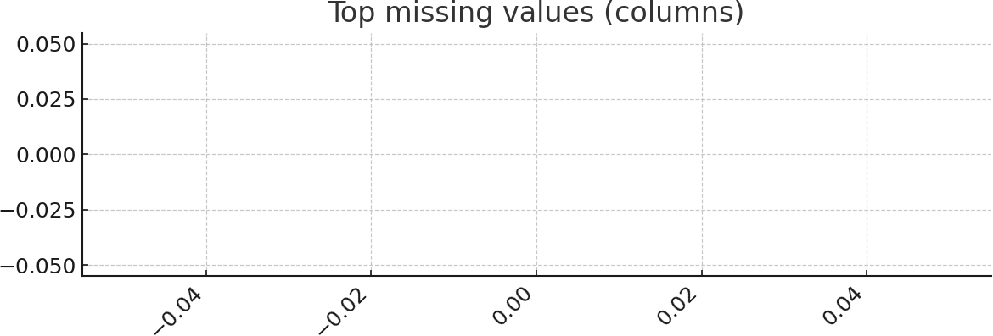
2. Data Description & Cleaning
Data description: The dataset contains 1000 rows and 9 columns. A preview of the first columns: name, age, gender, city, corona_status, has_name, has_age, has_gender, has_city.
Cleaning steps applied: Standardized column names, coerced 'age' to numeric, normalized gender labels, parsed date columns when present, and created flags to track missingness.
Sample data (first 10 rows):
name | age | gender | city | corona_statushas_name | has_age | has_gender | has_city
Person_550 | 7.0 | male | Ahmedabad | Positive True | True | True | True
Person_808 | 9.0 | other | Bangalore | Positive True | True | True | True
Person_47 | 76.0 | other | Jaipur | Positive True | True | True | True
Person_667 | 50.0 | male | Pune | Positive True | True | True | True
Person_820 | 45.0 | male | Mumbai | Positive True | True | True | True
Person_819 | 46.0 | female | Ahmedabad | Positive True | True | True | True
Person_659 | 60.0 | female | Chennai | Positive True | True | True | True
Person_926 | 15.0 | female | Ahmedabad | Positive True | True | True | True
Person_257 | 75.0 | female | Lucknow | Positive True | True | True | True
Person_105 | 59.0 | male | Delhi | Positive True | True | True | True

Slide 4
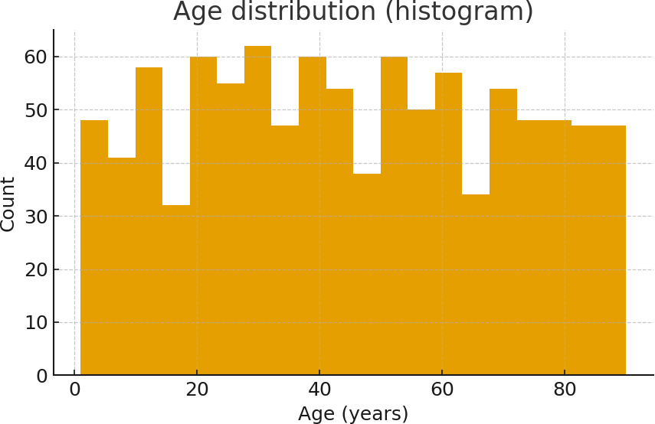
3. Descriptive Statistics
Age statistics (count, mean, std, min, 25%, 50%, 75%, max): {'count': 1000.0, 'mean': 45.195, 'std':
25.230210830243543, 'min': 1.0, '25%': 24.75, '50%': 44.0, '75%': 67.0, 'max': 90.0}
Gender counts: {'male': 356, 'other': 344, 'female': 300}

Slide 5
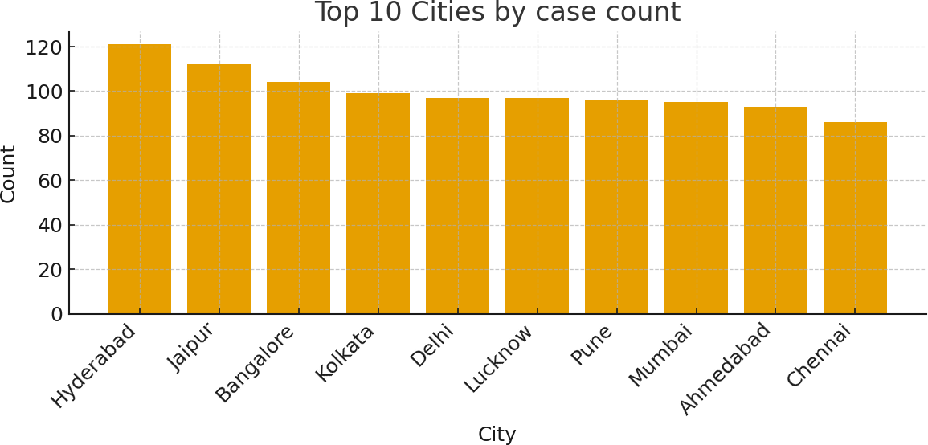
4. Location Analysis
Top locations by case count (top 5): {'Hyderabad': 121, 'Jaipur': 112, 'Bangalore': 104, 'Kolkata': 99,
'Delhi': 97}
City-level distribution is shown in the bar chart.

Slide 6
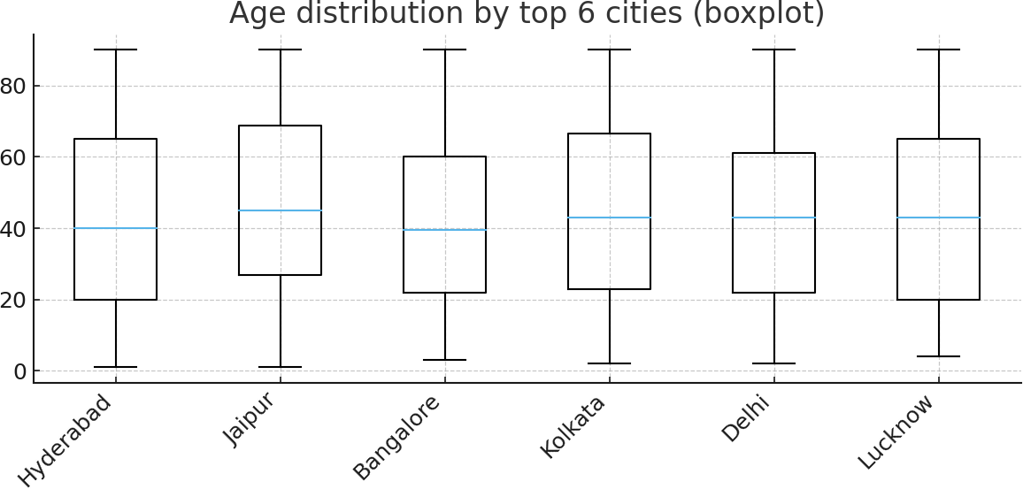
5. Segmentation & Advanced Visuals
Segmentation: We can segment cases by age groups and locations to identify vulnerable groups. Age-by-city boxplot for top cities is included below to show variation in ages across locations.

Slide 7
6. Findings & Recommendations
Findings: The dataset shows basic distributions and missingness patterns. Key observations depend on presence of age/gender/city columns.
Age median: 44.0 years.
Gender majority: male
City with highest cases: Hyderabad (121).
Recommendations: Improve data completeness (reduce missing ages/gender/city), collect comorbidity and severity if possible, and track dates
consistently for time-series analysis.

Slide 8
7. Conclusion & Appendix
Conclusion: This 10-page project contains EDA results, plots, code snippets and recommendations for further analysis.
Missing values summary (top columns): {}
Appendix: Sample of cleaned data and column descriptions.
Sample data (first 10 rows):
has_name | has_age | has_gender | has_city
True | True | True | True
True | True | True | True
True | True | True | True
True | True | True | True
True | True | True | True
True | True | True | True
True | True | True | True
True | True | True | True
True | True | True | True
True | True | True | True

