Slide 1

Terarya Showcase
Online store application

Slide 2



An online app store
For all your needs
Interactive, Innovative, Irresistible

Slide 3
Terarya app stores – Top Features
An online app stores for all your needs
Great user experiance
Responsive
Variety of categories
High availability
Personalized recommendations
High performance

Slide 4
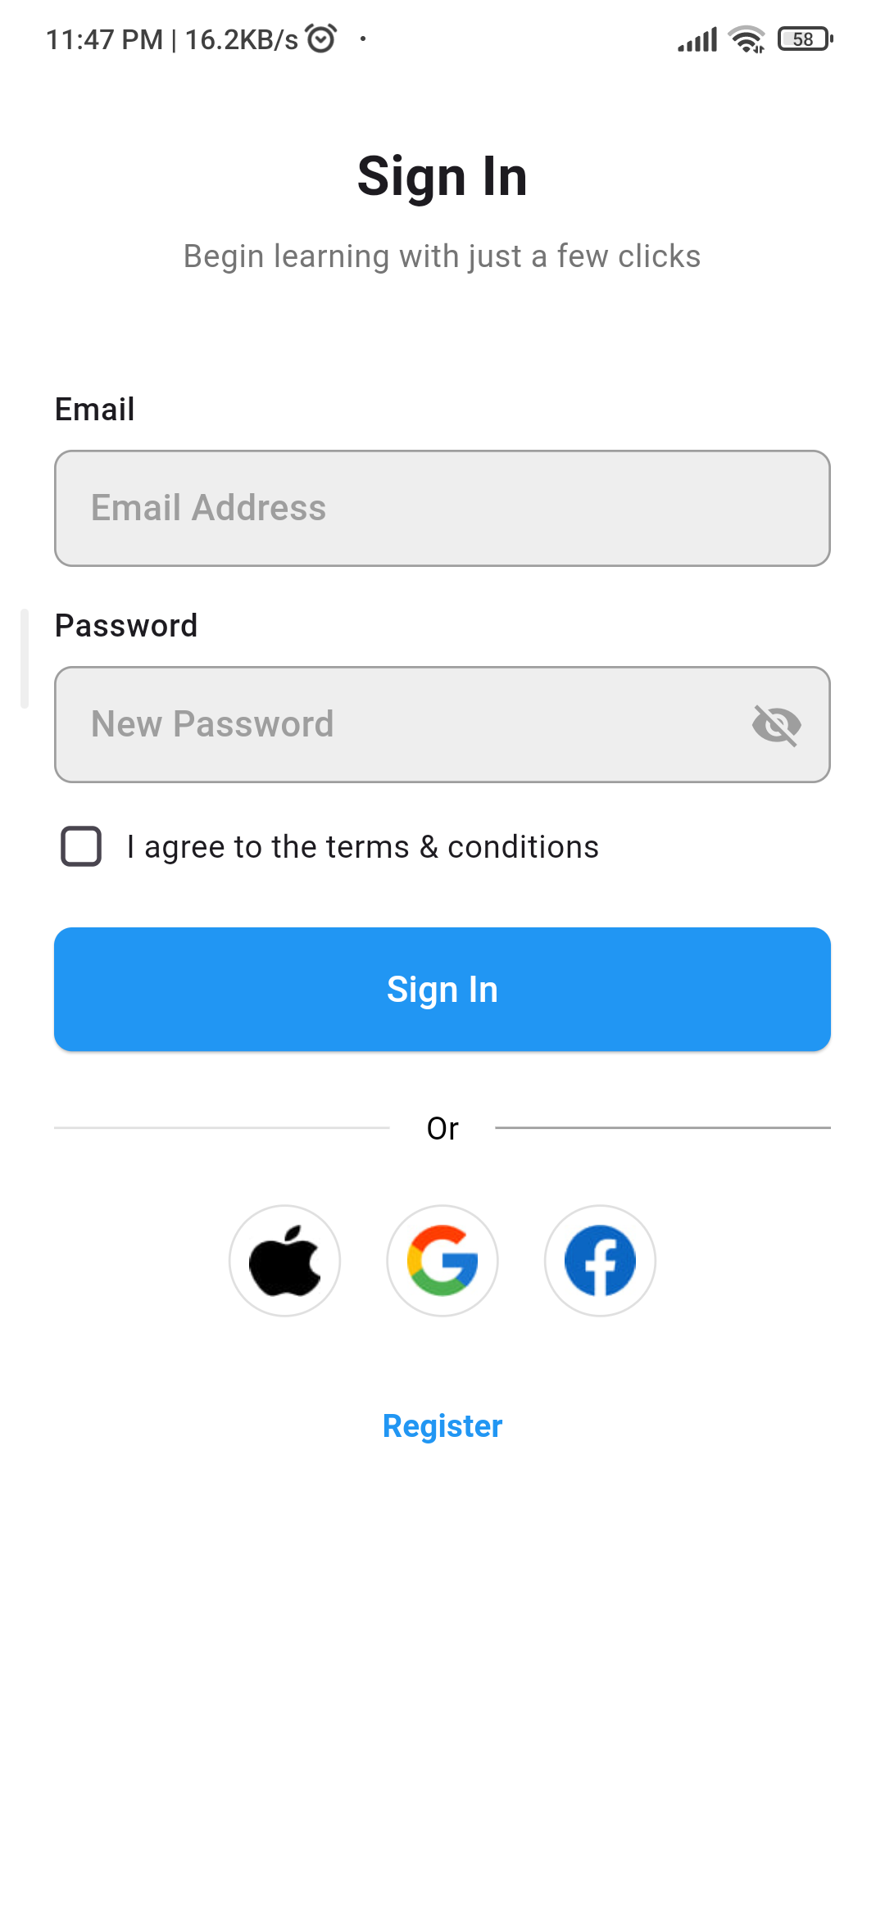
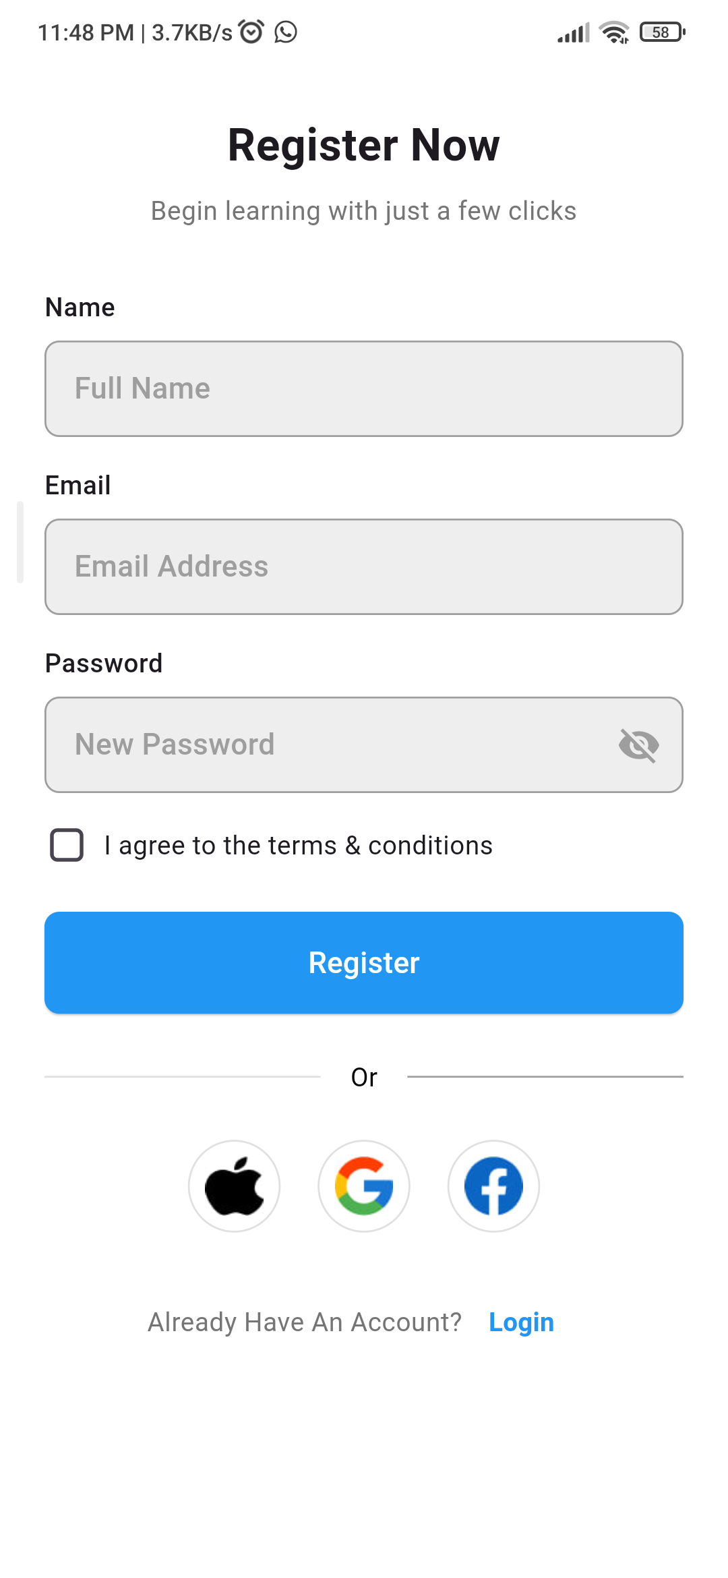
Terarya app stores
An online app stores for all your needs
Login features
and

Slide 5
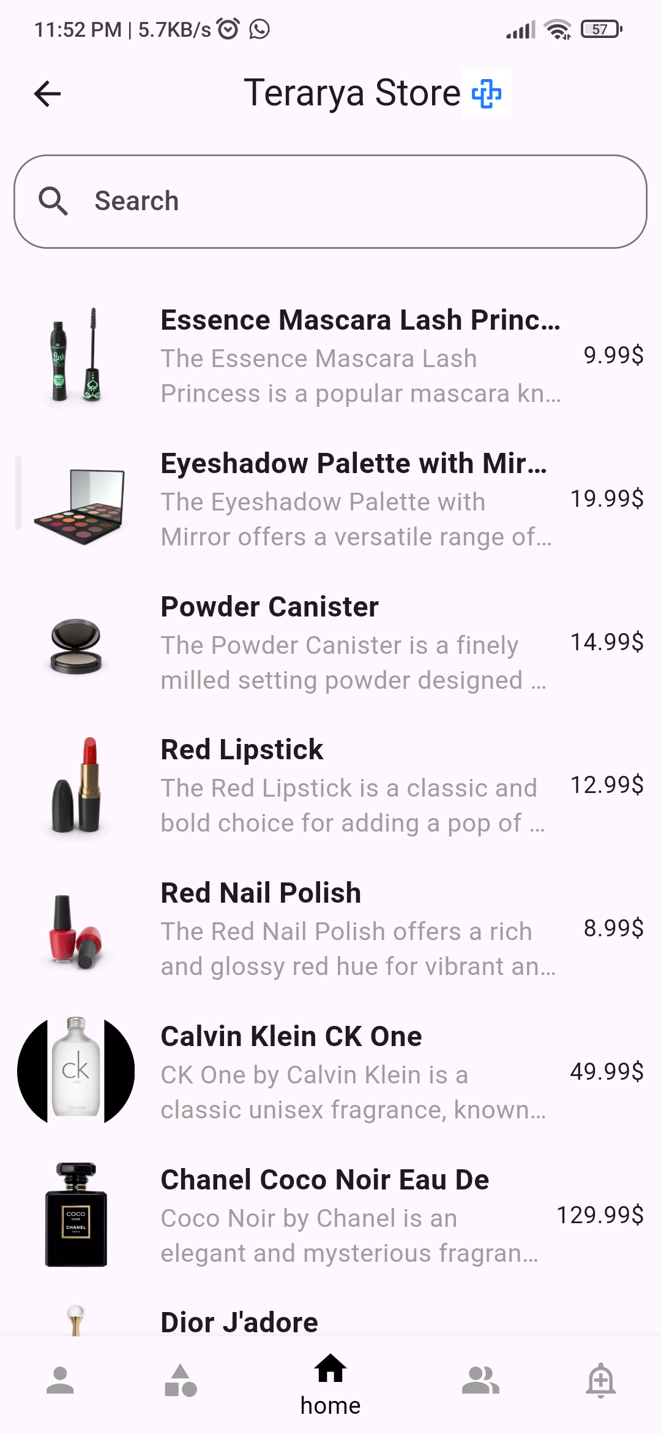
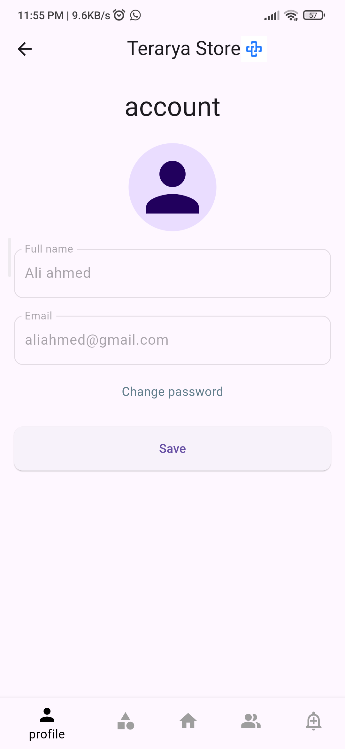
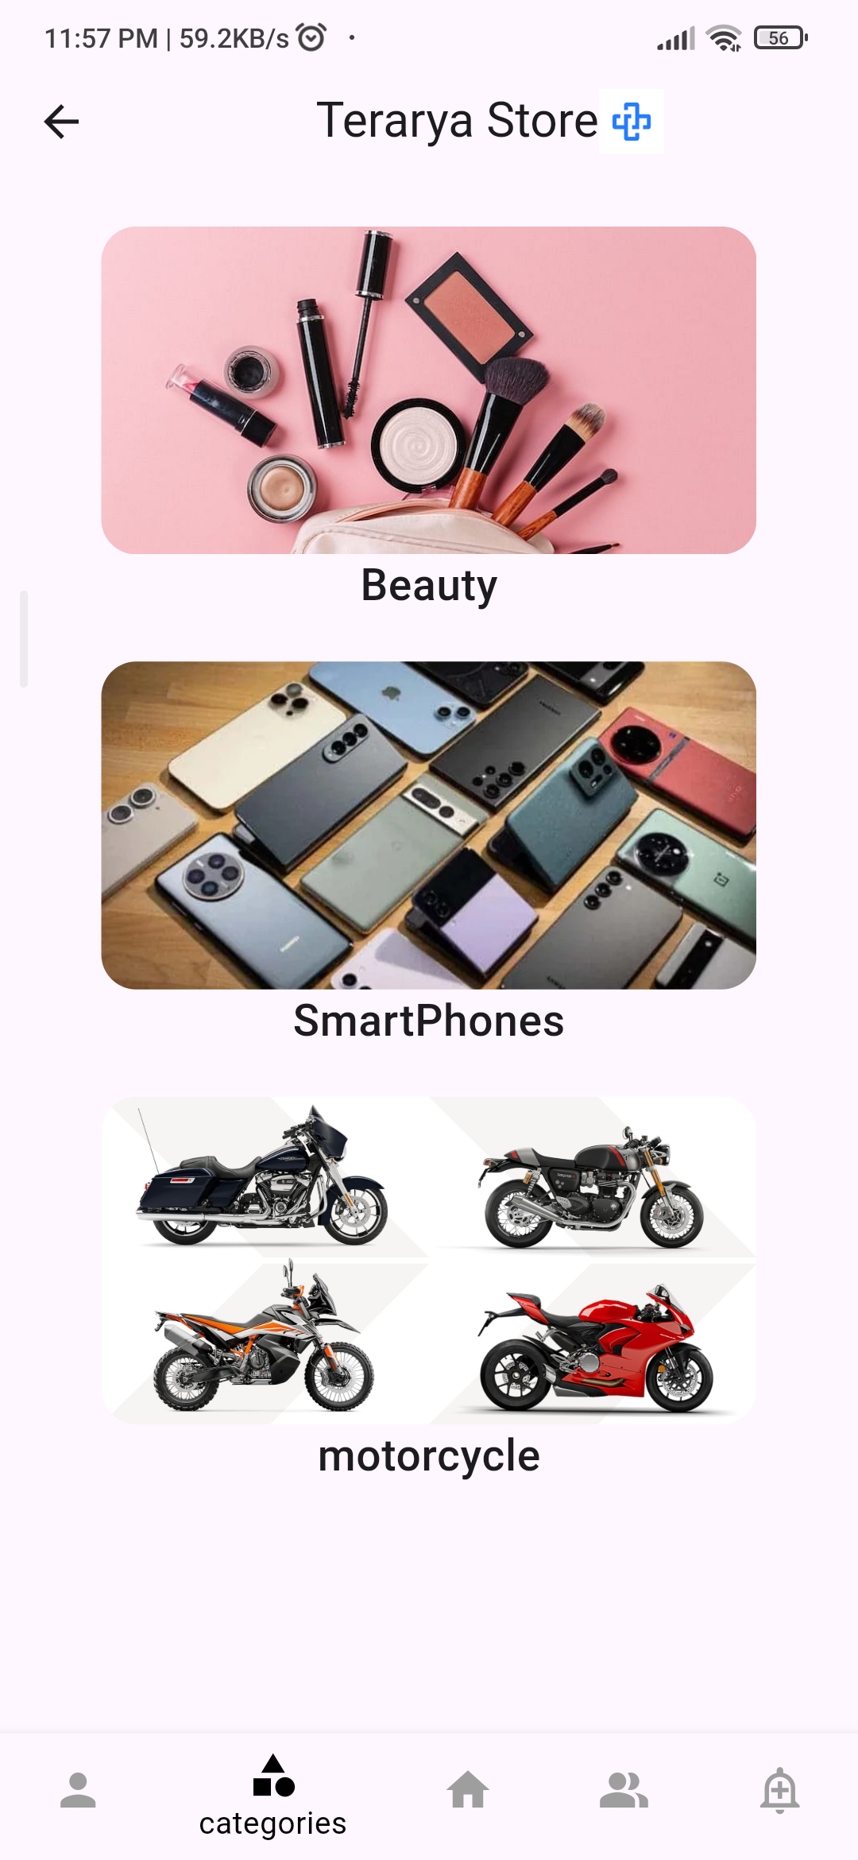
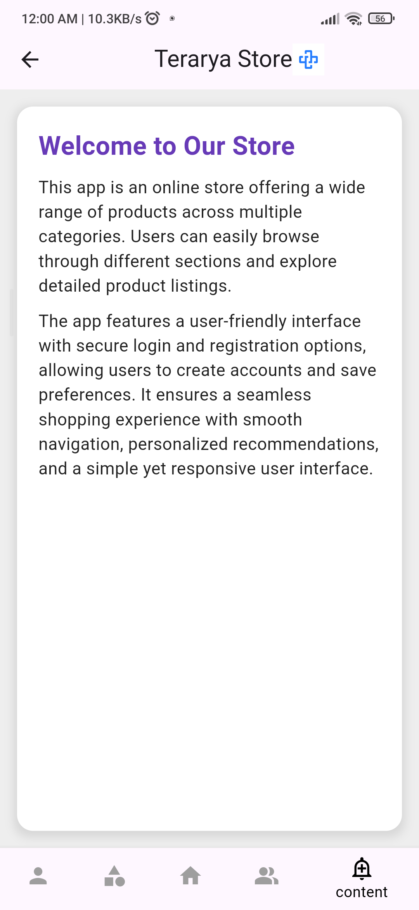
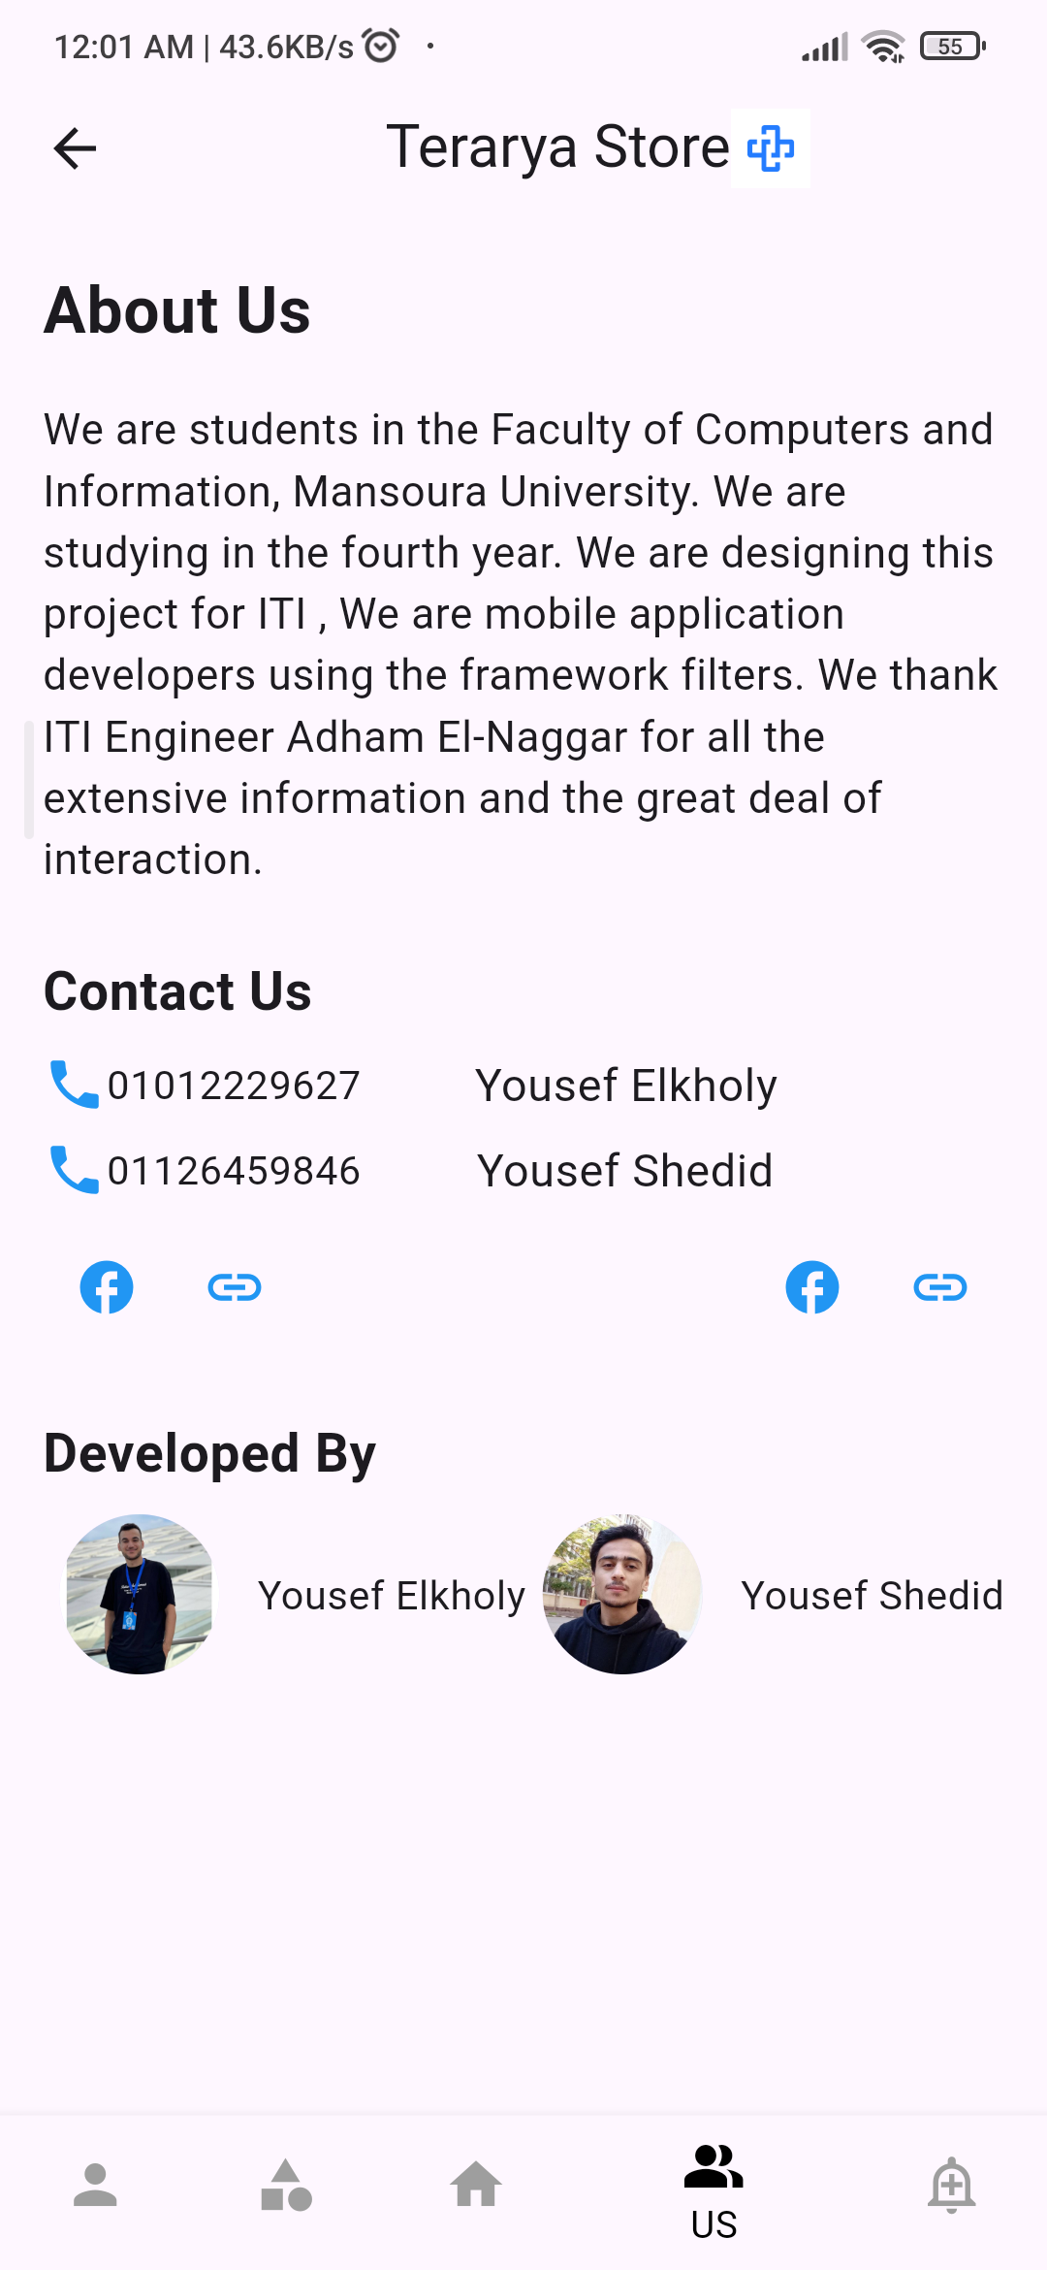
Terarya app stores
An online app stores for all your needs
Great layout and functionality

Slide 6
Thank you

