Slide 1



Chat App

Slide 2
A chat application developed using Firebase real-time database for real-time chatting and use Firebase auth for authentication

Slide 3


Slide 4
Features
Users
Leave group
Login & Register
Notifications
Block & Unblock
Chats
Group info
Create Group
Groups
Have Message
Sent & Seen
Send text & photos
One-to-one chatting
Group Chatting
Profile
Group Edit

Slide 5
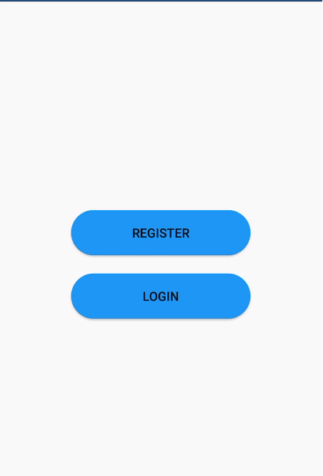
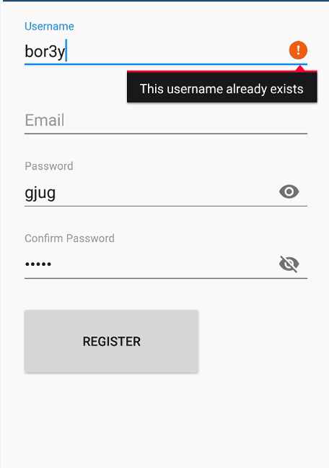
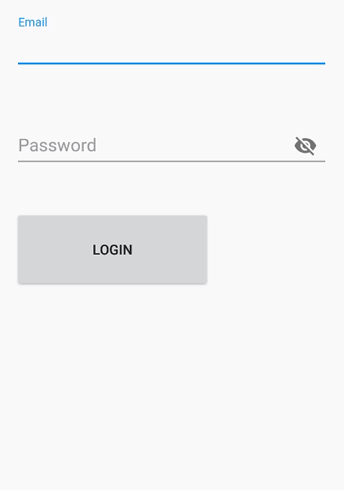
Register
Login
User has to pick unique username, username must be in English, but it could contain numbers 0-9 and _

Slide 6
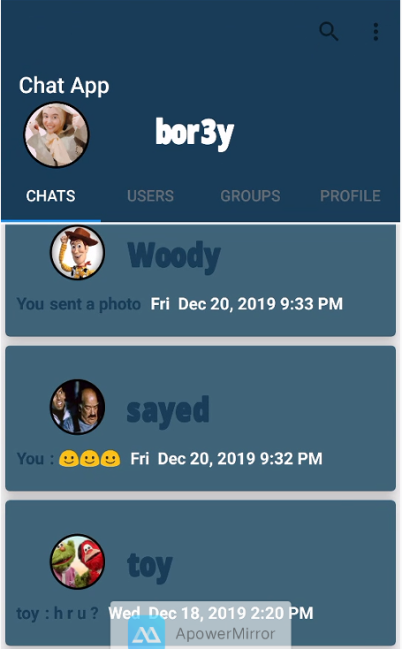
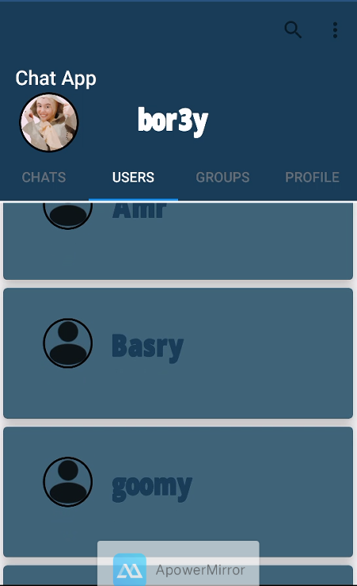
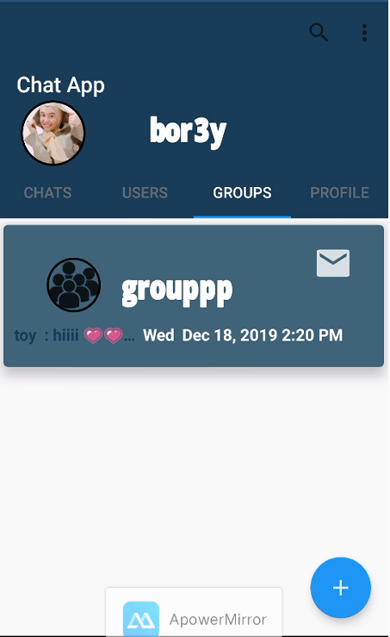
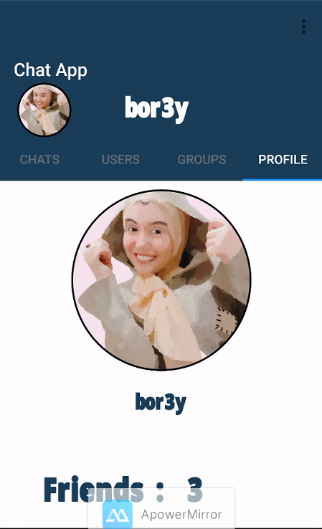
Chats
Users
Groups
Profile

Slide 7
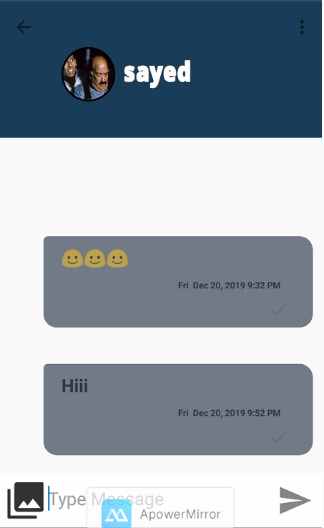
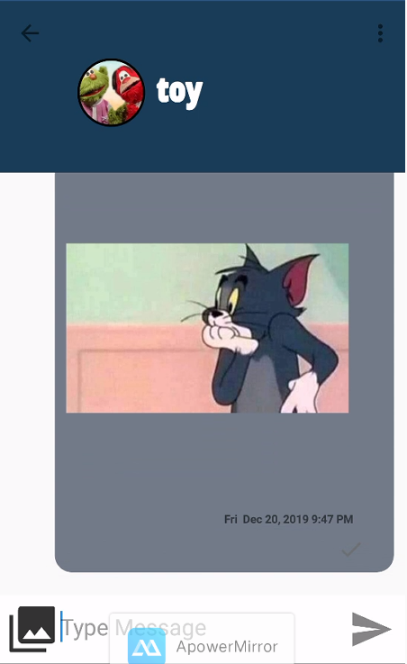
Send text
Send Photo

Slide 8
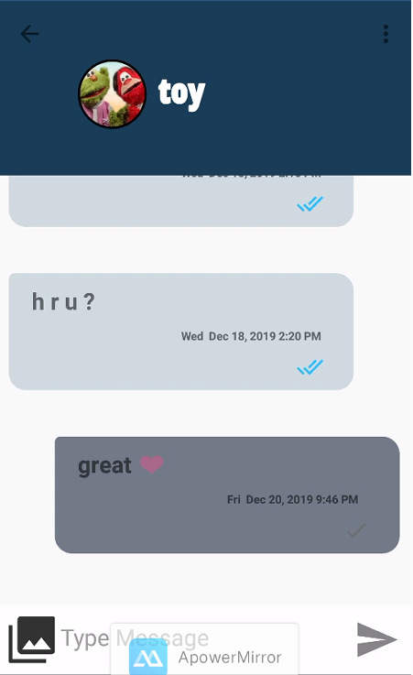
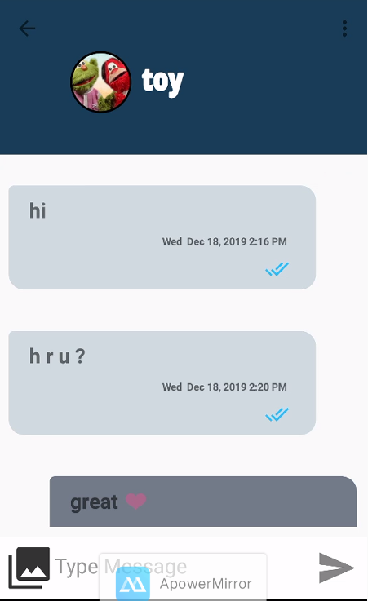
Sent
Seen

Slide 9
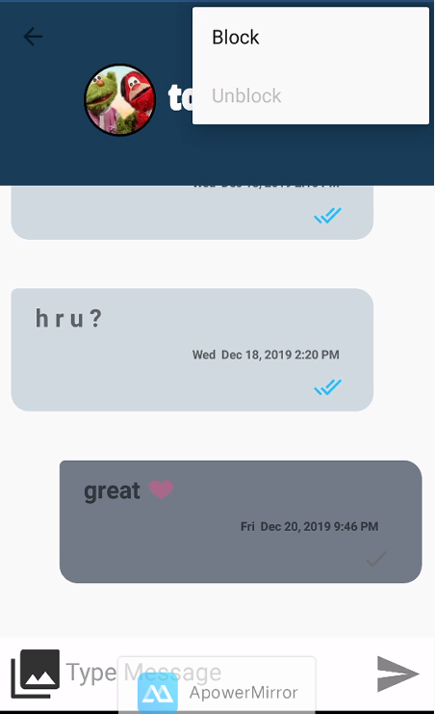
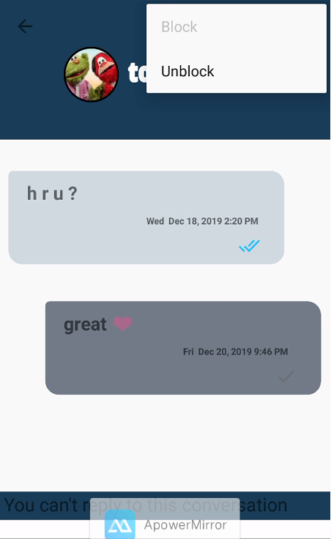
Block
Unblock

Slide 10
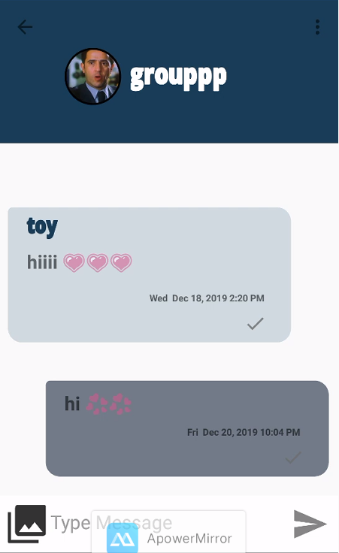
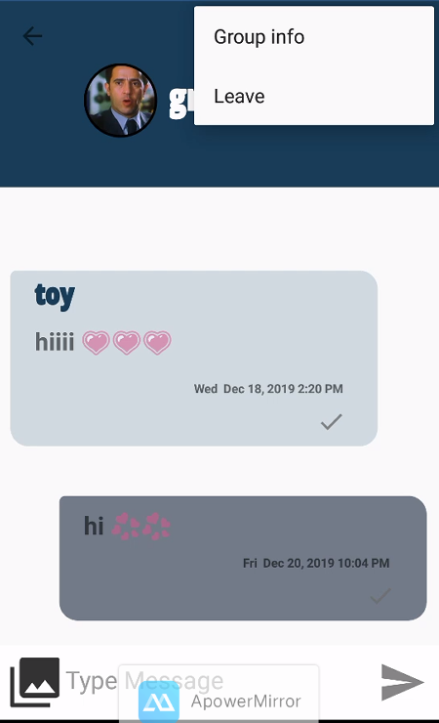
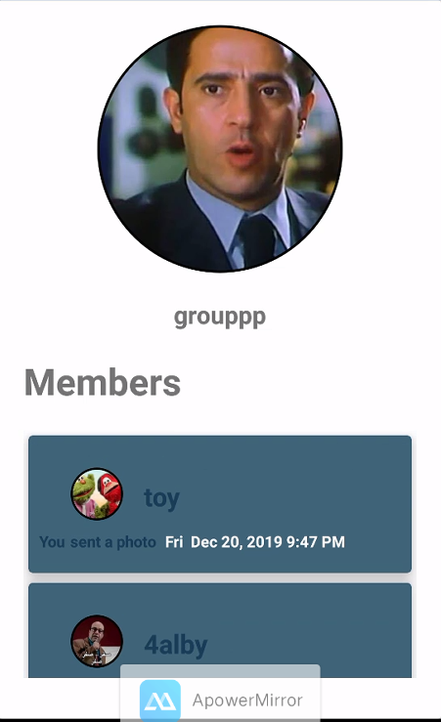
Group Message
Leave
Group info

Slide 11
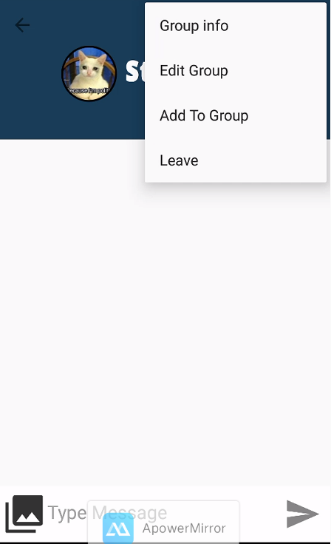
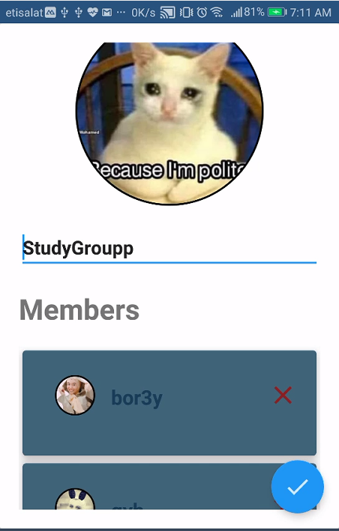
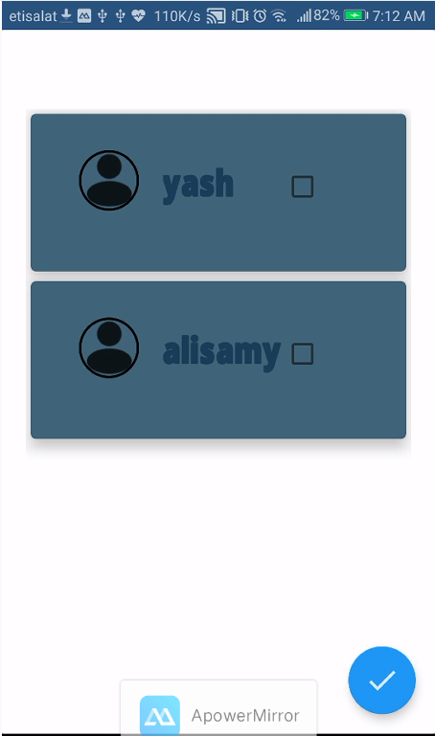
Edit Group Name
Remove members
Add Members

Slide 12
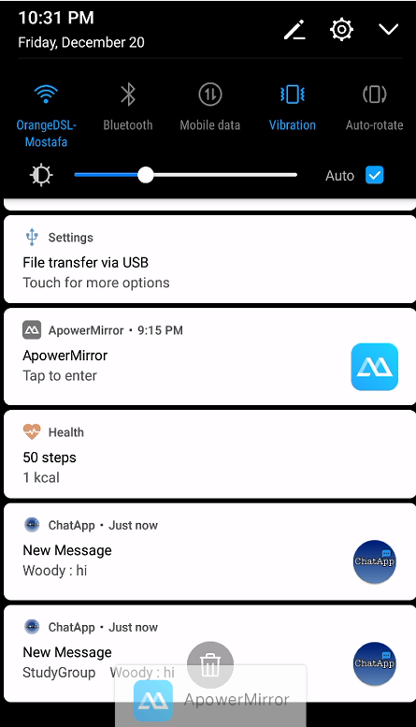
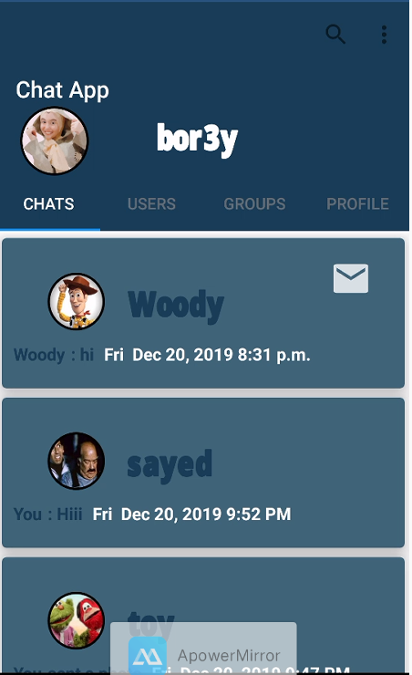
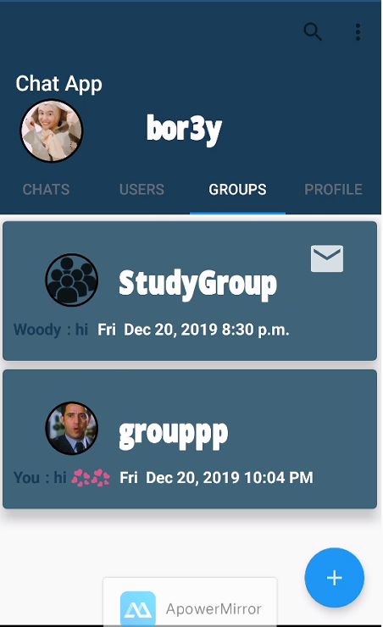
Notification
Have message

Slide 13


Slide 14
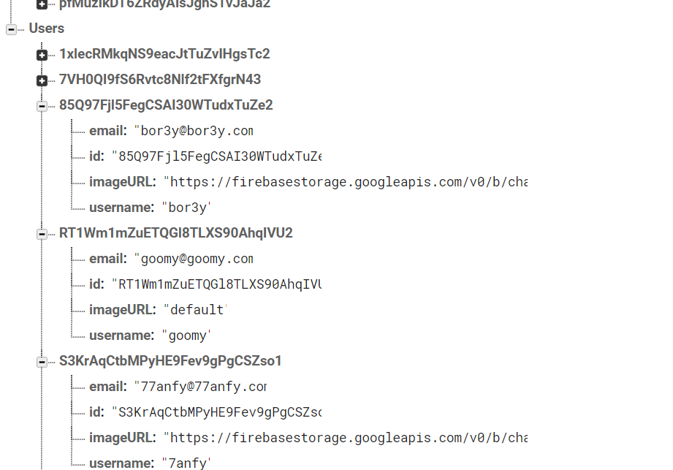
FireBase
Users

Slide 15
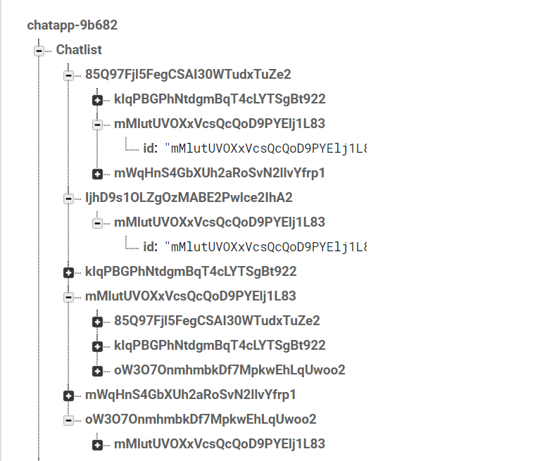
FireBase
Chatlist

Slide 16
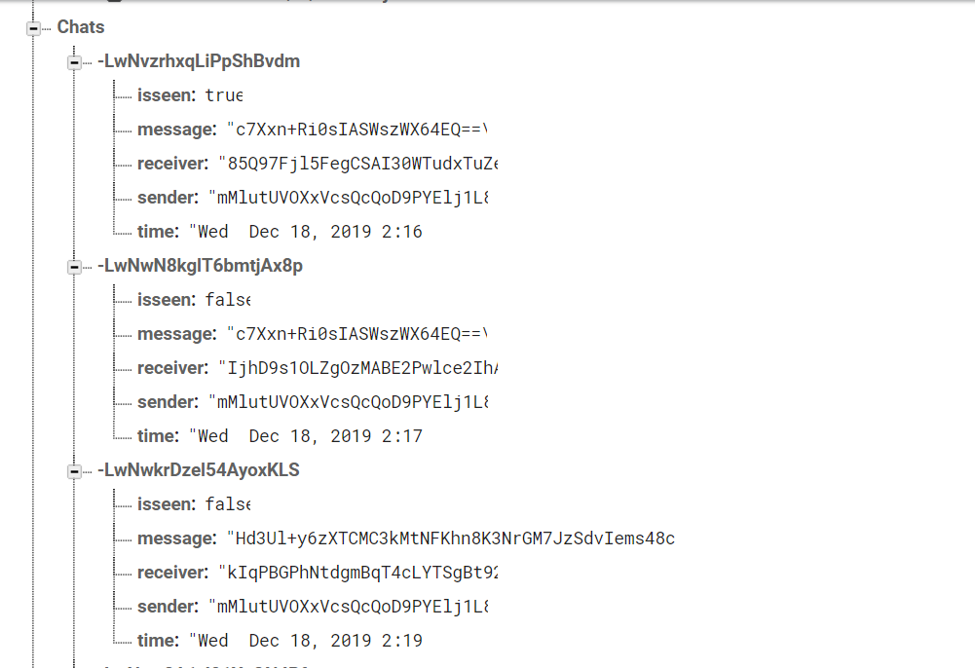
FireBase
Chats

Slide 17
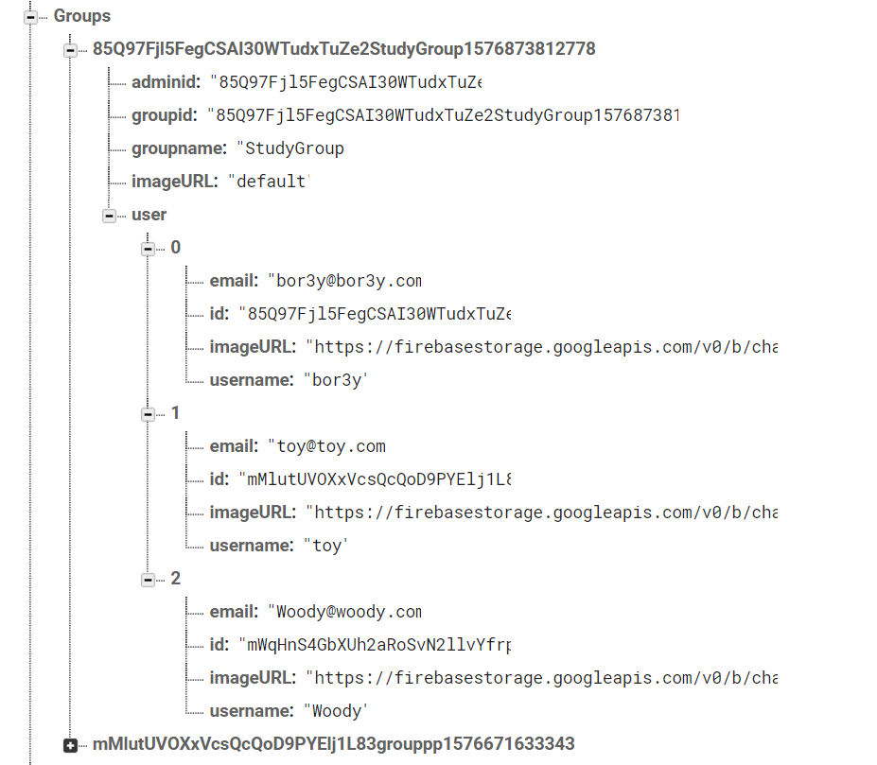
FireBase
Groups

Slide 18
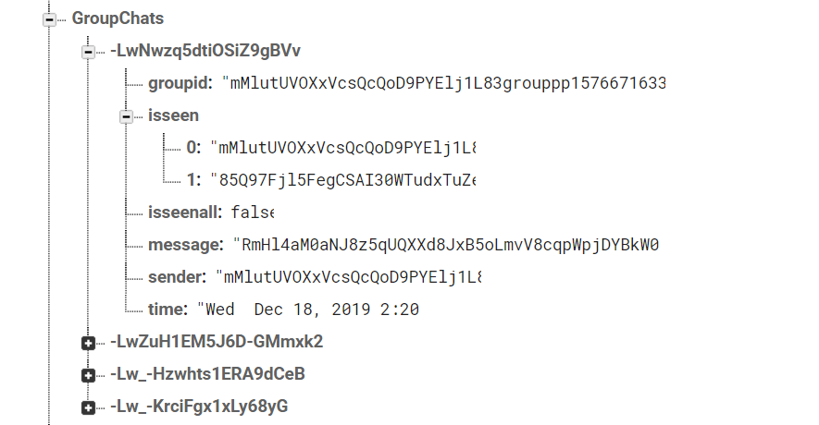
FireBase
GroupChats

Slide 19


Slide 21
Future Work
Adding extra features meeting clients’ needs, such as :
Suggestion according to location
Chat clear (from database as well)

Slide 22
Github
https://github.com/yshimaa66/ChatApp

Slide 23
Thanks!
Any questions?

Slide 24
Credits
Special thanks to :
- Prof. Wael Badawy - Eng. Ammar Ahmed Ismail

