Slide 1
基準
flux
{'batch_size': 128, 'epochs_check': 100, 'save_every': 10, 'hidden_dim_init': 4, 'num_hidden_dims': 4, 'hidden_dim_other': 16, 'hidden_dim_other2': 8, 'learning_rate': 0.001, 'hidden_dim_out': 50, 'hidden_dim_out2': 50, 'times': 1, 'result_name': 'pred_flux_brhc_swin_t_w_params', 'modelname': 'swin_t', 'typename': 'transfer_learning', 'pathmodel': None}
Iron loss
{'batch_size': 128, 'epochs_check': 100, 'save_every': 10, 'hidden_dim_init': 8, 'num_hidden_dims': 2, 'hidden_dim_other': 16, 'hidden_dim_other2': 8, 'learning_rate': 0.006325, 'hidden_dim_out': 50, 'hidden_dim_out2': 50, 'times': 1, 'result_name': 'pred_ironloss_brhc_swin_t_w_params', 'modelname': 'swin_t', 'typename': 'transfer_learning', 'pathmodel': None}

Slide 2
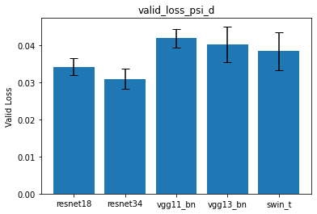
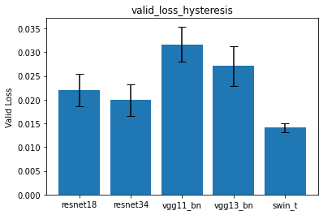
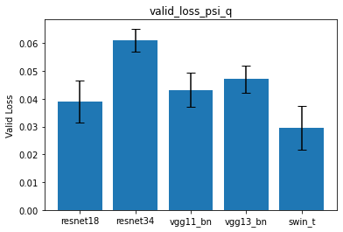
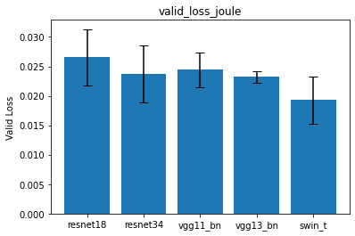
encoderの比較（res18,res34,vgg11bn,vgg13bn,vitl16,swin5）
Swin-tが良さそう
flux
Iron loss

Slide 3
出力側MLPの次元調査[4,8,12,16]
flux
{'batch_size': 128, 'epochs_check': 100, 'save_every': 10, 'hidden_dim_init': 4, 'num_hidden_dims': 4, 'hidden_dim_other’: x, 'hidden_dim_other2’: y, 'learning_rate': 0.001, 'hidden_dim_out': 50, 'hidden_dim_out2': 50, 'times': 5, 'result_name': 'pred_flux_brhc_swin_t_w_params_hidden_dim_other', 'modelname': 'swin_t', 'typename': 'transfer_learning', 'pathmodel': None}
Iron loss
{'batch_size': 128, 'epochs_check': 100, 'save_every': 10, 'hidden_dim_init': 8, 'num_hidden_dims': 2, 'hidden_dim_other': x, 'hidden_dim_other2’: y, 'learning_rate': 0.006325, 'hidden_dim_out': 50, 'hidden_dim_out2': 50, 'times': 5, 'result_name': 'pred_ironloss_brhc_swin_t_w_params_hidden_dim_other', 'modelname': 'swin_t', 'typename': 'transfer_learning', 'pathmodel': None}

Slide 4
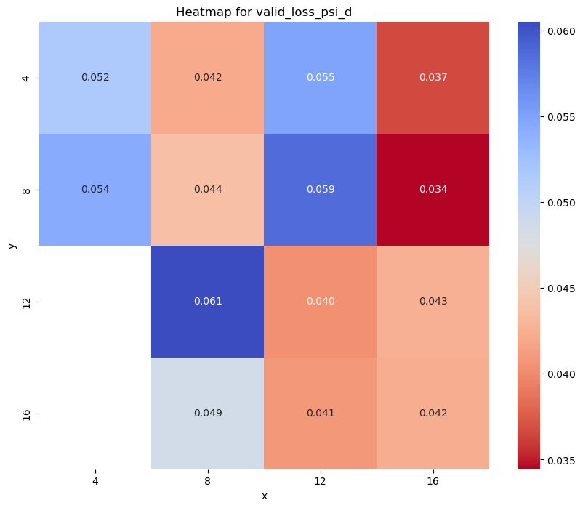
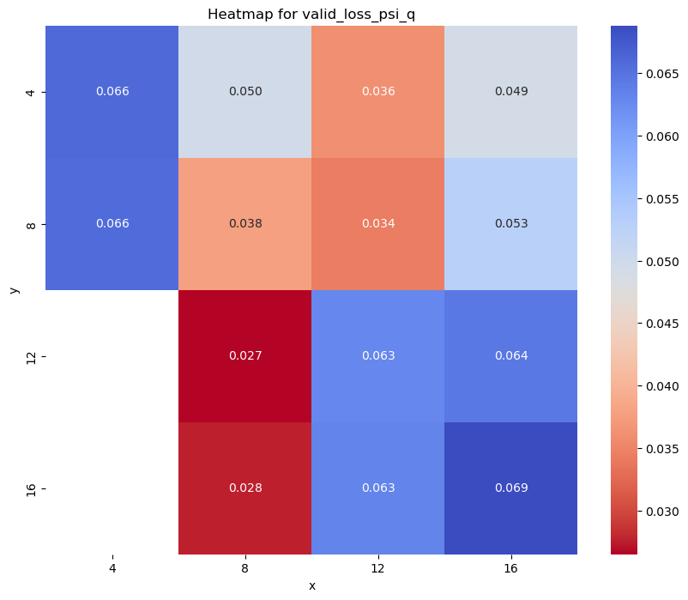
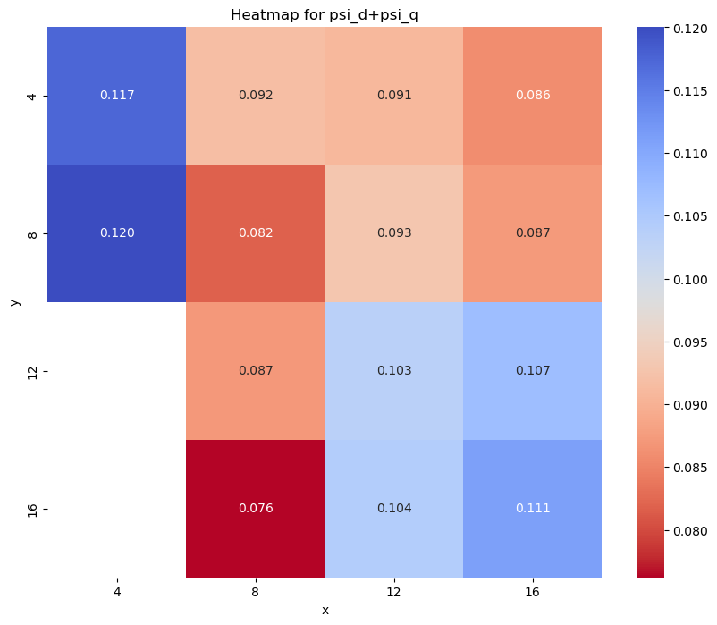
出力側MLPの次元調査
Validation loss
Psi_d
Psi_q
Psi_d+Psi_q

Slide 5
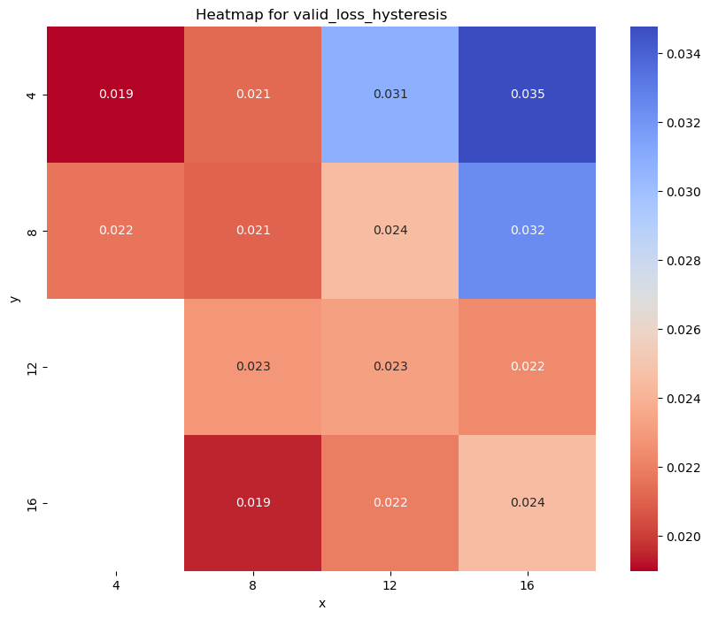
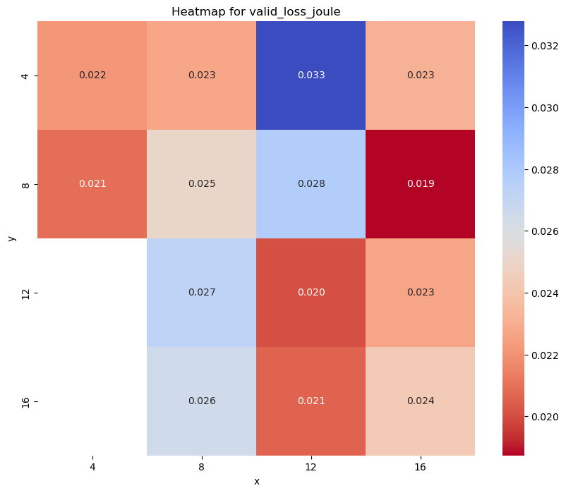
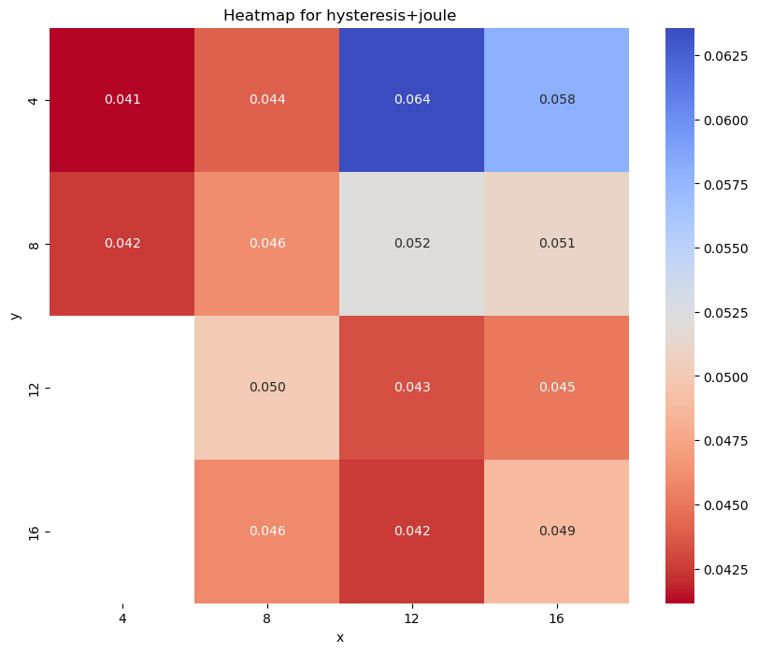
出力側MLPの次元調査
Validation loss
hysteresis
joule
Hys+jou

Slide 6
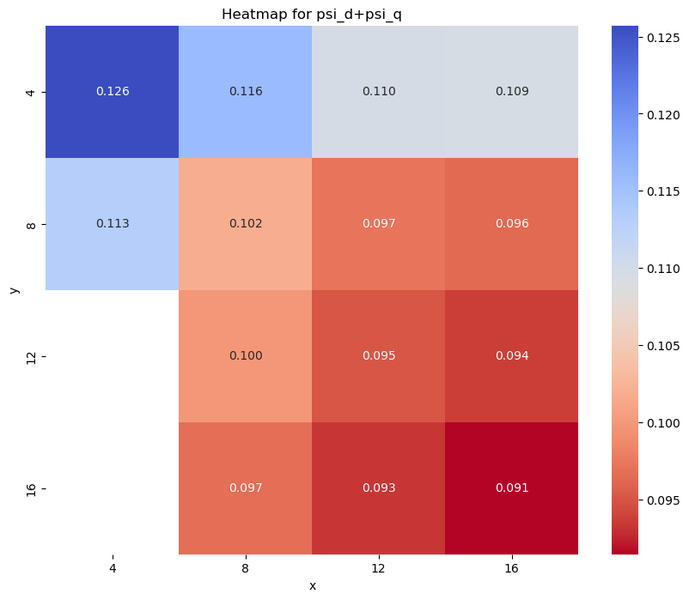
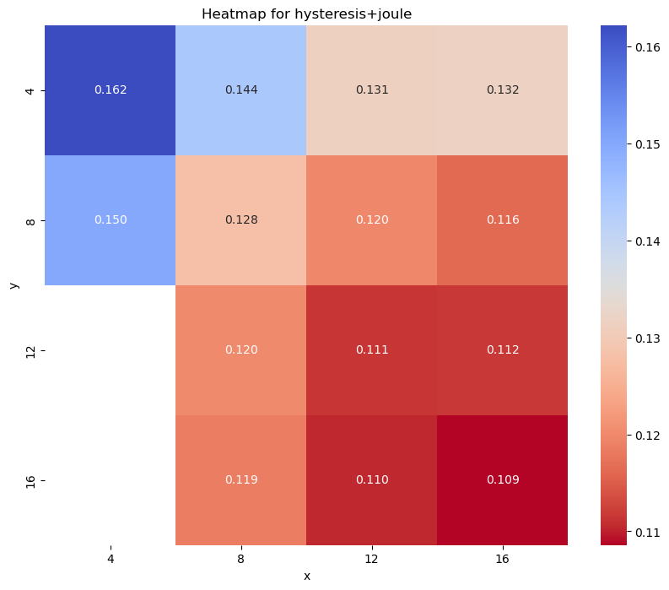
出力側MLPの次元調査
Train loss
Psi_d+ Psi_q
Hys+jou
12×16
8×16

Slide 7
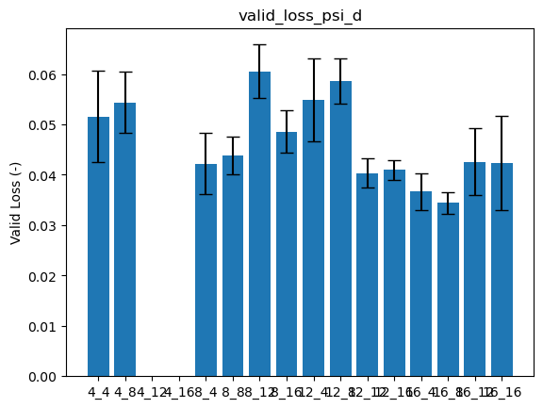
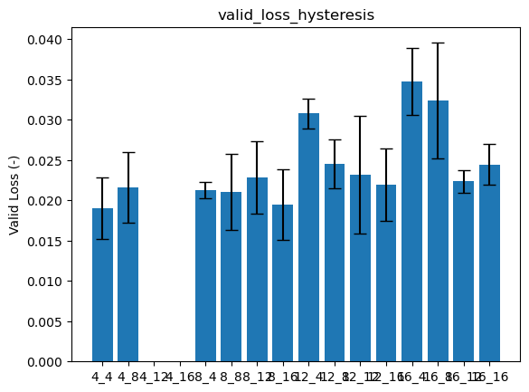
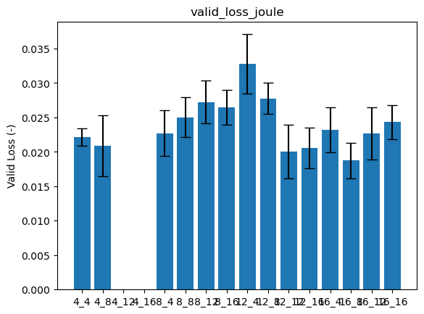
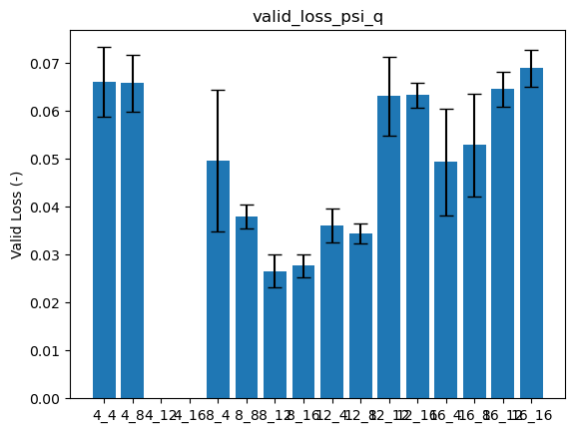
出力側MLPの次元調査
Validation loss
hysteresis
Psi_d
12×16
joule
Psi_q
8×16

Slide 8
出力側MLPの層数調査：[2,3,4,5,6]
flux
{'batch_size': 128, 'epochs_check': 100, 'save_every': 10, 'hidden_dim_init': 4, 'num_hidden_dims': x, 'hidden_dim_other': 16, 'hidden_dim_other2': 8, 'learning_rate': 0.001, 'hidden_dim_out': 50, 'hidden_dim_out2': 50, 'times': 5, 'result_name': 'pred_flux_brhc_swin_t_w_params_num_hidden_dims', 'modelname': 'swin_t', 'typename': 'transfer_learning', 'pathmodel': None}
Iron loss
{'batch_size': 128, 'epochs_check': 100, 'save_every': 10, 'hidden_dim_init': 8, 'num_hidden_dims': x, 'hidden_dim_other': 12, 'hidden_dim_other2': 16, 'learning_rate': 0.006325, 'hidden_dim_out': 50, 'hidden_dim_out2': 50, 'times': 5, 'result_name': 'pred_ironloss_brhc_swin_t_w_params_num_hidden_dims', 'modelname': 'swin_t', 'typename': 'transfer_learning', 'pathmodel': None}

Slide 9
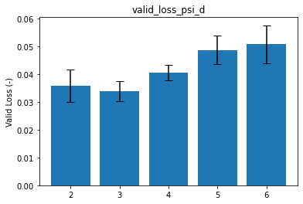
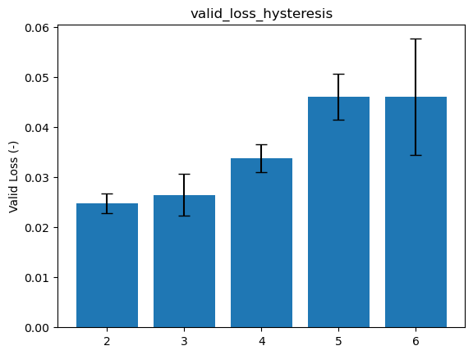
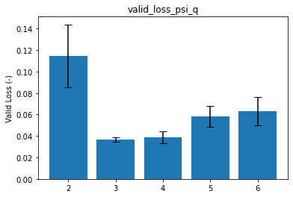
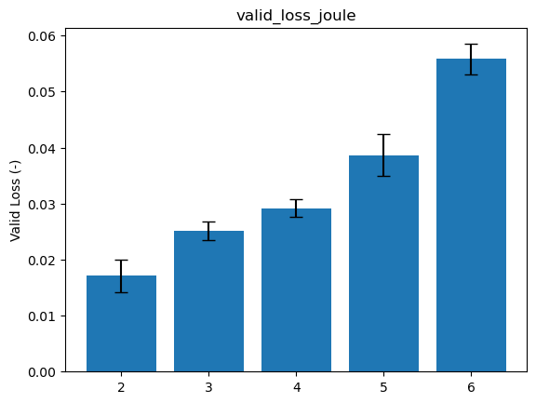
出力側MLPの層数調査：[2,3,4,5,6]
flux
Iron loss
３
３

Slide 10
出力側MLPの入力次元：[2,4,6,8,10,12]
flux
{'batch_size': 128, 'epochs_check': 100, 'save_every': 10, 'hidden_dim_init’: x, 'num_hidden_dims': 3, 'hidden_dim_other': 8, 'hidden_dim_other2': 16, 'learning_rate': 0.001, 'hidden_dim_out': 50, 'hidden_dim_out2': 50, 'times': 5, 'result_name': 'pred_flux_brhc_swin_t_w_params_hidden_dim_init', 'modelname': 'swin_t', 'typename': 'transfer_learning', 'pathmodel': None}
Iron loss
{'batch_size': 128, 'epochs_check': 100, 'save_every': 10, 'hidden_dim_init': x, 'num_hidden_dims': 3, 'hidden_dim_other': 12, 'hidden_dim_other2': 16, 'learning_rate': 0.006325, 'hidden_dim_out': 50, 'hidden_dim_out2': 50, 'times': 5, 'result_name': 'pred_ironloss_brhc_swin_t_w_params_hidden_dim_init', 'modelname': 'swin_t', 'typename': 'transfer_learning', 'pathmodel': None}

Slide 11
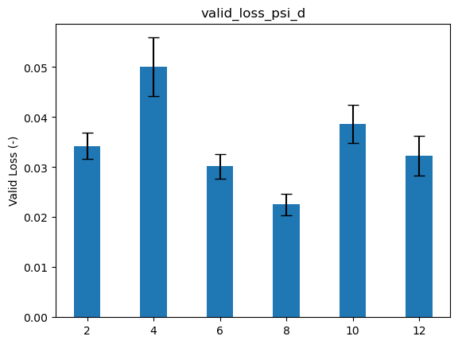
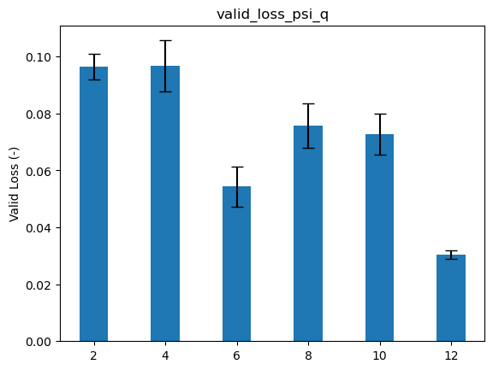
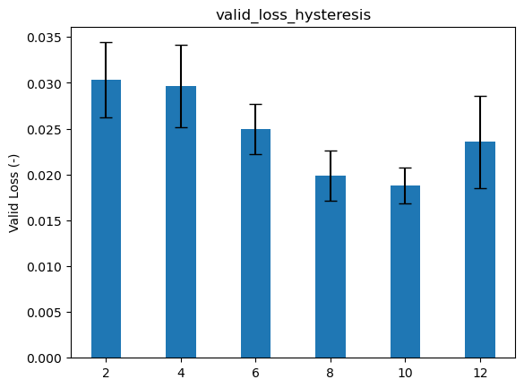
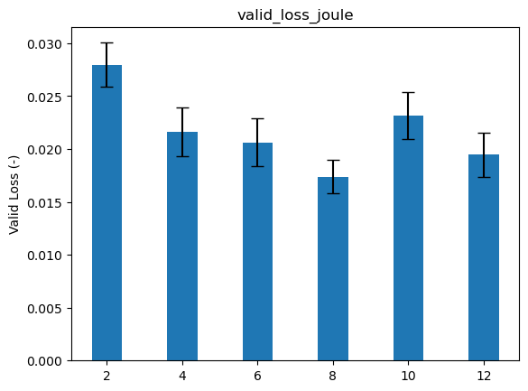
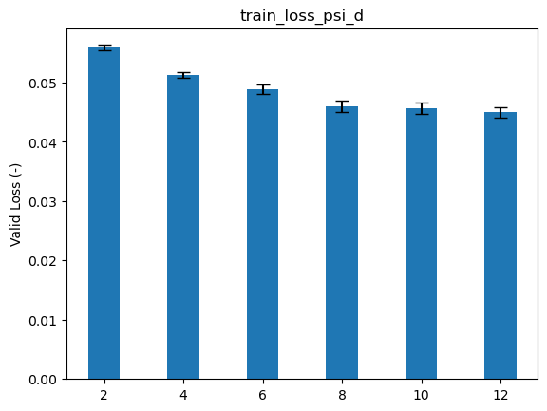
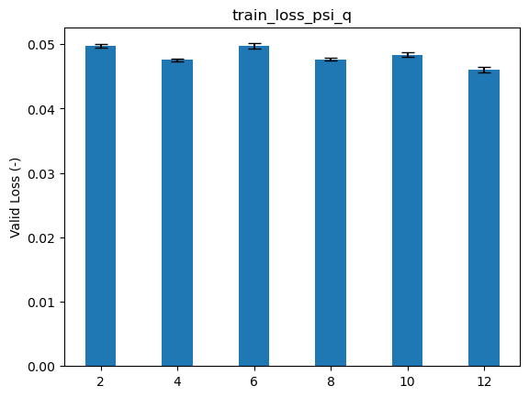
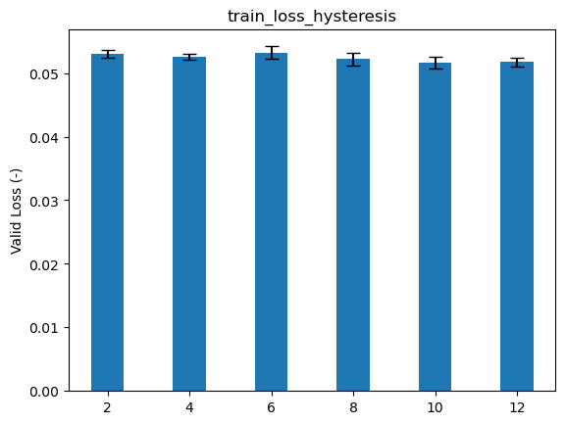
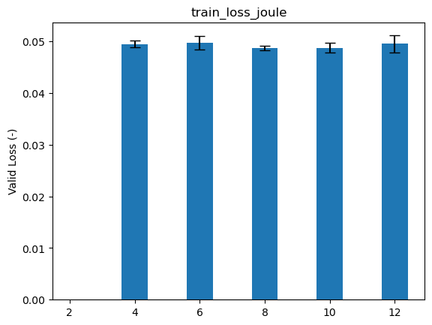
出力側MLPの入力次元：[2,4,6,8,10,12]
flux
Iron loss
8
8
6
6

Slide 12
他パラメータのoptuna
flux
{'batch_
Iron loss
{'batch_

Slide 13
MLP出力層の次元：[]
flux
{'batch_
Iron loss
{'batch_

Slide 14
Lr, adamなど：[]
flux
{'batch_
Iron loss
{'batch_

Slide 15
事前学習の有無：[]
flux
{'batch_
Iron loss
{'batch_

