Slide 1
Classification Model to Predict the Financial Severity of Hazardous Material Transportation Incidents
Group 6
11.21.2025

Slide 2
Motivation
PHMSA collects detailed incident reports on hazardous materials (hazmat) transportation accidents in the U.S.
Understanding financial impacts of hazmat incidents is crucial for improving safety and operational efficiency.
Insights can guide optimal packaging choices, transportation logistics, and risk-mitigation strategies to reduce financial losses during incidents.

Slide 3
Dataset Overview
10,237 incidents with 201 features
describing transportation mode, location, hazmat type, failure cause, financial impacts, and more.
Target Variable: Total severity of Damages
material loss, property damage, and cleanup costs
Goal: balanced_accuracy >0.6

Slide 4
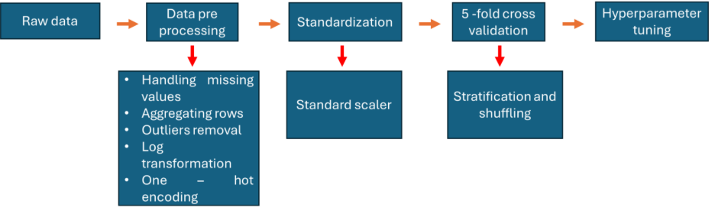
Workflow

Slide 5
Baseline Model
KNN as baseline
5-fold Stratified Cross-Validation
preserving class balance within each fold
GridSearchCV to tune hyperparameters
Number of neighbors

Slide 6
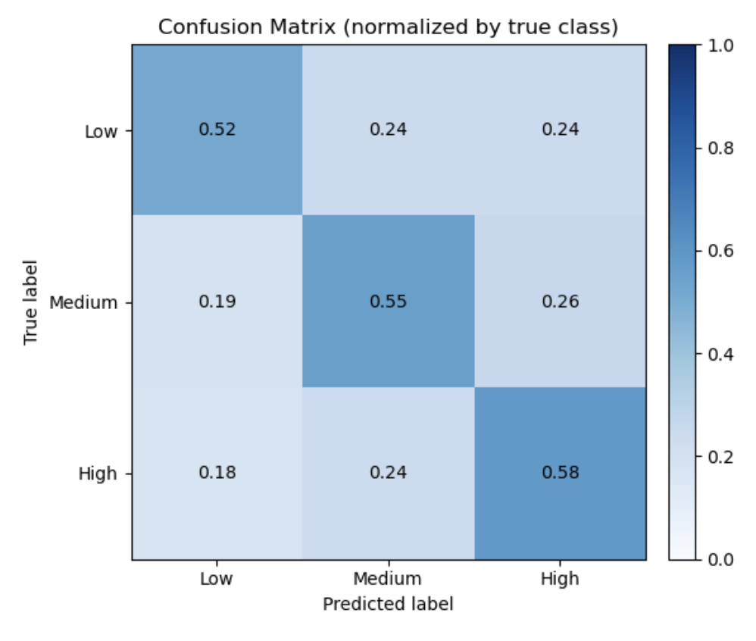
Baseline Model
Balanced accuracy=0.45
averages recall across classes to reduce bias toward the majority class
Suffer high dimension and can’t capture relationship well
More advanced model needed

Slide 7
Improved Model
Decision tree and random forest
class_weight=balanced
Decision Tree:
max_depth
min_samples_split
criterion ∈ {“gini”, “entropy”}
Random Forest:
All Decision Tree parameters
n_estimators (number of trees)

Slide 8
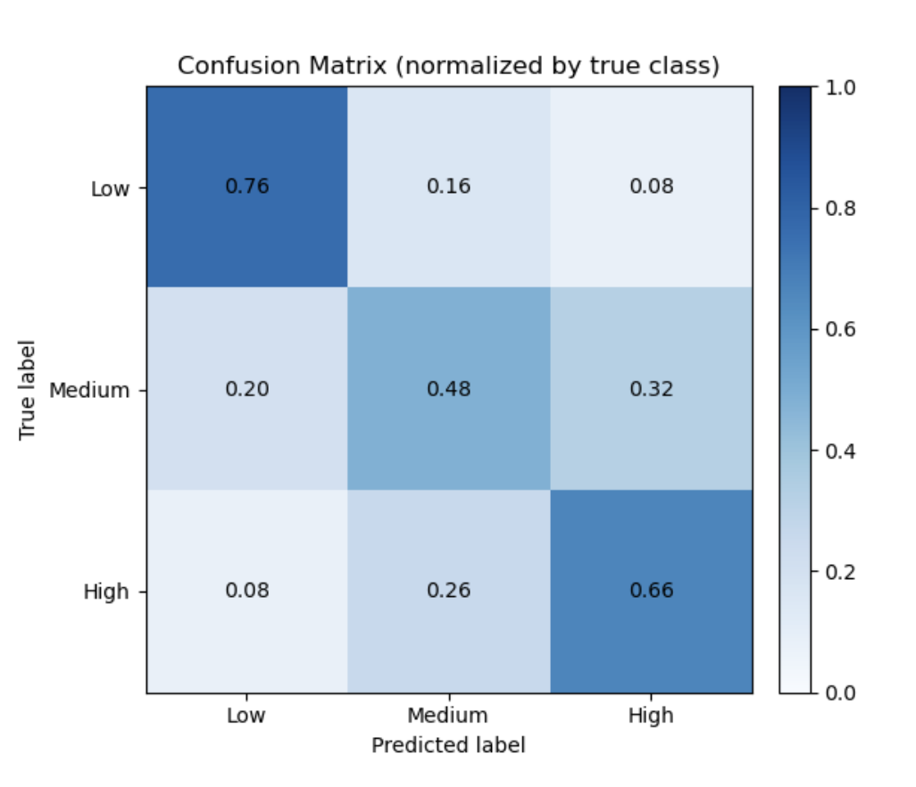
Improved Model
Decision Tree: balanced accuracy=0.63 > 0.45

Slide 9
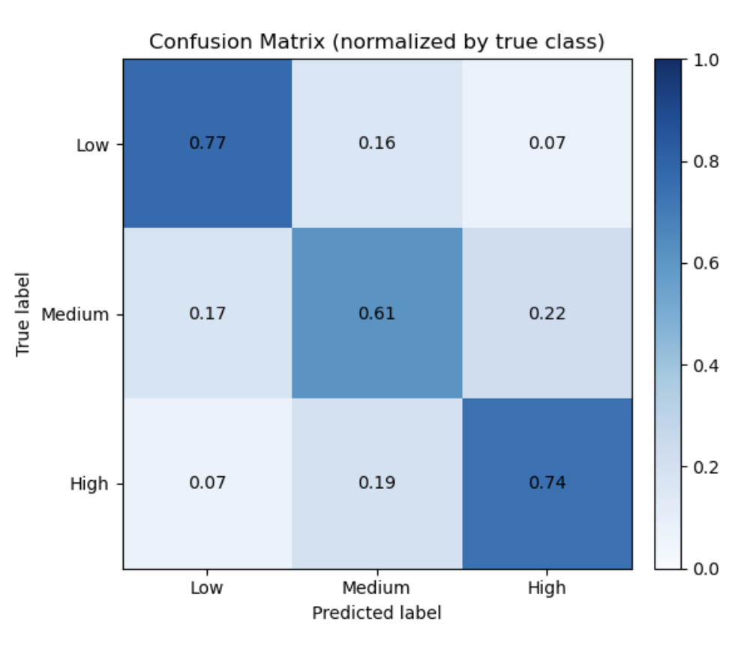
Improved Model
Random Forest: balanced accuracy=0.7 > 0.45

Slide 10
Neural Network?
Input layer: matches the number of features.
Hidden Layer 1:
128 neurons, ReLU activation
Batch Normalization
30% Dropout for regularization
Hidden Layer 2:
64 neurons, ReLU activation
Batch Normalization
20% Dropout for regularization
Output layer: 3 neurons, Softmax activation (probabilities for each class)

Slide 11
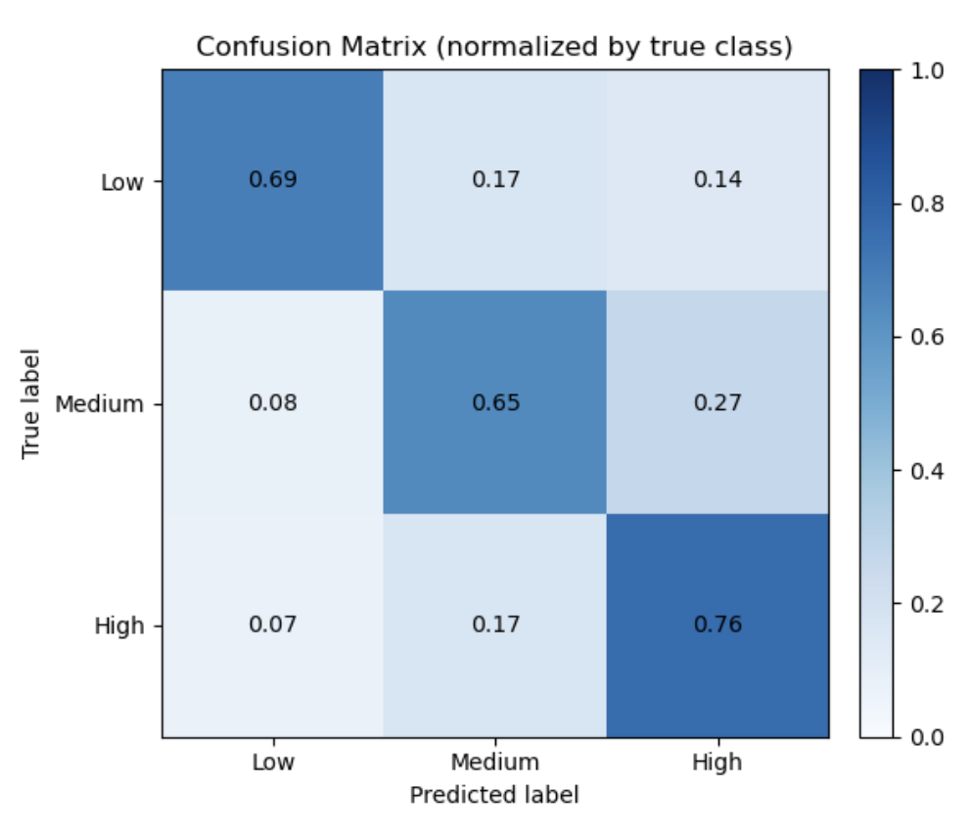
Improved Model
Neural Network: balanced accuracy=0.61 > 0.45

Slide 12
Feature Reduction
Over 200 features
Improve interpretability, robustness, training efficiency
Permutation Importance
Rank features by how much model accuracy drops when each feature is randomly shuffled
Select top 10 features including
Quantity Released (most important)
Estimated Speed
Vehicle Overturn (Yes)….
Retrained random forest with top 10 features
0.7 -> 0.6 not bad…

Slide 13
Conclusion
Overall successful project
Change project midway
Class imbalance
Extensive data cleaning, feature engineering
Lessons learnt
Proper evaluation metric (balanced_accuracy)
Tree–based models remain robust for structured tabular data
Intuition is a good sanity check
More complex model is not always good

Slide 14


