Slide 1

DOCTOR VISIT ANALYSIS
- Namuduri S S V L Vaishnavi

Slide 2
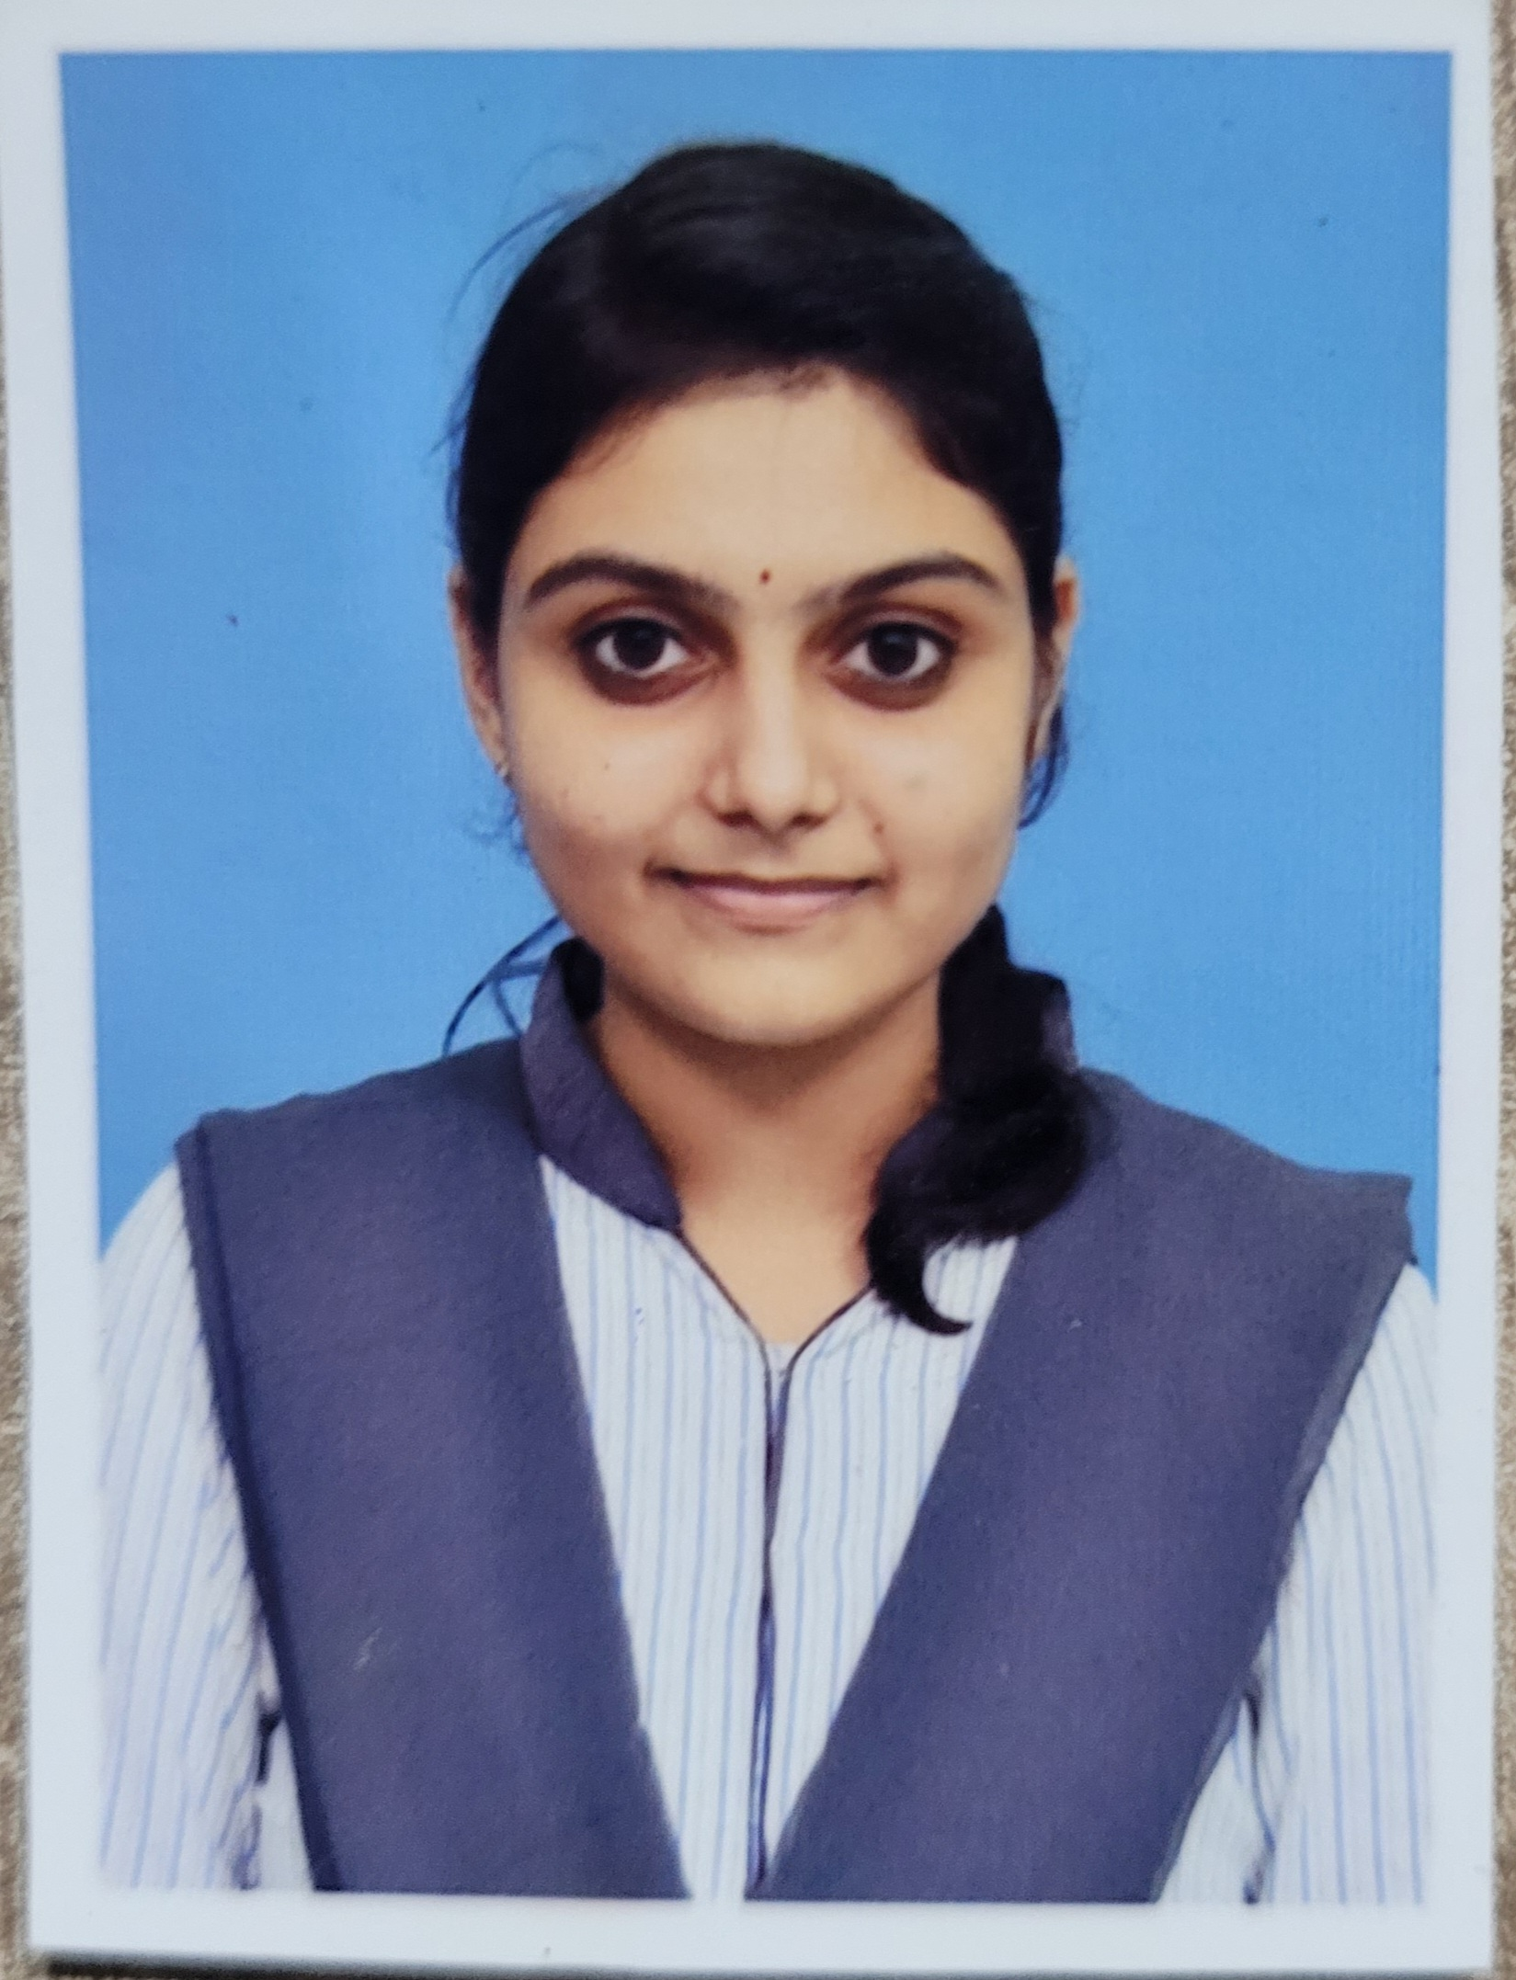
STUDENT DETAILS
Name : Namuduri S S V L Vaishnavi
Email Id : vyshu.namuduri@gmail.com
College name : BVC Institute of Technology and Science
College state : Andhra Pradesh
Internship
Domain : Data Analytics
Start Date : 15-06-2023
End Date : 23-07-2023

Slide 3
PROBLEM STATEMENT
To determine the relationship between the number of visits to the hospital and their gender.

Slide 4
Agenda
The main outline of things to be considered
in this analysis are the number of patients
visiting the hospital per day for diagnosis and checkups,
along with the gender of each patient.
With this analysis, we are going to get a keen idea
about what gender is getting sick in higher probability.

Slide 5
Project overview
This project gives a clear explanation about the gender related criteria.
It gives us a glance about the patient’s gender and this makes us take a step to conclude the most affected gender in today’s society and also take necessary precautions to make it low.
This study adds a further development of discussions to optimize the patient provider communication by identifying the potential gender to target with improvement efforts.

Slide 6
End users of the project
End users of the project includes the doctors and the staff in hospitals. The only factor considered here is the gender of each and every patient.
Based on either male or the female, the complete analysis is depended.
The doctors along with the other end users will be able to know who’s visiting number is in high, whether the males or the females.

Slide 7
Solution and its value preposition
In this, we will be working with the gender of patients.
It is the main attribute on which the complete solution is depended upon.
The solution gives us the rate of males and females visiting the hospital comparatively, with their illness being the sole cause.
Additionally, we emphasize the gender and the visits to the hospital which promotes target intervention and more effective resource allocation.

Slide 8
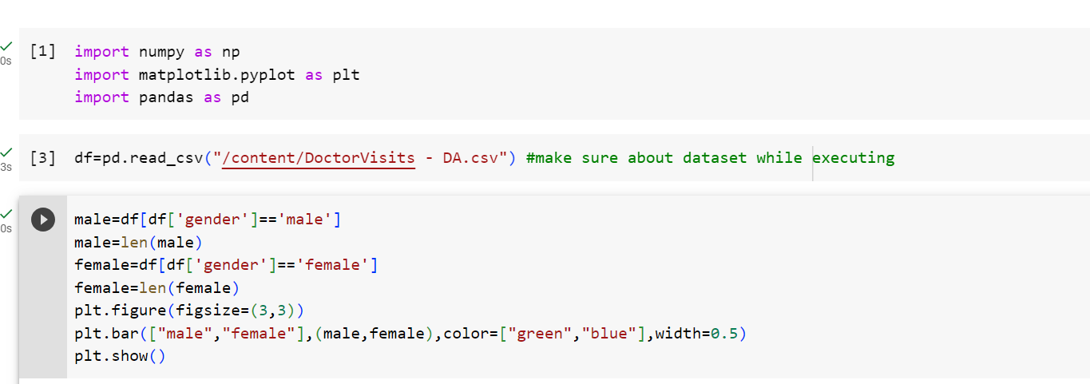

Slide 9
Customize the project and make it your own
I customize this project by providing regular training section for all the healthcare staff regarding my analysis.
Making them understand my perspective and carrying out all the necessary things to be done in a well executed manner.
Implementing efficient communication systems and tools within the hospital to ensure seem less information flow between different departments.

Slide 10
modeling
The doctor visit dataset contains the following attributes: Gender, Age, Income, Illness, Health, Private, Free poor, Free Rapt, n chronic, I chronic.
These provide a comprehensive overview of the patient’s status. Among all these, the data to be analyzed is identified and then collected. Then it is cleaned.
Once the data is cleaned, it is interpreted and I visualize the results in the form of some charts.
The tools used are Python and Jupyter Notebook.

Slide 11
Results
This project tells us about the number of people visiting the hospital with respect to the gender.
Based on this we will be drawing a clear idea about which gender is undergoing illness frequently the most.

Slide 12
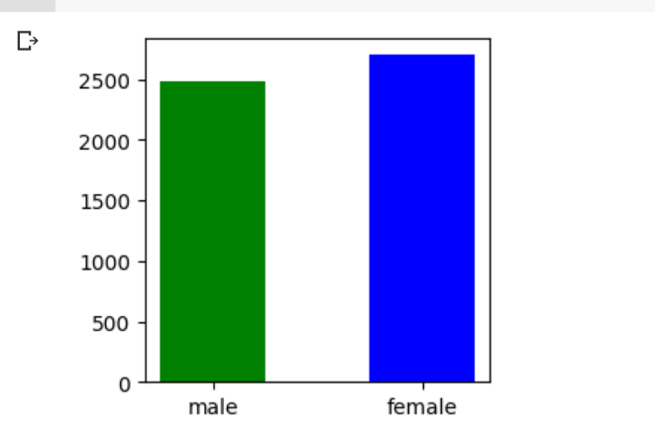

Slide 13
Google Colab Link :
https://colab.research.google.com/drive/1AEbIxbeU0eJOk2k6F3uVW4ovfrTA6_JA?usp=sharing

Slide 14
THANK YOU!!

