Slide 1
INVENTORY & PROCUREMENT DEPARTMENT IN MANUFACTURING INDUSTRY

Slide 2
PROBLEM STATEMENT
“Optimizing inventory and procurements by using demand forecasting.”

Slide 3
DATA COLLECTION
The first and foremost step taken after the problem statement was data collection.
All the available data is collected
The data collection is simply collecting the raw data and understanding it.

Slide 4
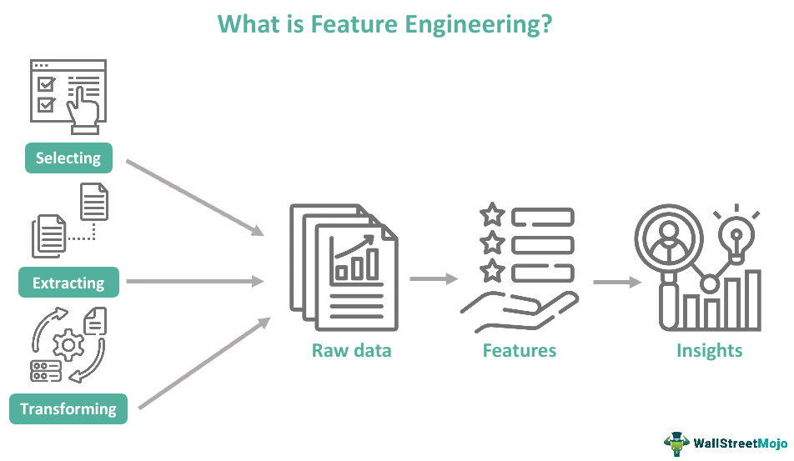
FEATURE ENGINEERING
transform raw data into features that can be used for creating a predictive model using Machine learning

Slide 5
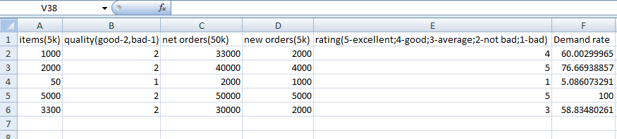
DATA SET

Slide 6
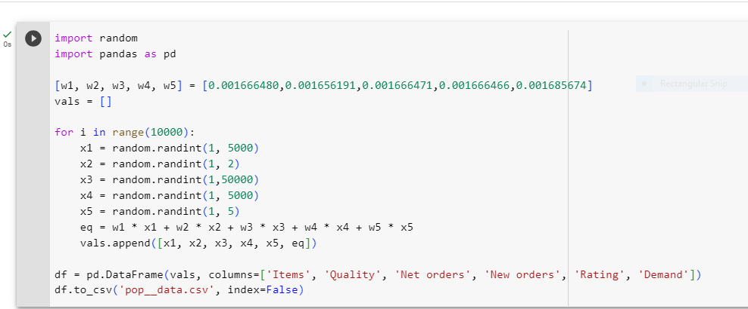

Slide 7
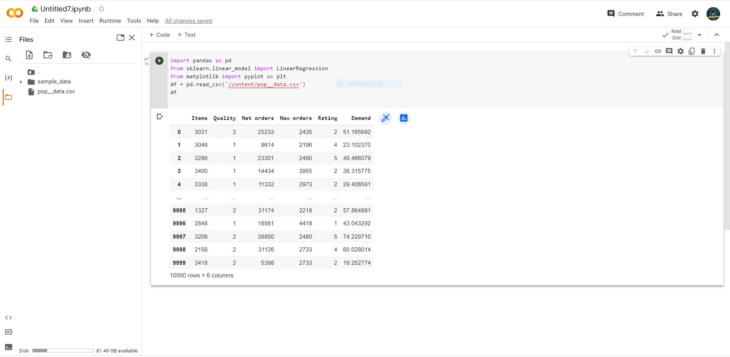
POPULATION SET

Slide 8
MODEL SELECTION AND ANALYSIS
All the suitable machine learning algorithms were evaluated for their suitability for the problem statement. The chosen model was selected based on its performance, interpretability and ability to handle the dataset characteristics.

Slide 9
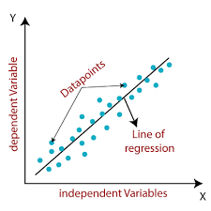
LINEAR REGRESSION

Slide 10
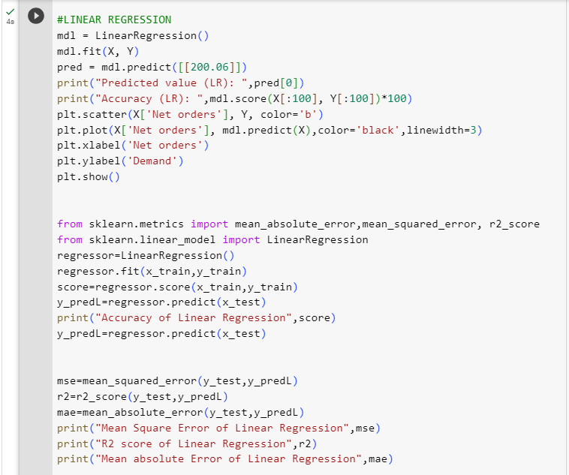

Slide 11
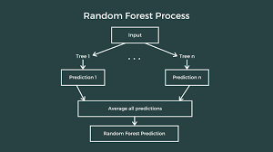
RANDOM FOREST:

Slide 12
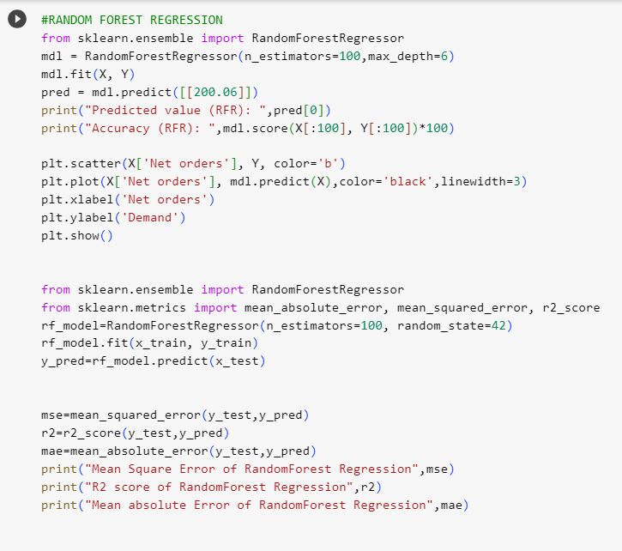

Slide 13
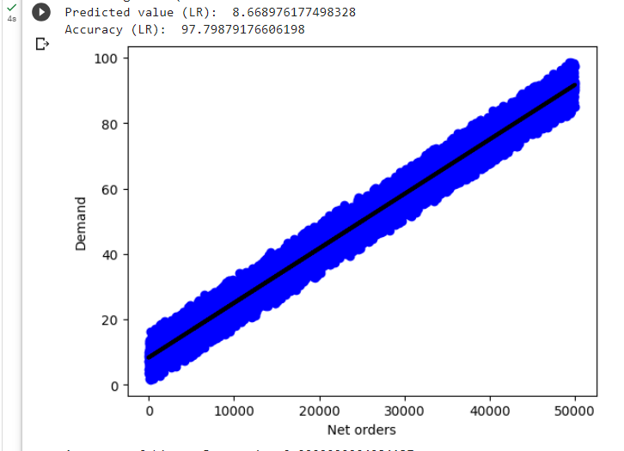
MODELING AND EVALUATION
Linear Regression:

Slide 14
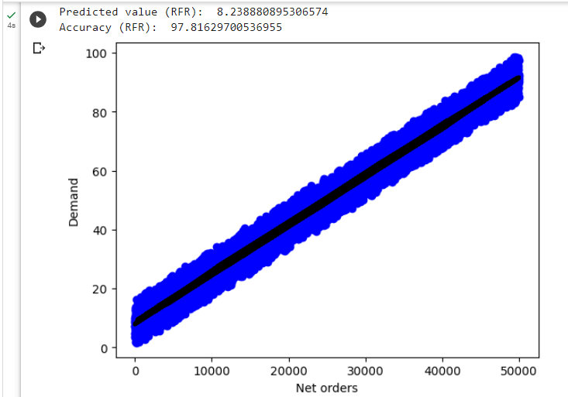
Random forest regression

Slide 15


RESULTS AND FINDINGS
The model outputs were interpreted to understand the relationship between the input features and the demand.

Slide 16
CONCLUSION
Demand plays a vital role and a poor demand forecasting leads to a poor maintenance of inventory which in turn results in bad procurement decisions.
This model facilitates the staff to perform the job of demand forecasting more accurately rather than predicting it manually which in turn helps them in letting know the current trends and requirements.

Slide 17
THANK YOU!

