Slide 1
Module 1 Project Presentation
By: Joseph Szpigiel

Slide 2
Question: What factors influence the sale price of a home in Kings county?
When trying to sell your home, you want to maximize profits as much as possible. Knowing how much your home will likely sell for is invaluable information when planning a sale.
Using data from home sales from homes sold in 2015, we attempt to uncover what factors help most accurately predict the sales price of a home.
The dataset included factors such as square footage, zip code, and grade assessment for all homes sold during 2015.

Slide 3
Methodology
We used the OSEMN data science framework to process our data
O – Obtained the data
S – Scrubed the data
E – Explored the data
M – Modeled the data
N – iNterpreted the data

Slide 4
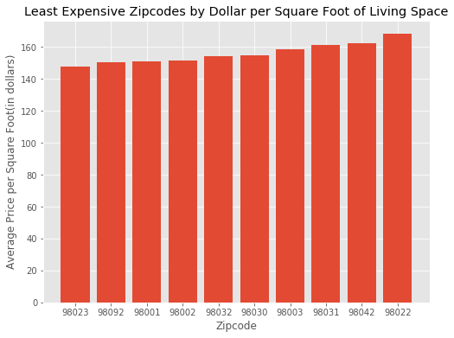
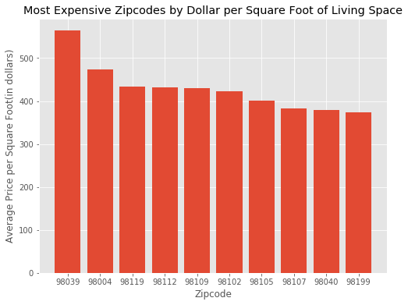
Results – Where is your home?
The difference between the average price per square foot of living space for the most expensive zip code and those of the least expensive zip code is $416

Slide 5
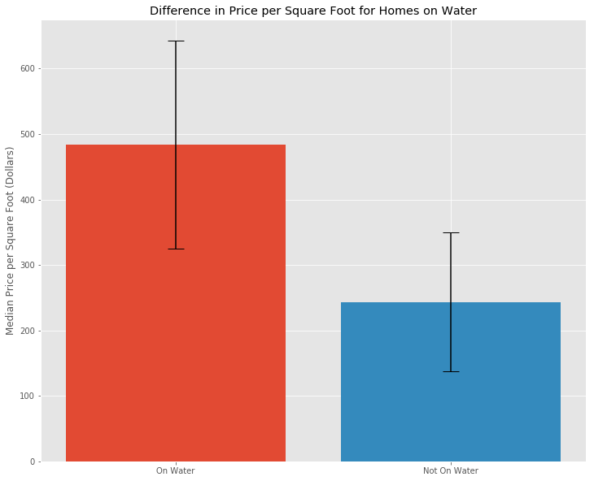
Results- Is your home on the water?
Homes on the water have a median price per square foot ofliving space nearly twice those not on water.

Slide 6
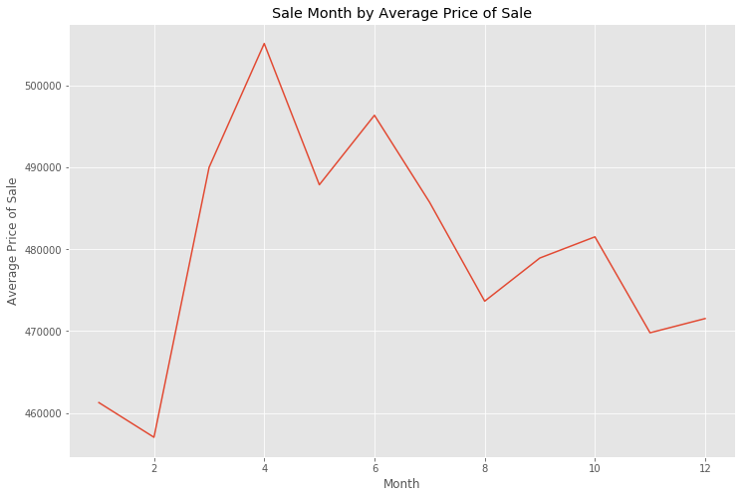
Results- When should you sell?
Top average sales prices were found to occur between March and July of the year.

Slide 7
Results – How big is your house?
How large your house is pretty well correlated to the price of your house.
However: it is important to note that this is true of the size of the living space of your home, and not the plot of your land.
Our final model associates each square foot of living space with an increase of $118.01 in the value of the home.

Slide 8
Takeaways and Limitations
If you can, try to put your home on the market before the spring/early summer times. This is when you are most likely to sell at the highest price
When looking to price your home, 3 things you should be looking at are:
Location of your home (Zipcode, Waterfront)
Quality of your home (Condition, Grade on King County’s 13 point system
Size of your home (Square footage of the interior of your home)
It should be noted that our model tends to underestimate the value of high value homes (over $1,000,000)

