Slide 1
FLIPKART MOBILE MARKET
& SENTIMENT ANALYSIS
CodeAlpha Data Analytics Internship Project
Web Scraping
EDA
Tableau Dashboard
NLP Sentiment Analysis
Presented By: Yash Shrivastav | Real-World Business Intelligence Project

Slide 2
Internship Tasks Completed
01
Web Scraping
02
Exploratory Data Analysis
ParseHub · Octoparse
Python · Pandas · Excel
Collected 677+ mobile reviews & product data from Flipkart
Pivot tables, brand-wise analysis & pricing trend identification
03
Data Visualization
04
Sentiment Analysis
Tableau · Matplotlib
NLTK · VADER NLP
Interactive dashboards for market & pricing intelligence
Classified 677 reviews; 83.9% positive customer sentiment

Slide 3
Task 1 — Web Scraping
01
Target Identification
677
162
Identified Flipkart as primary data source for mobile market analysis
Total Reviews Scraped
Unique Products
02
Product Scraping (ParseHub)
Scraped brand, model, price, storage, color — 162 unique products
12
11
Brands Covered
Data Fields Captured
03
Review Scraping (Octoparse)
Extracted customer reviews, ratings & reviewer info — 677 reviews
04
Dataset Preparation
Merged product + review datasets, exported structured CSV & Excel files
Tools: ParseHub (no-code) · Octoparse (no-code) · Python Pandas · Microsoft Excel

Slide 4
Task 2 — Exploratory Data Analysis
📊
Rating Distribution
💰
Price vs Satisfaction
5-star reviews dominate (61.2% = 414/677). Avg rating: 4.40 — classic e-commerce positivity skew.
Price-rating correlation = 0.073 (near zero). Apple avg ₹72,067 — higher price doesn't guarantee satisfaction.
📦
Storage Patterns
🏷️
Brand Market Share
128GB most popular (321 units). 176 null storage values identified and documented.
Ai+ leads with 230 reviews (34%). POCO, MOTOROLA follow. Budget brands dominate review volume.
🔍
Anomaly Detection
📈
Pricing Range
6 mismatch reviews (5-star rating but negative text). realme Narzo 90x 5G: worst score (−0.392).
Min ₹7,999 (budget) to ₹82,900 (Apple). Avg ₹14,940. Mid-range (10-15k) is the largest segment.

Slide 5
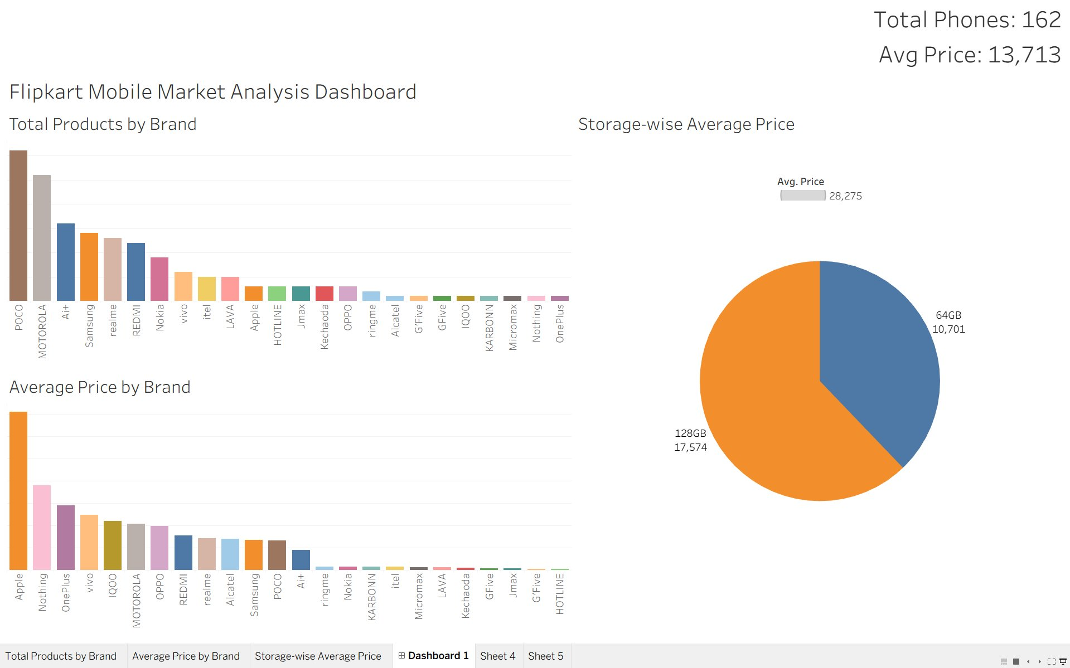
Task 3 — Data Visualization: Tableau Dashboard
162
₹13,713
₹28,275
25
Total Phones
Avg Price
Highest Avg (512GB)
Brands Covered
Features: Total Products by Brand · Average Price by Brand · Storage-wise Average Price · KPI Cards

Slide 6
Task 4 — Sentiment Analysis: NLP Method
Raw Reviews
Text Cleaning
VADER NLP
Compound Score
Classify Label
Dashboard Output
VADER Thresholds: Positive = score ≥ +0.05 Neutral = −0.05 to +0.05 Negative = score ≤ −0.05
83.9%
8.4%
7.7%
POSITIVE
NEUTRAL
NEGATIVE
568 reviews
57 reviews
52 reviews
677 customer reviews analyzed | Python · NLTK · VADER | Compound Score range: −1.0 to +1.0

Slide 7
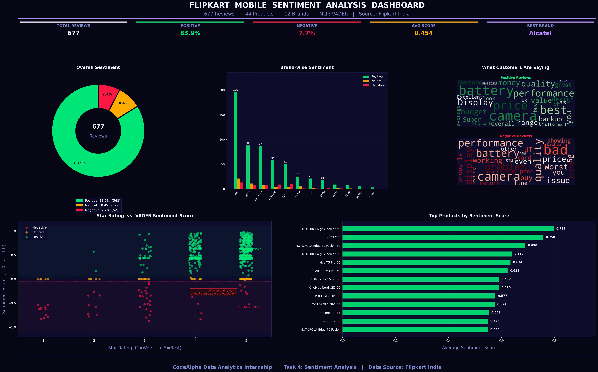
Task 4 — Python Sentiment Analysis Dashboard
5 chart types: Donut · Grouped Bar · Word Clouds · Scatter (Rating vs Sentiment) · Product Rankings

Slide 8
Key Insights
83.9%
Reviews Positive
4.40
Avg Star Rating
Camera & battery are the most appreciated features across all brands
5-star reviews = 61.2% of total — typical e-commerce positivity bias
🔋
⭐
0.073
Price–Rating Correlation
0.797
Top Product Score
Price ≠ satisfaction. Apple most expensive but proportionally fewer positives
MOTOROLA g57 power 5G — best sentiment score among all 44 products
📉
🏆
15.4%
REDMI Negative %
6
Rating-Sentiment Mismatch
Highest complaint rate among major brands — quality & service concerns
Reviews gave 5 stars but wrote negatively — hidden dissatisfaction detected
⚠️
🔍

Slide 9
Business Recommendations
Improve Budget Segment Quality
01
REDMI (15.4% negative) and Samsung (12.7%) need quality improvements. Budget buyers are vocal about hardware failures.
Market Camera & Battery Strengths
02
These are top positive keywords across all brands. Campaigns highlighting camera specs and battery life will resonate most.
Monitor Hidden Dissatisfaction
03
6 reviews gave 5 stars but wrote negatively. Implement NLP monitoring on all reviews regardless of star rating.
Leverage MOTOROLA's Success
04
MOTOROLA g57 power 5G (0.797) and Edge 60 Fusion (0.690) lead sentiment. Study their product strategy for replication.

Slide 10
Future Scope & Repository
🤖
ML-based sentiment models (BERT, RoBERTa) for higher accuracy
📁 GitHub Repository Structure
CodeAlpha_Flipkart_Mobile_Analysis
├── datasets/
│ ├── run_results.csv
│ ├── run_results_Cleaned_Pivot_3_new.xlsx
│ ├── Poco_C85x_Reviews.csv
│ ├── Mobile_Reviews_Dataset.xlsx
│ ├── Mobile_Reviews_Dataset.csv
│ └── reviews_with_sentiment.csv
├── dashboards/
│ ├── sentiment_dashboard.png
│ └── tableau_screenshot.png
├── python_scripts/
│ ├── sentiment.py
│ └── sentiment_dashboard.py
├── presentation/
│ └── Final_PPT_Yash_Shrivastav.pptx
└── README.md
⚡
Real-time dashboards using Streamlit for live review monitoring
🌐
Extend analysis to Amazon, Meesho & other marketplaces
😢
Emotion detection (joy, anger, fear) beyond basic polarity

Slide 11
Conclusion
This project demonstrates a complete end-to-end Data Analytics workflow using real-world
e-commerce data from Flipkart India.
✅ All 4 internship tasks completed successfully
🔬 Applied Web Scraping, EDA, Visualization and NLP on real data
📊 Built 2 professional dashboards — Tableau & Python Matplotlib
💡 Generated actionable business insights from 677 customer reviews
🚀 Demonstrated data-driven decision making for mobile e-commerce market

Slide 12
THANK YOU
Flipkart Mobile Market & Sentiment Analysis
Yash Shrivastav | CodeAlpha Data Analytics Internship
GitHub
Tools
Data
CodeAlpha_Flipkart_Mobile_Analysis
Python · Tableau · VADER · Pandas
Flipkart India · 677 Reviews · 12 Brands

