Slide 1
Team Seats
S
C
R
E
E
N
10
TA
1
2
3
9
13
4
5
6
8
12
7
11

Slide 2
Checkpoint #2
Due : 10/16/2020

Slide 3
Outline
CP 2 Supplies Check
Checkpoint #2
L298N
Motor with Encoder

Slide 4
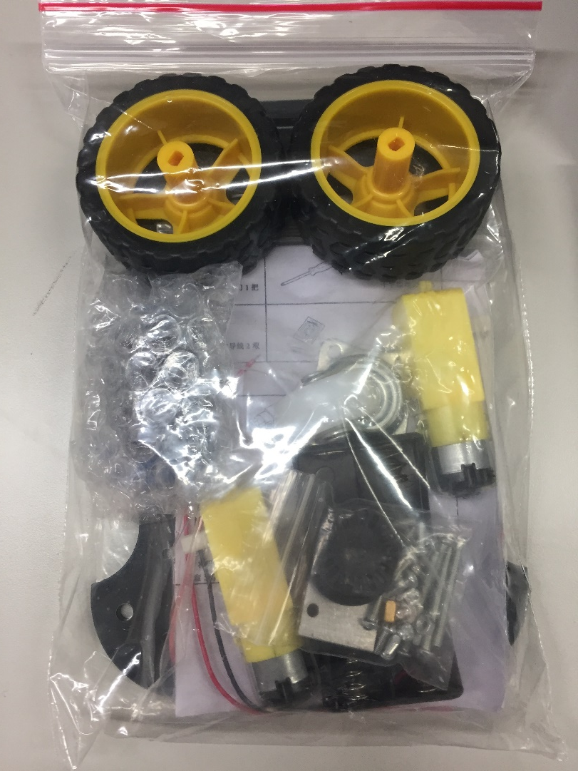
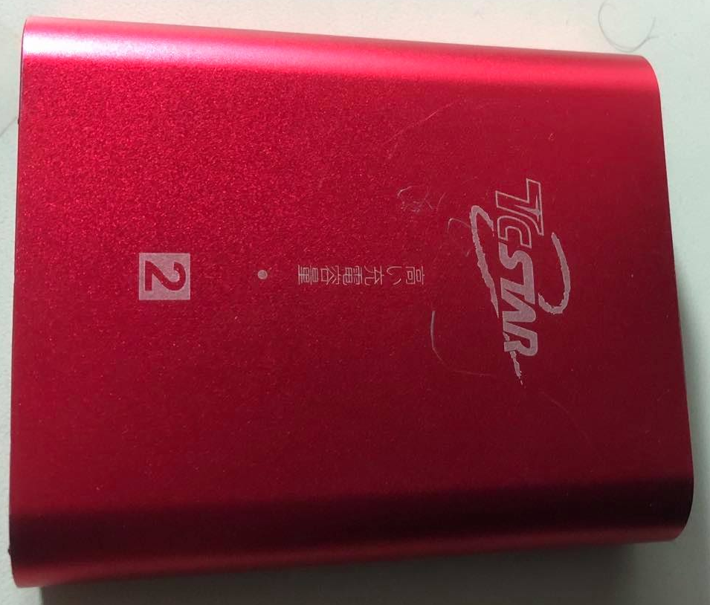
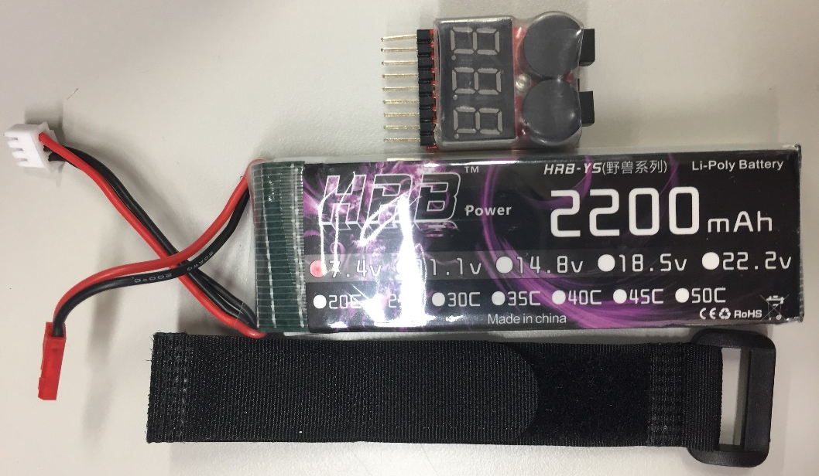
CP 2 Supplies
Checkpoint#2 Material List
1 | DC Motor with Encoder x 2 | 5 | Li-Po Battery
2 | Wheel x 2 | 6 | Low Voltage Alarm
3 | Support Wheel | 7 | Power Supply
4 | L298N Motor Control Module
Team__________

Slide 5
Checkpoint #2
Purpose: Motion Control of basic DC motors by encoder with Raspberry Pi and Arduino.
Tasks: To control two motors by encoder signals.
Move forward. (25%)
Move backward. (25%)
Turn right. (15%)
Turn left. (15%)
How straight the robot can move when moving forward. (20%)

Slide 6
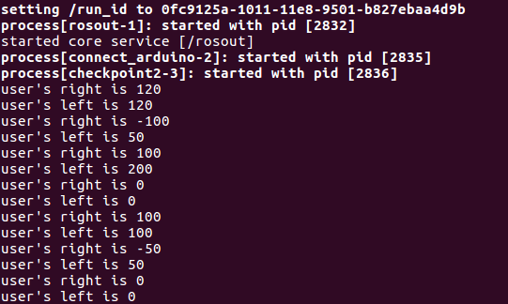
Checkpoint #2

Slide 7
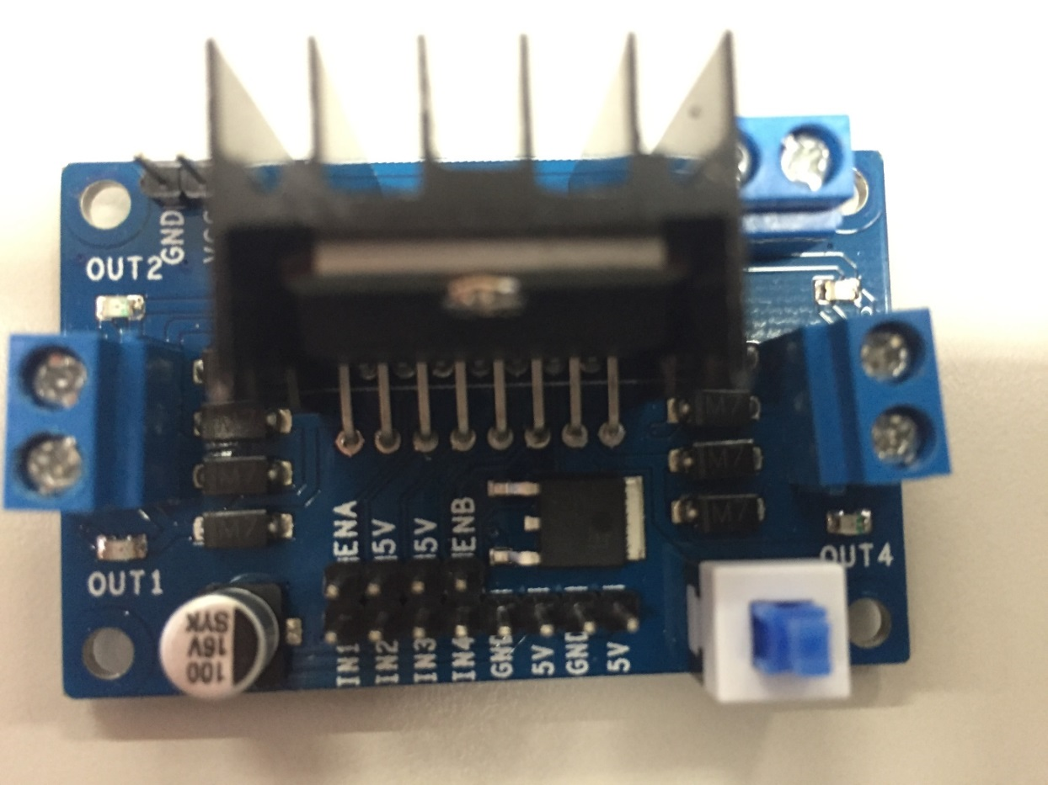
L298N
Double H-bridge driver module
When the input voltage is given around 7V to 12V, can supply 5V for motors
VCC
GND
Motor Terminal 2
Motor Terminal 3
Motor Terminal 1
Motor Terminal 4
IN1, IN2, IN3 and IN4 : High/Low pulse for rotation direction
ENA, ENB: PWM for speed control
Switch
Motor A Enable
Motor A Input
Motor B Input
Motor B Enable
Notes:
As shown in the diagram, you have Motor A inputs and Motor B inputs.
These are connected to the microcontroller.
The motor terminals are connected to Motor Terminals 1, 2, 3, 4 where Motor A is connected to terminals 1 and 2
Motor B is connected to terminals 3 and 4.
Speed control for Motor A and Motor B is achieved via PWM on ENA and ENB, we will explain it later.

Slide 8
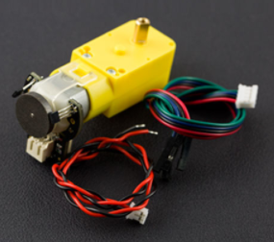
Motor with Encoder
This is the Micro DC geared motor with encoder.
The motor with a 120:1 gearbox and an integrated quadrature encoder that provides a resolution of 16 pulse single per round.
So, it can give a maximum output of 1920 within one round.
120 x 16 = 1920
Encoder
Notes:
The motors we use are called “Voltage-controlled motors”.
This means that the velocity of each motor is directly proportional to the voltage it is subject to.
Even though we use the same model of motor for left and right wheel, they are not exactly the same.
That‘s why we need to do the motor calibration.
The gain parameter g controls the maximum speed of the robot.
With g>1.0, the vehicle goes faster than given the same velocity command, and for g<1.0 it goes slower.
The trim parameter r controls the balance between the two motors.
With r>0, the right wheel will turn slightly more than the left wheel given the same velocity command;
with r<0, the left wheel will turn slightly more the right wheel.

Slide 9
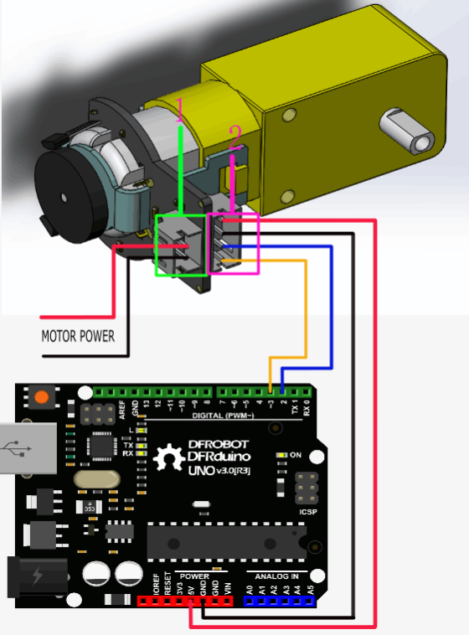
Motor with Encoder
Pin Description
Motor Power
Pin | Name | Description
A | Encoder A phase output | Changes square wave with the output frequency of Motor speed
B | Encoder B phase output | Changes square wave with the output frequency of Motor speed(interrupt port)
C | Encoder supply GND
D | Encoder supply + | 4.5-7.5V
A
B
C
D
Notes:
The motors we use are called “Voltage-controlled motors”.
This means that the velocity of each motor is directly proportional to the voltage it is subject to.
Even though we use the same model of motor for left and right wheel, they are not exactly the same.
That‘s why we need to do the motor calibration.
The gain parameter g controls the maximum speed of the robot.
With g>1.0, the vehicle goes faster than given the same velocity command, and for g<1.0 it goes slower.
The trim parameter r controls the balance between the two motors.
With r>0, the right wheel will turn slightly more than the left wheel given the same velocity command;
with r<0, the left wheel will turn slightly more the right wheel.

Slide 10
Motor with Encoder
Interrupts are useful for making things happen automatically in microcontroller programs and can help solve timing problems.
using an interrupt can free the microcontroller to get some other work done while not missing the input.
Interrupt Port with Different Board
attachInterrupt() | Board | Int.0 | Int.1 | Int.2 | Int.3 | Int.4 | Int.5
 | Uno,Ethernet | 2 | 3
 | Mega2560 | 2 | 3 | 21 | 20 | 19 | 18
 | Leonardo | 3 | 2 | 0 | 1 | 7

Slide 11
Reference
Micro DC Motor with Encoder
https://wiki.dfrobot.com/Micro_DC_Motor_with_Encoder-SJ01_SKU__FIT0450
Digital Pins With Interrupts
https://www.arduino.cc/reference/en/language/functions/external-interrupts/attachinterrupt/

Slide 12
Demo Time
Group A 09:30 ~ 10:30 | Group B 10:30 ~ 11:30
Team 1 | Team 7
Team 2 | Team 8
Team 3 | Team 9
Team 4 | Team 10
Team 5 | Team 11
Team 6 | Team 12
Deadline
--------------------------------------------------------
Checkpoint#2 Demo : 11/06
Checkpoint #2 Report : 11/13

