Slide 1


Lost & Found Locator Application
A Smart Solution for Your LostItem Recovery Inside the Campus
Team: Satej, Rahul, Suma, Vaishnavi, Ashwin, Sneha
Mentor: Suramya Biswas

Slide 2
Problem Statement
Lost Items Go Unrecovered
Manual Processes Fail
Matching is Difficult
Traditional notice boards and manual searches are time-consuming, inefficient, and lack proper tracking mechanisms.
Without a centralised platform, connecting lost items with their rightful owners becomes nearly impossible.
Valuable personal belongings are lost daily across campuses, with no efficient recovery system.

Slide 3
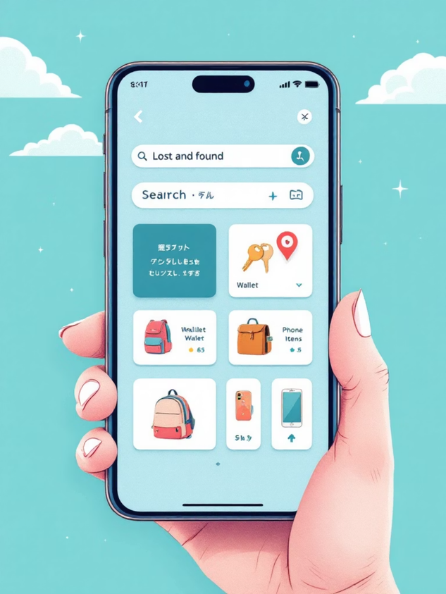
Our Solution
A web-based platform that connects people who have lost items with those who have found them through a secure, user-friendly interface.
Centralised lost and found database
Intelligent matching algorithms
Secure communication channels
Real-time notifications
Administrative oversight

Slide 4





System Modules
Authentication
Item Posting
Matching System
Secure user registration and login with encrypted credentials and session management.
Users can post lost or found items with detailed descriptions, photos, and location data.
Automated matching engine compares lost and found items based on descriptions and categories.
Chat Module
Admin Dashboard
Secure messaging system allows users to communicate directly for item verification and recovery.
Comprehensive control panel for monitoring, managing users, and overseeing all system activities.

Slide 5
Technology Stack
Frontend
Backend
React.js for component-based UI
React Router for navigation
Spring Boot for REST API
Spring Security for authentication
Spring Data JPA for persistence
Database
Tools & DevOps
MySQL for relational data
Structured schema design
Eclipse IDEA for backend development
Vs Code for frontend development
Git for version control

Slide 6

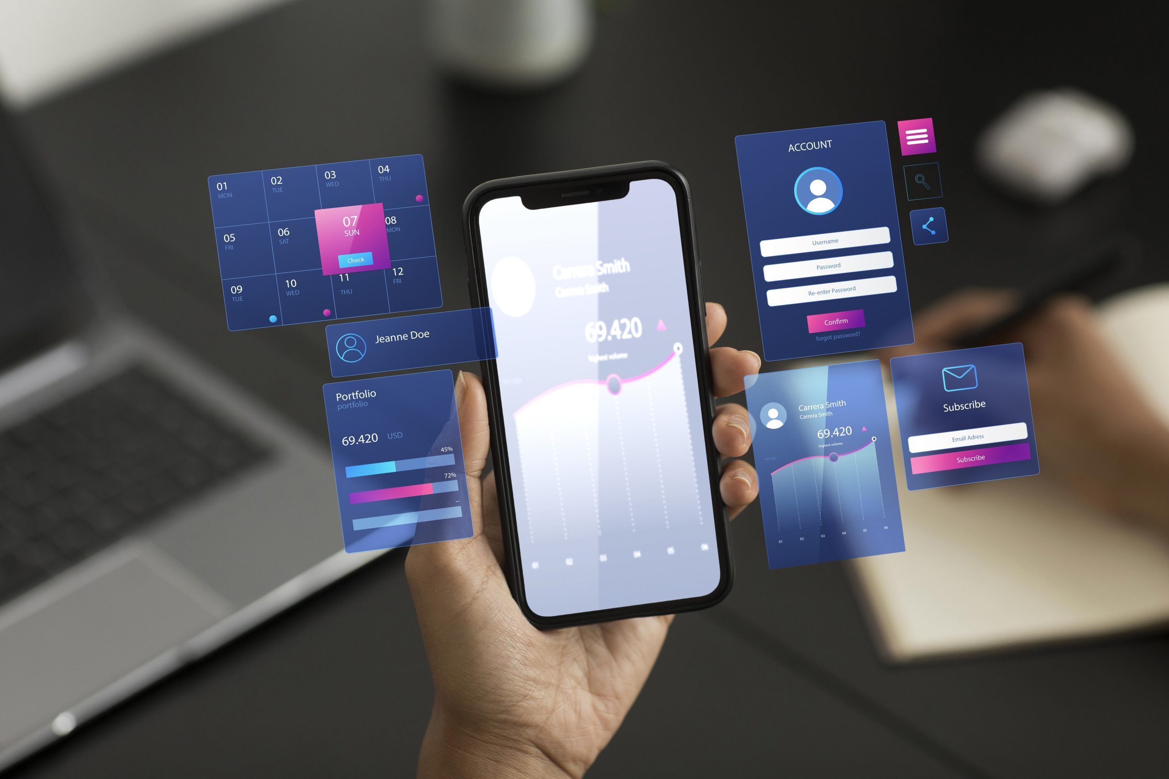




Workflow
User Login
Secure authentication with email and password verification
Post Item
User submits lost or found item with details and images
System Matches
Automated matching identifies potential item recovery
Chat & Verify
Users communicate to confirm item ownership
Item Recovery
Successful item return with system confirmation

Slide 7
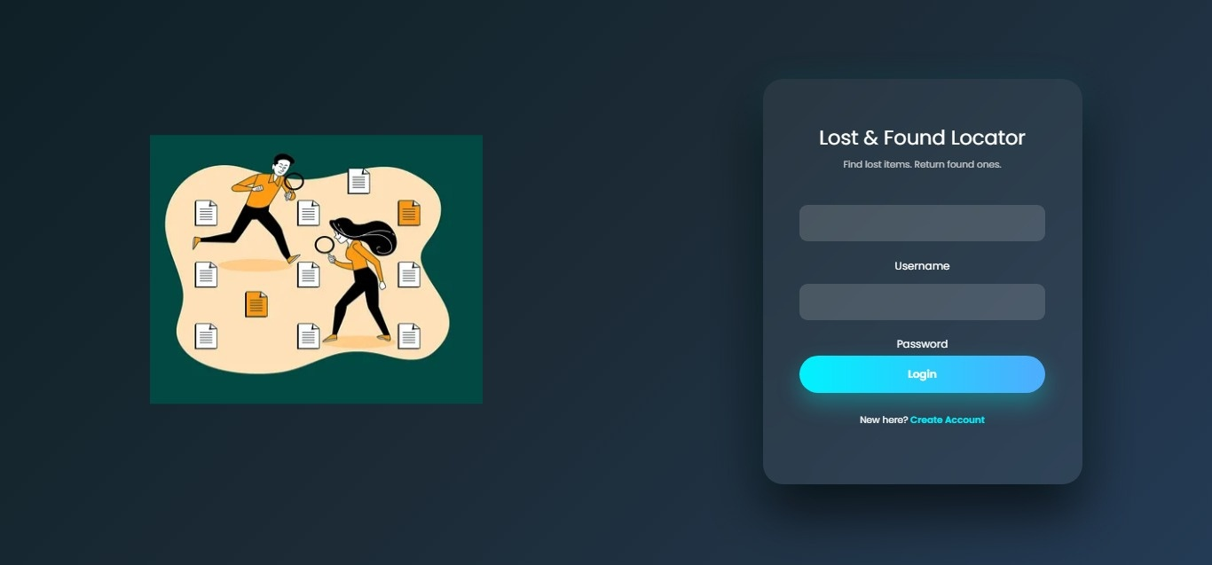
Project Outputs:

Slide 8
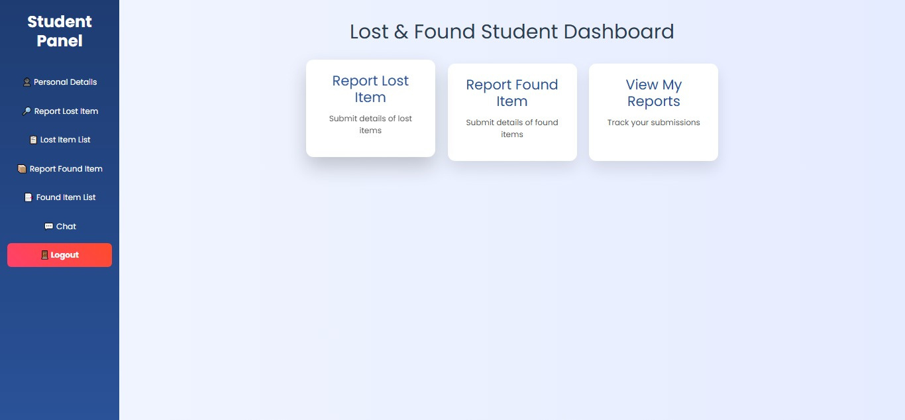

Slide 9
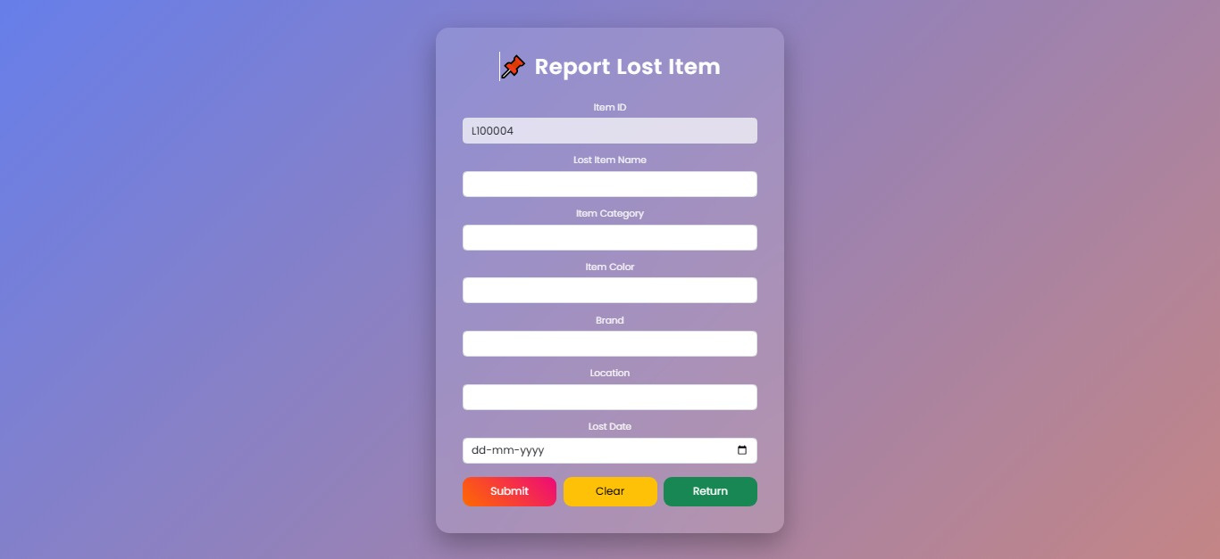

Slide 10
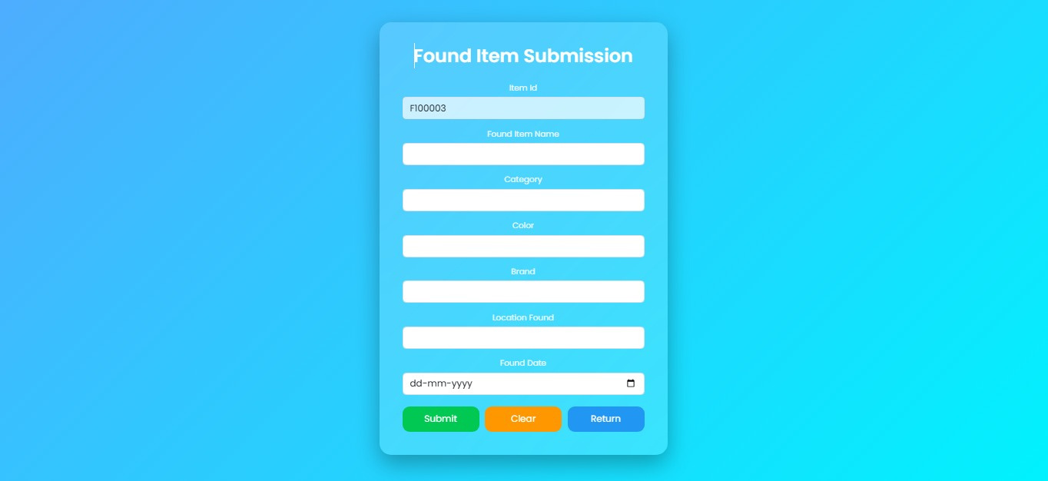

Slide 11
Future Enhancements
01
02
03
AI-Powered Matching
Mobile Application
GPS Integration
Implement machine learning algorithms to improve matching accuracy using image recognition and natural language processing.
Develop native iOS and Android apps for on-the-go access with push notifications and camera integration.
Add location tracking to help users find lost items based on last known GPS coordinates and movement patterns.
04
05
Smart Notifications
Multi-Language Support
Enable real-time alerts via email, SMS, and app notifications when potential matches are identified.
Expand platform accessibility by supporting multiple languages and regional preferences for wider user reach.

Slide 12




Conclusion
Increased Recovery Rate
Time Efficient
Digital platform significantly improves lost item recovery compared to traditional manual methods.
Reduces search time from days to minutes through automated matching and notifications.
Secure & Trustworthy
Scalable Solution
Encrypted communications and verified user accounts ensure data privacy and security.
Architecture supports expansion to multiple locations and thousands of users simultaneously.

Slide 13
Thank You!

