Slide 1
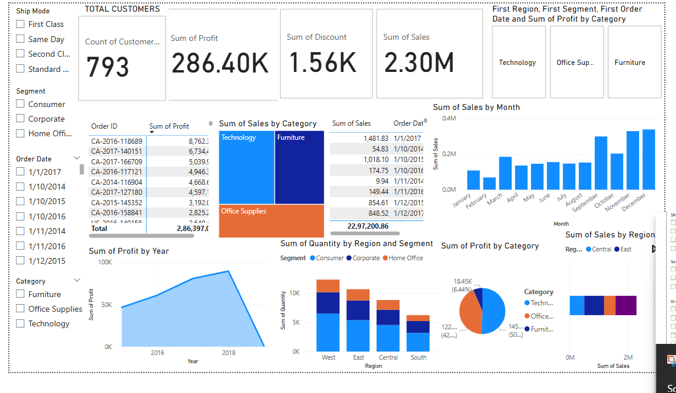
Dashboard Overview

Slide 2
Dashboard KPIs & Visuals
- Cards: Total Sales, Total Profit, Discount, Distinct Customers
- Sales by Category: Highest in Technology
- Profit by Year: Peaked in 2018
- Region Breakdown: West leads with 678.78K sales
- Monthly Sales Trend: Peaks in Q4
- Segment & Region Bar: Consumer dominates
- Filters: Slicers for Segment, Ship Mode, Category, Date

Slide 3
Key Business Insights
- Technology still dominates sales and profit
- Sales and profit rise sharply in Q4
- Western region performs best across all KPIs
- Sales spike in November–December, indicating seasonal peaks
- High profit concentrated in a few top-selling products
- Consumer segment has highest order volume

Slide 4
Tools & Dataset Used
- Tool Used: Power BI Desktop
- Dataset: Kaggle Superstore Sales
- purpose: Visualize sales, category, region, and customer behavior in an interactive and analytical format
- Features: Time series, category breakdown, regional performance

