Slide 1

Developing a fluid-structure interaction finite element formulation for GPU calculations with Pogo: Application to underwater acoustics
Yiannis Simillides, Peter Huthwaite, Michael J.S. Lowe, Michał K. Kalkowski, Richard Craster, Oliver G. Sanford and Stewart Haslinger

Slide 2
Talk Outline
Motivation for FE modelling using GPU calculations
Mathematics and Formulations
Examples and Results
Summary

Slide 3
Motivation : Modelling
Calculate TES / seabed responses
Developing new approaches and methods before running costly experiments
Carry out parametric studies of defects and setups
Acquire training data for ML algorithms

Slide 4
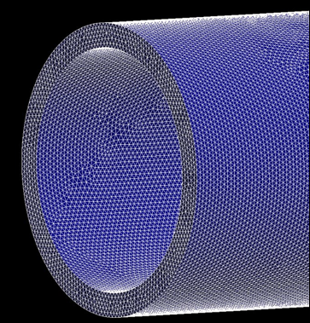
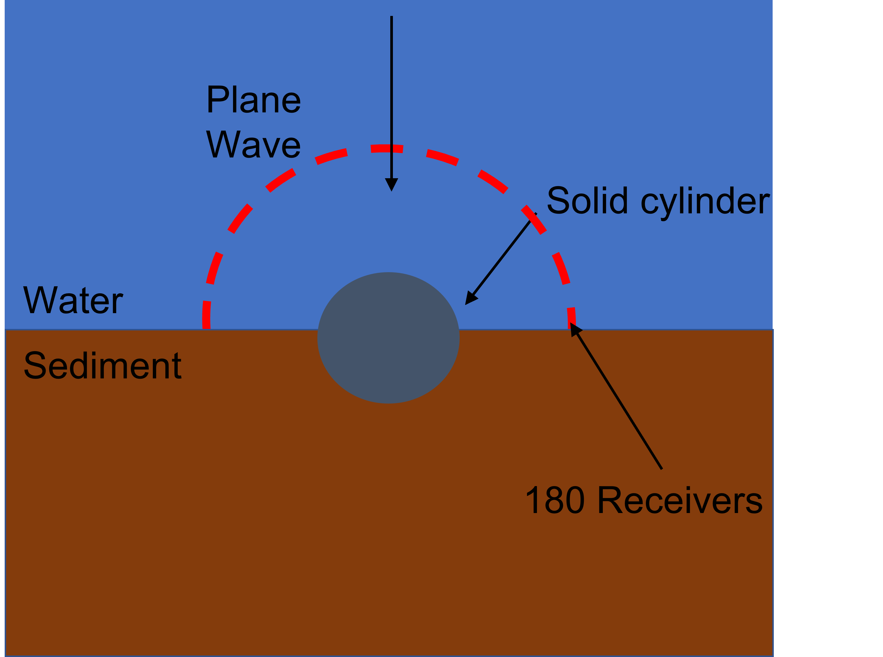
Motivation : FE

Slide 5
Motivation : GPU calculations
Designed to run the same calculation many times
High memory bandwidth for loading data
Pogo has demonstrated speed ups of 1-2 orders of magnitude compared to CPU software for solid calculations
Wish to replicate this for underwater acoustics

Slide 6
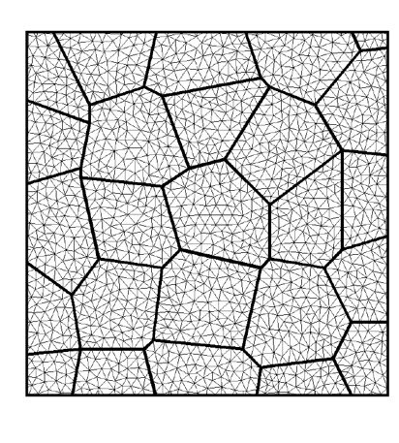
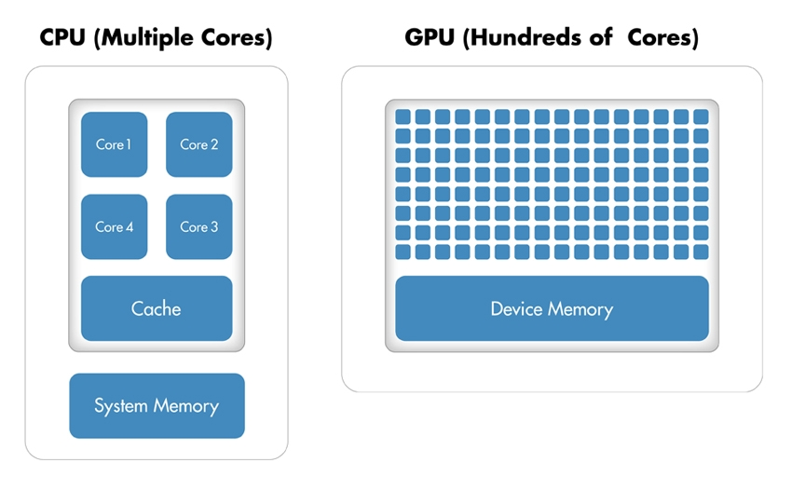
Motivation : GPU calculations

Slide 7

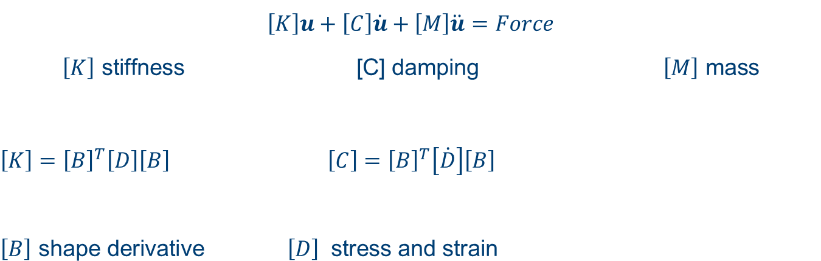
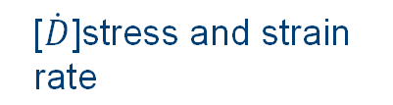
FE Formulation
$$\left[K\right]u+\left[C\right]\dot{u}+\left[M\right]\ddot{u}=Force$$
$$\left[K\right] \text{stiffness}\text{ [}\text{C}\text{] }\text{damping} \left[M\right] \text{mass}$$
$$\left[K\right]={\left[B\right]}^{T}\left[D\right]\left[B\right] \left[C\right]={\left[B\right]}^{T}\left[\dot{D}\right]\left[B\right]$$
$$\left[B\right] \text{shape} \text{derivative} \left[D\right] \text{stress} \text{and} \text{strain}$$
$$\text{[}\dot{D}\text{]}\text{stress} \text{and} \text{strain} \text{rate}$$

Slide 8
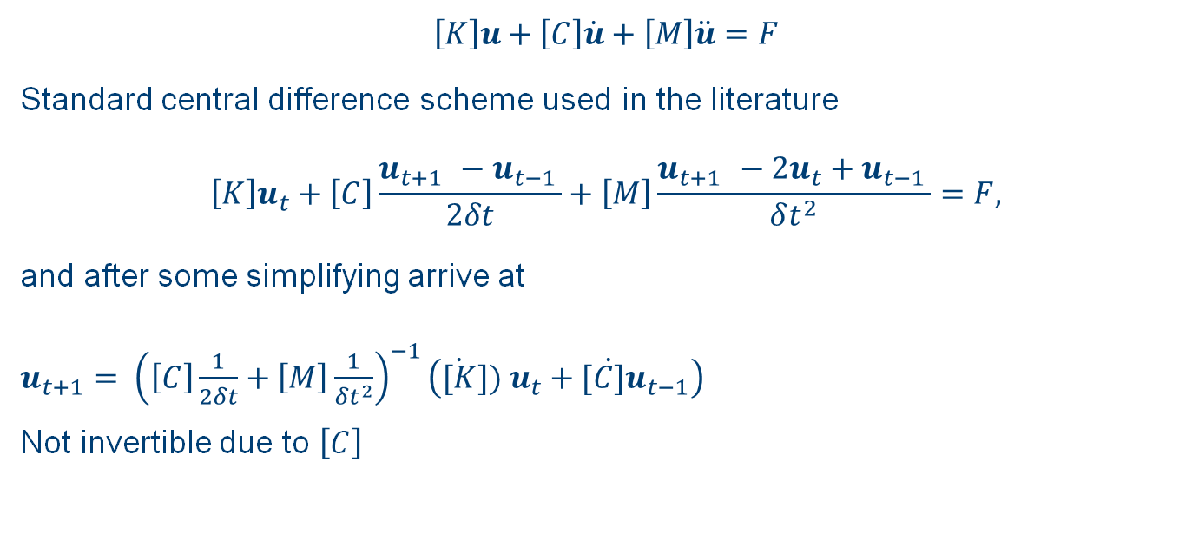
$$\left[K\right]u+\left[C\right]\dot{u}+\left[M\right]\ddot{u}=F$$
Standard central difference scheme used in the literature
$$\left[K\right]u_{t}+\left[C\right]\frac{u_{t+1 }−u_{t−1 }}{2δt}+\left[M\right]\frac{u_{t+1 }−2u_{t}+u_{t−1 }}{δt^{2}}=F,$$
and after some simplifying arrive at
$u_{t+1}= {\left(\left[C\right]\frac{1}{2δt}+\left[M\right]\frac{1}{δt^{2}}\right)}^{−1}\left(\dot{[K}]) u_{t}+[\dot{C]}u_{t−1}\right)$
Not invertible due to $\left[C\right]$

Slide 9
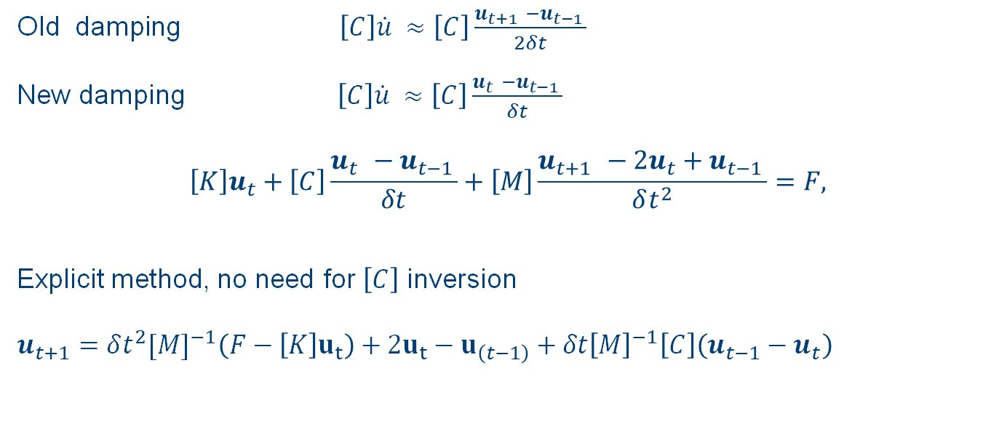
Old damping$\left[C\right]\dot{u} ≈\left[C\right]\frac{u_{t+1 }−u_{t−1 }}{2δt}$
New damping $\left[C\right]\dot{u} ≈\left[C\right]\frac{u_{t }−u_{t−1 }}{δt}$
$$\left[K\right]u_{t}+\left[C\right]\frac{u_{t }−u_{t−1 }}{δt}+\left[M\right]\frac{u_{t+1 }−2u_{t}+u_{t−1 }}{δt^{2}}=F,$$
Explicit method, no need for $\left[C\right]$ inversion
$$u_{t+1}=δt^{2}[{M]}^{−1}\left(F−\left[K\right]u_{t}\right)+2u_{t}−u_{\left(t−1\right)}+δt{\left[M\right]}^{−1}\left[C\right]\left(u_{t−1}−u_{t}\right)$$

Slide 10
CFL Condition
Ideally we want the Courant number to be <=1 for best results
>=1 is unstable
<<1 gives inaccurate frequency result
Courant number of 1 for steel (velocity ~ 6000m/s) gives courant number of 0.25 for water (velocity ~ 1500 m/s)
Always have some error which can’t be directly avoided

Slide 11
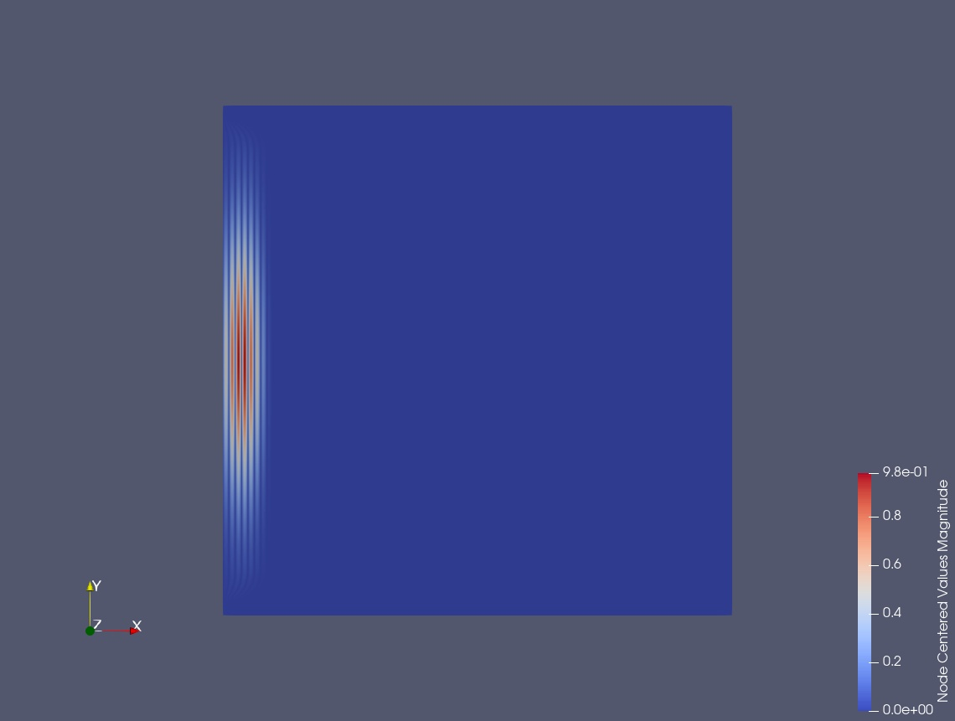
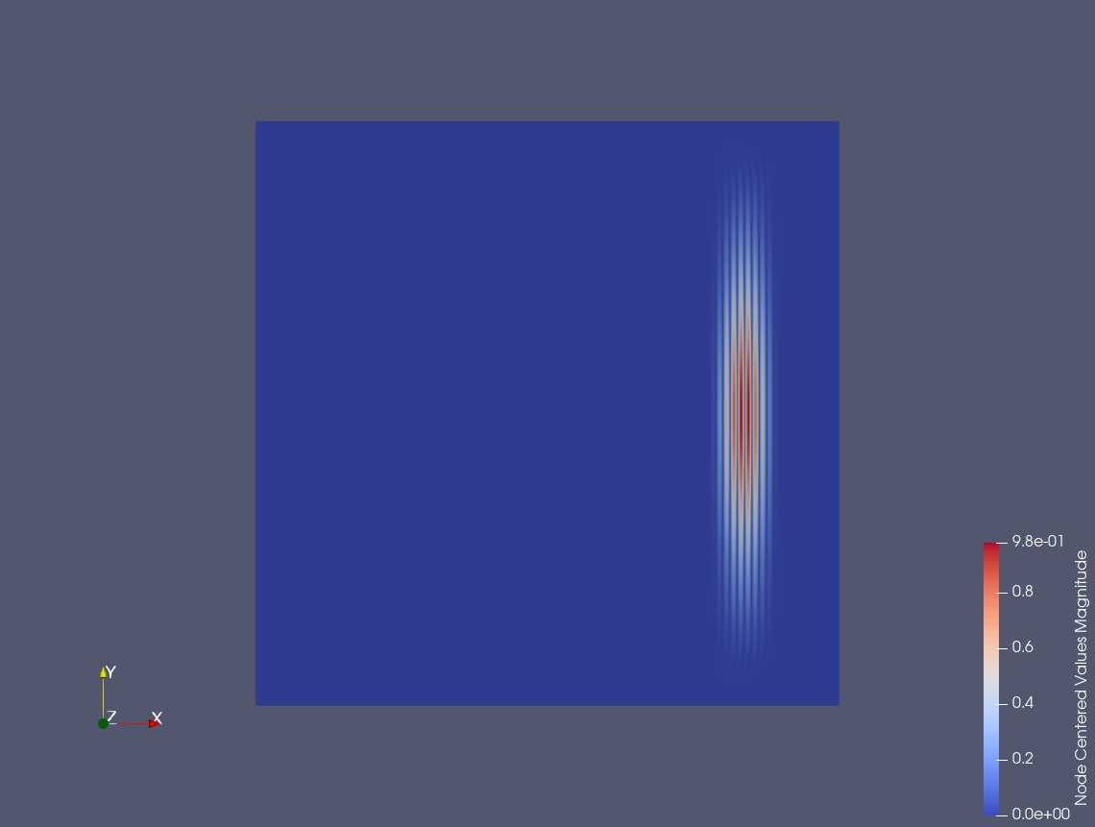
Pure Fluid Propagation
Measurement points
Measurement points

Slide 12
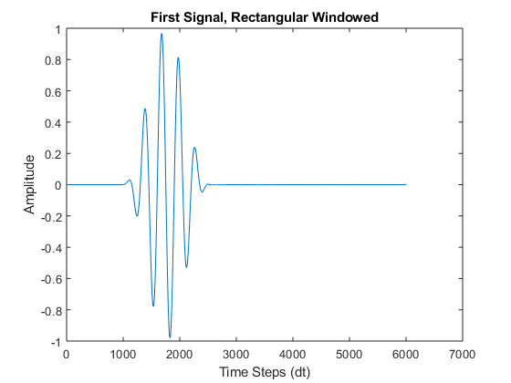
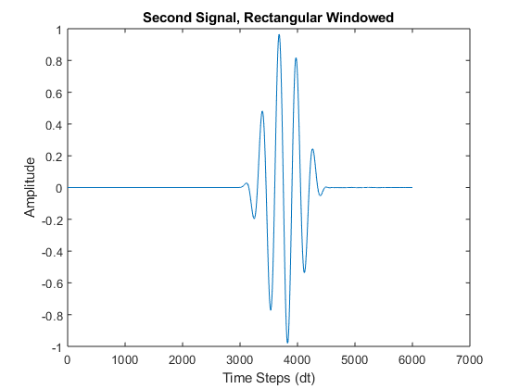
Pure Fluid Propagation

Slide 13
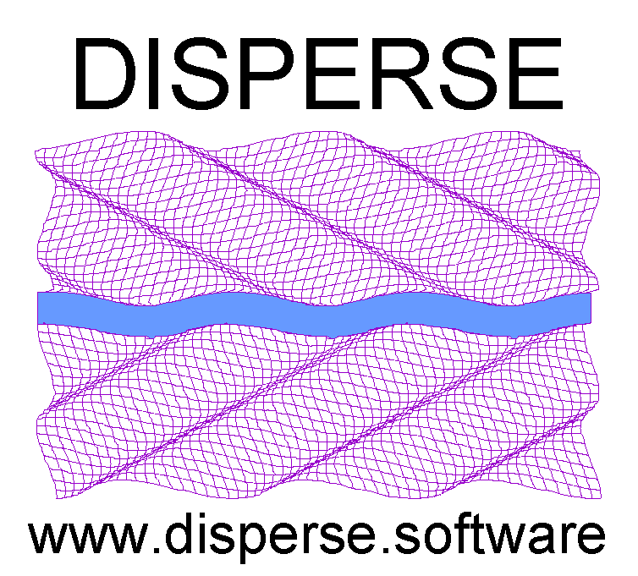

Existence of Wavemodes
Water
x
x x x
Steel
Sources
Receivers
(1024 in total)

Slide 14
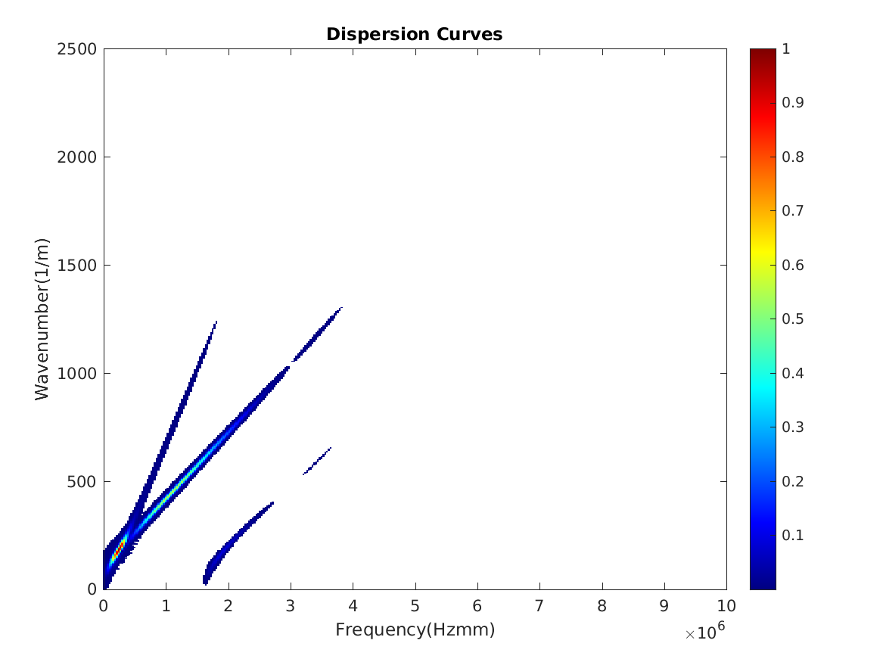
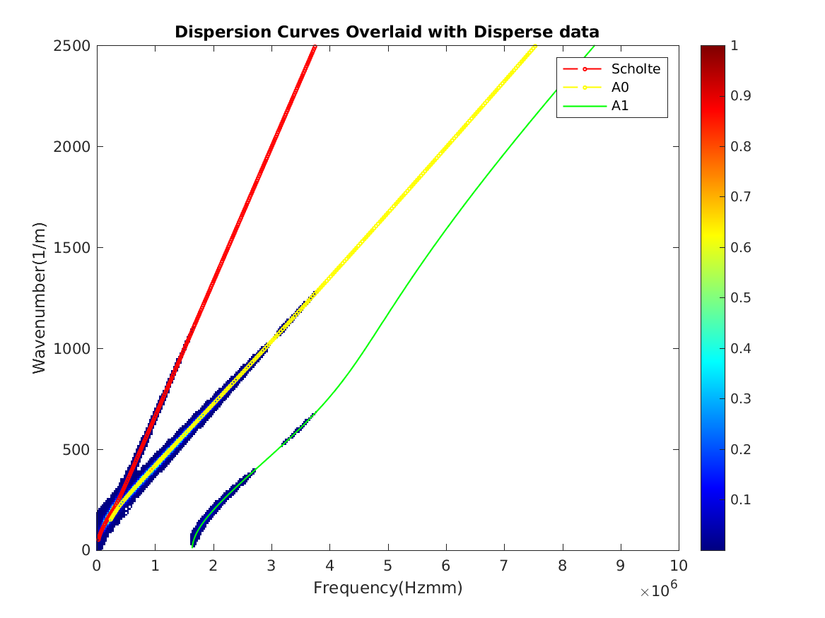
Existence of Wavemodes, low frequency

Slide 15
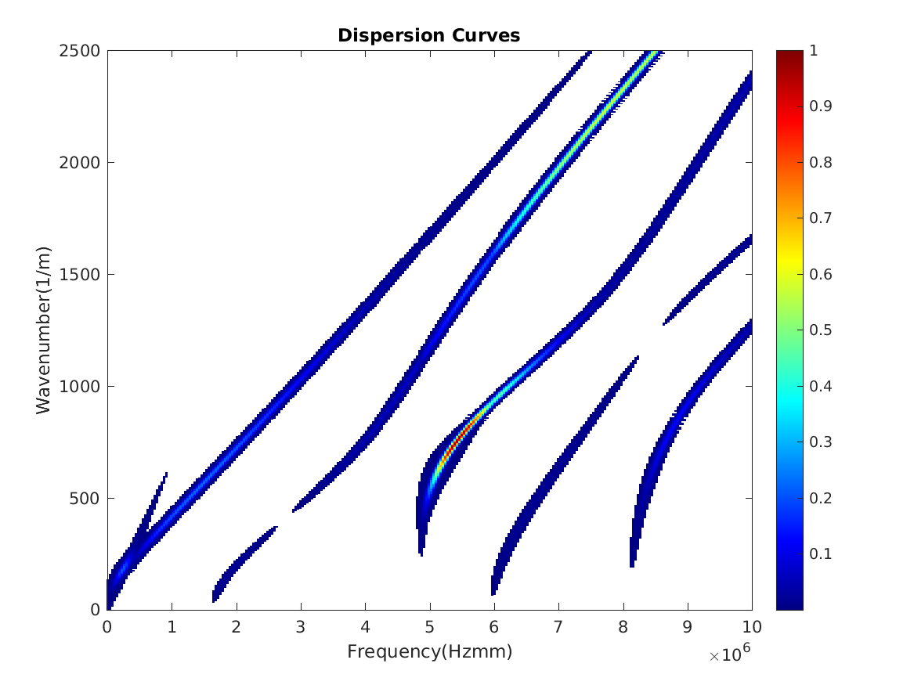
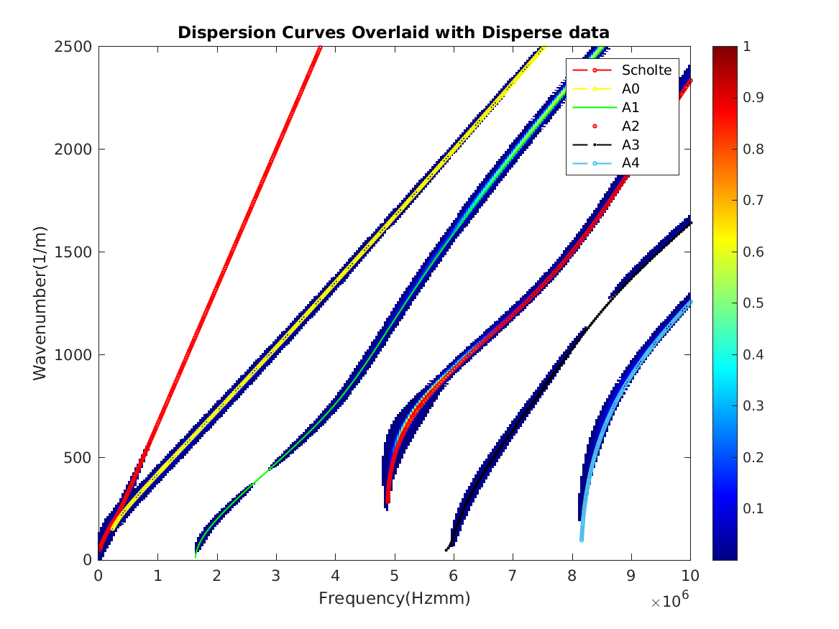
Existence of Wavemodes, high frequency

Slide 16
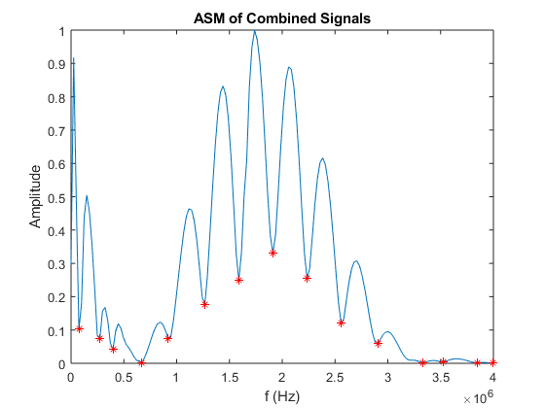
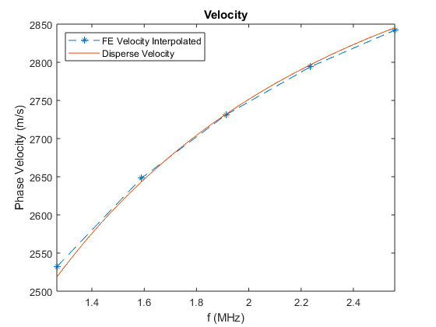
Velocity Measurements, A0 mode

Slide 17
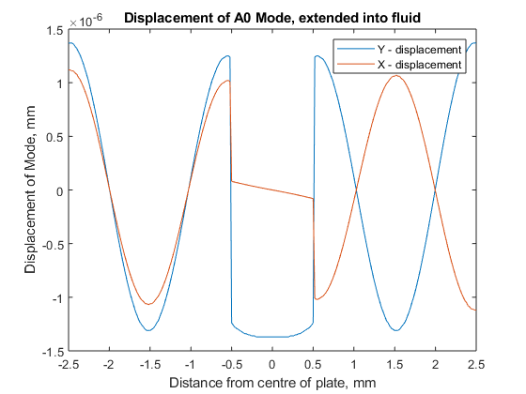
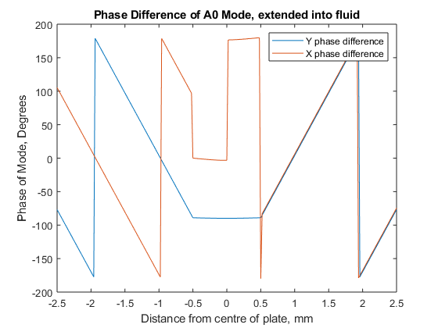
Attenuation Measurements, A0 mode

Slide 18
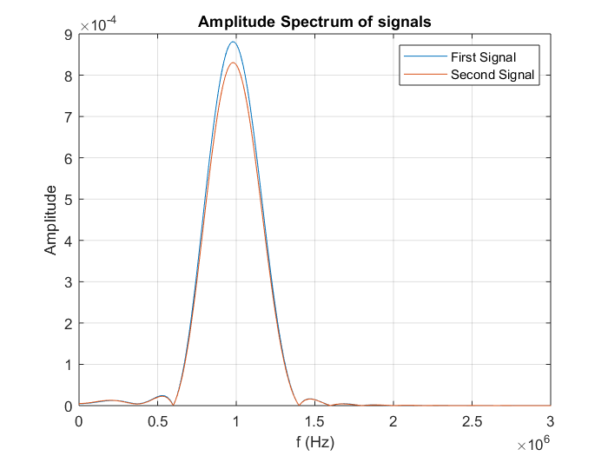
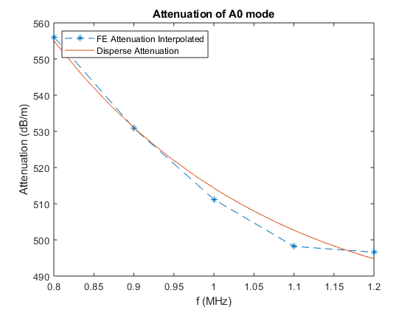
Attenuation Measurements, A0 mode

Slide 19
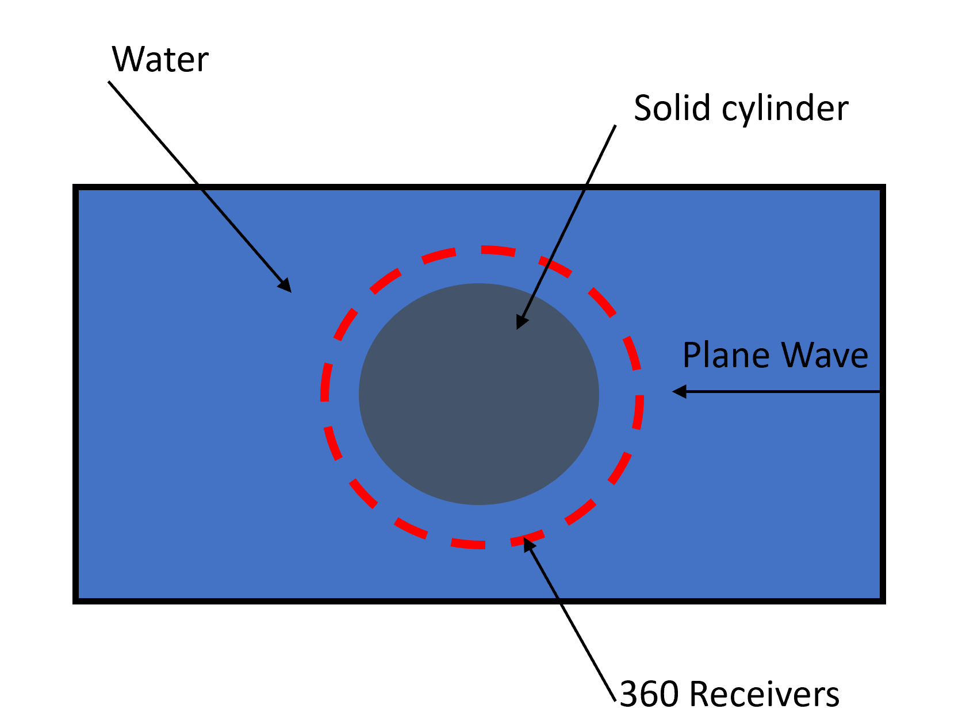
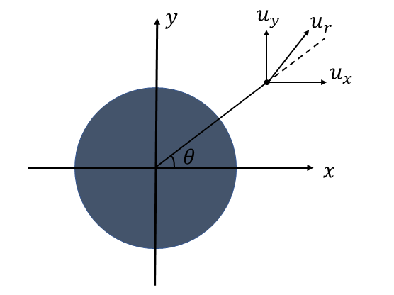
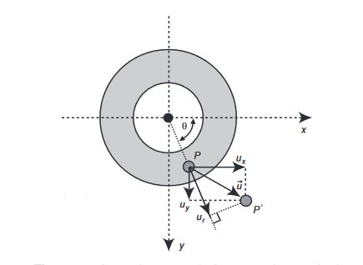
Scattering from a solid cylinder in fluid

Slide 20
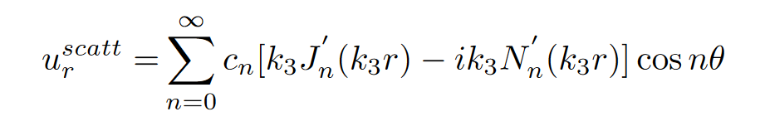
Scattering from a solid cylinder in fluid
Cylinder Radius : 1m
Receiver Location : 2.5m
https://bit.ly/ICUA2022
Faran Jr, James J. "Sound scattering by solid cylinders and spheres."

Slide 21
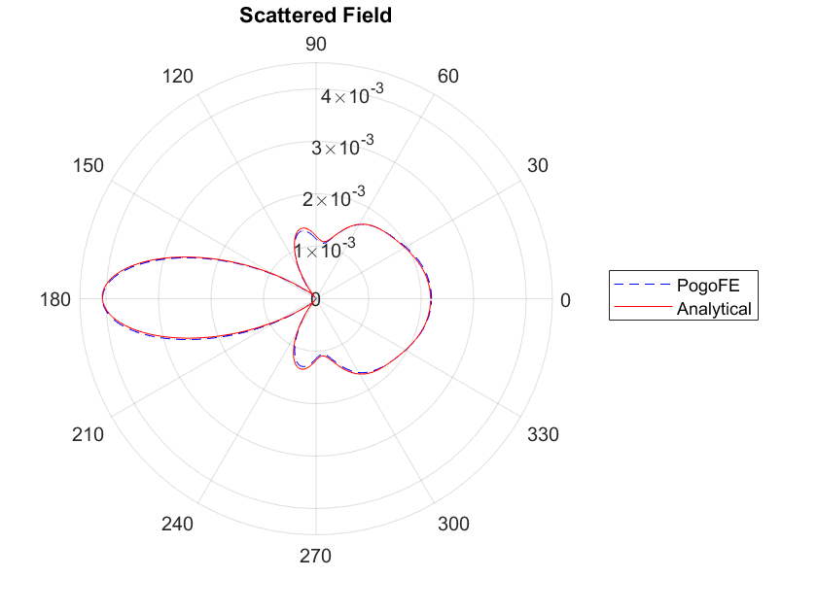
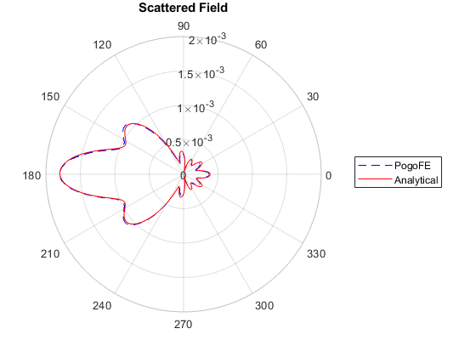
Scattering from a solid cylinder in fluid, ka = 4.2
steel
perspex

Slide 22
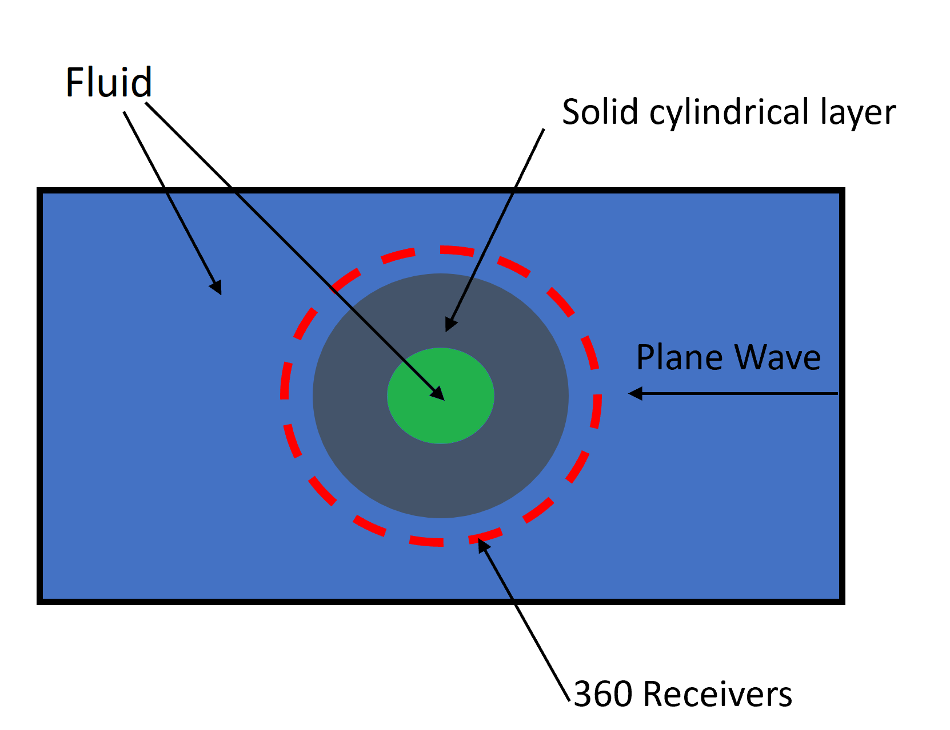
Scattering from cylindrically layered media in fluid

Slide 23
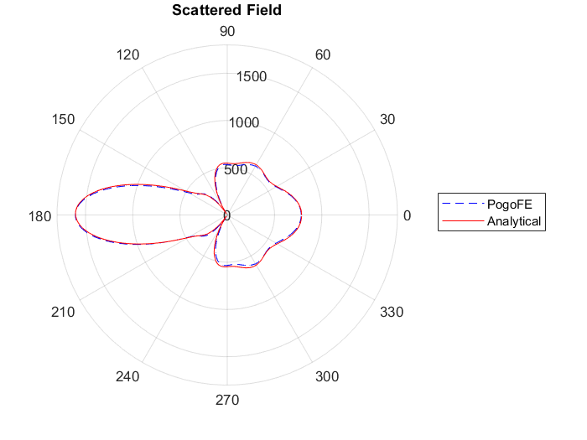

Scattering results for steel annulus in fluid
Air Interior
Water interior

Slide 24
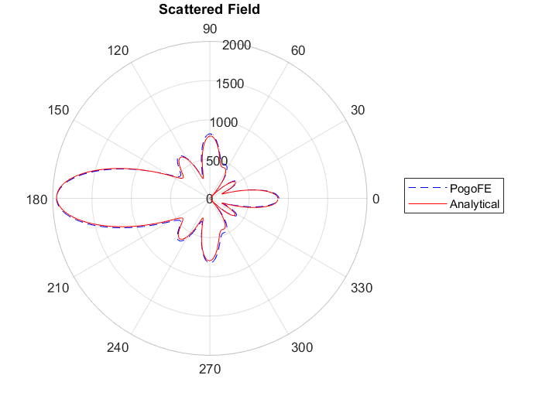
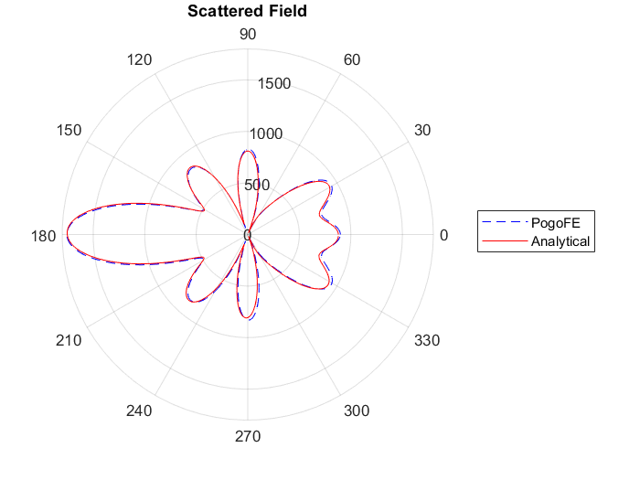
Scattering Results for perspex annulus in fluid
Water interior
Air Interior

Slide 25
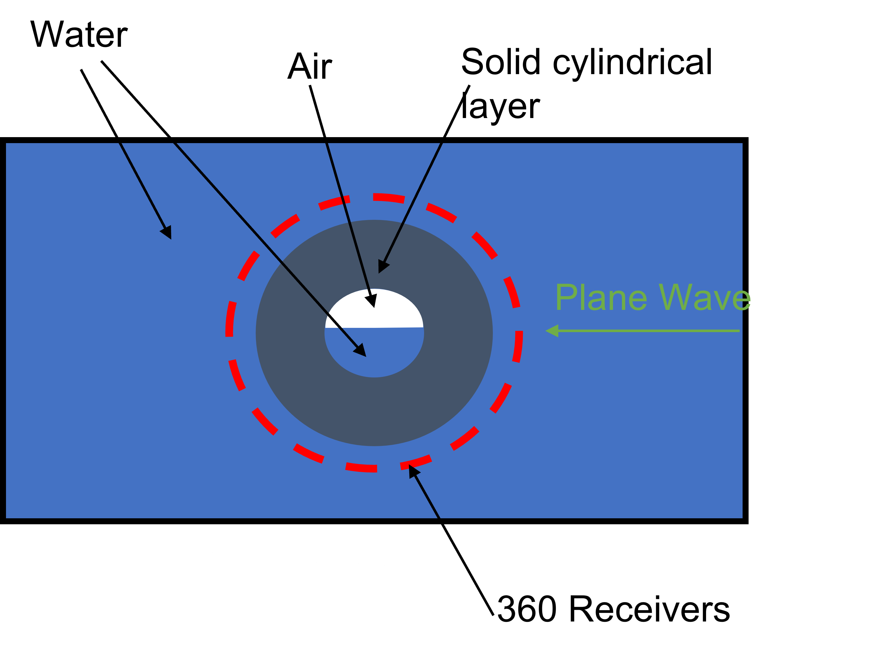
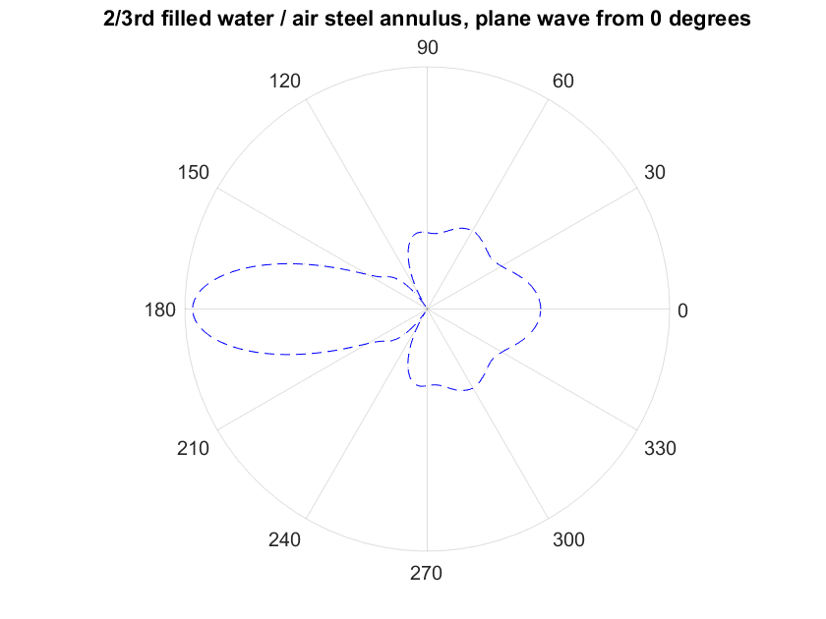
Scattering from cylindrically layered media in fluid, 2/3rd full

Slide 26
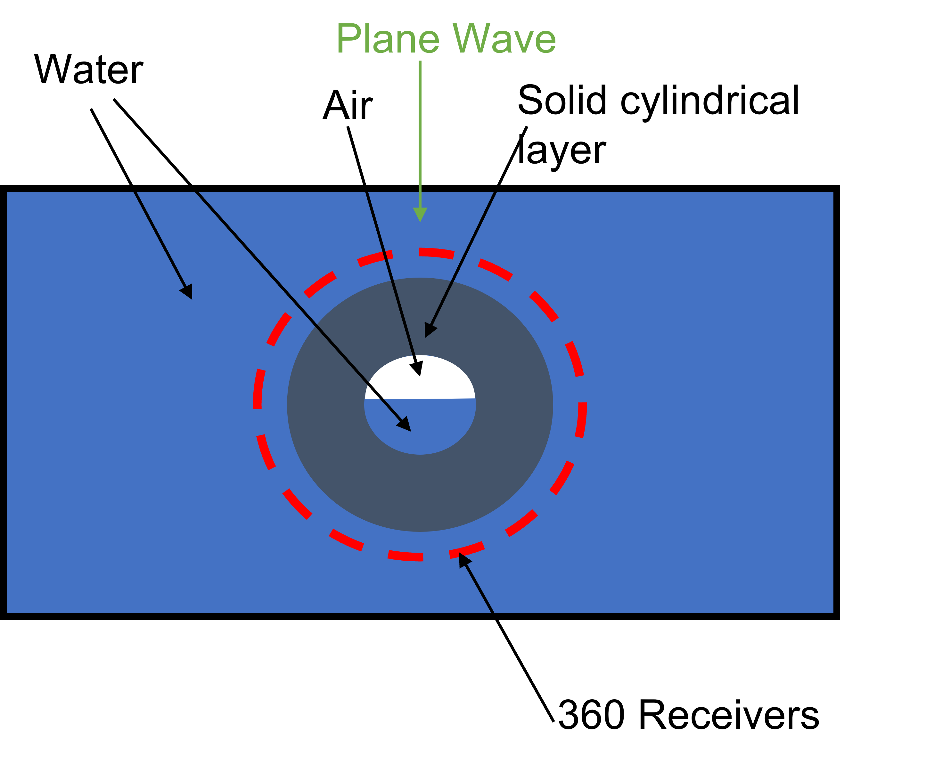
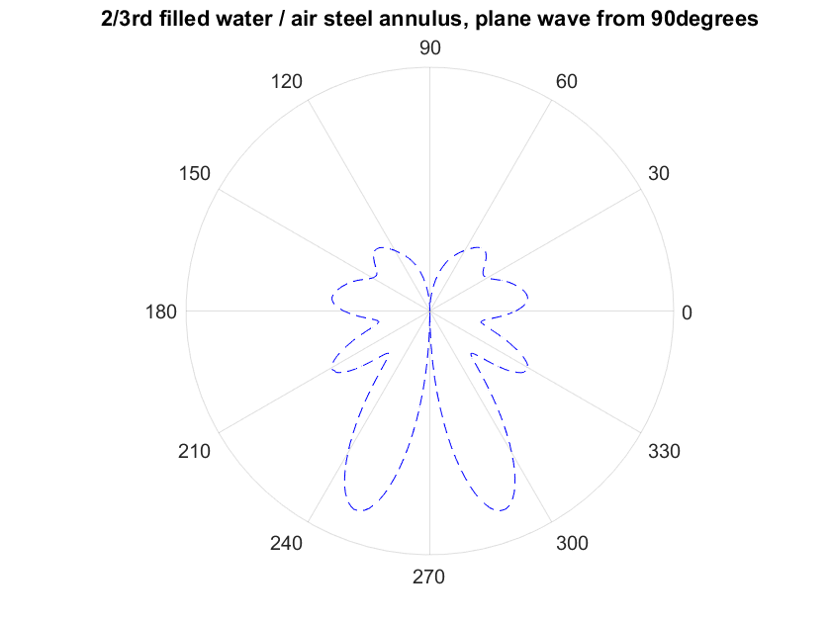
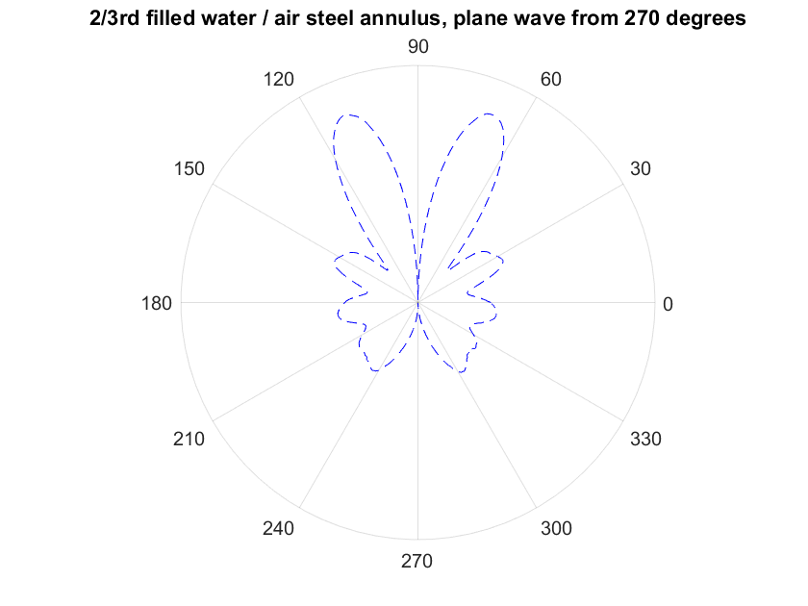
Scattering from cylindrically layered media in fluid, 2/3rd full

Slide 27
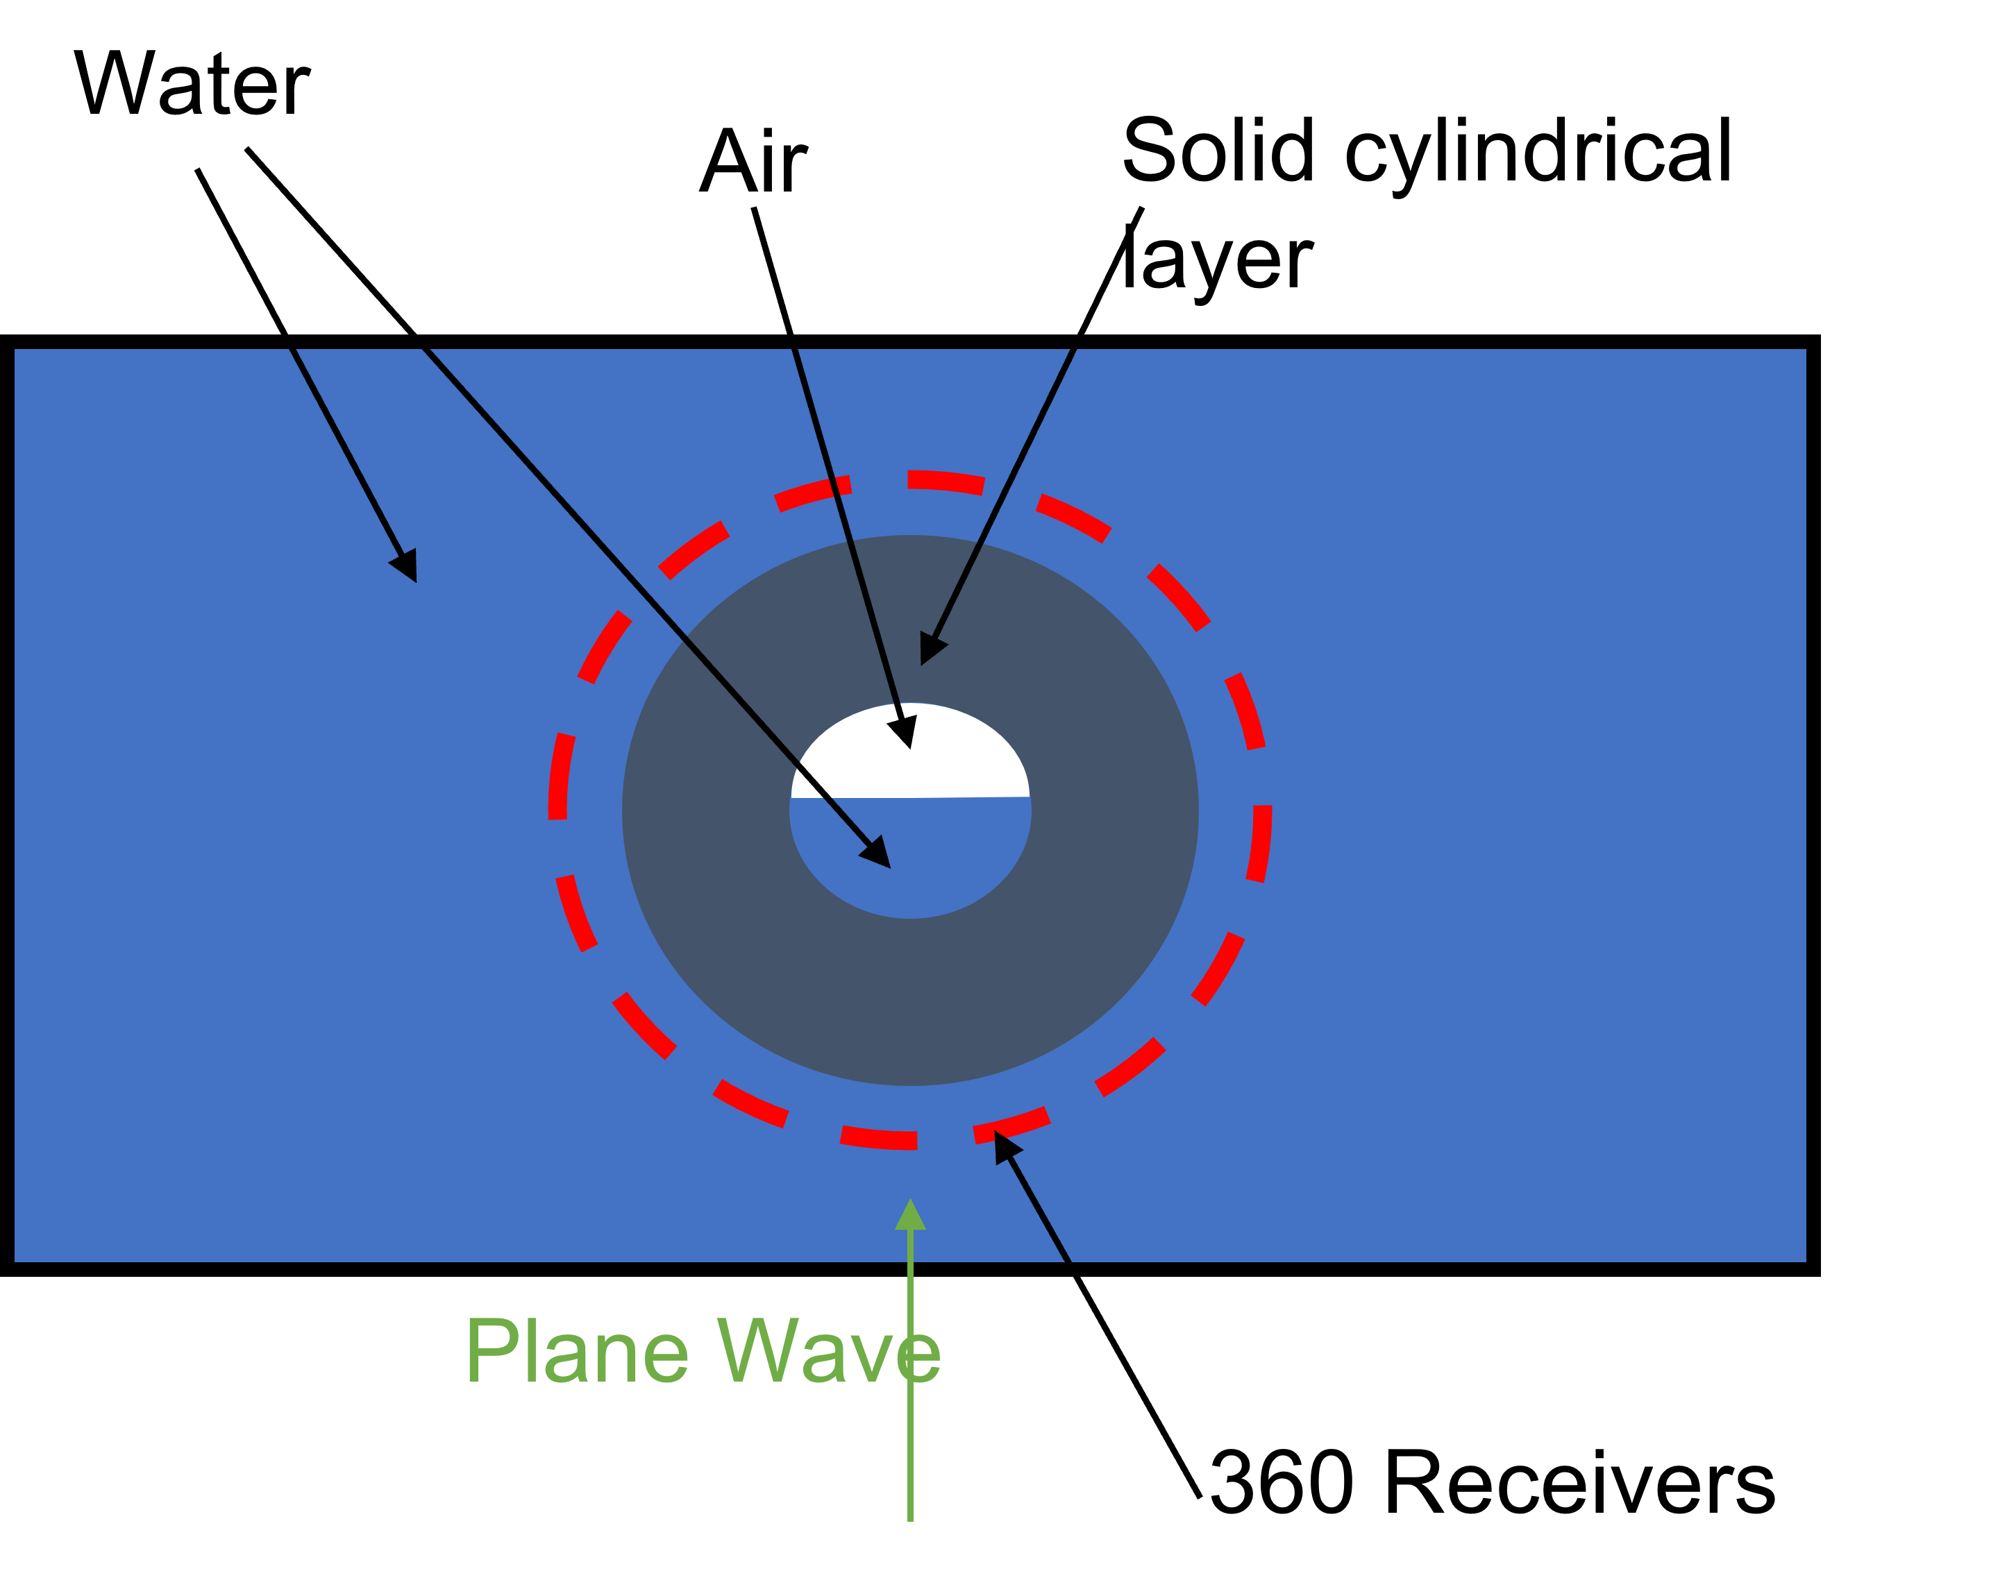
Scattering from cylindrically layered media in fluid, 2/3rd full

Slide 28
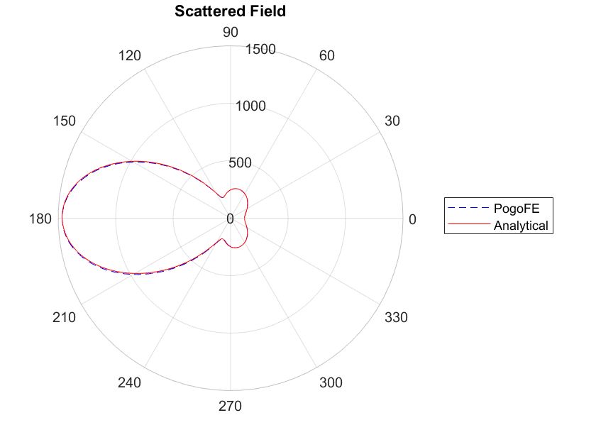
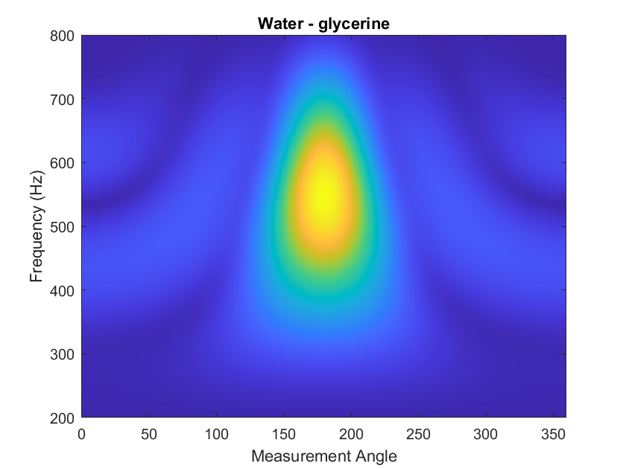
Scattering Results for fluid cylinder (Tamarkin)
https://bit.ly/ICUA2022
Tamarkin Paul
“Scattering of an underwater ultrasonic beam from liquid cylindrical obstacles."

Slide 29
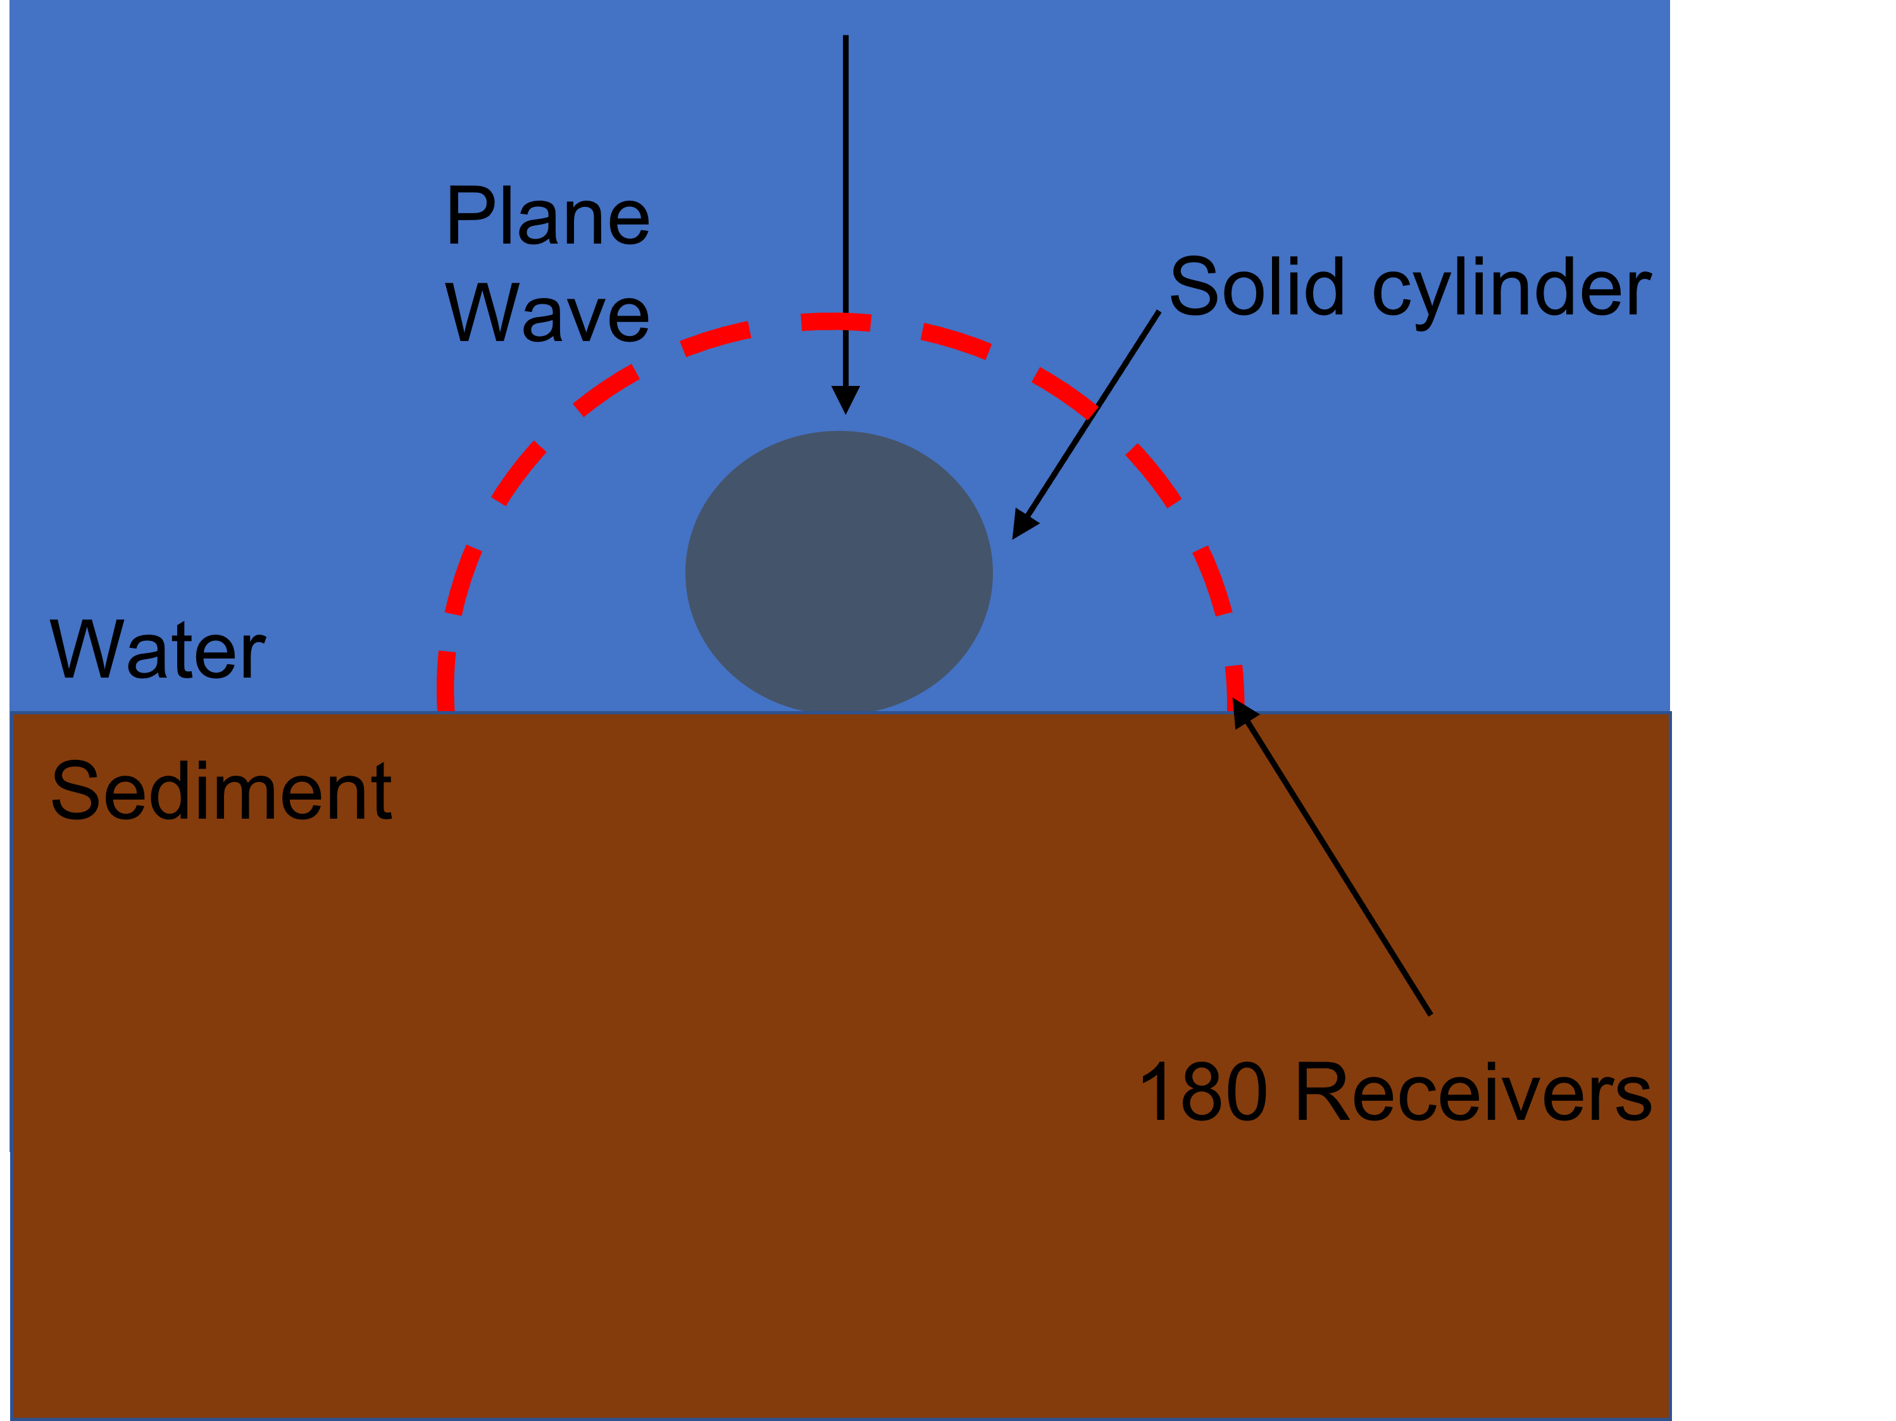
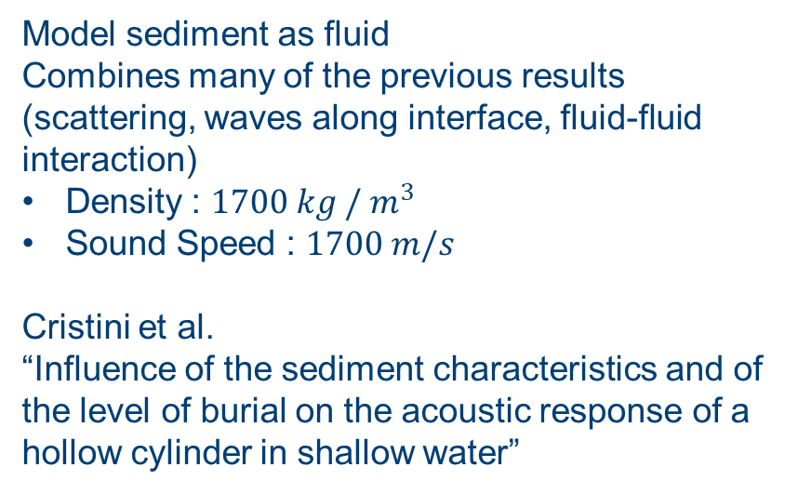
Proud and buried cylinders
Model sediment as fluid
Combines many of the previous results (scattering, waves along interface, fluid-fluid interaction)
Density : $1700 kg /{ m}^{3}$
Sound Speed : $1700 m/s$
Cristini et al.
“Influence of the sediment characteristics and of the level of burial on the acoustic response of a hollow cylinder in shallow water”

Slide 30
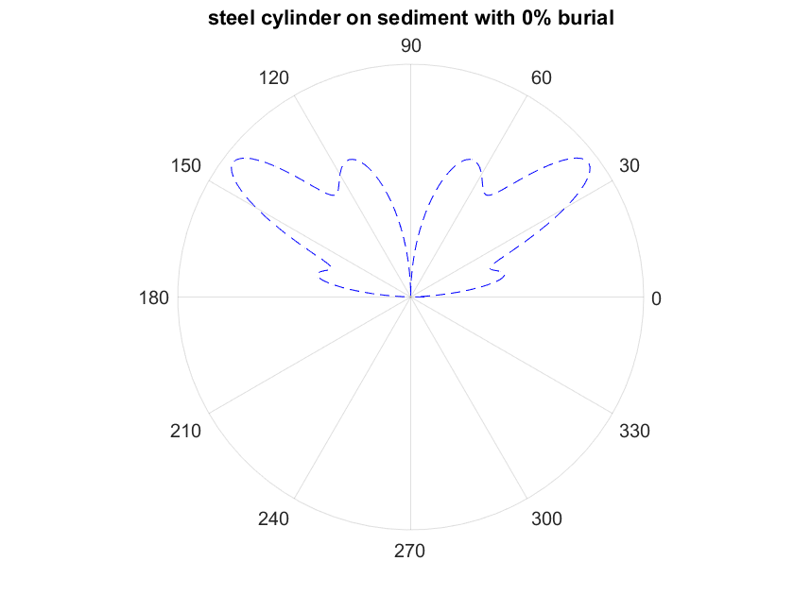
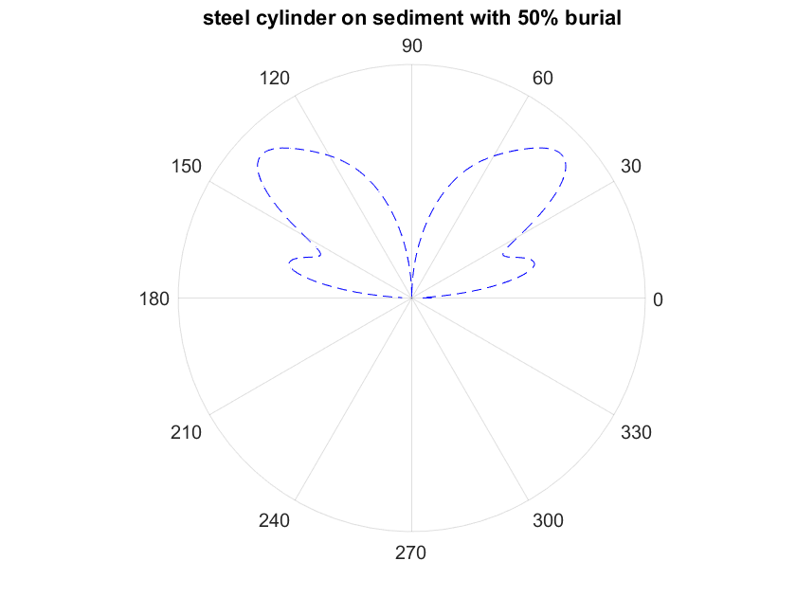
Proud and buried cylinders

Slide 31
Proud and buried cylinders

Slide 32
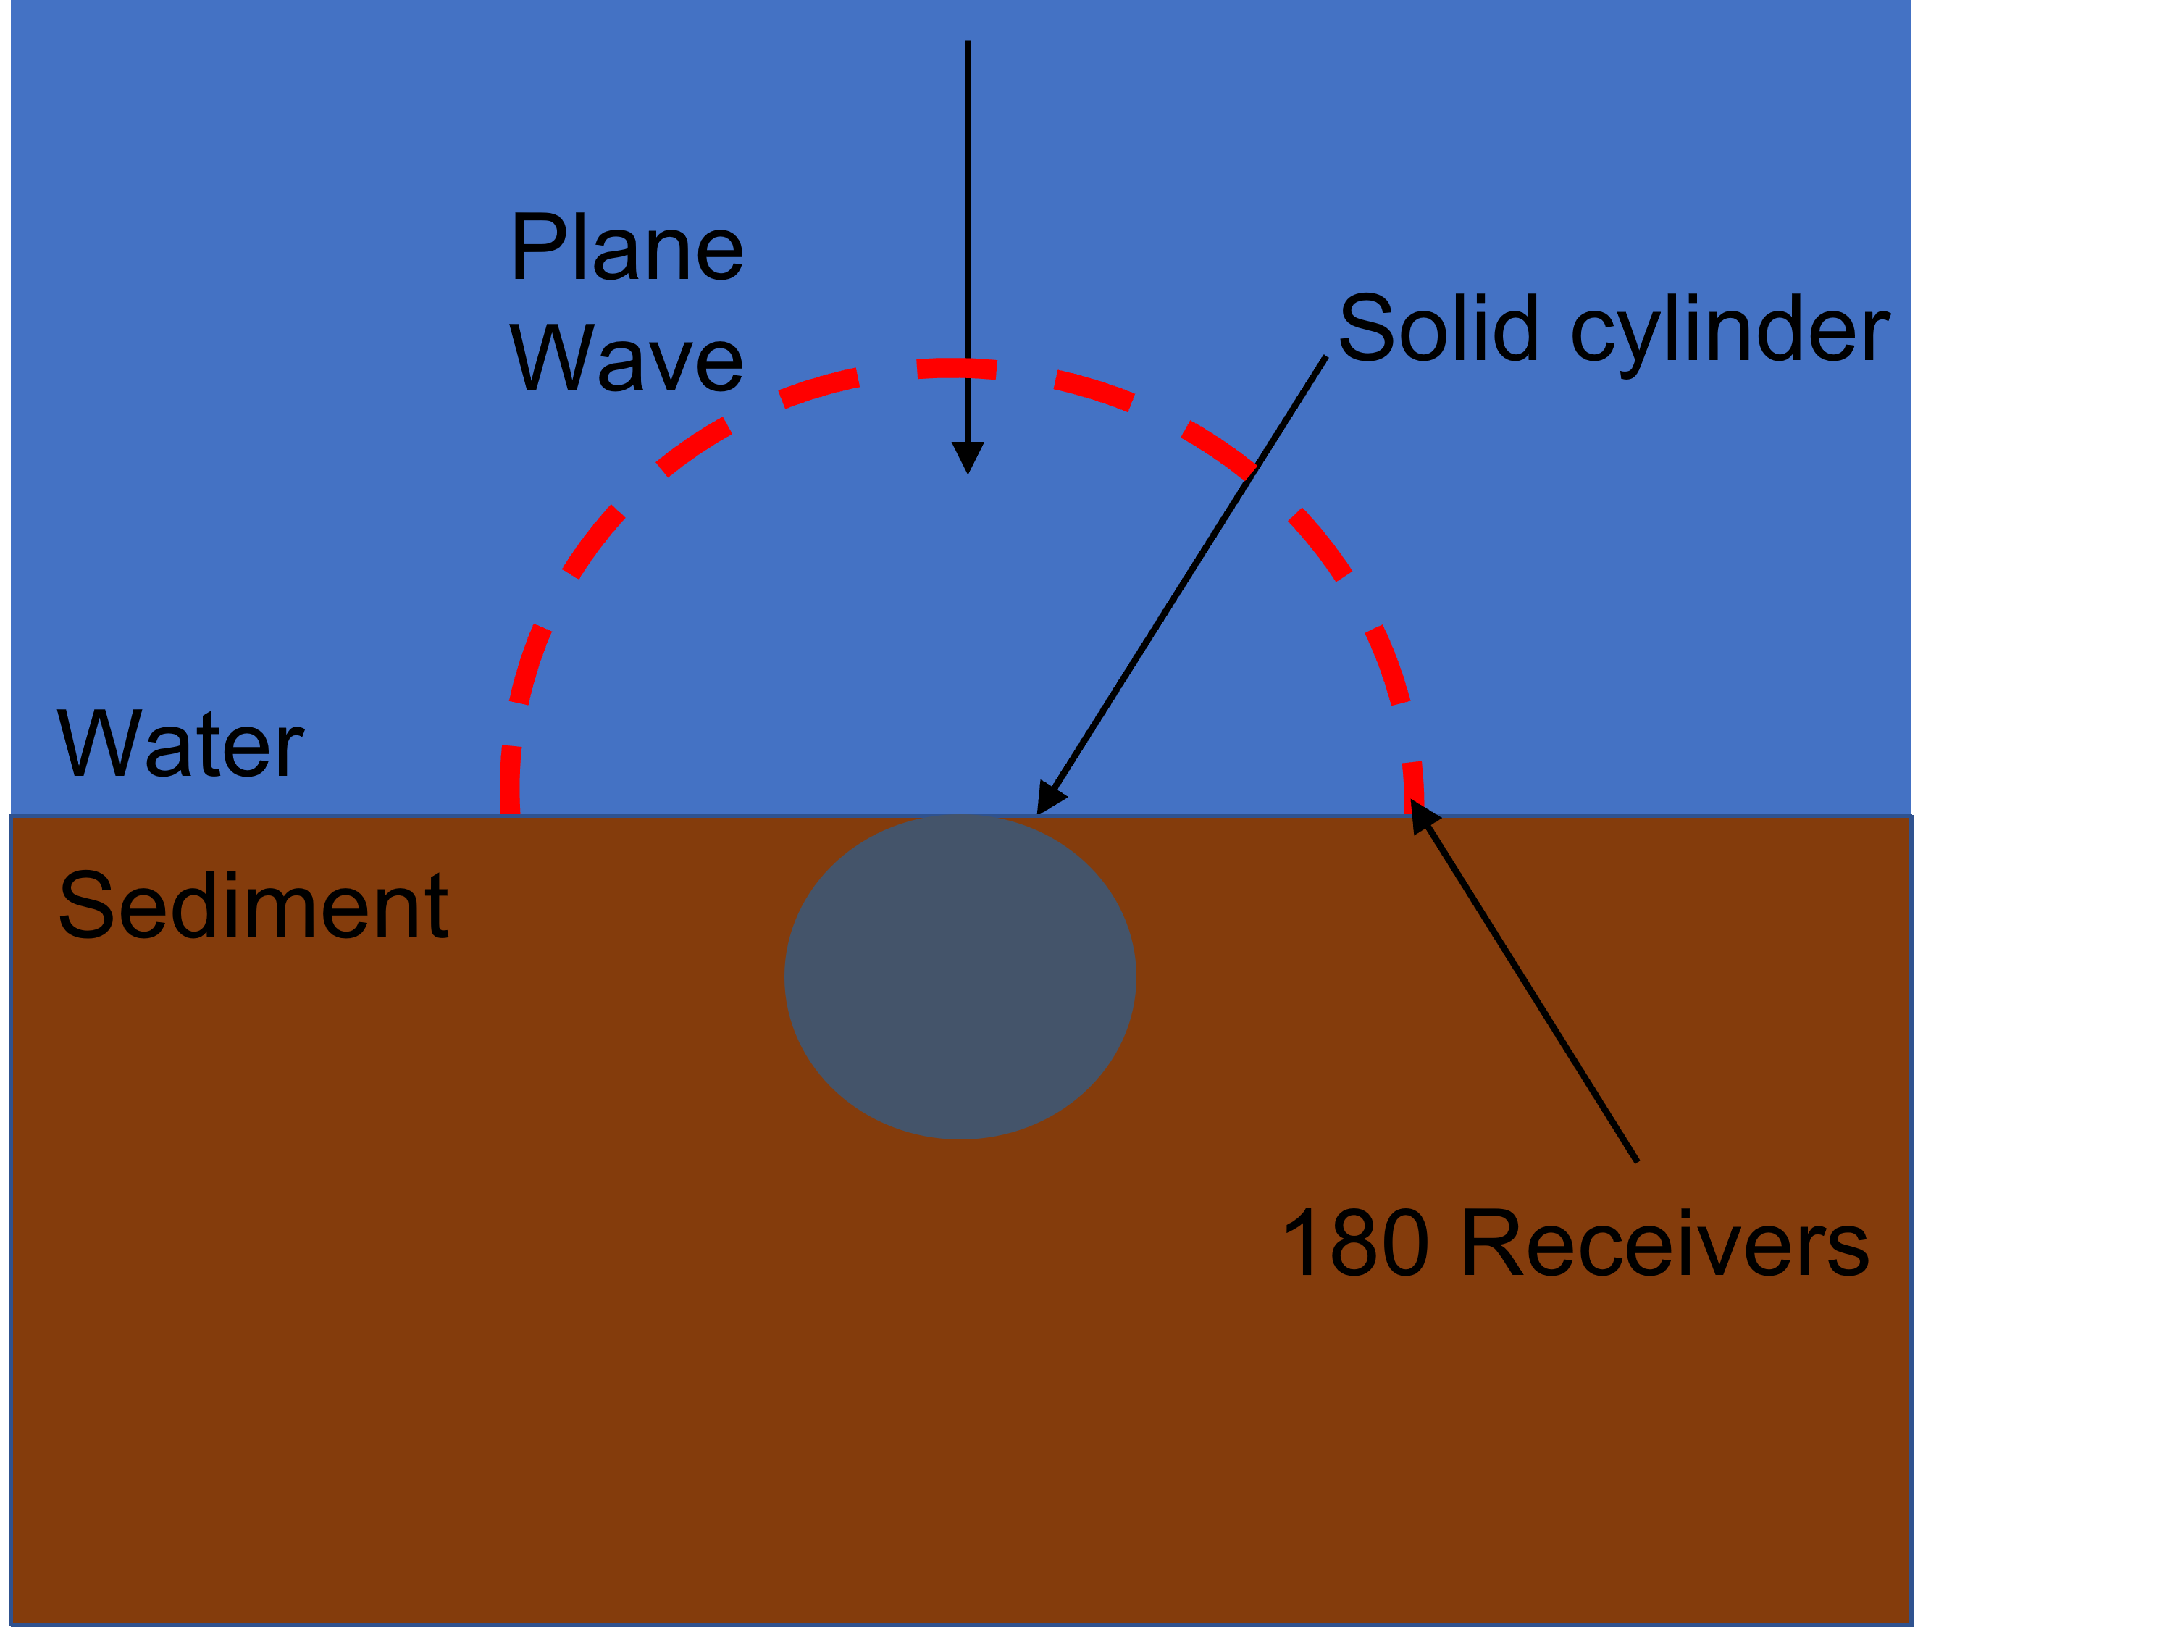
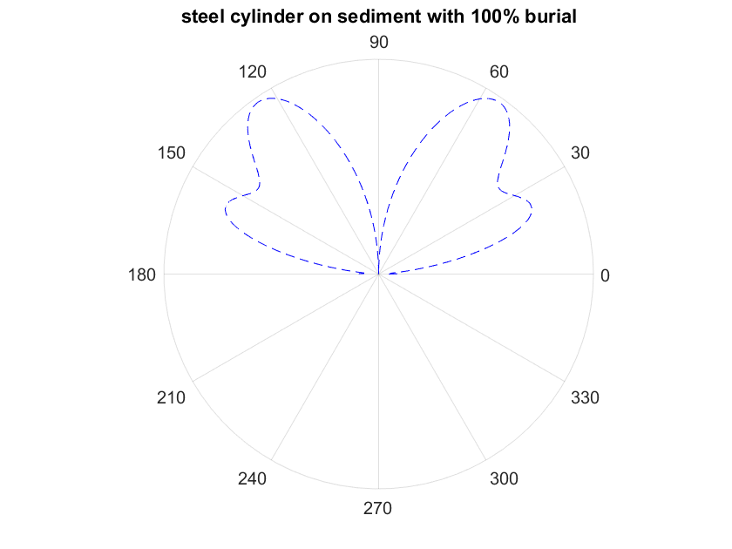
Proud and buried cylinders

Slide 33
Summary and next steps
Formulation derived and implemented in Pogo
Verified and validated, in both underwater acoustics and other fields
Remains to compare to experimental data and 3d non-axisymmetric cases

Slide 34
Thank you for listening, any questions?
Email : y.simillides18@imperial.ac.uk
Pogo Website : www.pogo.software
Analytical solutions : https://bit.ly/ICUA2022

