Slide 1
Cyclist Customer Analysis
How do we add more subscribers?

Slide 2
Overview
How do subscribers and casual users use Cyclist bikes?
This presentation will attempt to answer this question
Why would causal riders become subscribers?
How can Cyclistic use digital media to convert casual users to members

Slide 3
Data Overview
8,587,768 bike trips were analyzed from 2014 to 2017
Cleaning (performed with R)
Removed rides for which the bikes were removed
Removed duplicates
Removed any faulty data (i.e. negative trip duration)
For more details see appendix

Slide 4
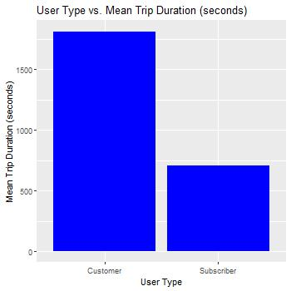
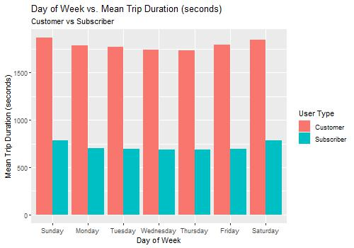

Slide 5
Analysis and Recommendations
Regardless of the day of week, casual users’ trips are much longer than subscribers’
Focus marketing on the ease of using Cyclist bikes to perform mundane tasks within a small radius of home
Focus marketing on Cyclist as an alternative to walking
Focus marketing on Cyclist as a tool to explore one’s neighborhood

