Slide 1
Locally enhanced Convolutional Transformer with appropriate Inductive Bias(LeCT)
윤석주

Slide 2
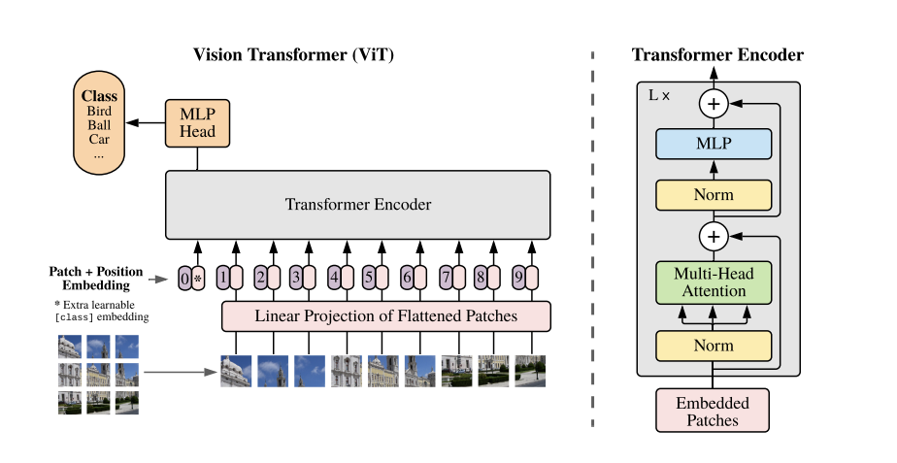
Background – Vision Transformer
1

Slide 3
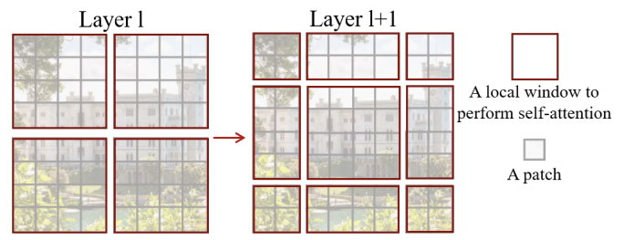
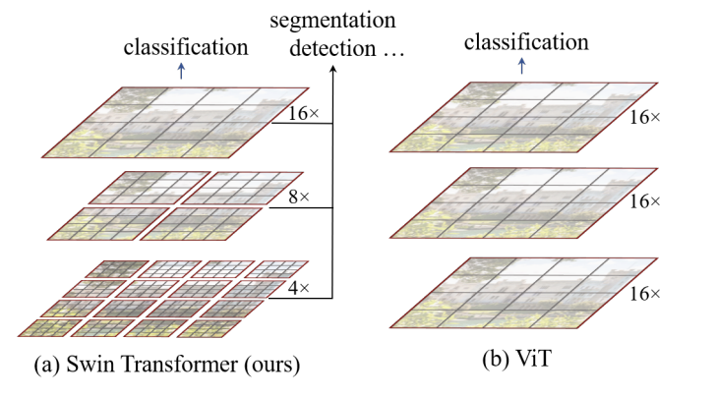
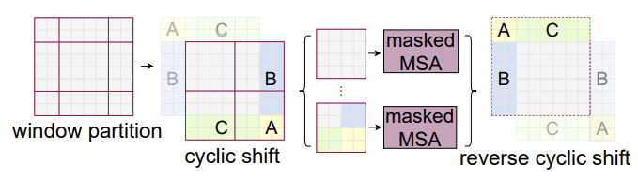
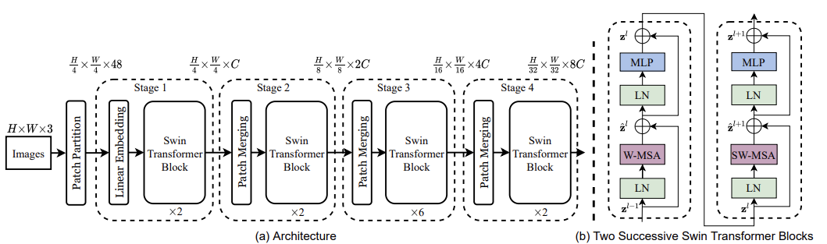
Background – Computational costs
Swin Transformer
Shifted windows Transformer
Self-attention in non-overlapped windows
Hierarchical feature maps
2

Slide 4
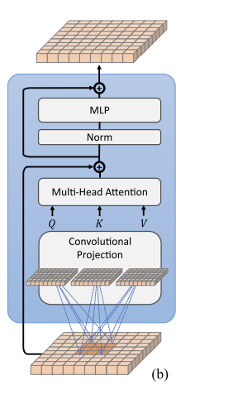
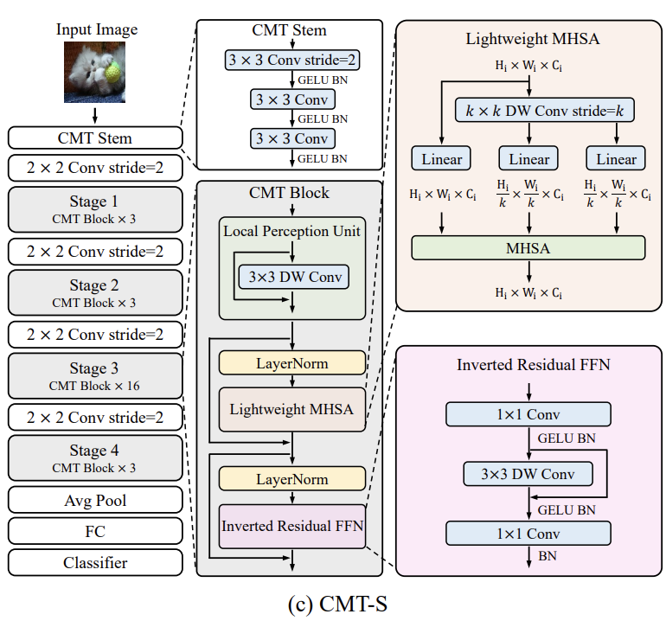

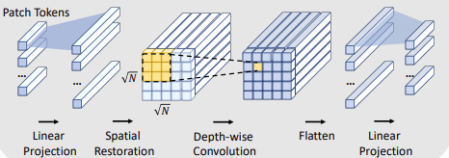
Background – weak inductive bias
CvT
CMT ~ PvT(spatial reduction)
CeiT
Single-scale features
Class token -> GAP
-for fair comparison
3

Slide 5
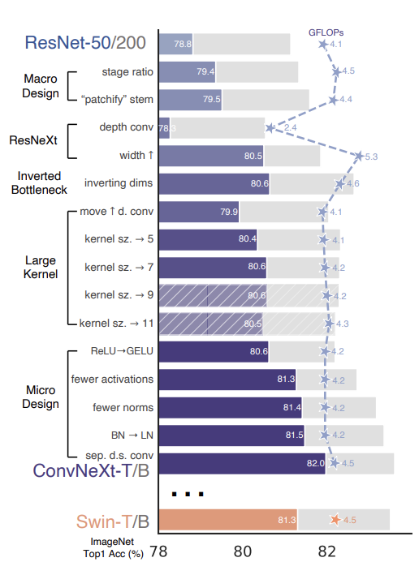
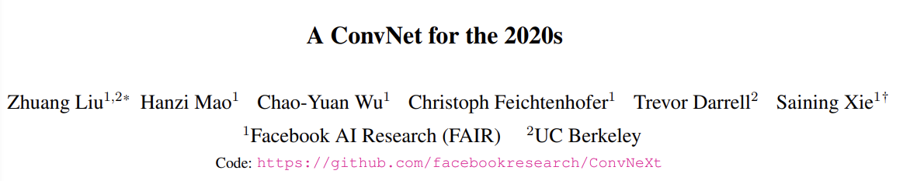
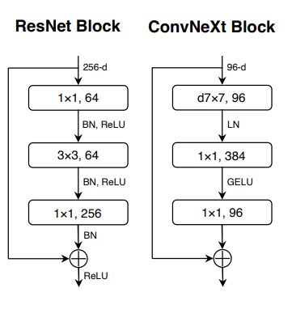
Background - CNNs
4

Slide 6
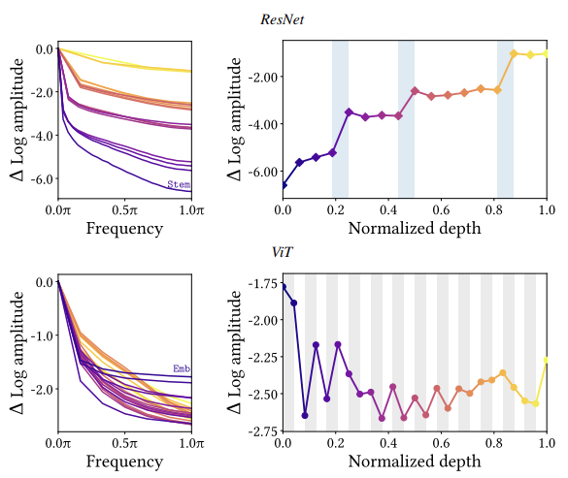
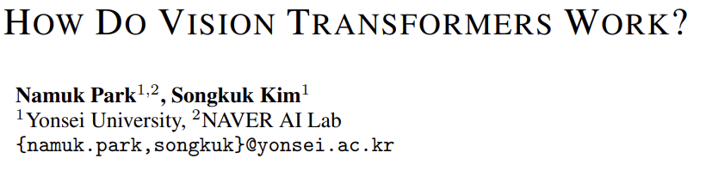
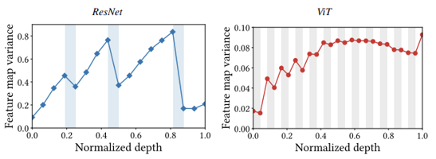
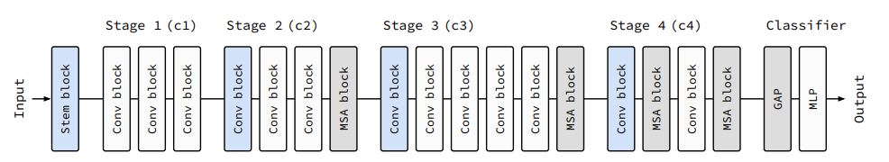
Background - MSAs and Convs are complementary
5

Slide 7
Main Contributions
[ 문제 상황 ]
Weak inductive bias로 인해서 large-scale training dataset, strong data augmentation, longer training schedul이 필요하다.
Global MSAs는Sequence length의 제곱에 비례하는 Computational costs를 갖는다.
CNNs, MSAs 를 적절하게 절충한 모델이 거의 없다.
[ 해결 방안 ]
Conv, pooling, upsampling layer를 적절하게 사용해서 모델이 적절한 inductive bias를 가지고 효율적인 global MSAs를 통해 빠르게 학습할 수 있도록 하고 정확도 또한 높였다.
Convolutional Skip Connection을 통해서 global features와 local features를 적절히 활용해 local features를 강화하고 학습의 정확도와 안정성을 높였다.
6

Slide 8
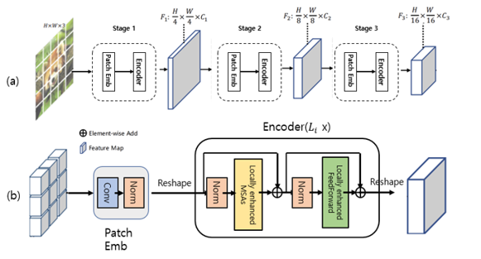
Model Architecture Overview
7

Slide 9
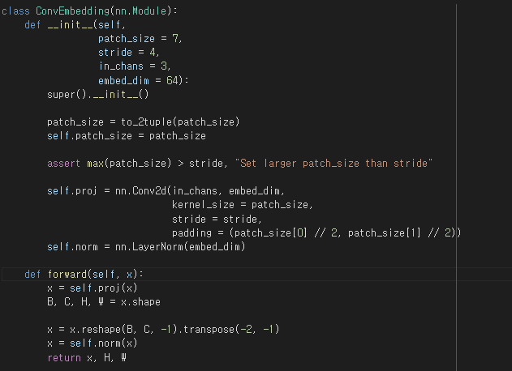
Patch Embedding
8

Slide 10
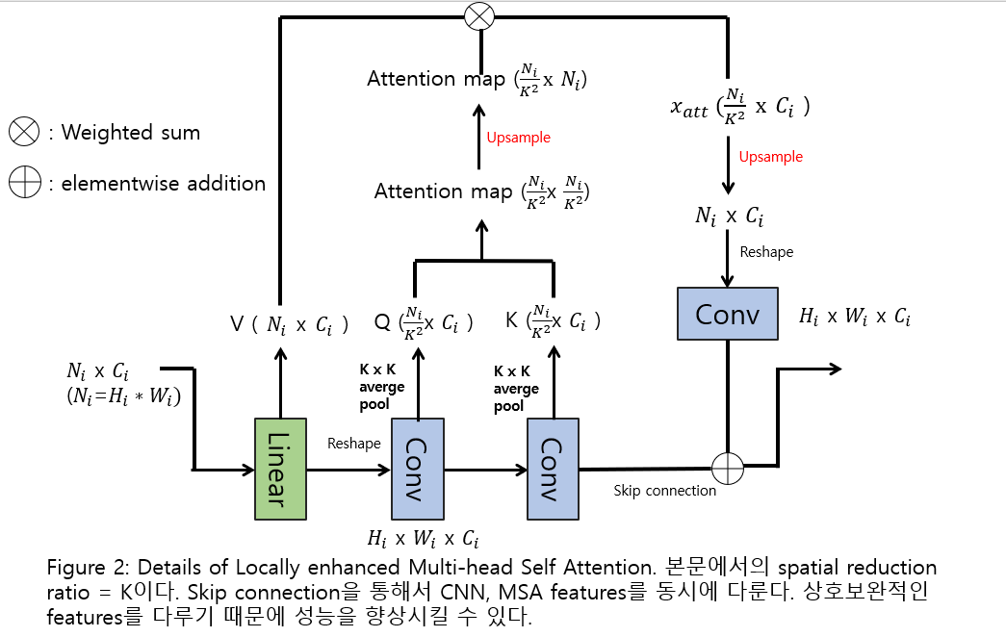
Locally enhanced Attention(v2)
9

Slide 11
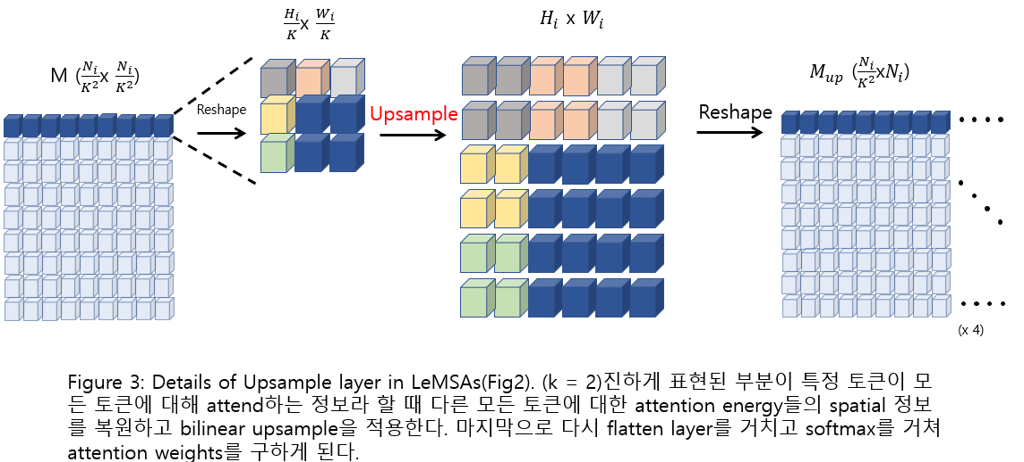
Upsample layer
10

Slide 12
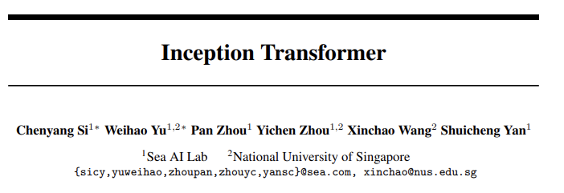
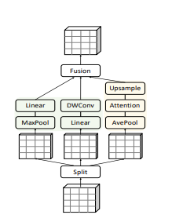
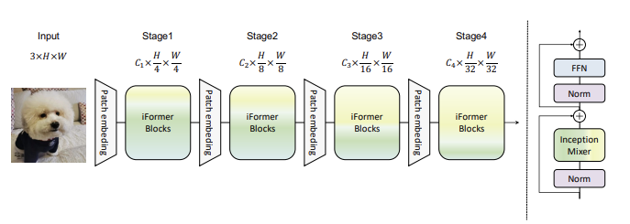
LeCTv3
11

Slide 13
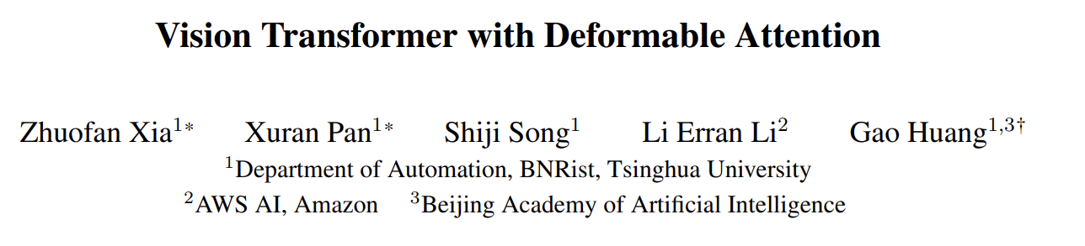
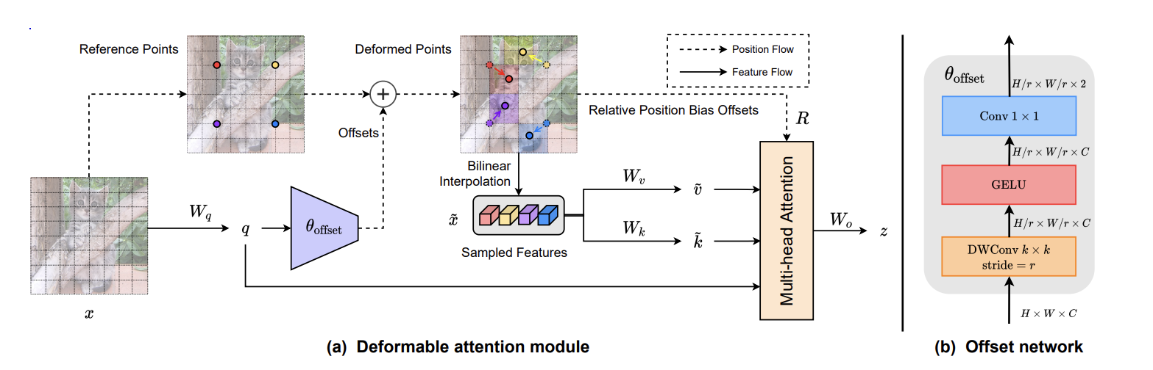
LeCTv4
12

Slide 14
Training Settings
Training config
Optimizer
Weight decay
Batch size
# of epoch
Resize
Learning rate schedule
Drop path rate
Dropout rate
Data augmentation
Base learning rate
AdamW
0.05
64
60 (STL10 – 100 epochs)
224
Cosine decay
0.1
0.1
Crop(padding = 4), Random horizontal flip
(p = 0.5), RandAugment
0.001(ViT, CeiT, LeCT, AlterNet),
0.006(ResNet, ConvNeXt)
Dataset
Classes train data val data img size
CIFAR10
CIFAR100
STL10
10 50000 10000 32
100 50000 10000 32
10 5000 8000 96
13

Slide 15
Experiment & Ablation study
CIFAR100
CIFAR10
STL10
Model
#param Accuracy
Model
#param Accuracy
Model
#param Accuracy
ResNet
ConvNeXt
ViT
CeiT
AlterNet
LeCT
LeCTv2
LeCTv3
1.2M
1.2M
1.7M
1.2M
9.5M
1.2M
1.1M
1.3M
69.68
71.84
59.46
74.98
73.16
76.53
74.46
76.08
ResNet
ConvNeXt
ViT
CeiT
AlterNet
LeCT
LeCTv2
LeCTv3
-
-
-
-
-
-
-
-
92.83
93.52
79.53
93.82
-
94.41
-
ResNet
ConvNeXt
ViT
CeiT
AlterNet
LeCT
LeCTv2
LeCTv3
-
-
-
-
-
-
-
-
79.71
73.95
61.78
80.53
-
82.94
-
81.85
14

Slide 16
Ablation study
Model
CIFAR10 CIFAR100 STL10
LeCT
LeCT (w/o
Convolutional skip connection)
94.41 76.53 82.94
92.31 71.68 79.88
15

Slide 17
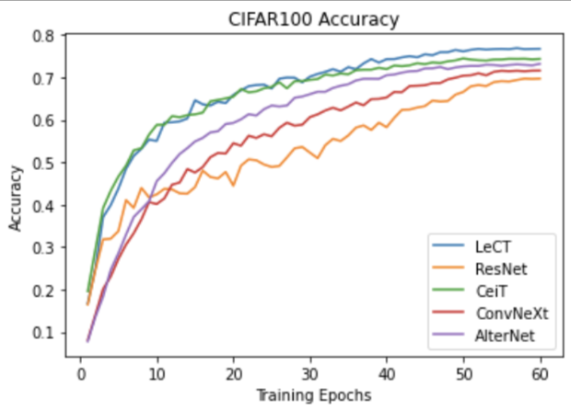
Convergence speed
16

Slide 18
Thank you! Q&A

