Slide 1
The effects of covid on the real estate market
By Alexandru Croitoru, James Jang, Pinda Johnson, Vincent Pacilio, Clark Shu
June 22, 2021

Slide 2
Key Findings
Overall, housing price has surged during pandemic in all regions: Northeast, West, South and Midwest
West had the highest pricing level from 2020 onwards, but Northeast increased the most
Home Prices showed higher growth in the West and Northeast based on results of our predictive model
High housing price growth rate is associated with low mortgage rate
Increases in housing price are correlated with low housing supply and high lumber costs

Slide 3
Hypothesis
Region: The Midwest region has seen the highest increase in America over any other region.
Mortgage rate: Investigate the supply and demand of real estate by focusing on mortgage rates. If the mortgage rate is low, then housing prices will increase because of increased demand.
Housing supply: There is a low supply of houses in America that is driving up real estate prices due to people not listing homes and home construction delays.
Income: The pandemic has caused increased disposable income and savings rate in America. Potential home-buyers, having more money, has driven up prices for the real estate market.

Slide 4
Data Acquisition
Data Sources: Quandl, Freddie Mac, Fred, Zillow datasets
Challenges: For income hypothesis, difficult to conclude where individuals are spending money (i.e. Real Estate)
Find comprehensive publicly available datasets
Aggregate data from all the states properly
Create time-series data that align with all data sources
Data has Jan-31 set as our date for the pandemic start – this is normalized across our visualizations

Slide 5
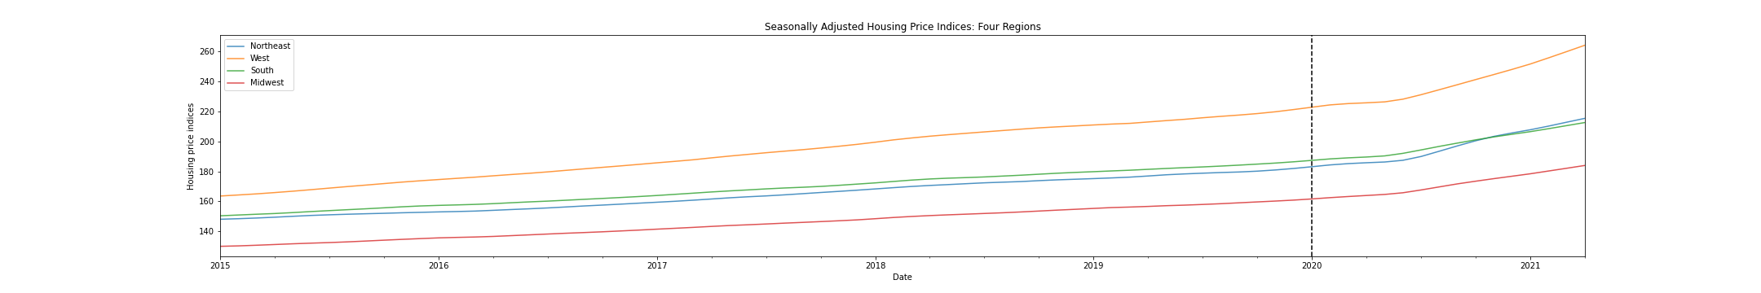
Housing price trend

Slide 6
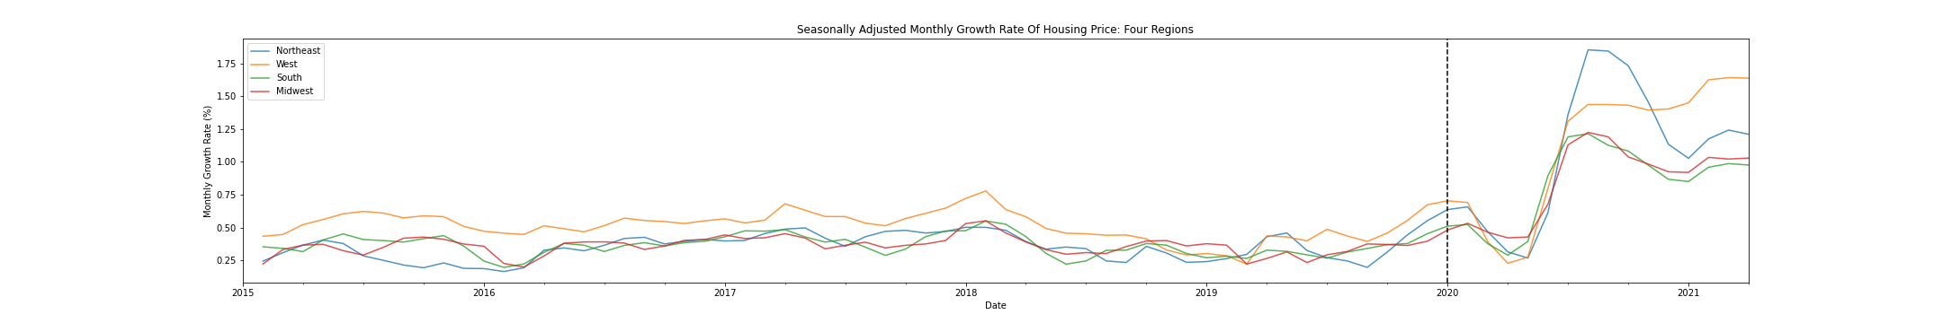
Housing growth rate

Slide 7
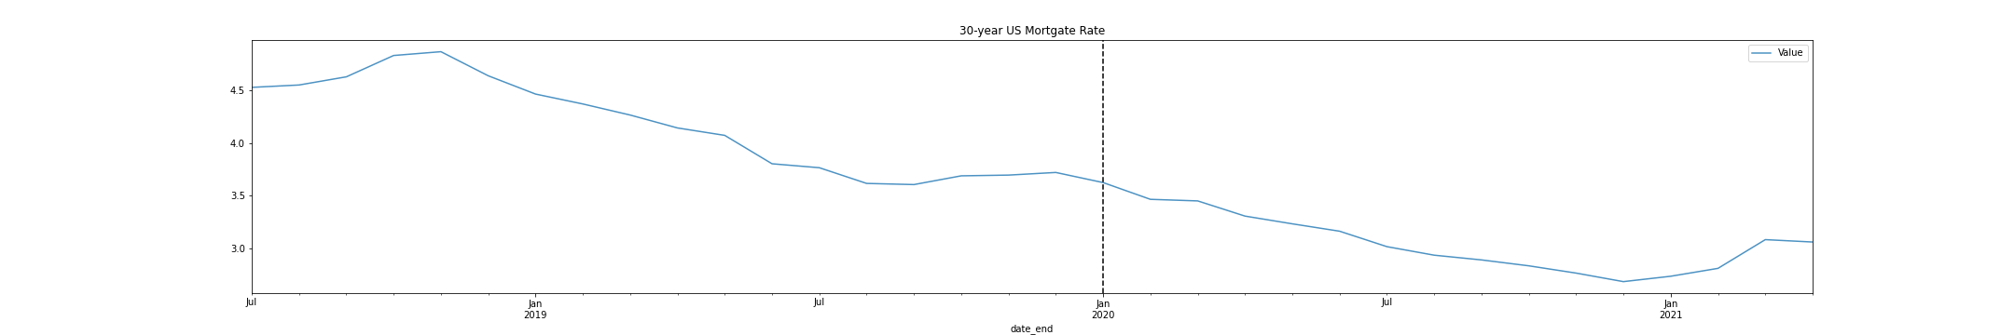
Mortgage rate

Slide 8
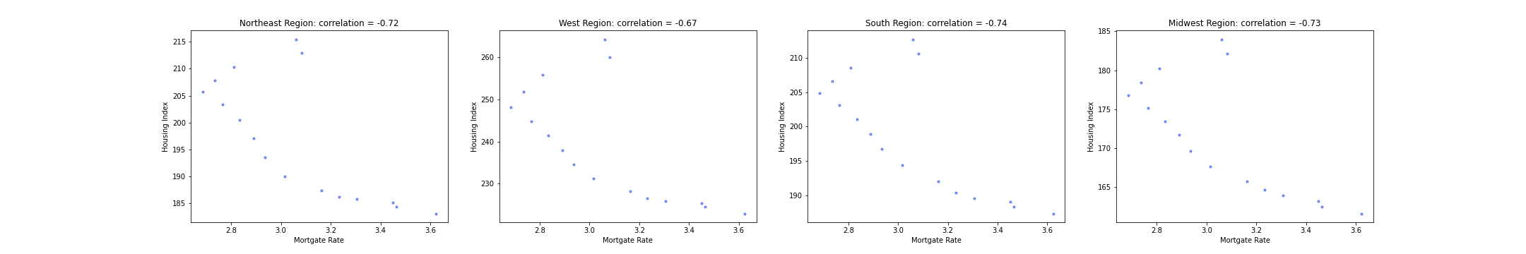
Relationship between mortgage rate and housing index

Slide 9
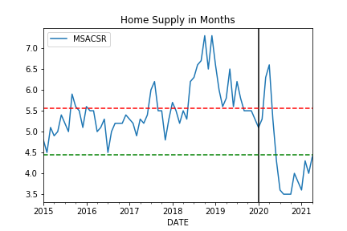
Housing supply

Slide 10
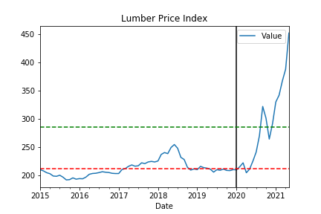
Lumber costs

Slide 11
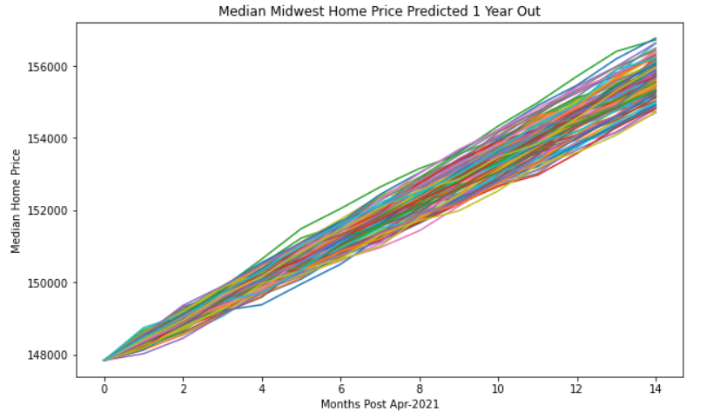
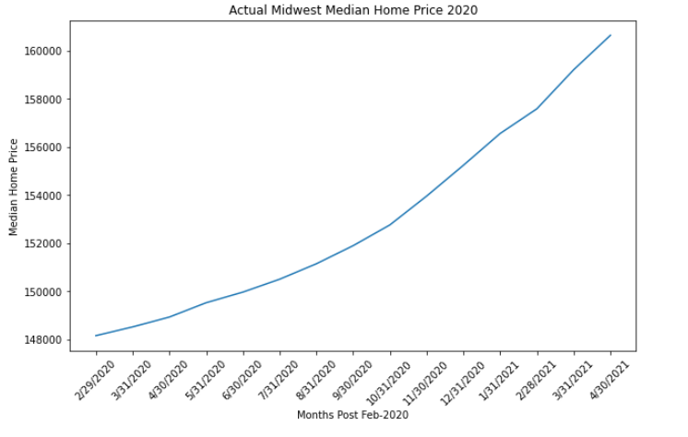
Housing price predictions: Midwest
Difference against actual prices and predicted prices pre 2020 for the Midwest is 3.25%

Slide 12
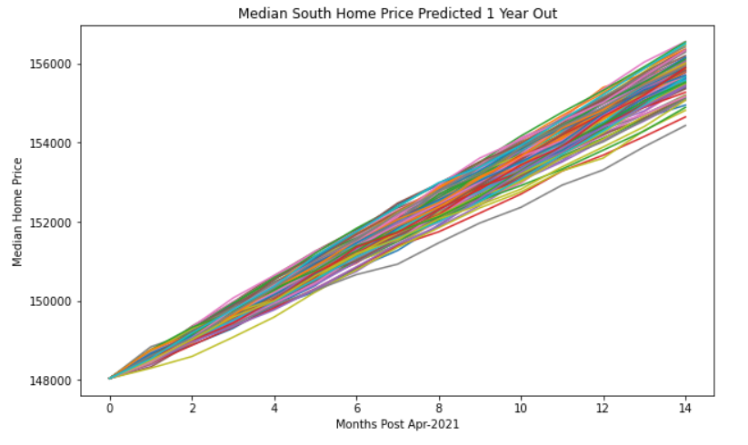
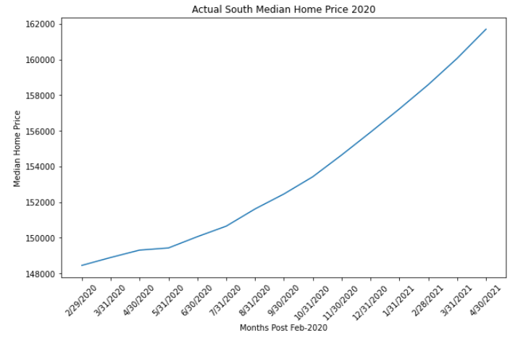
Housing price predictions: south
Difference against actual prices and predicted prices pre 2020 for the South is 3.87%

Slide 13
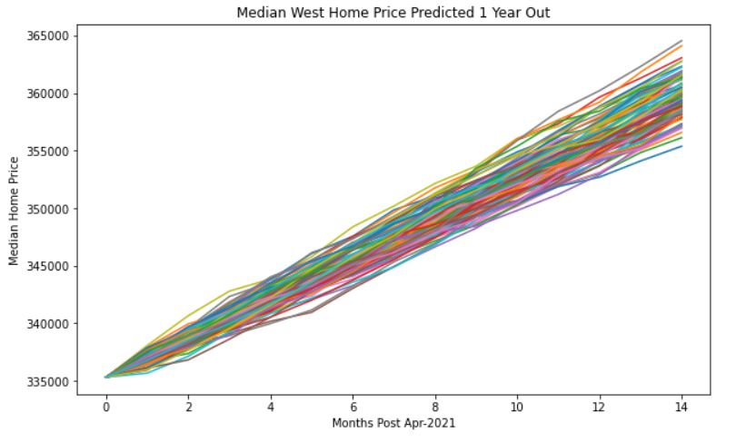
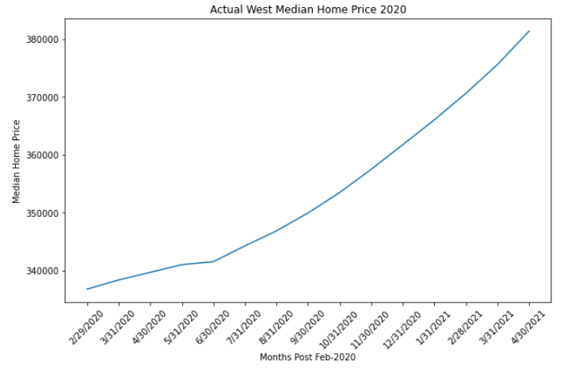
Housing price predictions: WEST
Difference against actual prices and predicted prices pre 2020 for the West is 6.13%

Slide 14
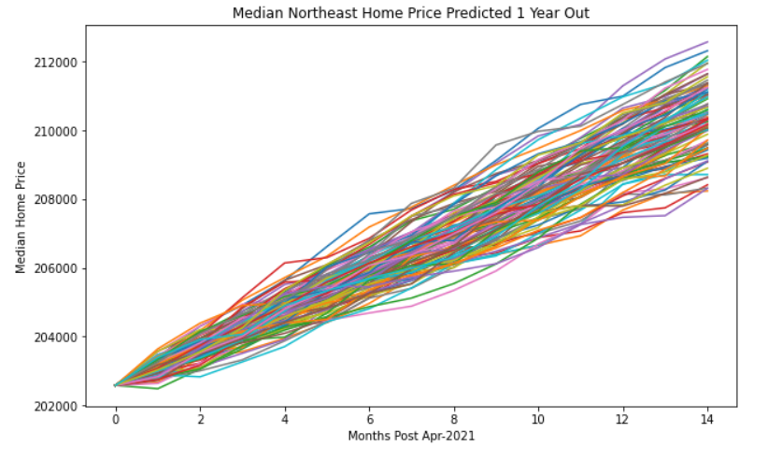
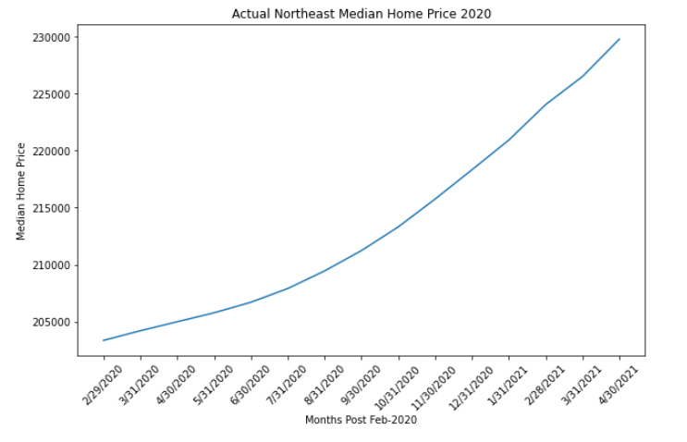
Housing price predictions: northeast
Difference against actual prices and predicted prices pre 2020 for the Northeast is 9.25%

