Slide 1

DOCKER
KT Session by Keerthi

Slide 2
Docker at a Glance...
What is Docker
Why Docker
Docker vs Virtual Machines
Docker Architecture
Contanerization
Dockerfile & Images
Containers
Docker Compose
Production Considerations

Slide 3
What is Docker?
Docker is an open platform that helps you develop, ship, and deploy applications quickly by packaging them into lightweight containers that run consistently across different environments.

Slide 4
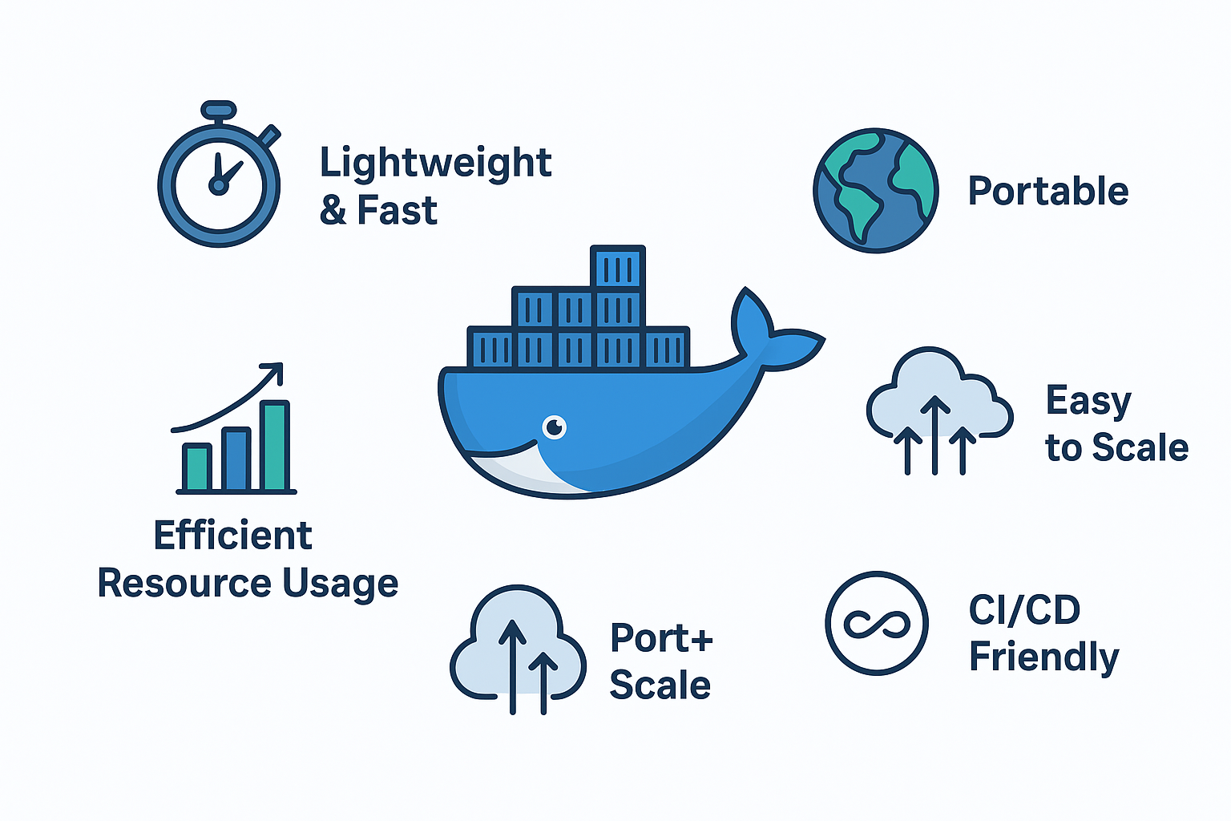
Why Docker??
Lightweight & Fast
Portable
Efficient Resource Usage
Easy to Scale
CI/CD Friendly

Slide 5
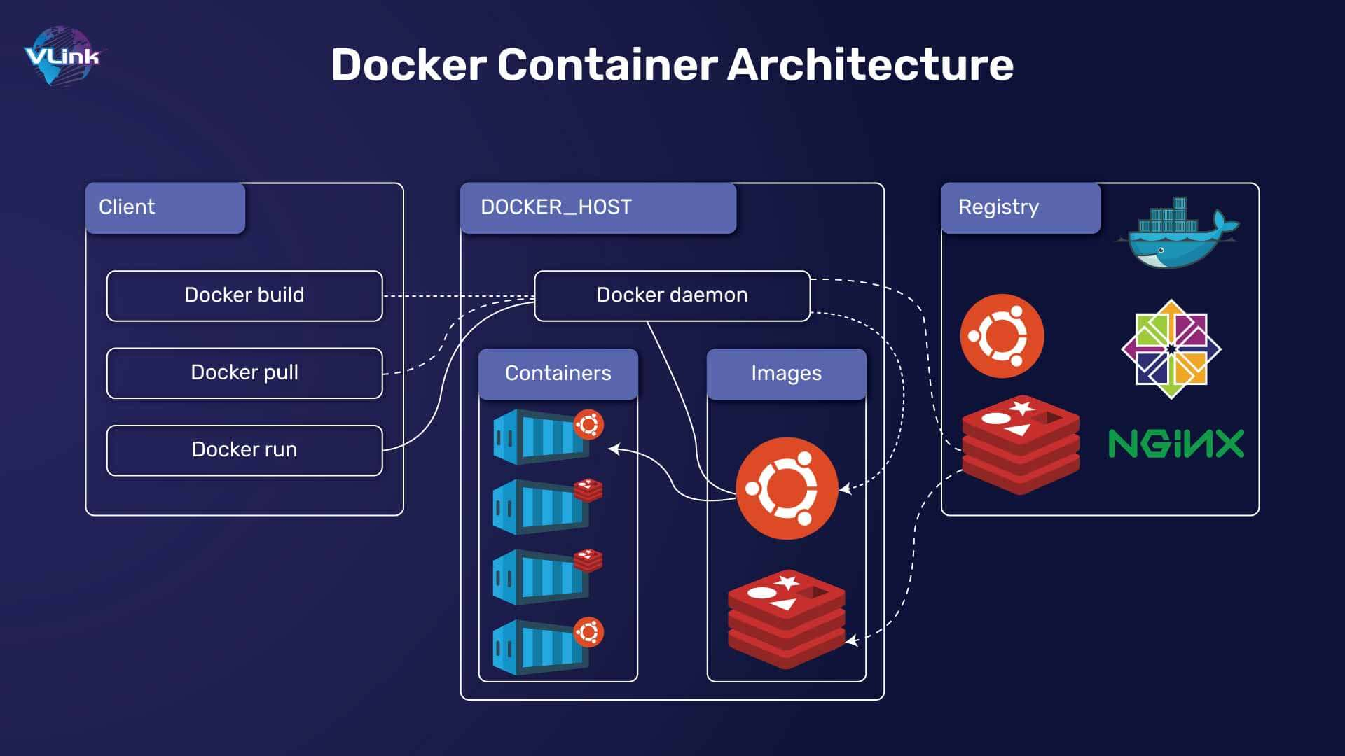
Docker Architecture..

Slide 6
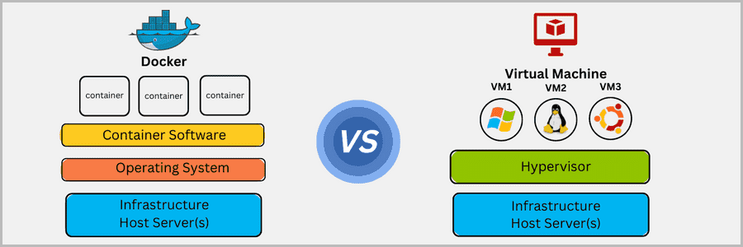
Docker vs Virtual Machine
Architecture & OS
Docker: Shares host OS kernel (lightweight)
Docker: Fast startup, near-native performance
Portability & Size
Docker: Small, portable containers
VM: Runs full guest OS on a hypervisor (heavy)
Performance & StartUp
VM: Slow boot, more resource-heavy
VM: Large, less portable VM images

Slide 7
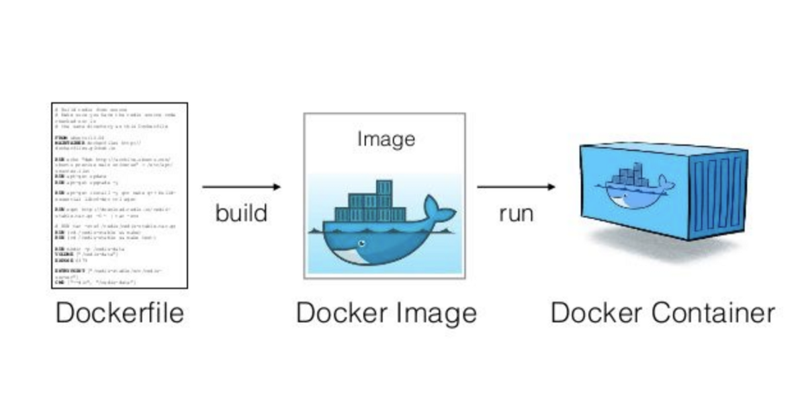
Containerization
Containerization is the process of packaging an application with everything it needs (code, runtime, libraries, configs) into a single container. This container can run consistently across different environments (dev, test, prod).

Slide 8
Docker File
A text file containing a set of instructions to create a Docker image.
Base Image (FROM) – starting point (e.g., python:3.11)
Working Directory (WORKDIR) – sets folder inside the container
Copy Files (COPY) – adds files from host to container
Run Commands (RUN) – installs packages or runs setup commands
Expose Ports (EXPOSE) – opens network ports for the container
Default Command (CMD or ENTRYPOINT) – what runs when container starts

Slide 9
Docker Image
Definition: Docker image is a read-only template for creating containers.
Contains: App code, libraries, dependencies, and OS settings.
Role: Acts as a blueprint for containers, ensuring consistency.
Benefit: Portable, version-controlled, and reproducible across environments.
Cmd:: docker build -t myapp .

Slide 10
Docker container
Definition: A running instance of a Docker image.
Lightweight & Isolated: Shares host OS kernel but runs in a separate environment.
Contains: App code, dependencies, and configuration from the image.
Role/Benefit: Ensures consistent, portable, and reproducible application environments.
Cmd: docker run -it image_name:tag
List Conatiners-> docker ps

Slide 11
Docker compose
Definition: Tool to define and manage multi-container Docker applications using a
docker-compose.yml file.
Multi-container orchestration: Easily runs app + database + other services together.
Networking & volumes: Automatically sets up networks and persistent storage for containers.
Simplified commands: Start, stop, or rebuild all containers with a single command
(docker-compose up/down).
Configuration as code: Keeps container setup version-controlled and portable across environments.

Slide 12
Docker Compose.yml
version: Compose file format version
services: Defines all containers and their configurations
networks: (Optional) Sets up container communication
volumes: (Optional) Defines persistent storage
env_file / environment: (Optional) Sets environment variables for containers

Slide 13
Thankyou..☺

