Slide 1
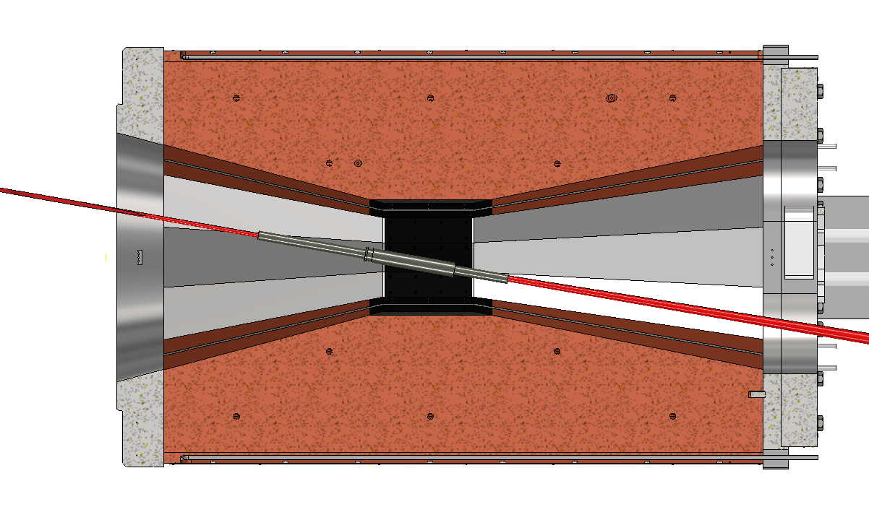
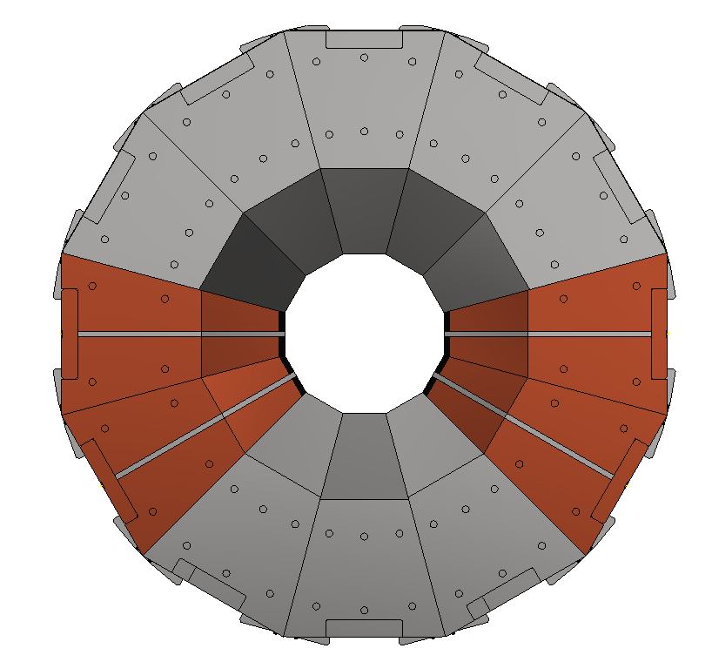
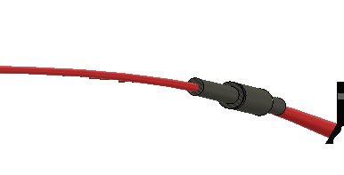


30°module × 12
1850 mm
SS304
OFC
$$p$$
420 mm
420 mm
150
OFC
$$π^{−}$$
OFC modules at high radiation region
(the other side is for weight balance).
Max 160 W/module.
110 W in target (max 200℃)
radiatively cooled
View from upstream side of proton beam
Horizontal section

