Slide 1
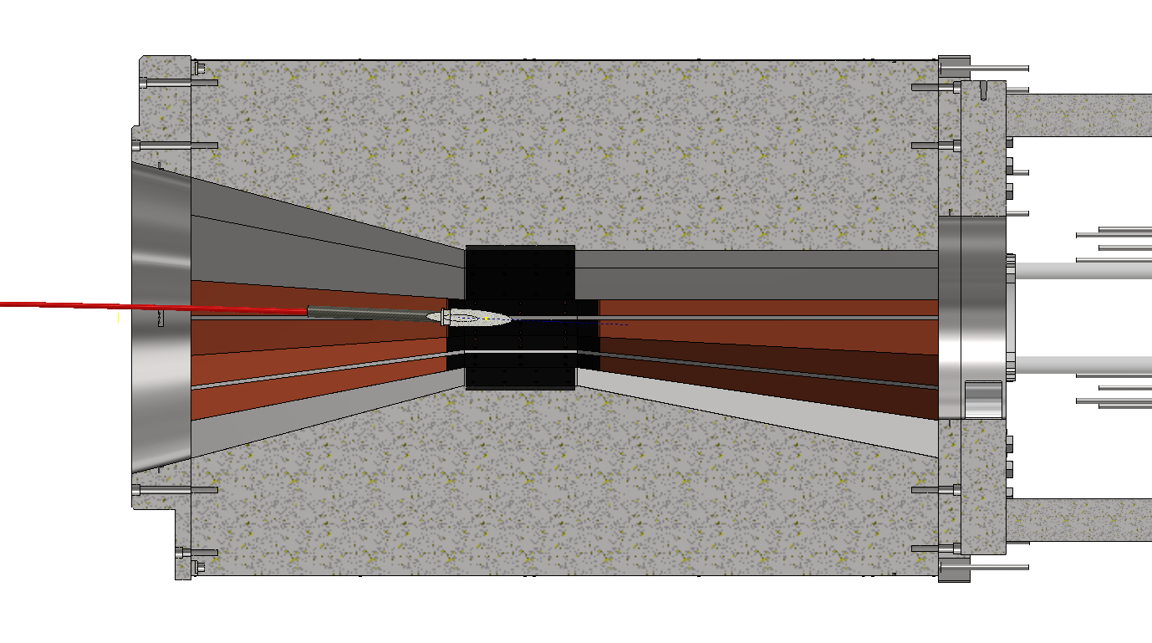

SS304
To shield scattered protons going above ground
Vertical section

