Slide 1
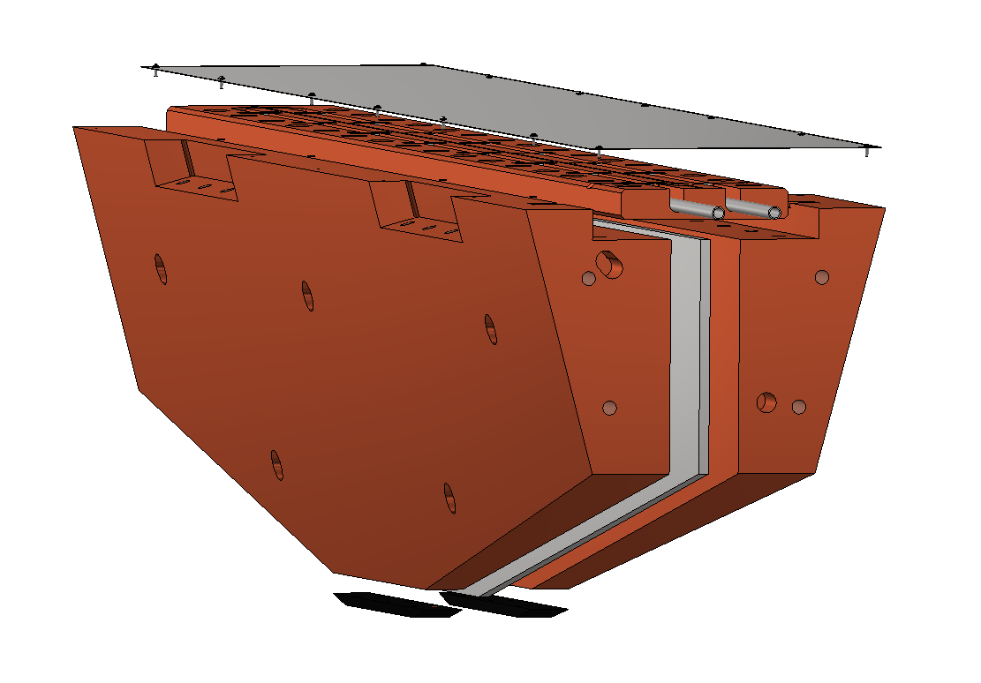
Thermal isolation shield
Cooling plate
SS304 plate to
suppress eddy
current force
Black-body plate

